Slide 1
Reaching a Wider Audience An overview of two collaborative content delivery programmes
Richard Gedye
Director of Publishing Outreach Programmes, STM
SCHOLARLY OUTREACH, IMPACT AND OUTCOMES
The Sixth UCL Bloomsbury Conference 28-29 June 2012

Slide 2
Reaching a Wider Audience
New Business Models
Open Access
Information philanthropy
patientINFORM
Research4Life

Slide 3










Gold Open Access
Gold open access, author/funder pays models are now offered by almost every STM member

Slide 4
Green Open Access
Authors self-archive a version of their article for free public use in an institutional repository, or in a subject based repository, or on some other Open Access website.
What is deposited is either the author's refereed, revised final draft or the publisher's version of record.

Slide 5








The PEER Project
www.peerproject.eu

Slide 6
Reaching a Wider Audience
New Business Models
Open Access
Information philanthropy
patientINFORM
Research4Life

Slide 7
Reaching a Wider Audience
New Business Models
Open Access
Information philanthropy
patientINFORM
Research4Life

Slide 8












Slide 9




















Slide 10
A carer’s problem......
“I’m educated to degree level but my degree is in geography. Most research articles that relate to my son’s condition are couched in such detailed specialist scientific jargon and presuppose such an immense knowledge of biology, biochemistry, genetics, pharmacology etc that they might as well be written in Esperanto.”

Slide 11
“Even for any articles which are marginally more comprehensible, it is still just about impossible for me to know which, of the many hundreds that appear, represent significant advances in knowledge or significant steps in the quest for a treatment or cure.”

Slide 12
A recommended solution.....
Publishing a lay summary alongside every research article could be the answer to assisting in the wider understanding of health-related information......
Patients... want easy-to-understand, evidence-based information relating to biomedical and health research....
Dr Liz Lyon, director of UKOLN, University of Bath explains, "The Patients Participate! Project has demonstrated the potential value of lay summaries to make research more accessible to a wider audience. ...."
Medical research charities have an important role in providing patients and the public with information about the research they fund.
From the Patients Participate! project press release at http://www.jisc.ac.uk/news/stories/2011/10/participate.aspx

Slide 13
A recommended solution.....
the Patients Participate! Report recommended publishing a lay summary alongside every research article and had two suggestions as to ways in which this might be achieved:-
Each researcher produces such a summary for each paper they publish, with training provided by their institutions and others to help them develop the communication skills necessary to share their findings with a lay audience and so bridge the understanding gap
Encourage, support and further leverage the role of medical research charities in providing patients and the public with information about the research they fund.

Slide 14

patientINFORM:-
Makes it easier for medical research charities, or voluntary health
organisations (VHOs), to keep up to date with the latest research
in their field by giving them unlimited access to around 1000
subscription based journals from participating publishers
Provides a mechanism whereby VHO lay summaries of what they
judge to be key articles can be linked to the full text of these
articles without users encountering paywalls.
This means that patients and carers can get an intelligible
summary of the most significant and important latest research, but
can also access and print out the research article on which the
summary is based and share it with their physician, as part of
their physician-patient dialogue on matters of disease progression
and treatment.

Slide 15
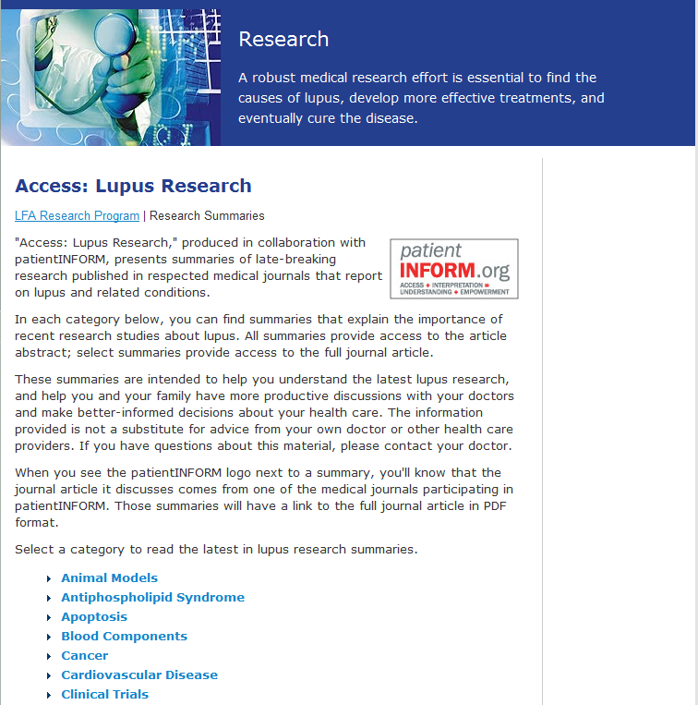

Slide 17
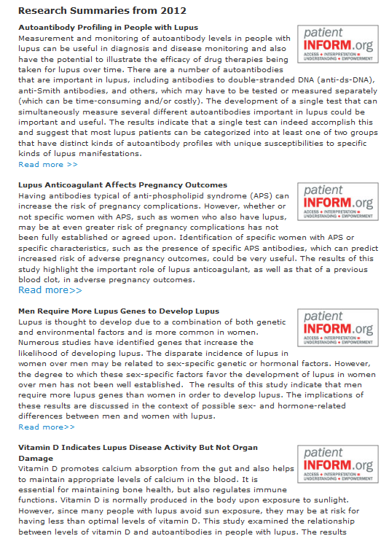

Slide 18
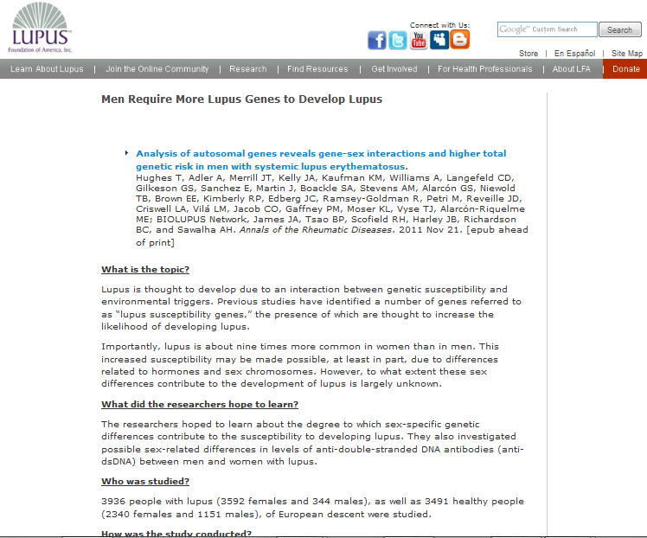

Slide 19
What is the topic?
What did the researchers hope to learn?
Who was studied?
How was the study conducted?
What did the researchers find?
What were the limitations of the study?
What do the results means for you?

Slide 20
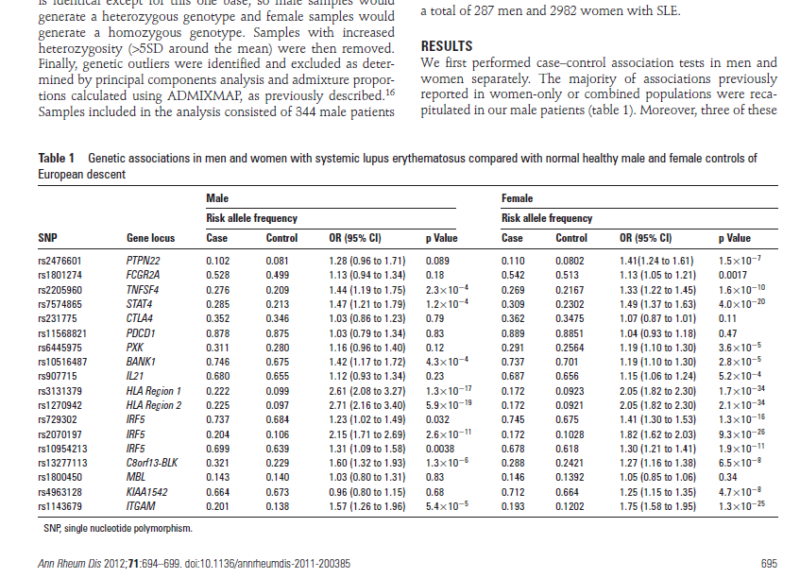

Slide 21
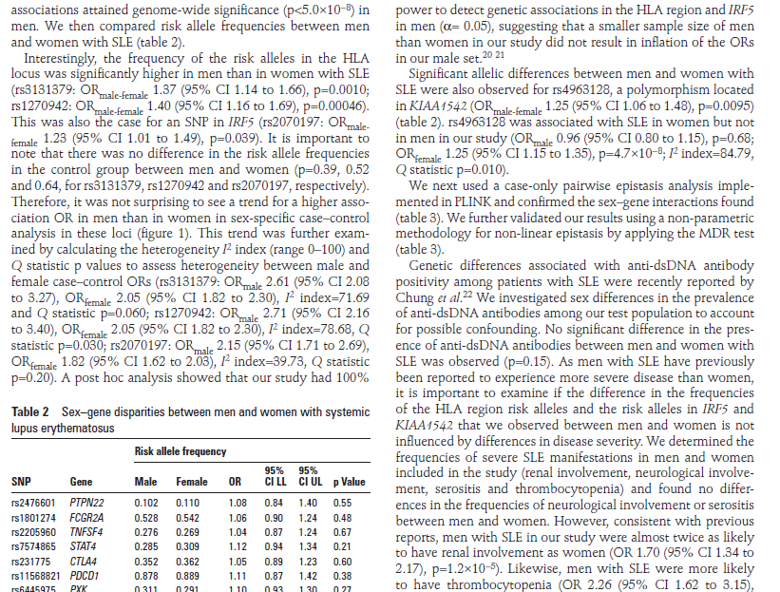

Slide 22
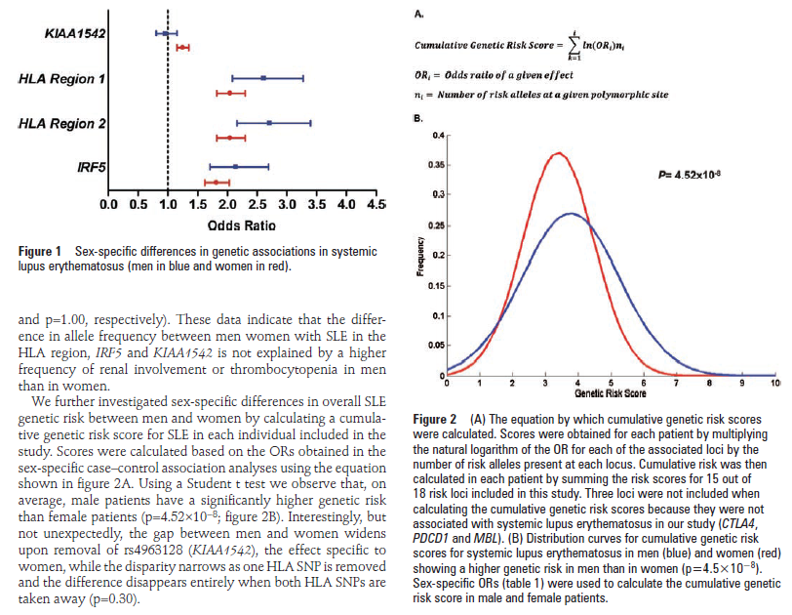

Slide 23
patientINFORM – making an impact?
Over 20,000 article downloads in 2011 from HighWire hosted journals, which comprise 22% of patientINFORM journals
Initial evidence shows 2% of lay summary readers click through to access the original article

Slide 24
www.patientinform.org

Slide 25
Reaching a Wider Audience
New Business Models
Open Access
Information philanthropy
patientINFORM
Research4Life

Slide 26

Reducing the knowledge gap between industrialized countries and developing countries by providing affordable access to critical scientific research.
www.research4life.org

Slide 27
Institutions in 78 of the world’s poorest countries receive free access to journal and book content via Research4Life
Institutions in a further 28 countries pay US $1,000 per year for a subscription to the Research4Life content – an effective discount of over 99.9%.

Slide 28








Research4Life Programmes
HINARI (2001): www.who.int/hinari MEDICINE
270 publishers: 8100 journals
4800 institutions registered for access
AGORA (2003): www.aginternetwork.org AGRICULTURE
80 publishers: 3000 journals
2400 institutions registered for access
OARE (2006): www.oaresciences.org ENVIRONMENT
85 publishers: 3900 journals
2200 institutions registered for access
ARDI (2009): http://www.wipo.int/ardi TECHNOLOGY
12 publishers: 200 journals
100 institutions registered for access
Notes:
In 2000, the World Health Organization (WHO) convened a meeting of developing country researchers and asked what was their greatest information need. The answer was "access to the priced literature." HINARI Access to Research in Health programme, a public-private partnership between publishers, WHO, Yale University Library, and other partners was launched in July 2001, and developing country institutions began accessing the journals in January 2002.
AGORA was launched in 2003 and OARE in 2006.

Slide 29
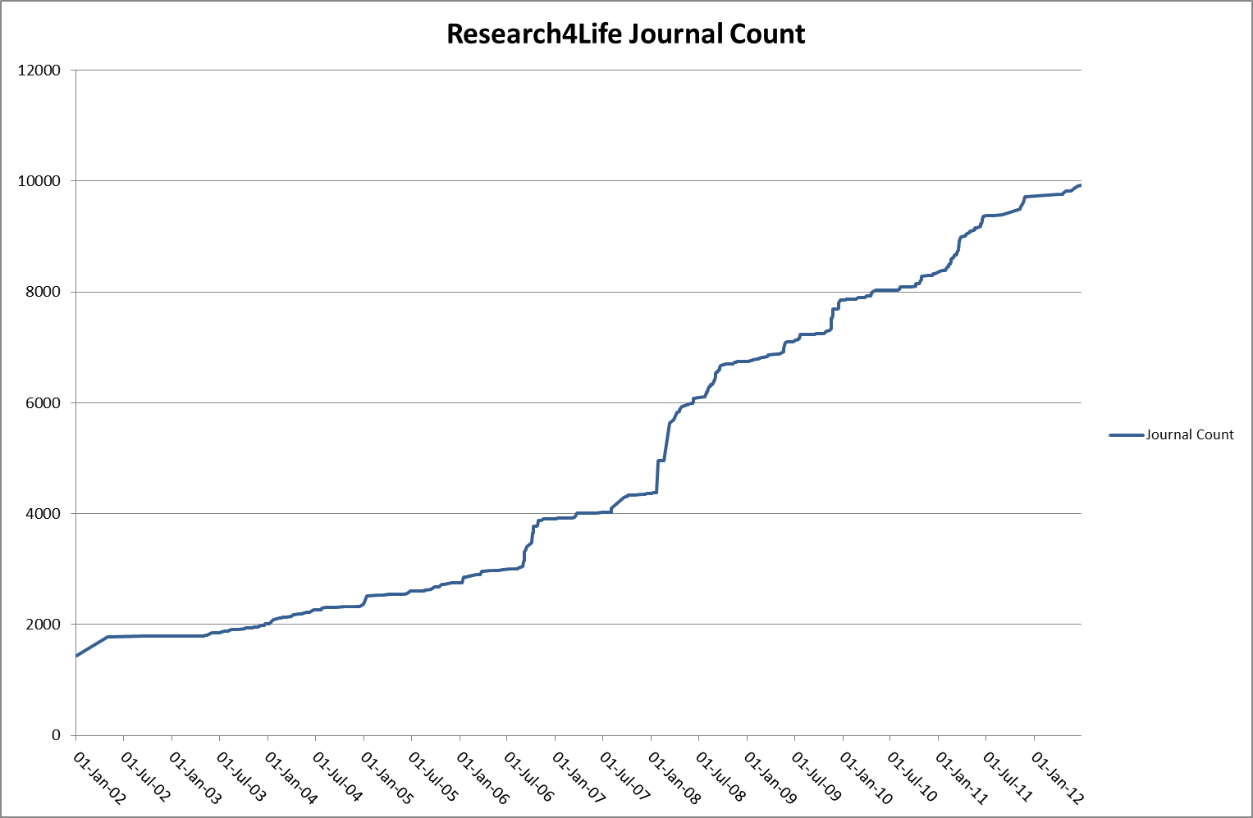
Research4Life – 10 years of growth

Slide 30
Research4Life – making an impact?
10 years after the launch of Research4Life’s first programme, what do we know of its impact on its target communities?

Slide 31
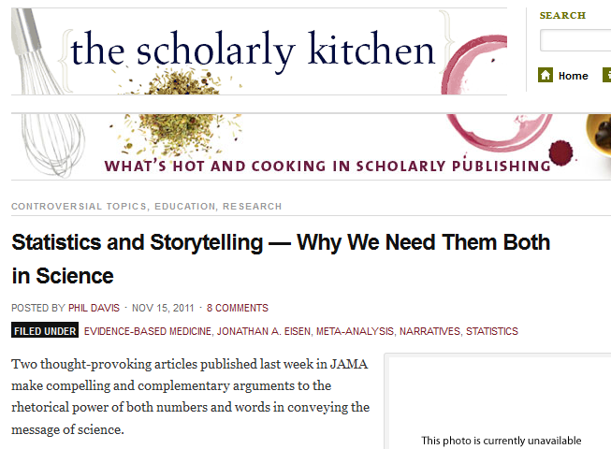

Slide 32

Stories (Personal Testimonies)

Slide 33
Stories (Personal Testimonies)
Access to Research4Life content has resulted in:-
More effective clinical treatment and training
More successful bids for research funding
More productive and effective research
More credibility and respect from peer-reviewers and journal editors
More opportunities for participating in international collaborative research
Improved scientific writing skills
More evidence based policy development
More opportunities for distance learning
http://www.research4life.org/competitionbook

Slide 34
Statistics
Research4Life is developing a programme which will aim to use bibliometric analysis as a tool to see if there is evidence that access to HINARI mediated content has affected research output and quality at participating user institutions.

Slide 35
Statistics
We will identify a number of institutions that have registered for HINARI at least four years ago (and have had significant use of its content)
By examining their research output over the last 15 years, we will seek to measure whether, since the introduction of access to HINARI content:-
there has been a significant increase in the production of research articles
there has been a significant increase in the number of cited references in these articles
article reference lists include more citations to HINARI journals
the median age of article references decreases

Slide 36
Statistics
We will identify a number of institutions that have registered for HINARI very recently (in the last 12 months) and will gather the same data on research article production over the last 15 years.
We will identify a number of developing world institutions that have not registered for HINARI, and who do not have formal institutional access to HINARI journals via any other means, and gather the same data on research article production over the last 15 years.

Slide 37
Statistics
This work is just starting
Comments, suggestions, critique welcomed

Slide 38
Thank you
Richard Gedye gedye@stm-assoc.org

