Slide 1

Squash Wales AGM
Monday 5th October 2026

Slide 2






Zoom Guidance
Please mute your microphones when you’re not speaking.
Cameras are optional.
Any questions throughout the session, please add to the chat box.
We’ll be recording the session and sharing with membership.
Please could you use your full name and the club you’re representing as your screen name.

Slide 3

Agenda
Welcome & Introduction
Present
- Apologies
Minutes of and matters arising from the 2025 AGM
Presentation of the Squash Wales Annual Accounts
Appointment of the Accountants
Annual Reports – Operations & Performance
Motions Received
Any other business
Date of next meeting

Slide 4
Finances
Summary (Full accounts filed with Companies House)
Income
£474,718
% of Total
Sport Wales Grant Funding
£311,614
66%
Membership & Services
£29.187
6%
Events
£71,671
15%
Other Income
£62,246
13%
Expenditure
£412,563
% of Total
Salaries and Staff
£181,978
44%
Non-Pay Administration
£31,712
8%
Digital, CRM and Marketing
£14,184
3%
Administration/membership/services Expenses
£23,993
6%
Domestic Events
£60,080
15%
National Squads
£5,409
1%
International Programme and Performance Support
£87,449
21%
Other
£7,758
2%
Surplus/(Deficit)
£62,155
13%

Slide 5
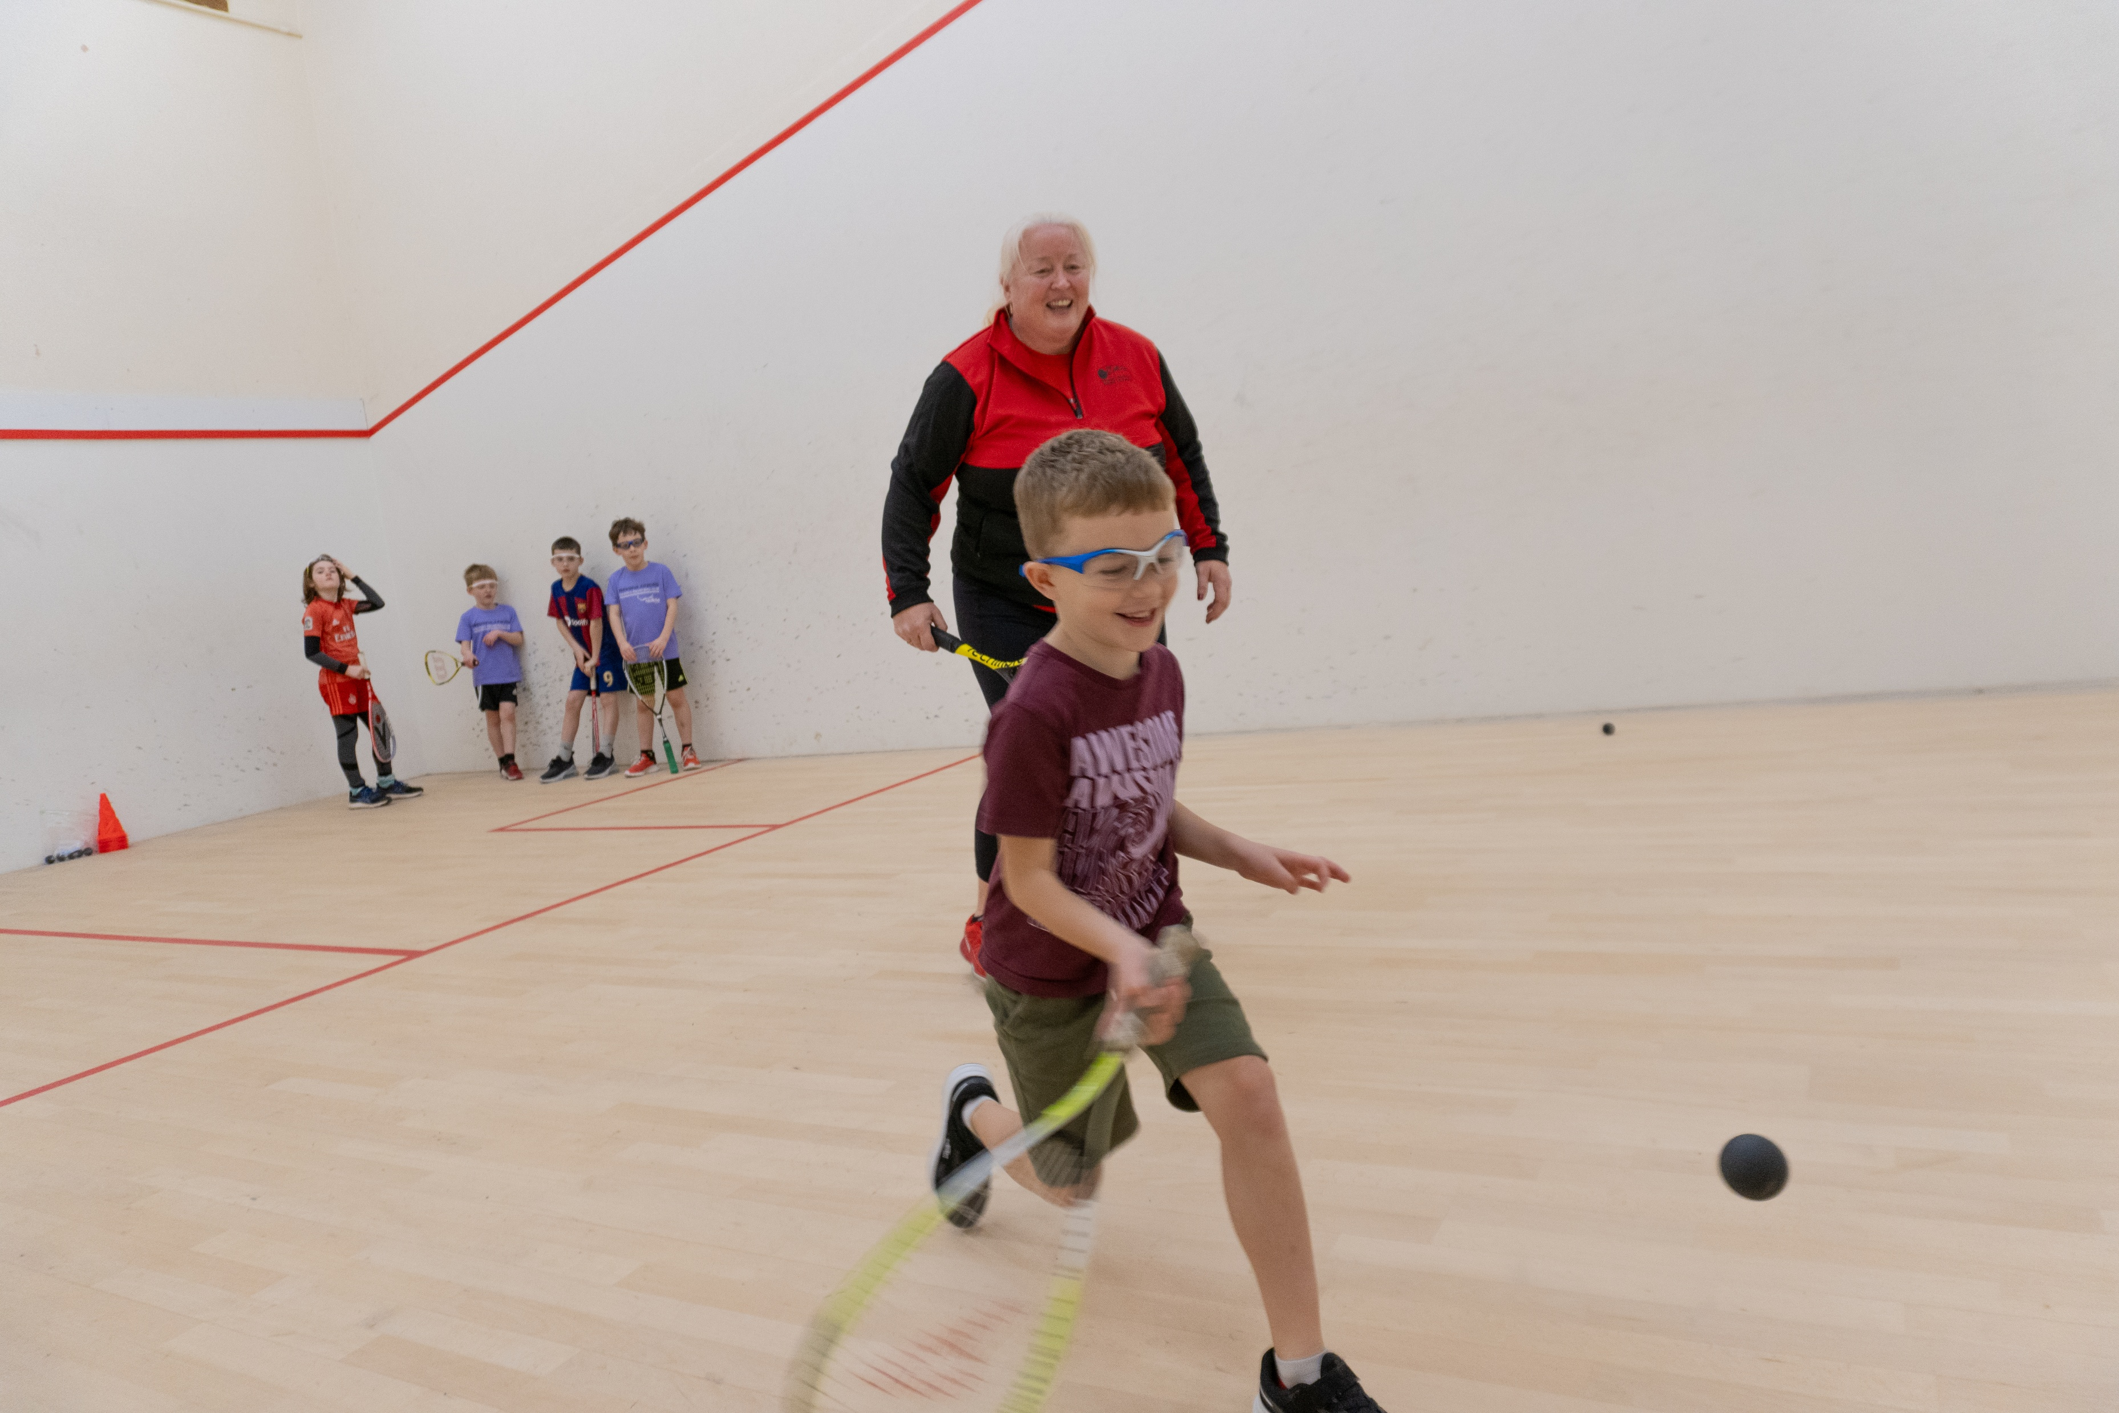
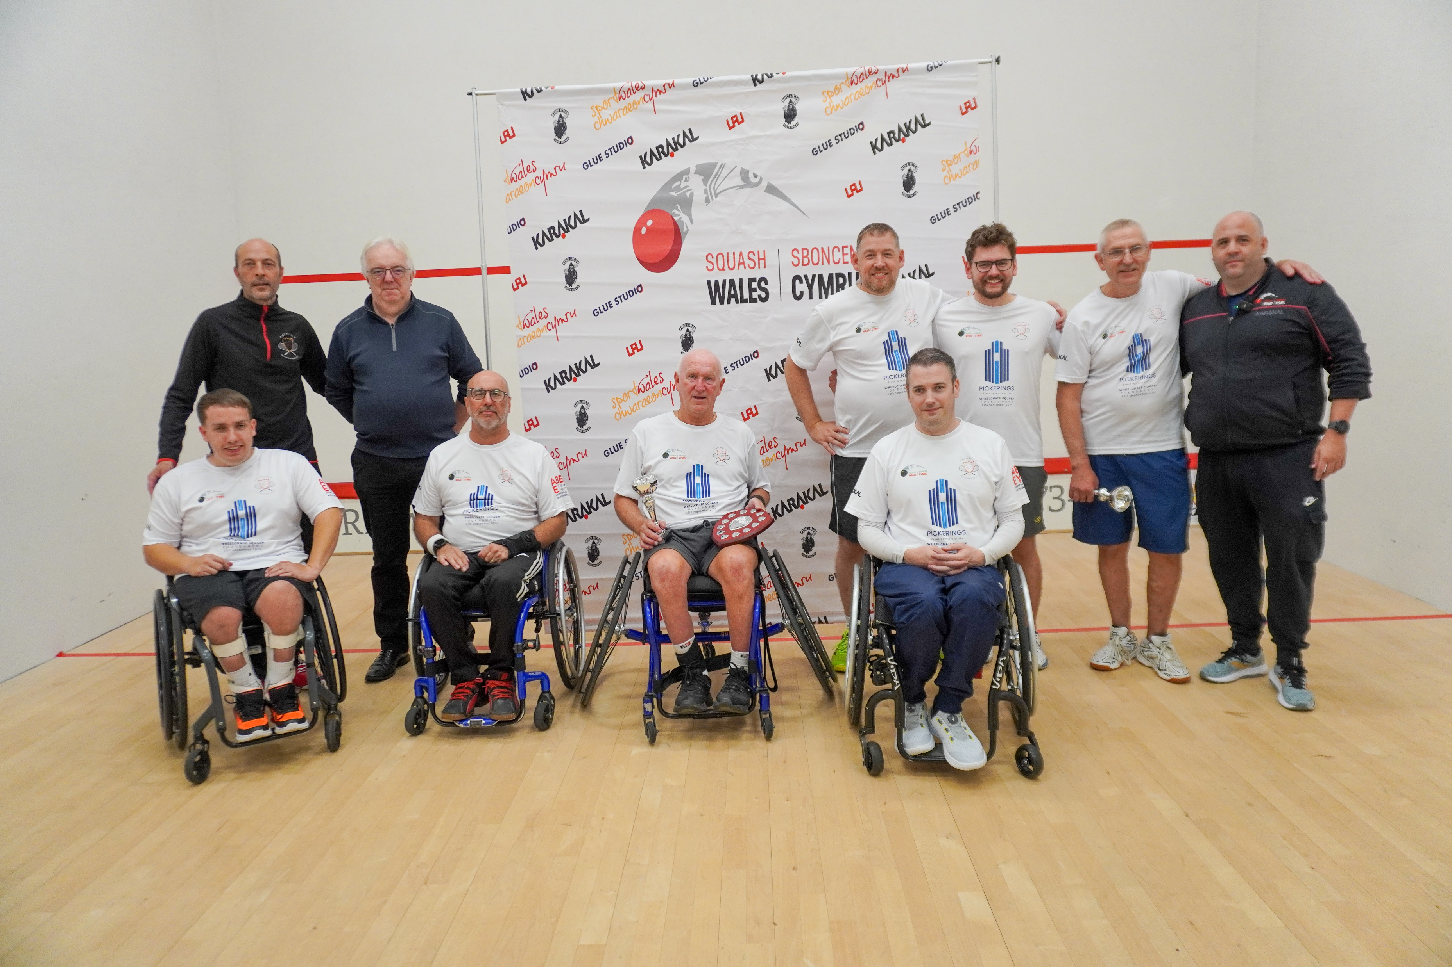
Operations Report
Membership & Growth
1658 MEMBERS +33% YEAR ON YEAR
Continued growth across the organisation
Increased cross-department accountability
Stronger partner and digital engagement
Next Focus: retention, engagement & member value
Events & Participation
Welsh Junior Open –151 Participants, highest entry to date
Strong Junior and Masters competition entries
Royal Welsh Show generated 64 new members
Continued development of the National events calendar
130 + Children attended our Squash Wales Summer Camps
Development, Coaching & Leagues
• Continued coach development across Wales
2025/2026 Leagues completed
9 New Leaders Coaches qualified
Inclusion & Governance
• Continued collaboration with Tennis Wales
Successful Welsh Open Wheelchair event held in Rhiwbina
Long term aim to embed inclusion across the sport
Adult & Child Safeguarding compliance maintained
Policies and governance systems maintained
Financial systems monitored

Slide 6
Operations Report
PRIORITIES FOR 2026-2027
Membership Grow and retain
Engagement Increase member value
Events Deliver a strong National Calendar
Leagues & Pathways Continue development
Performance Embed the New National Coach
Governance Strengthen plannings

Slide 7
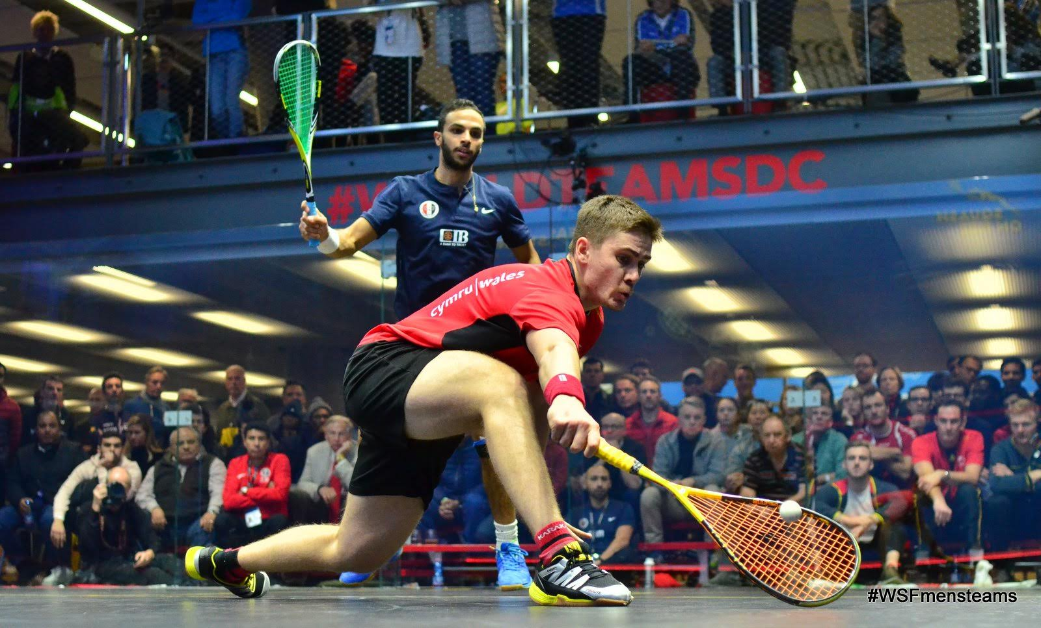
Performance Report
International & PSA Success
• Rhys Evans Gibraltar Open Champion
• Owain Taylor x 3 Titles in Australia
• Murphy claimed Monte Carlo & Irish Opens.
World Rankings
• Joel Makin – World Number 8
Rhys Evans – Career high World No 80
Multiple Welsh players competing inside the World Top 100
Representation & Teams
• Senior Men’s & Women’s teams retained places in Top Division at European Team Champs.
• Junior squads achieved seeded finishes at European Team Champs.
• Strong Masters Home International performances, incl. WO65 and WO35/40 Champions and multiple runner-up finishes.
Pathway & Player Development
Programme restructuring underway
New National Performance Coach appointed
Swansea added as a regional training venue
Player Support
Sport Wales supported Strength & Conditioning
Continued player profiling and performance monitoring
Focus on international competitiveness, depth & sustainability

Slide 8
Operations & Performance
KEY NUMBERS FROM 2025-2026
1,658 MEMBERS - 33% Membership Growth
151 Welsh Junior Open Participants
64 New members from the Royal Welsh Show
World Ranking 8 – Joel Makin
130 + Children attended our Squash Wales Summer Camps

Slide 9
Motions
No motions received

Slide 10
Any other business
Any other competent business

Slide 11
Thank you for your time
Date of Next AGM
04/10/27

