Slide 1

Squash Wales AGM
Monday 6th October 2025

Slide 2






Zoom Guidance
Please mute your microphones when you’re not speaking
Cameras are optional
Any questions throughout the session, please add to the chat box .
We’ll be recording the session, and sharing with affiliated clubs
Please could you use your full name and the club you’re representing as your screen name

Slide 3

Agenda
Welcome & Introduction
Present
- Apologies
Minutes of and matters arising from the 2024 AGM
Presentation of the Squash Wales Annual Accounts
Appointment of the Accountants
Annual Reports – Operations & Performance
Motions Received
Special Resolutions
Any other business
Date of next meeting

Slide 4

Finances
Summary (Full accounts filed with Companies House)
Income
£396,515
% of Total
Sport Wales Grant Funding
£280,395
71%
Membership & Services
£24,929
6%
Events
£46,645
12%
Other Income
£44,547
11%
Expenditure
£410,059
% of Total
Salaries and Staff
£193,202
47%
Non-Pay Administration
£33,399
8%
Digital, CRM and Marketing
£17,171
4%
Administration/membership/services Expenses
£20,495
5%
Domestic Events
£53,864
13%
National Squads
£4,435
1%
International Programme and Performance Support
£76,074
19%
Other
£11,418
3%
Surplus/(Deficit)
(£13,543)
-3%

Slide 5
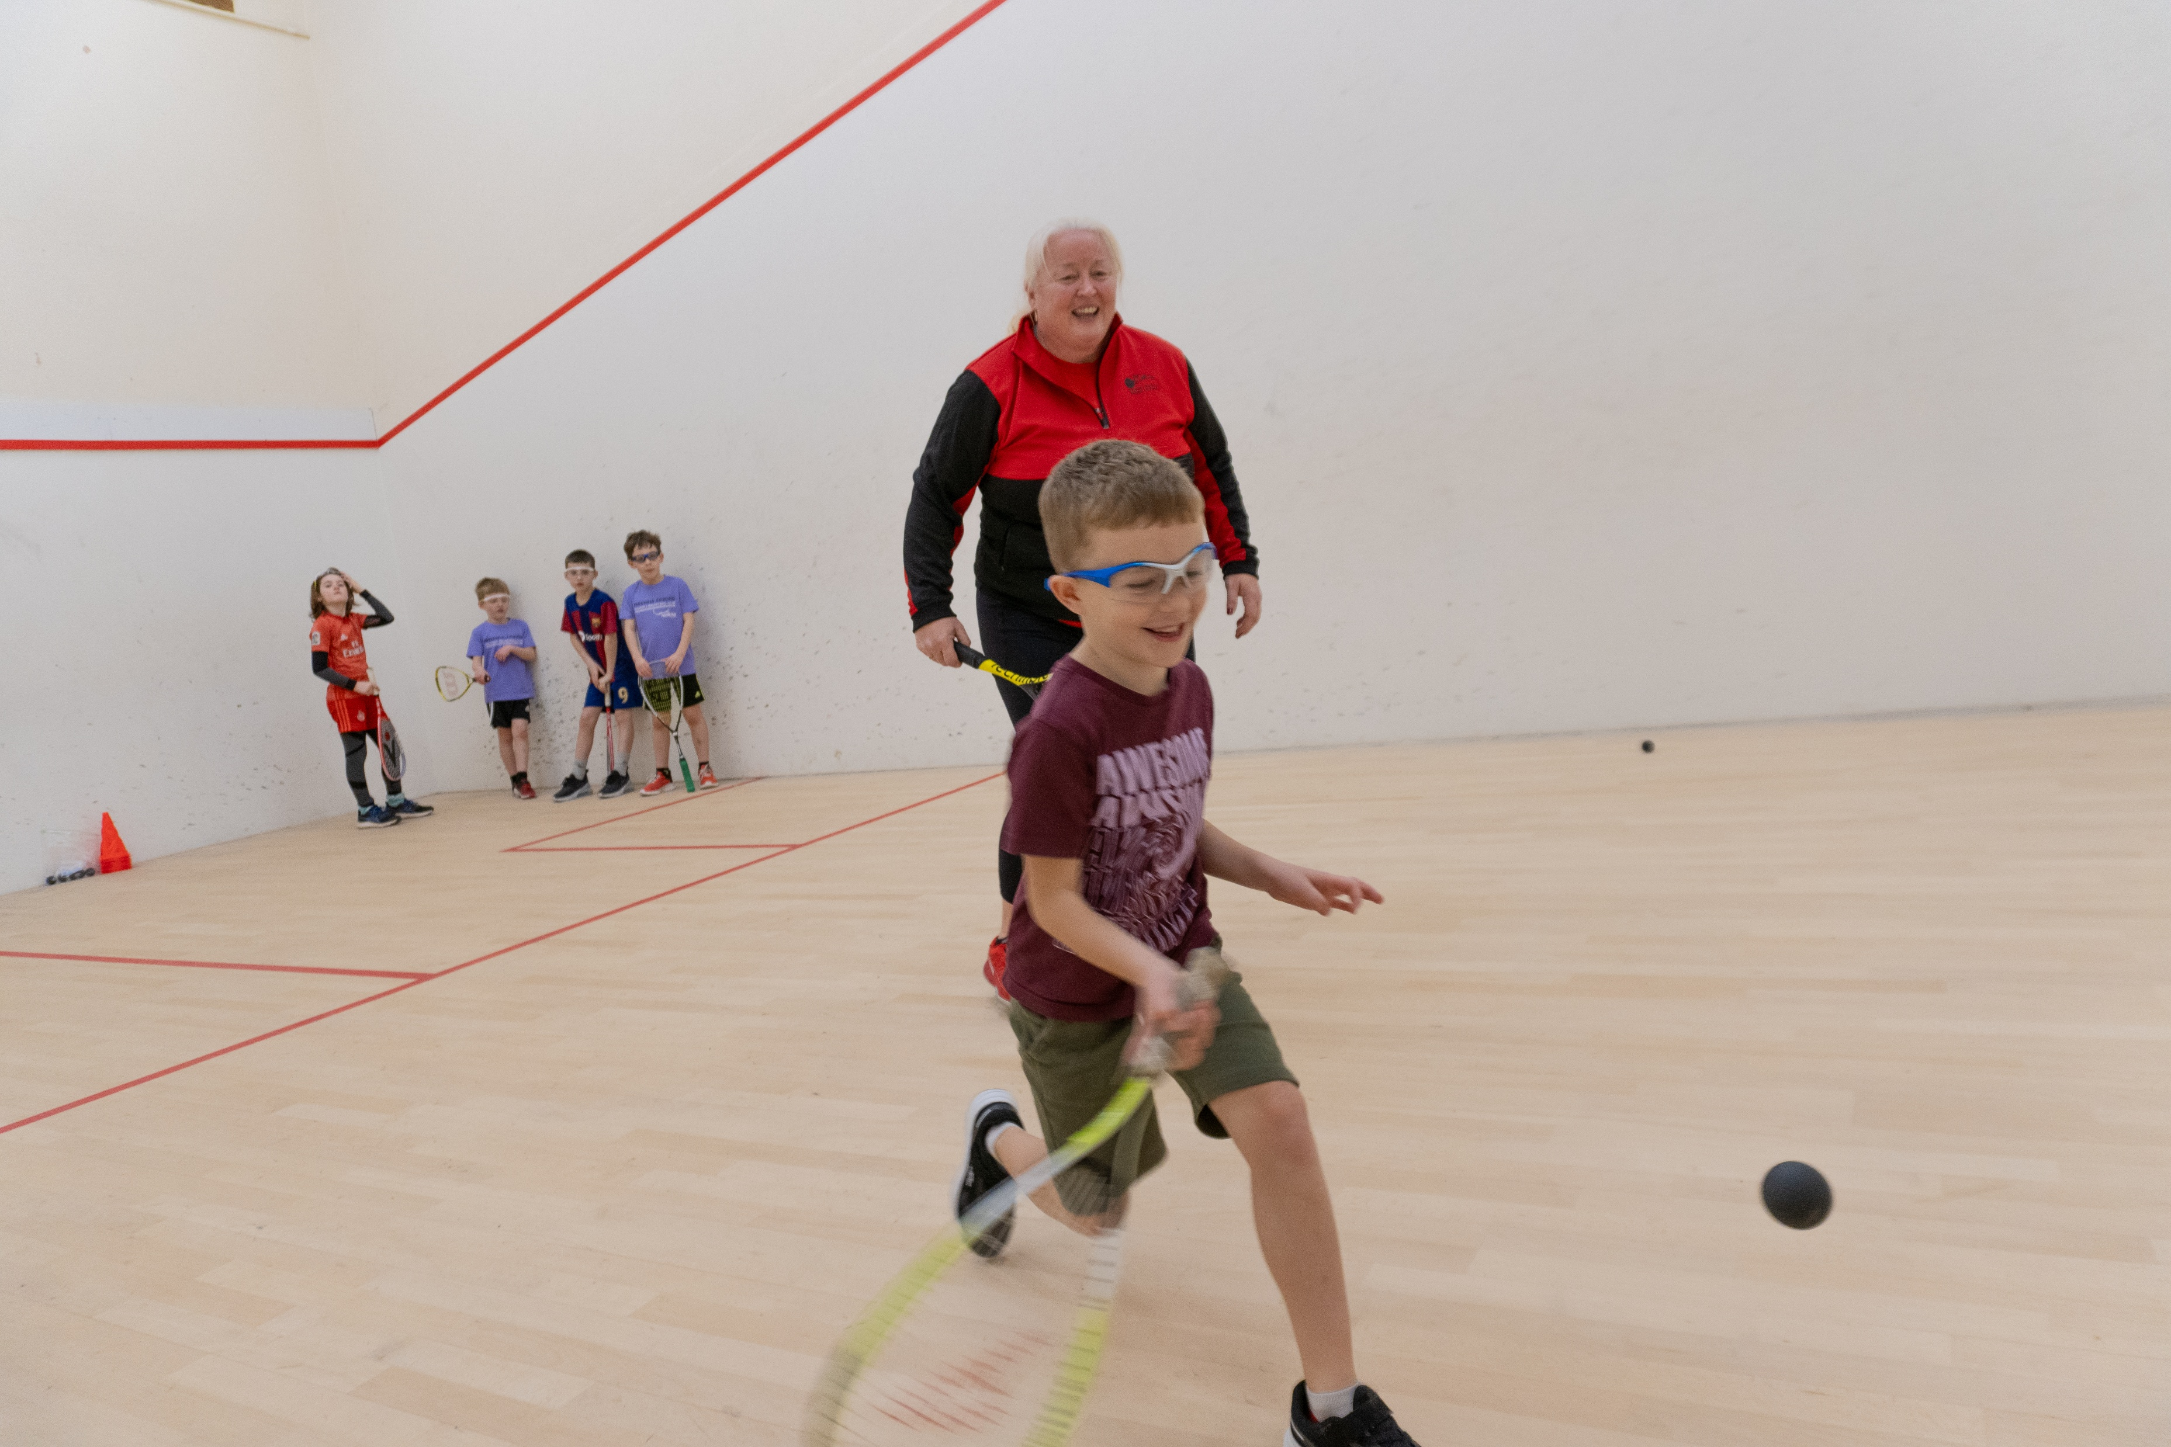

Operations Report
Membership & Participation
• Membership up to 1,338 (+6% year-on-year).
• Growth across Social, Junior & Academy categories.
• Smooth transition to new rewards platform & membership package.
Events & Engagement
• Delivered 8 major national events plus 15 junior camps (115+ players).
• Inaugural Welsh Wheelchair Open – major step for inclusion.
• Tournament participation up 26%, presentation evening attendance up 13%.
• Portable Mini Court boosted visibility (Royal Welsh Show = 30 new juniors).
Development & Coaching
• 734 pupils engaged through Squash in Schools across 20 schools.
• 28 new Level 1 and 5+ Level 2 coaches qualified (more awaiting assessment).
Leagues
• Successful Premier & Winter Leagues, improved rules for 2025–26.
Safeguarding, Governance & Staff
• Achieved Level 2 Child Safeguarding Standards & UKAD compliance.
• Volunteer Board providing strong governance support.
Finance & Grants
• All domestic events delivered profit for the first time.
• Clubs secured £110k Sport Wales Energy Grants; Newport progressed to Phase 2.
• Growing income from online shop, squash camps & new Welsh Business Open.
Digital & Media
• Campaigns reached thousands (e.g. Respect Starts with You, Squash Lingo).
• Innovative wheelchair squash media coverage & documentaries.
• 1,000+ members engaged through newsletters.
Recognition
• Shortlisted for WSA Business Award & Sports EDI Award (London, 2025)

Slide 6



Performance Report
International & PSA Success
• Joel Makin (WR 4) & Tesni Murphy (WR 20) both crowned British National Champions – a first for Wales.
• Makin won World Tour Finals + Silicon Valley & Pittsburgh Opens.
• Murphy claimed Monte Carlo & Irish Opens.
• Welsh juniors & seniors secured multiple PSA finals and ESF titles (e.g. U15 Girls British Inter-County Champions, Nia Seren Thomas, Salah Farrag, Oliver Jones).
• Masters success: multiple British & European titles (Stacey Gooding, Jill Campion, Helen Barnard).
World Rankings Progress
• Players climbing the rankings:
O Makin 9 → 4, Murphy 30 → 20, E. Evans 76 → 67, R. Evans 167 → 128.
• Total Welsh PSA players: 15
Representation & Teams
• Senior Men’s & Women’s teams retained places in Top Division at European Team Champs.
• Junior squads achieved seeded finishes at European Team Champs.
• Strong Masters Home International performances, incl. WO65 Champions and multiple runner-up finishes.
Pathway & Player Development
• Player Pathway running at full capacity – weekly training, half-term squads, regional & national squads.
• Training attendance at record levels (South Squads 95–97%, Elite 97%).
• Sport Wales-supported Strength & Conditioning programme embedded – strong player feedback.
• Player profiling system established – tracking progress across key metrics.

Slide 7
Motions
No motions received

Slide 8

Any other business
Any other competent business

Slide 9
Thank you for your time Date of Next AGM 05/10/26

Slide 10


Slide 11
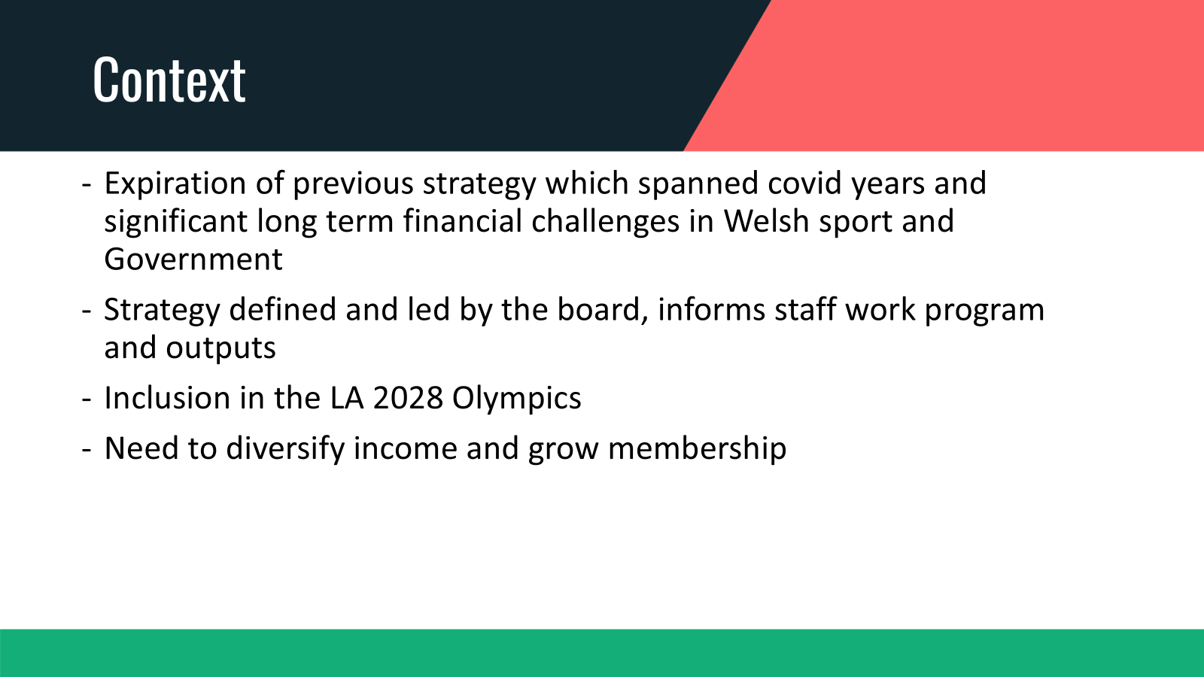

Slide 12
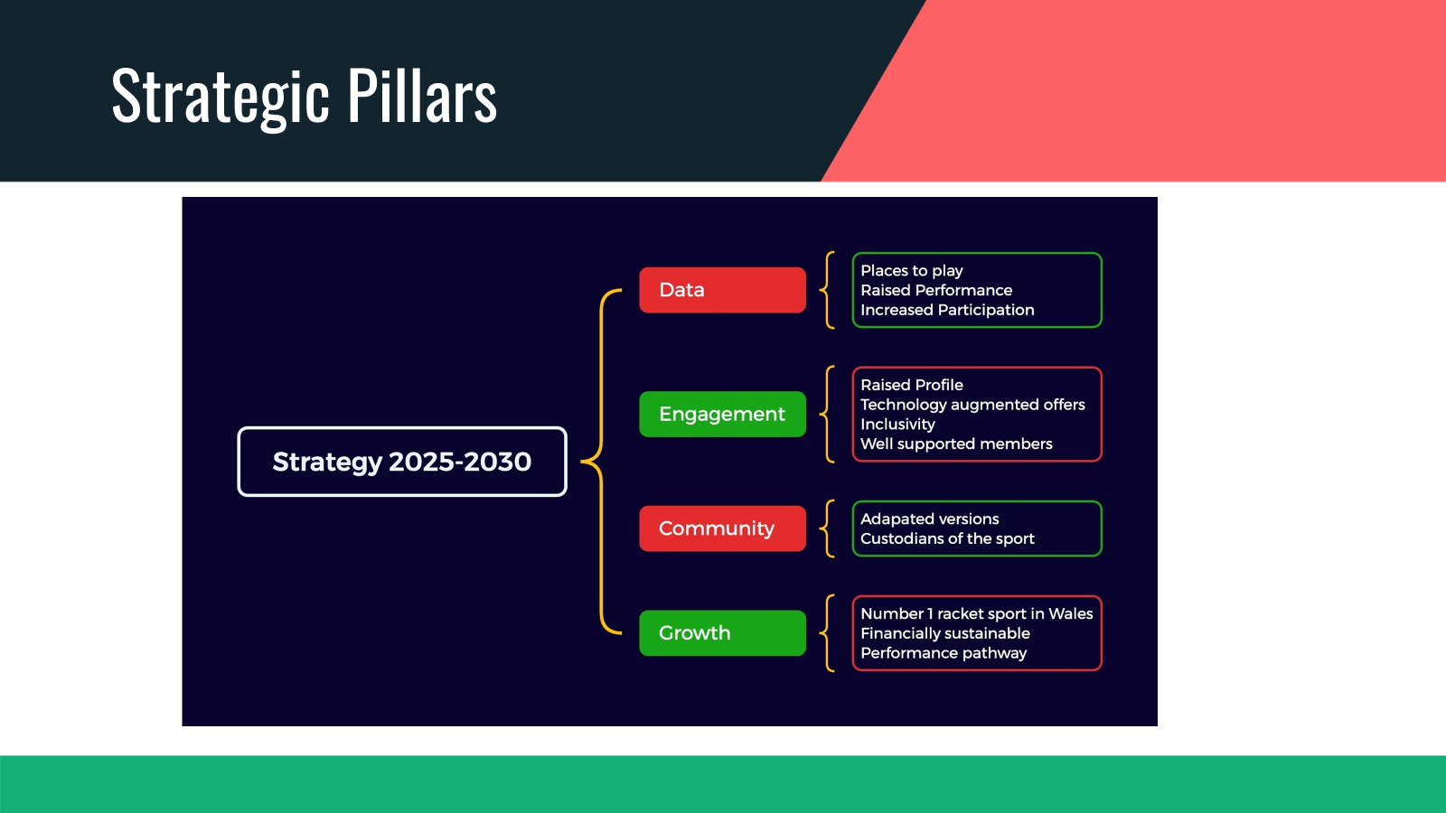

Slide 13
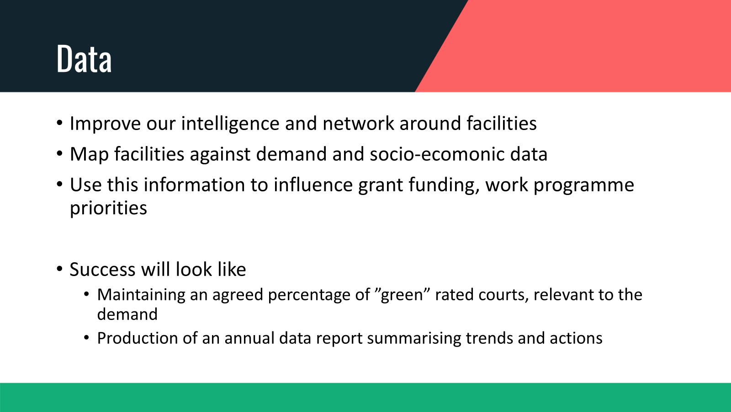

Slide 14


Slide 15
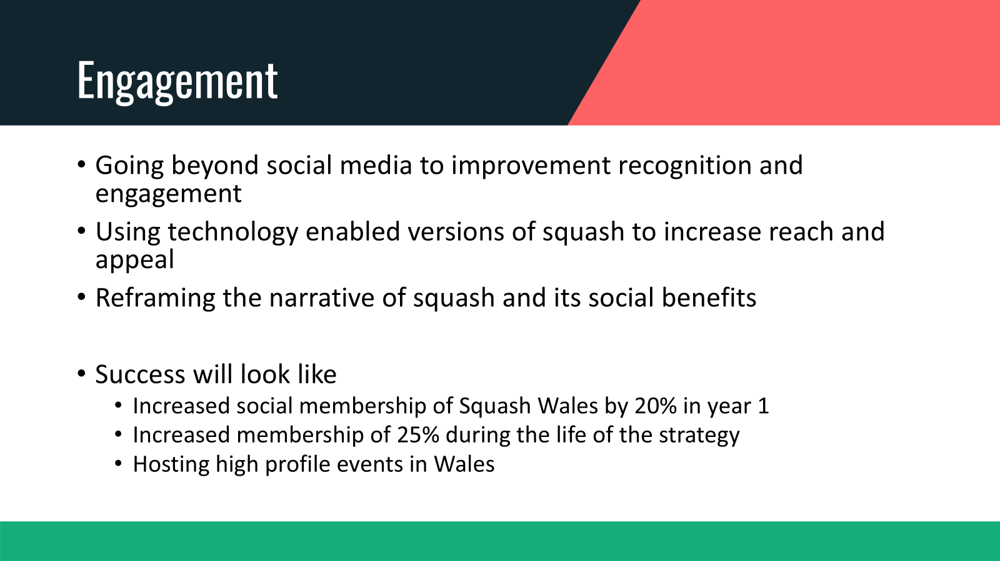

Slide 16


Slide 17
