Slide 1
IMG Induction
Doctors working for the NHS
Liam McDowell DipFA
Independent Financial Adviser

Slide 2
Important Pension Factors to Consider
How does the NHS Pension work?
Is the NHS Pension worth joining?
What does it give me?
How much does it cost?
What happens if I die or become sick?
What happens if I leave?
What happens to my pension if I return home either before or at retirement?

Slide 3
2015 NHS Pension Scheme Explained
Build up rate
The amount of pension you earn each year is determined by what is known as the ‘build up rate’ which is usually shown as a fraction of your pensionable earnings.
In this Scheme the build-up rate is 1/54th, so you earn a pension each year of 1/54th of your pensionable earnings. For example, if you earn £54,000 in a year you would earn a pension for that year of 1/54th of £54,000, which is £1,000. This is the pension you would build up for that year.

Slide 4
2015 NHS Pension Scheme Explained
Annual revaluation
Your pension earned each year will be increased each year by a rate, known as ‘revaluation’, in the period before you retire or leave.
The revaluation rate is currently Consumer Prices Index (CPI) plus 1.5% each year. For example, if CPI was 2% then the pension would be revalued by 3.5% at the beginning of the following year.
If you leave this Scheme before becoming entitled to claim your retirement benefits, annual revaluation stops and is replaced at retirement by the addition of Pensions Increase. Pensions Increase is used to maintain the value of your pension against rises in the cost of living.

Slide 5
2015 NHS Pension Scheme Explained
Length of Scheme membership
You can continue to build up pension rights in this Scheme until age 75 with no limit to the number of years’ pensionable earnings.
Each year of membership adds a value to the pension. The years of membership are then added together to provide one overall pension.

Slide 6
What if I leave the NHS Pension Scheme and move abroad?
To qualify for a refund of pension contributions you must have less than two years’ qualifying membership.
You do not qualify for a refund of pension contributions if you have 2 or more years’ qualifying membership. However, you will have accumulated a pension benefit which can start to be paid at any age from the minimum pension age (currently 55*) up to age 75.
This pension can be payable wherever you are resident in the world and can be paid directly into any UK authorised Bank Account.
If you decide not to maintain a bank account in the UK, payments can be made direct to your own bank account, held in the country specified on the bank mandate, in local currency.
*Legislation has been introduced to increase the minimum pension age to 57 from April 2028

Slide 7
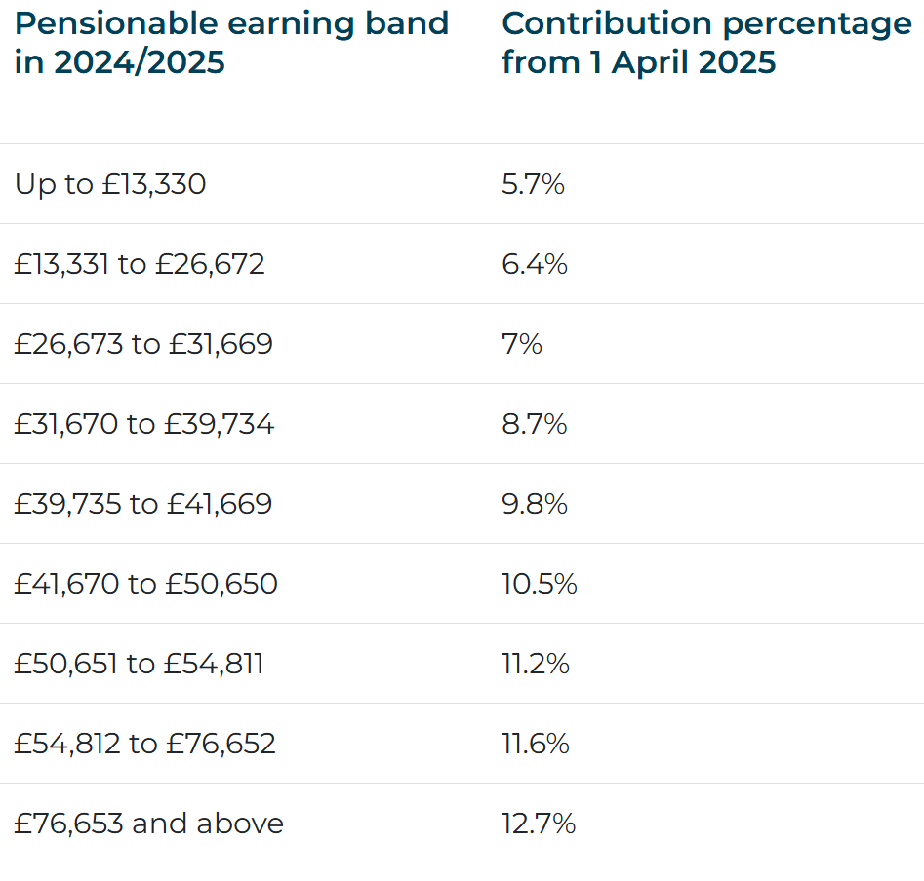
SPPA Scotland Contribution Rates

Slide 8
Buying Additional Pension in the 2015 (CARE) Scheme
Additional Pension is a flexible way of increasing your NHS Pension. Under this option you choose to buy a set amount of annual pension, which you can pay for either with a lump sum payment or by regular contributions deducted from your pay for an agreed period.
The minimum amount of Additional Pension you can buy is £250 and the maximum it’s possible to purchase up to £8,575 for the 2024/25 tax year.
Additional Pension is protected against inflation by being index linked both before and after retirement.
You can choose whether your Additional Pension is just for you or also provides benefits for your dependants when you die.

Slide 9
Early Retirement Reduction Buy Out (ERRBO)
Scheme benefits are paid without reduction from your Normal Pension Age.
In this Scheme your Normal Pension Age is the same as your State Pension Age or age 65 if later and may rise if the State Pension Age rises. You can pay extra contributions to buy out the reduction that would otherwise apply if you claimed your benefits up to three years before your Normal Pension Age (but not earlier than age 65).
The amount of additional contributions payable depends on your age and the number of years’ reduction to be bought out.
For an application to apply from the date of joining it must be received within three months of your joining date.
Applications received after this time will apply from the beginning of the next Scheme year. A reduction contract cannot be taken out retrospectively for previous scheme years.

Slide 10
The NHS Pension is not just about the Pension itself

Slide 11
Additional benefits
Life Insurance
The NHS Pension Schemes provide lump sum and pension benefits to eligible dependants in the event of the member’s death.
As an active member of the pension scheme the benefits payable will be approximately 2 x relevant pensionable earnings.
Dependants’ Benefits
These are payable to a spouse, registered civil partner, nominated qualifying partner or dependent child or children from the date of the member’s death.

Slide 12
The Foundation of Financial Planning

Slide 13
Income Protection Insurance
Considered the most essential of all financial planning tools
Guaranteed to pay out until your normal retirement age, your return to work or your death
Can provide benefits on an ‘own occupation’ basis
Can provide the security of index linked guaranteed premiums
Does any existing cover you have provide these benefits?
Have you had a significant wage increase or other change in circumstances since you took out any existing cover?
We will discuss appropriate levels of income protection taking into consideration your opinions and thoughts
Is now the time to review and take back control?

Slide 14
How can Chase de Vere help?
Our service

Slide 15





Why use a financial adviser?
Saves time
There’s so much information out there: and you've got better things to do than wade through it all.
Reduces noise
A financial adviser will cut through all the noise and the sheer weight of information to get the information or advice that is right for you.
Quantify goals
Knowing how much is enough is half the battle. Financial advisers are skilled at taking your dreams and goals and quantifying them.
Straight talking
A financial adviser has the objectivity to help stop your heart from ruling your head, to make rational decisions.
Hints & tips
Financial advisers have a wealth of practical hints and tips to help improve your finances.

Slide 16

What makes
our service different?
Bespoke
Your goals and circumstances are unique to you, so is the financial advice we provide.
Independent
We’re not tied to any provider and so have the marketplace at our disposal to find the best solutions to suit you.
Specialist
We empower doctors to make well informed financial decisions. Our expertise is truly specialised to your profession.
Comprehensive
From investment planning and wealth preservation to insurance protection and providing for retirement – we can help.
Award-winning
We are often recognised for our unparalleled standards by fellow professionals and independent judges.
Trusted
Over 14,000 doctors have entrusted their personal finances to our advice

Slide 17

What to expect from your complimentary meeting
You will meet with one of our specialist advisers by phone, video or in-person – your choice.
Typically between 60 and 90 minutes.
Together, we will build a picture of where you are now, where you want to be in the future, and start thinking about how best to get there.
We will be clear about how we can help, and what our fees might be. It’s then up to you whether you instruct us – no pressure.

Slide 18
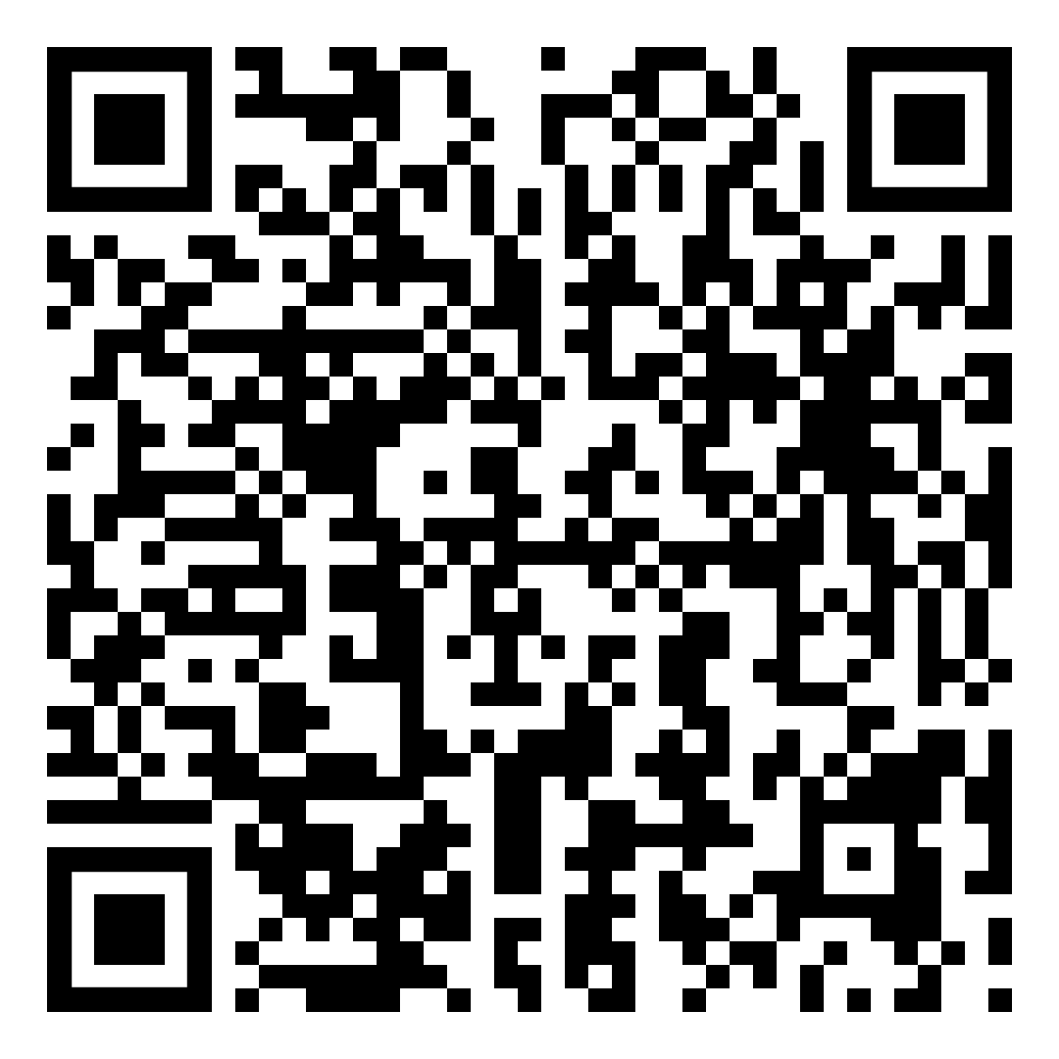
Scan below to arrange a meeting:

