Slide 1
NHS Lothian IMG Induction Day
18 February 2026
SAS doctors and support available
Lynne Meekison
Associate Specialist Gastroenterology RIE
SAS Education Adviser Lothian
Associate Postgraduate Dean (SAS Scotland)

Slide 2
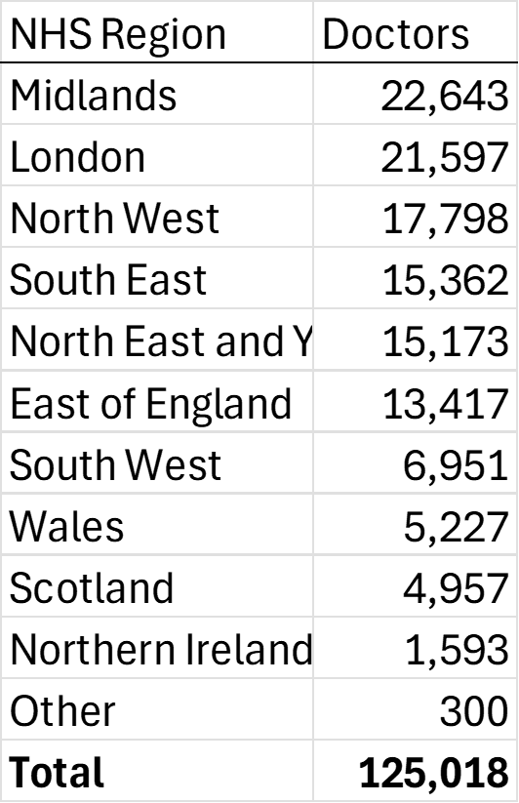
GMC data explorer (downloaded 16/02/2026)
All world PMQ
EEA and non-UK PMQ
NHS Region | Doctors
London | 54,810
Midlands | 44,105
North East and Yorkshire | 37,764
South East | 37,715
North West | 37,655
East of England | 25,841
South West | 25,003
Scotland | 23,376
Wales | 13,117
Northern Ireland | 8,061
Other | 754
Total | 308,201

Slide 3
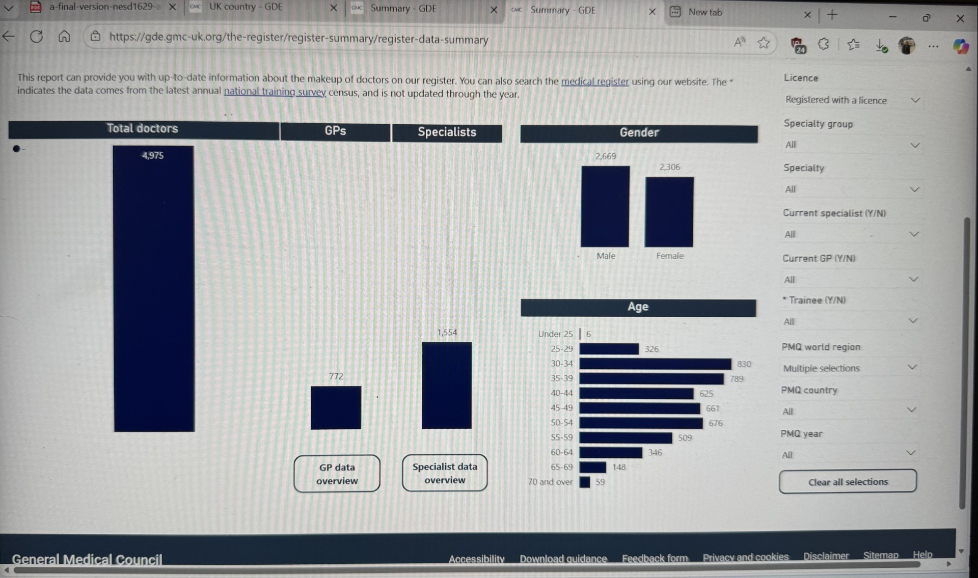

Slide 4
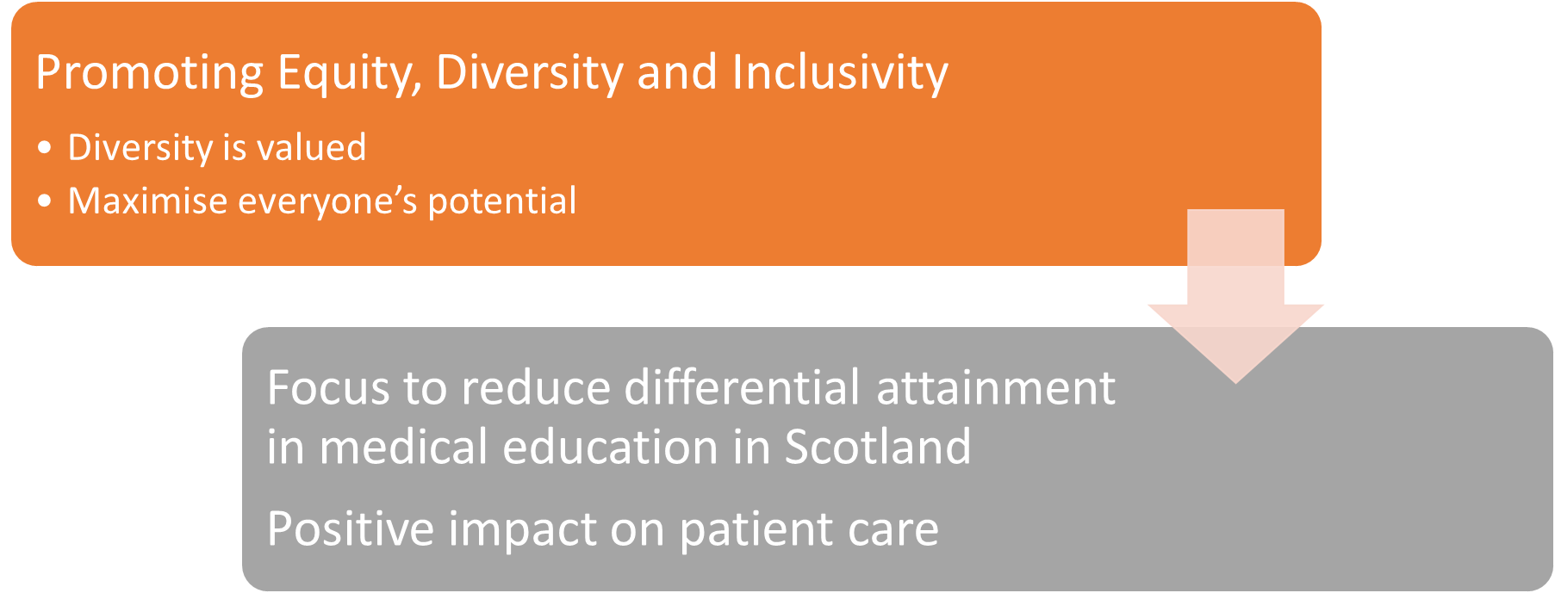
NES: SAS and LE doctors

Slide 5
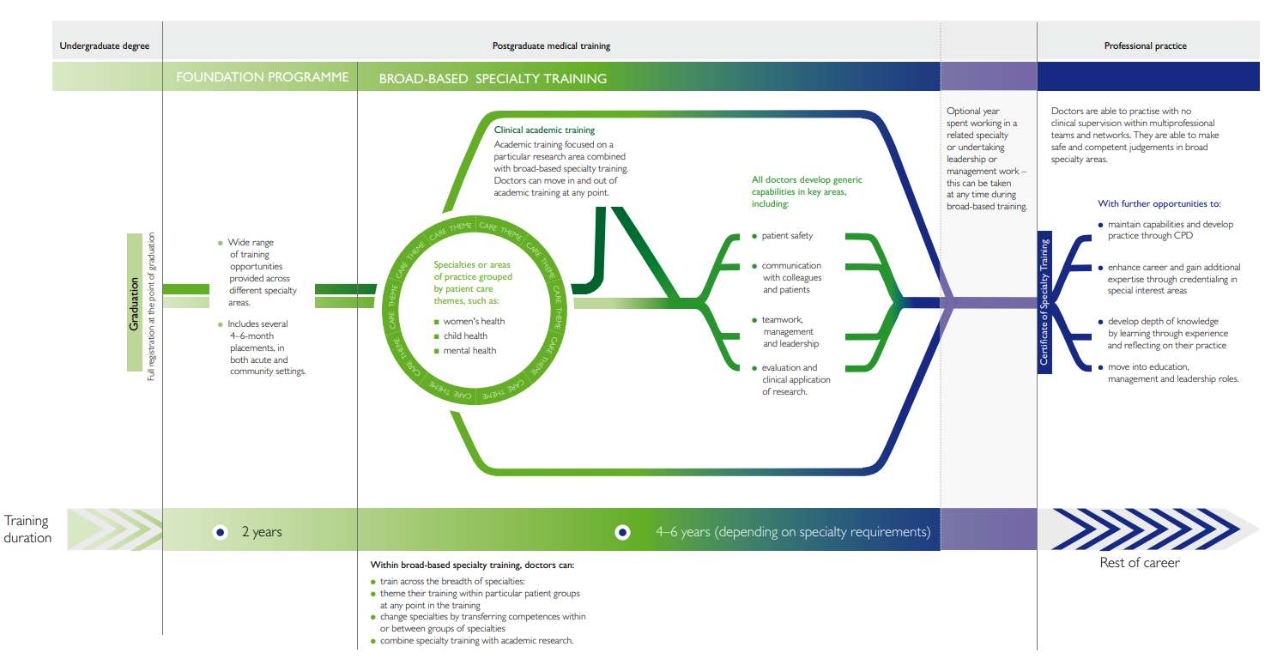
Specialty Doctor
min 4 years
SAS grade posts
Specialist minimum
10 years
Notes:
2013 David Greenaway
-SD >4 yrs postgraduate training (or its equivalent gained on a less than full-time or flexible basis) at least 2 of which will be in a specialty training programme or specialty registrar locum appointment for training (LAT).
-Specialist Minimum 10 years medical work since PMQ; >6 years in relevant specialty in the SD or closed SAS grades

Slide 6
SAS contracts
Specialty Doctor
Minimum 4 yrs postgraduate training (or its equivalent gained on a less than full-time or flexible basis) at least 2 of which will be in a specialty training programme or specialty registrar locum appointment for training (LAT) or
shall have equivalent training, experience or competencies, either in the UK or overseas.
Specialist
Minimum 10 years medical work since PMQ; >6 years in relevant specialty in the Specialty Doctor or closed SAS gradess. Equivalent years’ experience in a relevant specialty from other medical grades including from overseas will also be accepted
shall meet the criteria set out in the Specialist grade generic capabilities framework.

Slide 7

Who are SAS?
Specialty, Associate Specialist, Specialist Doctors/Dentists
1320
SAS in Scotland
been in training/ stopped for a reason
work life balance
part time / increase hours as children get bigger
achieve Portfolio– aim to become a Consultant
wish to re-enter training
trained/ partially trained abroad, keen to work in UK
gain experience in a specialty / stayed
2008 “new” AS and SD contracts; development fund in England
2012 Joint bid Scotland: BMA / NES for a Training & Development fund for SAS
April 2016 funding became integrated into core NES funding
2015 : £500 000 Scottish Government guidance - improve patient care
Notes:
17% AS (41 of 232)
35% 7 or more yrs training- 14.3% on Specialist register.
7% exams, 3% break from training, 3% different specialty, 5% specialty of choice
Worklife 24% Working hours 13%, childcare 17%, carer 2.5%
Re-enter training 5.7% in next year; 21% considering in 5years

Slide 9
SAS Development Programme: AIMS
SAS Development Programme: to enable SAS to achieve their full potential
Scottish Government:
improve care of patients in NHS Scotland
Notes:
so

Slide 10

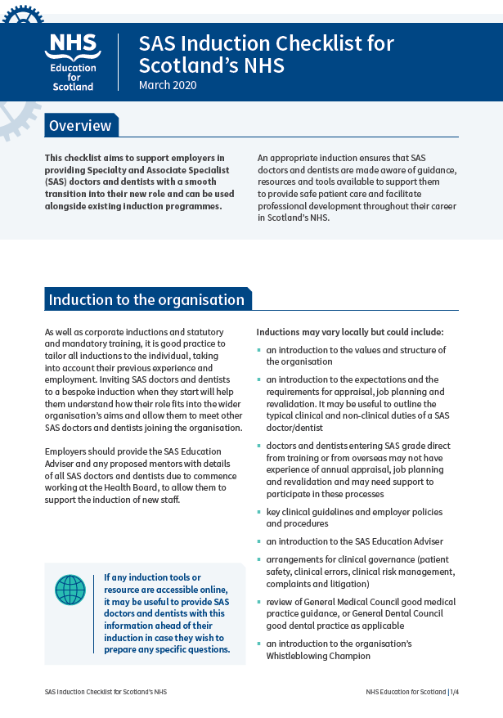


SAS Programme and SAS Funding
Development of SAS
Opportunities to develop new skills relevant to role
Upskill
Support for Portfolio
Access to trainee training opportunities
BoardsNESGMCCollegesBMA

Slide 11
What does the SAS Education Adviser (EA) do?
SAS profile in Health Board
Aims to support SAS
Induction
Information/ signpost
Local meetings
CESR/ portfolio
Application for funding
Supporting national work

Slide 13
Study Leave + SAS Fund
SAS
Development
Study leave budgets
About me
Maintaining current skills
My CV development
My CPD to remain up to date & skilled
SAS development fund
New or enhanced skills
Towards Portfolio
That will change what I do at work
College / TPD confirmation of route
New service development
CD support

Slide 14
What the SAS Development Fund will fund
Eligibility:
MUST hold a substantive SAS contract
Activities which enhance or improve service provision/ patient care/ patient safety
Online / distance learning or in-person courses
Postgrad Qualifications - Cert/Dip/Masters
Must be in relevant clinical areas or leadership/education etc.
Short-term clinical secondments for additional experience of relevance to the service they support
Limited top-up training for Portfolio applications, when all other competencies have been achieved

Slide 15
Applying for funding
Applications need supporting statements from SAS Education Adviser, Clinical Director (or clinical lead) and DME
Programme Boards meets every 3 months
Submissions can be made at any time prior to deadline, but funding can only be awarded at the Board meetings, not in between times
Funding is not retrospective
Summer 2026
Spring
22/5/26
Autumn 2026
Winter
Jan/Feb 2027

Slide 16
Evolution of SAS role: Potential options/ opportunities
Specialty doctor
Specialist
LED
Formal training
Other specialty or leave UK
Portfolio
Consultant

Slide 17
Routes to Specialist Registration
Standard Training pathway - CCT
Standard entry points FY1, 2, Core, Specialty training, run through training
set criteria, key exams, experience, ARCP, ES / CS
Alternative routes to Specialist Registration
Recognition route
Portfolio pathway (previously CESR) to demonstrate that you have Knowledge, Skills and Experience to be a day 1 Consultant

Slide 18
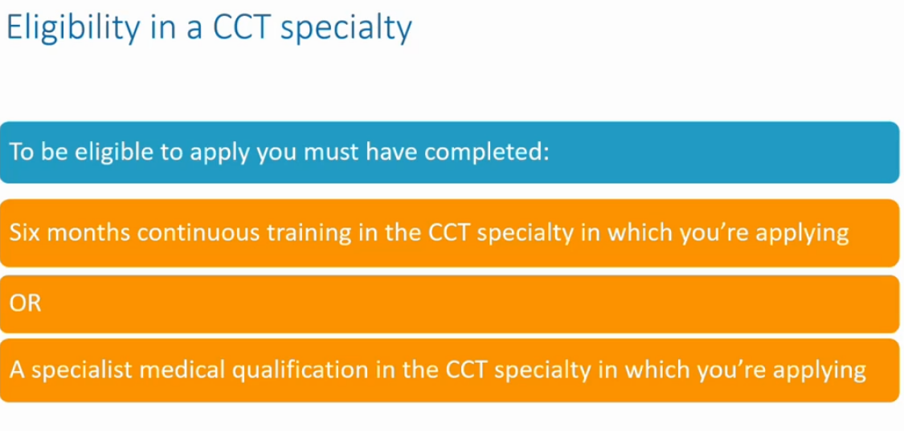
Portfolio pathway : GMC eligibility criteria

Slide 19
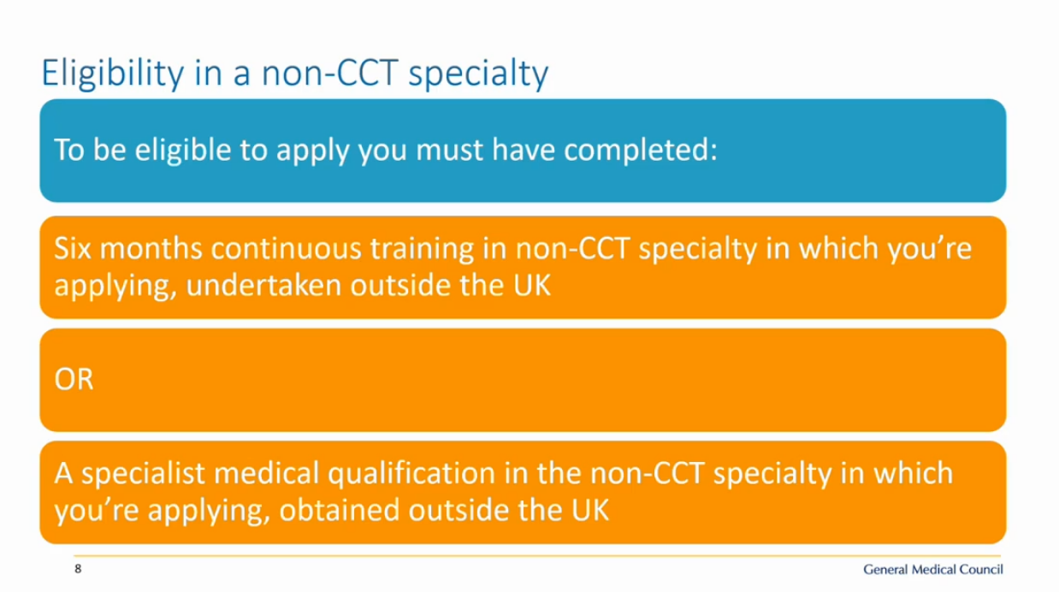
Portfolio pathway

Slide 20
Top tips for Portfolio
Familiarise yourself - read your curriculum / college specialty specific guidance in detail
Map your experience - what you can clearly demonstrate in the format requested
Map your gaps
Can you gather evidence in this role?
Gather evidence prospectively
Ideally, use a College based portfolio to gather your evidence
Follow guidance on GMC website

Slide 21
Applying for Portfolio – or if you plan to do so
Follow the guidance
Certificate of Eligibility for Specialist Registration or Certificate of Eligibility for GP Registration application – GMC
Support from your team – a recording for ES/ CS/ colleagues will be made available on Portfolio Pathway - Employer Guidance | Turas | Learn shortly

Slide 22
Portfolio
SAS in substantive posts
Funding for key courses & limited top-up training (up to 6 months to complete final competencies, if everything else achieved)
Peer support network for SAS
Open to attend for LE too, for the first time
GMC Portfolio workshop for SAS doctors 21.05.26
(register via SAS GMC Specialist Registration workshop 21.05.26 flyer; recording will be made available on the SAS website

Slide 23
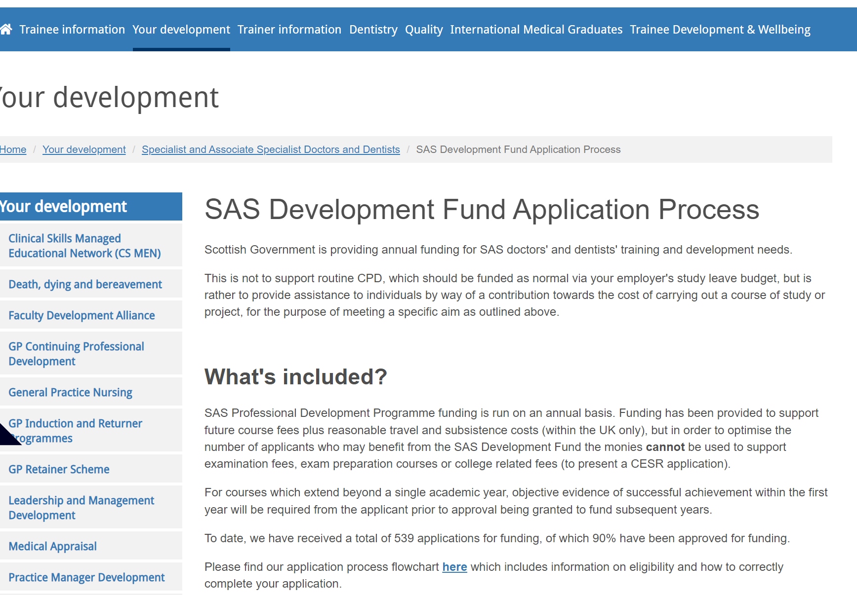

Lynne.meekison@nhs.scot

Slide 24
NES
Medical Training (Prioritisation) Bill
Does not impact SAS careers, or those applying for SAS careers.
Sharing info, relevant to those applying to enter training, available on the Scotland Deanery website
Link has been shared with Goran – on the Lothian MED website for IMG
Please speak to Goran / your own Supervisor if impacts you

Slide 25
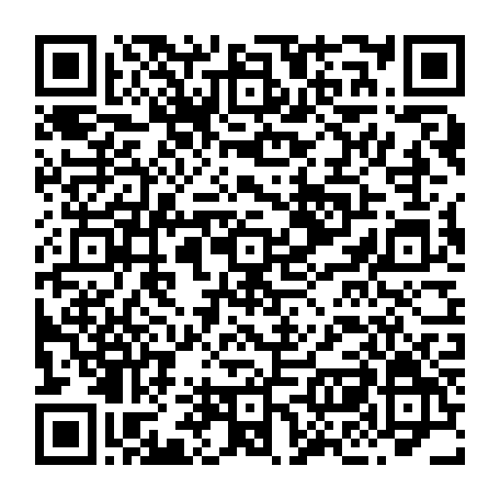
Medical Training (Prioritisation) Bill – Information for app
“Since the lifting of visa restrictions in 2020, UK-trained doctors have faced growing competition from overseas-trained doctors for specialty medical training posts, with applicants rising from 12,000 in 2019 to nearly 40,000 this year”

Slide 26
The Medical Training (Prioritisation) Bill intends to implement the commitment set out in the 10 Year Health Plan for England (applicable in Scotland too) to prioritise UK medical graduates for foundation training places, and to prioritise UK medical graduates and other doctors with significant NHS experience for specialty training places.
Internationally trained doctors make a huge contribution and will continue to do so. If passed, the bill will also enable us to prioritise internationally trained doctors with significant NHS experience, and we are not excluding anyone from applying for training places, they just won’t be prioritised.

Slide 27
As the application process is currently live, for specialty training the Bill requires that for posts starting in 2026 onwards there must be prioritisation at the offer stage of UK medical graduates, individuals in the priority group and individuals who have completed the Foundation Programme or another relevant qualifying UK programme. For offers made in 2026 for specialty training only, it will also require prioritisation of individuals with certain immigration statuses.
For specialty training posts starting from 2027 onwards, the immigration status category will not apply automatically. Instead, we will be able to make regulations to specify any additional groups who will be prioritised. For future years we want the power to define significant experience in a way that best delivers our policy intent to prioritise doctors with a better understanding of UK epidemiology and the healthcare system.
Including those with significant NHS experience is crucial to delivering the policy intent of the Bill. The aim is to prioritise those applicants who have spent substantial time working here as a doctor, who have demonstrated long-term commitment to the NHS and who best understand the health needs of the UK population.

Slide 28
FAQ 10.Exactly which applicant groups will be prioritised for specialty training?
For 2026 the following groups will be prioritised:
Those with a primary medical qualification from medical schools in the UK or Republic of Ireland
Those with a primary medical qualification from medical schools in Iceland, Principality of Liechtenstein, Norway, or Switzerland
Persons who have completed or are currently on the relevant qualifying UK training programme (e.g. Foundation for core training, core training for higher training)
Those within the following priority groups:
British citizen,
a Commonwealth citizen who has the right of abode in the United Kingdom under section 2 of the Immigration Act 1971
an Irish citizen who does not require leave to enter or remain in the United Kingdom under that Act, Compare 5th January 2026 Medical Training (Prioritisation) Bill 1
person with indefinite leave to enter or remain in the United Kingdom
a person who has leave to enter or remain in the United Kingdom which was granted by virtue of residence scheme immigration rules within the meaning given by section 17 of the European Union (Withdrawal Agreement) Act 2020.

Slide 29
11. Is prioritisation occurring at core and higher training?
Prioritisation will be implemented both at core and higher specialty training.
12. Will applicants who have completed core be prioritised for higher training?
Yes, applicants who have completed or currently on the relevant qualifying programme will be prioritised
Foundation Programme completers will be prioritised for core, (both those completing the two-year programme and 1-year standalone FY2).
Applicants who have completed core specialty training will be prioritised for higher specialty training in the relevant specialty. Completing a core programme in an unrelated specialty to the higher specialty training programme will not lead prioritisation (e.g. completing core psychiatry and applying for higher surgery).
Applicants who have previously completed the foundation programme will also be eligible for prioritisation and do not necessarily need to have completed the relevant core programme.
All applicants will also need to meet the relevant eligibility criteria in the relevant specialities person specification.

Slide 30
Implications for SAS and LE posts
No implication for entry criteria to either SAS or LE posts
Possibility to consider Portfolio pathway

Slide 31
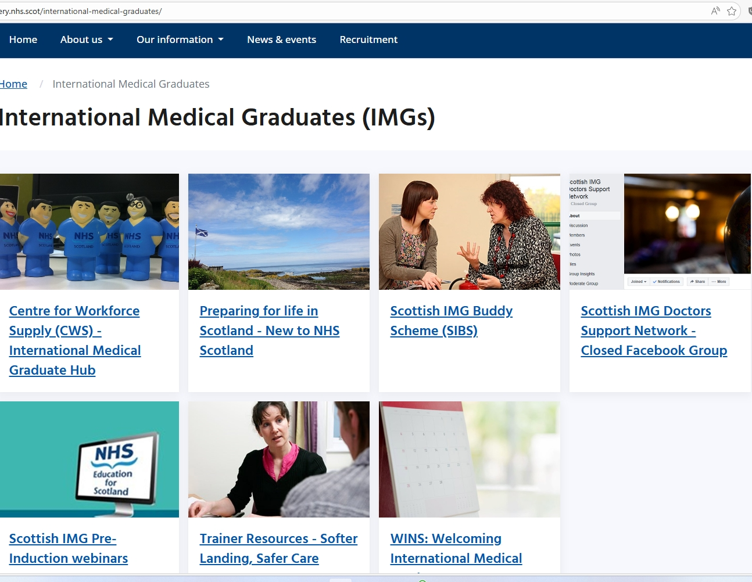
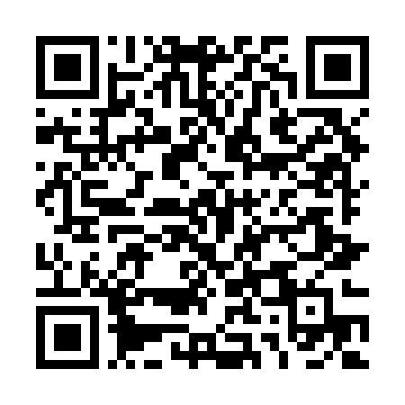

Slide 32
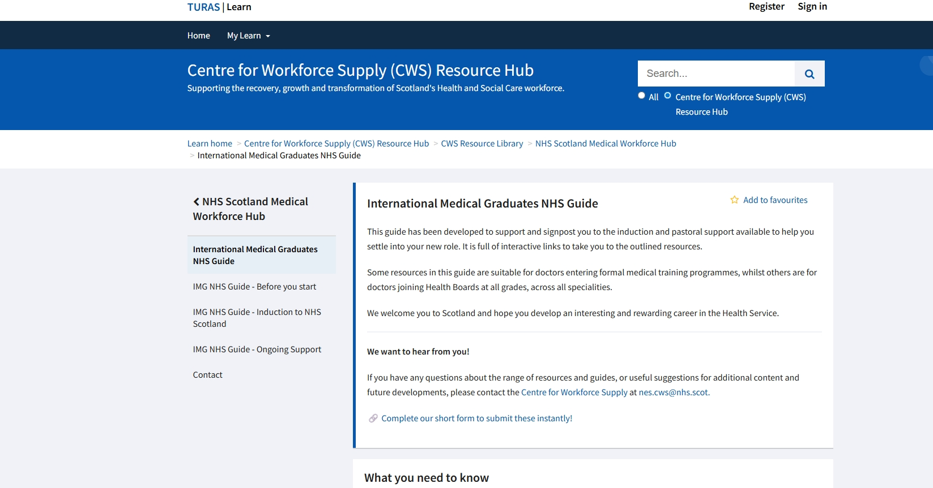


Slide 33
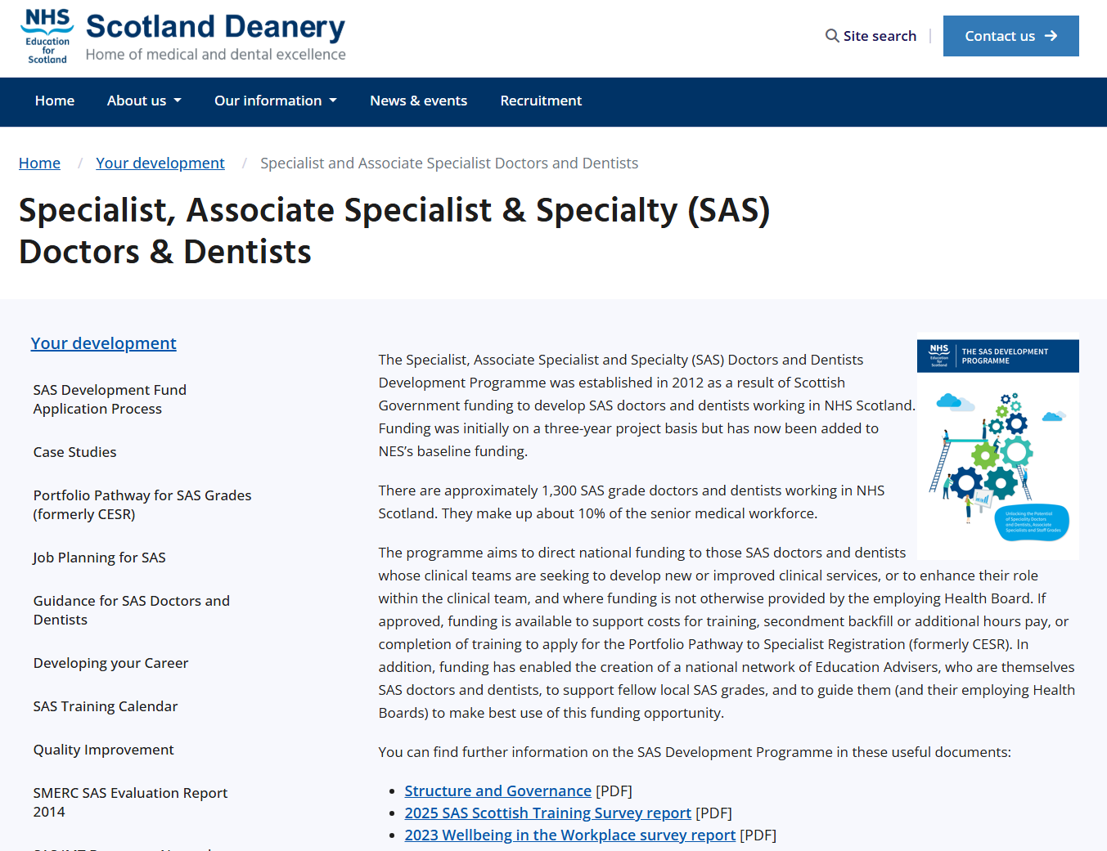

Lynne.meekison@nhs.scot

