Slide 1
Where Are You From The Hidden Curriculum of Training through an IMGs lens in Obstetrics & Gynaecology
Dr Isioma Okolo | Consultant Obstetrician & Gynaecologist

Slide 2
TODAY…. 1. Introduce myself 2. Introduce the Hidden Curriculum(#TheHC) 3. Introduce Individual Solutions 4. Share My Resources
Dr. Isioma Okolo | @dr_isi_obgyn | drisiomaokolo.com

Slide 3

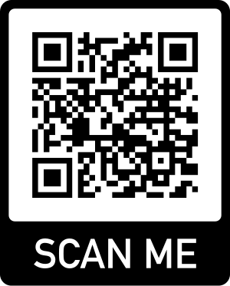
Medical careers Women’s Health Social change
📍
📍
Clinician
Researcher
Activist
Writer

Slide 4

Where Are You From?
📍
📍
📍
📍
📍
📍
📍
📍
📍
📍
📍

Slide 5
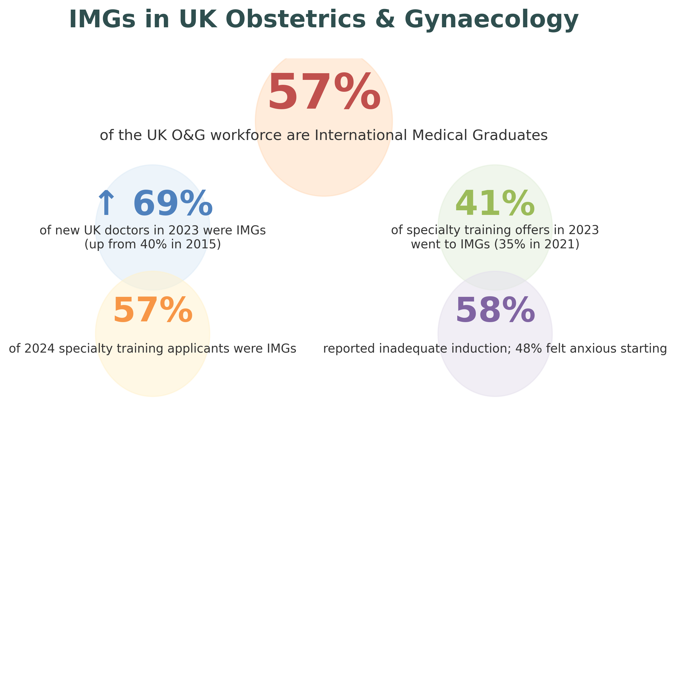

Slide 6
Statistics are Not Destiny IMG Differential Attainment in O&G
Lower pass rates in Exams/ ARCP
Discrimination & Racism
Bullying & Undermining
Referrals to GMC
Dr. Isioma Okolo | @dr_isi_obgyn | drisiomaokolo.com

Slide 7

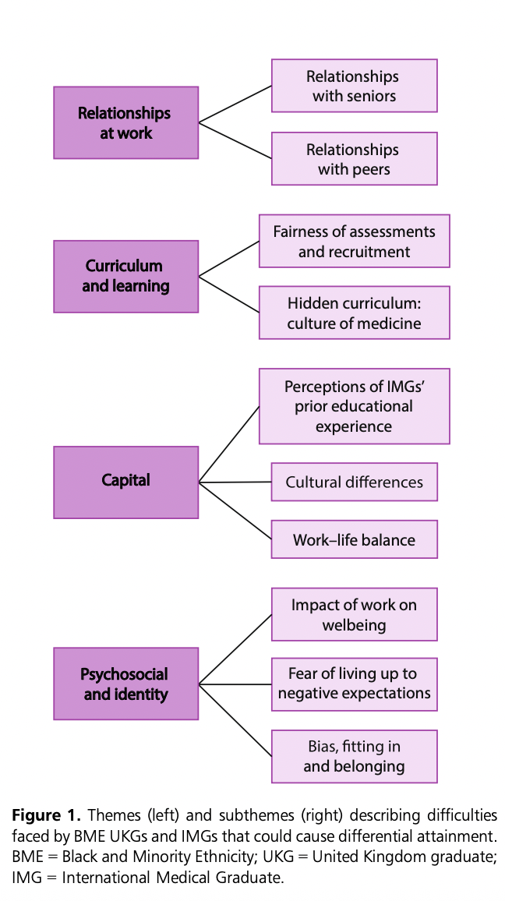
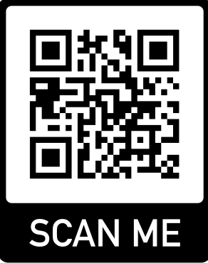
A Race to the Finish Line
Okolo ID, Prasad M, Siddiqui F, Mountfield J, Khan R, et al. A race to the finish line. The Obstetrician & Gynaecologist 2023;25:92–6. https://doi.org/10.1111/tog.12863

Slide 8
The Hidden Curriculum of Training
Unspoken rules, values, and power structures that trainees absorb alongside formal teaching. It shapes how doctors learn to behave, decide, survive—and who ultimately thrives—during residency and medical training.
Everything you are expected to know, navigate, and perform — without ever being formally taught.

Slide 9
#TheHC Decoded
Culture
Power
Perception
Access

Slide 10
7 Ways the Hidden Curriculum Might Trip You Up. HOW TO AVOID IT
#TheHC
Dr. Isioma Okolo | @dr_isi_obgyn | drisiomaokolo.com

Slide 11

1. Entry ≠ Belonging
Early negative impressions are sticky
IMGs spend cognitive energy decoding culture rather than showcasing skill
#TheHC
Expectations assumed, not explained
Local norms treated as common sense
Less access to informal knowledge
Solutions
Ask early: “What does good look like here?”
Identify one trusted senior
Treat cultural learning as part of induction
Notes:
IMGs often enter training laterally—clinically competent, but unfamiliar with local norms
Expectations are assumed, not explained (how to escalate, how to disagree safely, how to be “visible”)
Accent, training background, or unfamiliarity with informal cues is misread as lack of confidence or competence
System: Structured induction that teaches unwritten rules, not just IT systems
Leadership: Name belonging as a training outcome, not a personality trait

Slide 12

2. Scrutiny Is Higher, Grace Is Lower
IMGs are over-represented in referrals
Under-represented in praise
Confidence erodes even when objective performance is strong
#TheHC
Errors remembered differently
Feedback often vague
Strengths under-documented
Solutions
Control the Evidence Trail
Ask for written, specific behaviour-based feedback
Keep a personal evidence log
Clarify expectations early
“What should I do different next time?”
Notes:
HC explained
Errors are more likely to be attributed to “background” rather than circumstance
Feedback is often vague (“needs confidence”, “communication issues”) rather than actionable
Informal remediation happens without transparency
Other solutions
Supervisors: Separate accent, style, and culture from competence
System: Standardise feedback language; audit differential attainment by training background

Slide 13

3. Mentorship Is Uneven and Informal
Greater reliance on trial-and-error
Slower access to leadership, research, and career opportunities
#TheHC
Mentorship is often offered to those who feel “familiar”
Less sponsorship (advocacy in rooms you’re not in
Advised to “just work hard” rather than taught strategy
Solutions
Identify one influential sponsor (not many mentors)
Ask about opportunities
Notes:
Identify one influential advocate
• Ask about opportunities
• Position yourself intentionally
HC explained
Mentorship is often offered to those who feel “familiar”
Sponsorship (advocacy in rooms you’re not in) is rare for IMGs
IMGs are advised to “just work hard” rather than taught strategy
Solutions
System: Formal sponsorship programmes—not just mentorship
Institutions: Reward senior doctors for equitable sponsorship

Slide 14

5. Confidence is Culturally Coded
IMGs self monitor more
To Assimilate or Not to Assimilate…that is your biggest question
#TheHC
Accent and tone influence perception
Your communication is being judged differently
Solutions
Learn local communication norms
Intentionally expand your circle
Adapt without self-erasure
Notes:
Other solutions:
System:
Transparent career roadmaps shared early
Organisations:
Publish criteria for progression, awards, and leadership roles

Slide 15

6. Career Navigation Is Assumed Knowledge
IMGs plateau despite competence
Late discovery of missed opportunities
#TheHC
Less likely to be told about fellowships, discretionary points, leadership tracks
CV-building rules are opaque and change by region
Solutions
Treat career planning as a clinical skill
—schedule it
Vision boards
Quarterly CV updates
Mentor + Sponsor check ins
Ask yourself- “what is my Ikigai?”
Notes:
Other solutions:
System:
Transparent career roadmaps shared early
Organisations:
Publish criteria for progression, awards, and leadership roles

Slide 16

7. Emotional Load Is Invisible
Burnout presents earlier and deeper
IMGs delay help-seeking
#TheHC
IMGs carry migration stress, family separation, visa pressure
Financial remittance/ security
Racism or microaggressions are normalised
Gratitude is expected; complaint is risky
Solutions
Build support outside formal hierarchies
Build community within and outside yours
Notes:
Other solutions
System:
Psychological safety policies that explicitly
include IMGs
Leadership:
Make wellbeing structurally protected, not discretionary

Slide 17
The Pattern.. IMG disadvantage is rarely about ability. It is about access to the invisible curriculum
#TheHC
Dr. Isioma Okolo | @dr_isi_obgyn | drisiomaokolo.com

Slide 18
Reframing the Ask: How is the hidden Curriculum showing up here?
#TheHC
Equity is not remediation
Support is not lowering standards
Naming the hidden curriculum benefits everyone
When the rules are spoken, talent can surface.
Dr. Isioma Okolo | @dr_isi_obgyn | drisiomaokolo.com

Slide 19
Positive Initiatives & Support
RCOG Race Equality Taskforce & Coaching
RCOG Workplace Behaviour Toolkit
RCOG Hub for International Medical Graduates
BMA Guide for IMGs
NHS Lothian Cultural Sensitivity Training

Slide 20
Jisi Ike hold steady
IMGs bring diversity, resilience, and perspective to NHS
Challenges can be turned into opportunities
Decoding #TheHC + Institutional tools + personal resilience = Success

Slide 21

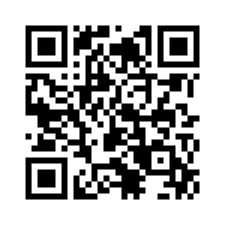
My Resources
Dealing With Imposter Syndrome
Mentorship is Not a Luxury
Discovering Your Ikigai: When Clinical Excellence Isn’t Enough
5 Lessons in Self Leadership I Wish I’d Known Sooner
Why I Hate the Word Resilence
Rest as Resistance in Medicine
Becoming a Consultant: Things Nobody Tells You
Beyond Bias: Tackling Racisim in O& G

Slide 22


CONNECT WITH ME
Dr. Isioma Okolo | @dr_isi_obgyn | drisiomaokolo.com

