Slide 1
Who am I ?
Geoff Dobson FRCGP FRCPE
31 years a GP in Leith Edinburgh. 25 as a trainer in GP. Training Programme Director for GP to the Scottish Borders. RETIRED
Hundreds of hours observing and helping young trainees and himself on video /in the flesh to improve our consulting
No competing interests

Slide 2
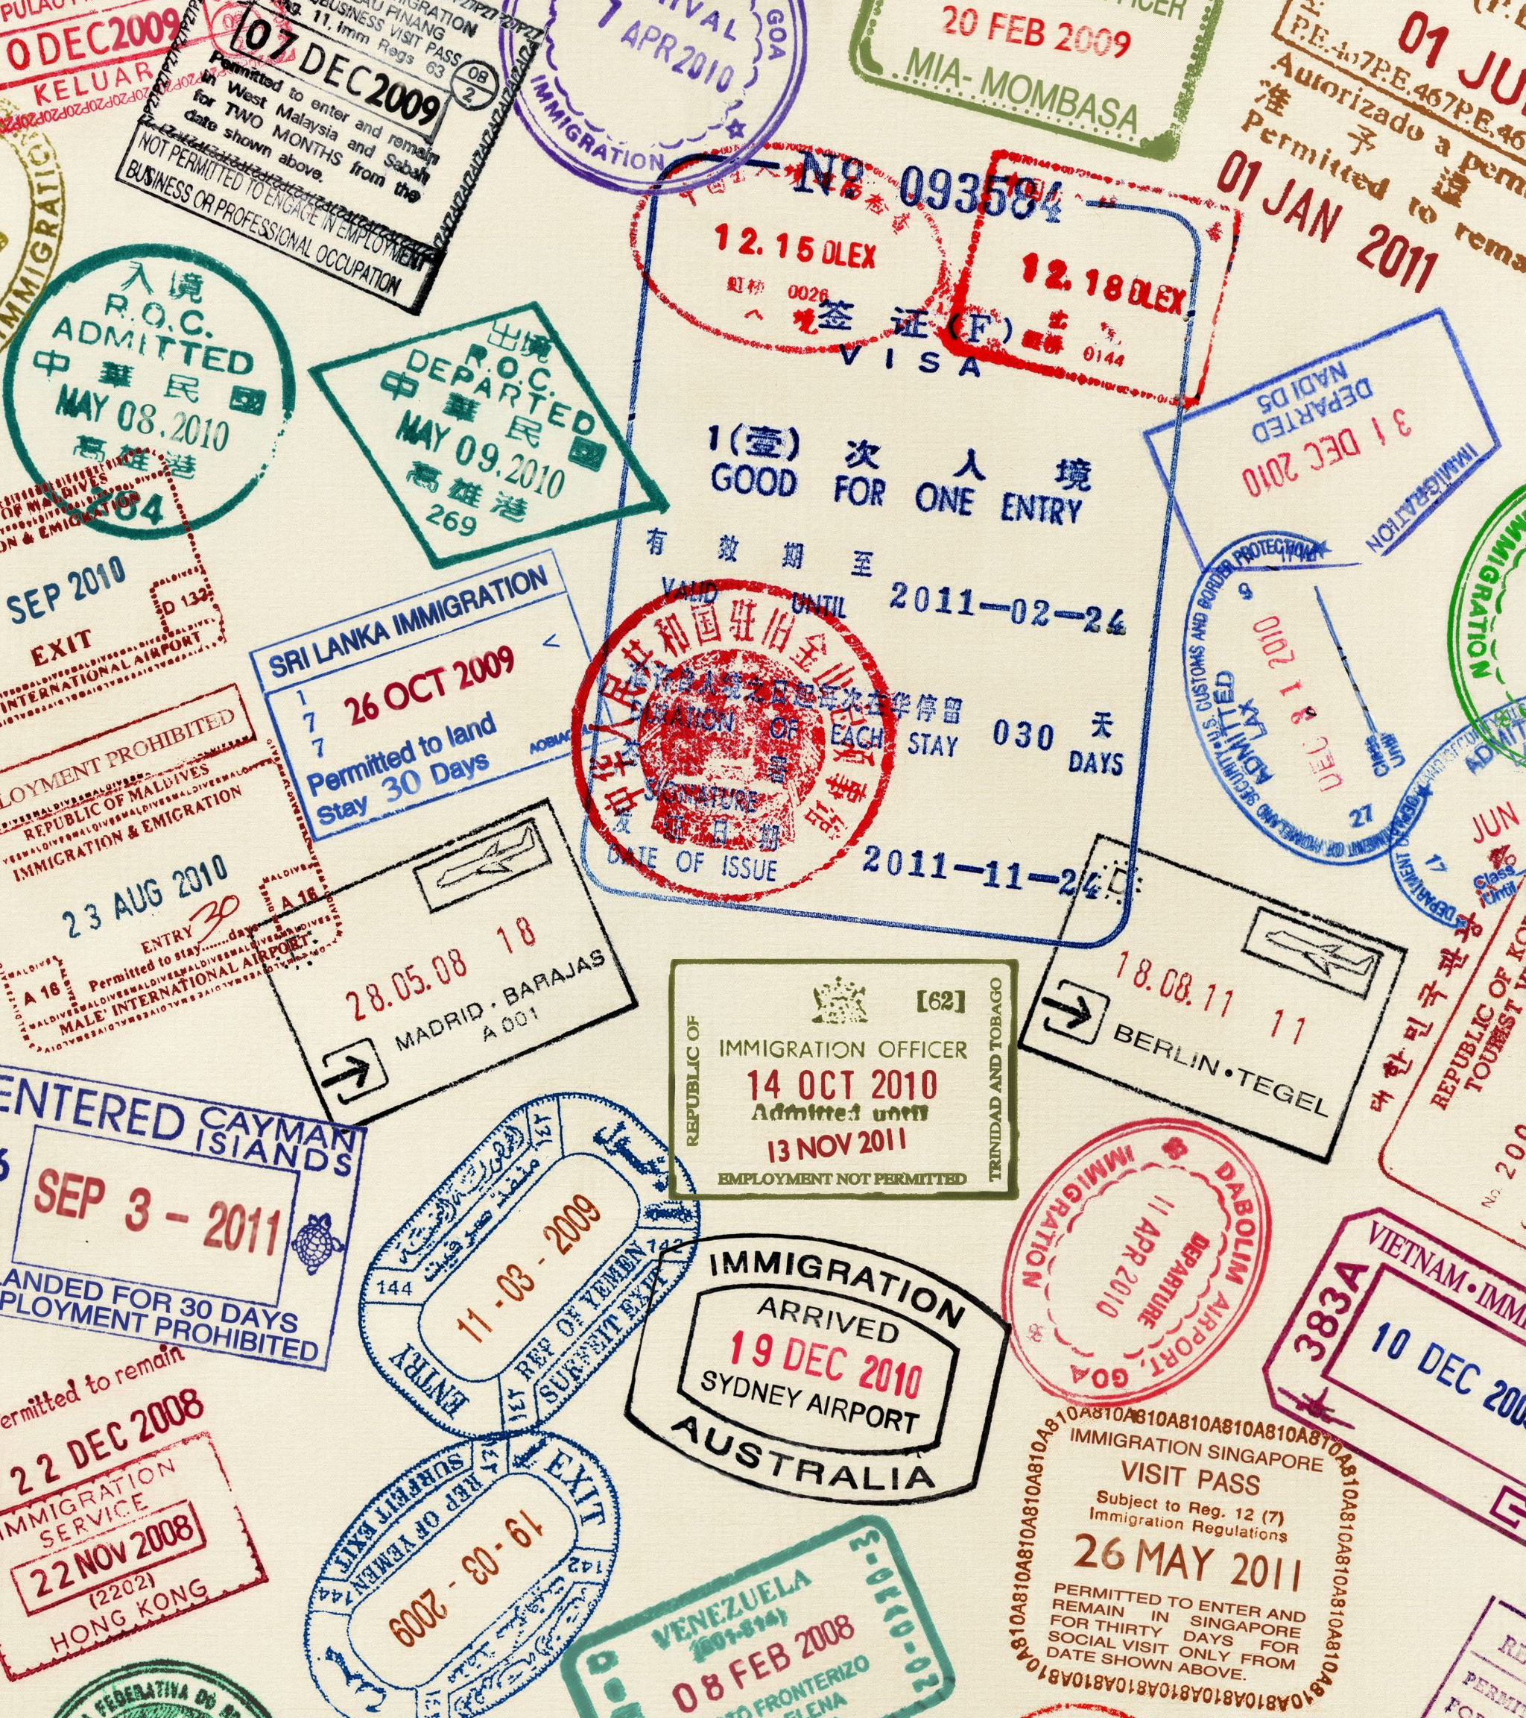
Some of the languages spoken in Britain
English , Scots , Scots Gaelic,Welsh , Irish Gaelic
All the major European languages , especially Polish ,Ukrainian,Italian
Many languages from Britain’s colonial past e.g.
Hindi , Arabic ,Urdu, Punjabi, , Cantonese ,
Many African languages eg Hausa , Yoruba , Igbo, Zulu ,Xhosa
Mandarin

Slide 3

We are a multicultural society. Or at least we should aspire to be
Your cultural experience is important for us to learn from.We need to learn from each other
We need to respect each other
Understand each other’s cultural differences in terms of communication, expressing emotions etc

Slide 4
Official Scottish languages recognised in Scotland and the UK
English
Scots. The official language of the Law until 1745 Jacobite rebellion. The language of our greatest poet Rabbie Burns
Scots Gaelic spoken by about 57,000 people in Scotland
And in the rest of the UK
Welsh, Irish Gaelic

Slide 5
Scots is not a dialect of English
It has its own grammar and spelling
Many Scots speak a crossbreed between English and Scots.
This is what will confuse you to say the least

Slide 6
What’s the diagnosis here?
Hey Doac, Ma mither’s fa’en doon the the stairs.
She’s banged her heid af the flair.
And there’s a hail load aw blud poorin out her lugs

