Slide 1

Quality Improvement

Slide 2

Introduction to those speaking today
Eilidh Brown
Quality Manager
Medical Education Directorate
eilidh.brown8@nhs.scot

Slide 3




Quality Improvement
Improving gaps in performance, enhancing processes, systems or outcomes
Quality Improvement: involves a systematic and coordinated approach to solving a problem using specific methods and tools with the aim of bringing about a measurable
improvement. Health Foundation
Audit
Data
Intelligence

Slide 4
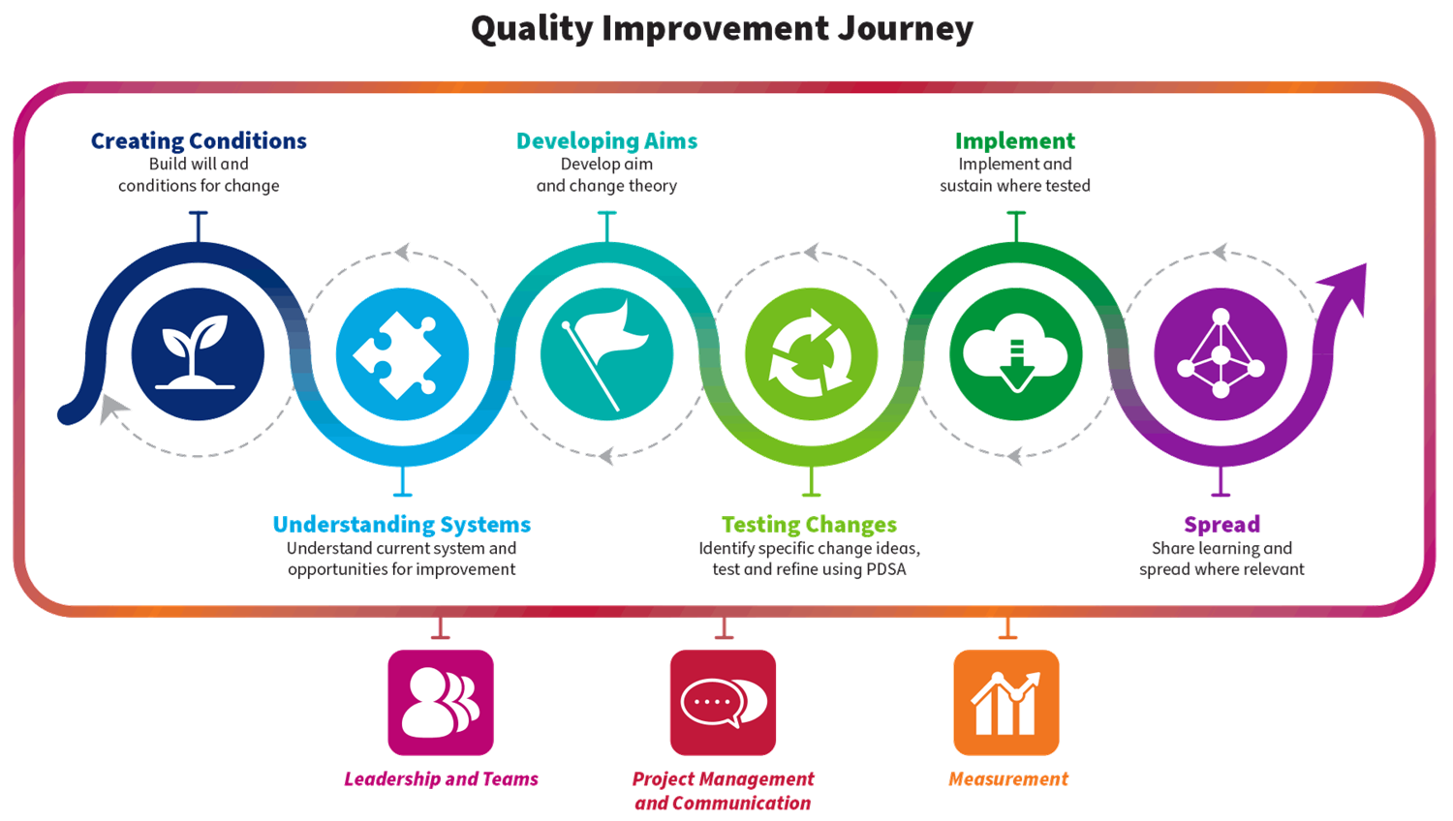
Quality Improvement Journey
Notes:
Quality Improvement is a journey and it is important that you consider each stage of that journey. Not always as linear as it appears in the diagram.
Throughout the journey the 3 elements of leadership, communication and measures must be considered

Slide 5









What is quality care
Six dimensions of quality in healthcare:
Safe
Effective
Person centred
Timely
Equitable
Efficient
Institute of Medicine (IOM). Crossing the Quality Chasm: A New Health System for the 21st Century. Washington, D.C: National Academy Press; 2001.

Slide 6

NHS Lothian: Quality Strategy
The quality strategy is built upon eight key actions:
Make it easier for everyone to test their improvement ideas without always needing prior ‘permission’
Leaders devote more time and energy to encouraging local testing and improvement
Involve everyone in developing improvement priorities and ideas
Greater focus on patient and population needs and wishes in improvement work
Constantly learn, share and embed new knowledge from all improvement activities
Explicitly measure and realise the financial gains of better quality
Move to more integrated health and social care quality management
Adopt quality management universally to support everything we do
https://org.nhslothian.scot/strategies/wp-content/uploads/sites/33/2023/05/QualityStrategy5YearPlan.pdf

Slide 7
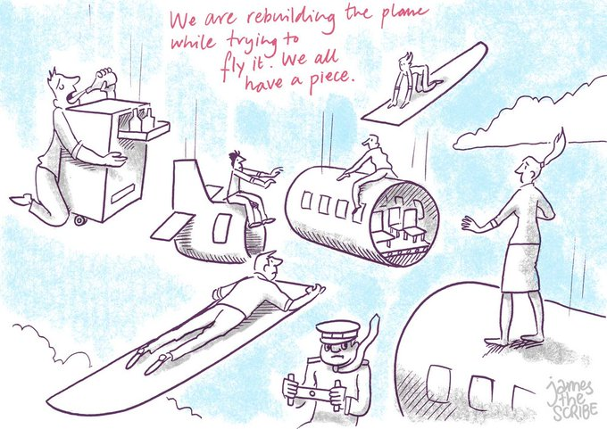

"In the world of improvement everybody has two jobs. They have their job, then they have the job of improving their job”.
Don Berwick
Institute of Health Improvement
Notes:
Don Berwick was a paediatrician and founding member of the institute for healthcare improvement
QI within current pressures – can be easily seen as an additional pressure or tick box but I would argue is an integral part of all our roles within NHS.
By improving how we do our job we often have more time and resource to do our job better

Slide 8

National Programme:
Scottish Patient Safety Programme (SPSP)
SPSP is the first national approach to patient safety improvement in the world.
SPSP was launched (2008) at a time where global evidence suggested nearly 1 in 10 patients admitted to a hospital would be unintentionally harmed and that over 40% of the incidents could have been avoided (de Vries et al., 2008, Weingart et al 2000, Crossing the Quality Chasm, 2001).
Facing this evidence, leaders came together in Scotland to develop the national Scottish Patient Safety Programme (SPSP).
https://ihub.scot/improvement-programmes/scottish-patient-safety-programme-spsp/the-story-of-spsp/

Slide 9
National Programme:
Scottish Patient Safety Programme (SPSP)
SPSP Programmes include:
Acute Adult
  Pressure Ulcers
  Delirium
  Falls
  Deteriorating Patient
Paediatric Programme
Perinatal Programme
Primary Care
Medicines
Mental Health

Slide 10
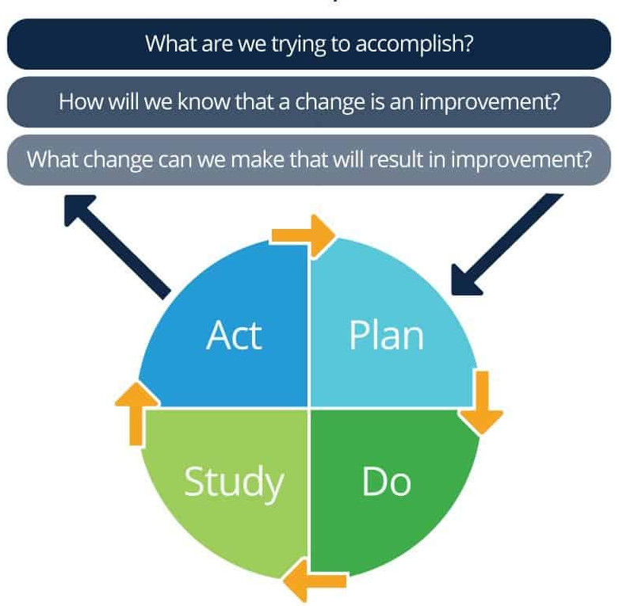
Model for Healthcare Improvement (Institute of Health Improvement)

Slide 11

Quality Improvement – over to you!
Please get into a team
Identify roles:
  Test pilots
  Test of change manager
  Data recorder

Slide 12
Quality Improvement – over to you!
AIM: Fly the paper plane – gather baseline data
Each test pilot should fly the plane once
The data recorder should measure each flight and plot this on the chart

Slide 13
Quality Improvement – over to you!
AIM: Fly your paper plane 50% further than your baseline distance
TASK
Plan: Design a new paper plane.
Do: Each pilot should fly the plane once.
The Test of change manager should guide the PDSA process of predicting and
capturing learning
The data recorder should measure and plot results
Study: The data recorder should measure the distance of each
flight and plot it on the chart
Act: Review any learning and progress made. If your aim is not achieved
look for one improvement you can make that might result in an
improvement.

Slide 14
Quality Improvement – reflections

Slide 15




Getting involved in QI / learning more
E-learning: Turas Quality Improvement Zone https://learn.nes.nhs.scot/741/quality-improvement-zone
Tools and resources: QI Lothian Website https://qilothian.scot.nhs.uk/resources-new
Coaching, advice or support: If project relates to Drs in training: Ross Paterson / Cheryl Tudor
/ Eilidh Brown - loth.medlothianqualitymanagement@nhs.scot
If project relates to clinical setting: IMG Quality Champion
or local Quality Improvement Team (QIT) on each site
Publishing / presenting QI work: SQUIRE 2.0 Guidelines (easily found on internet search)

