Slide 1


Medical Education Fellows (MEFs)

Slide 2
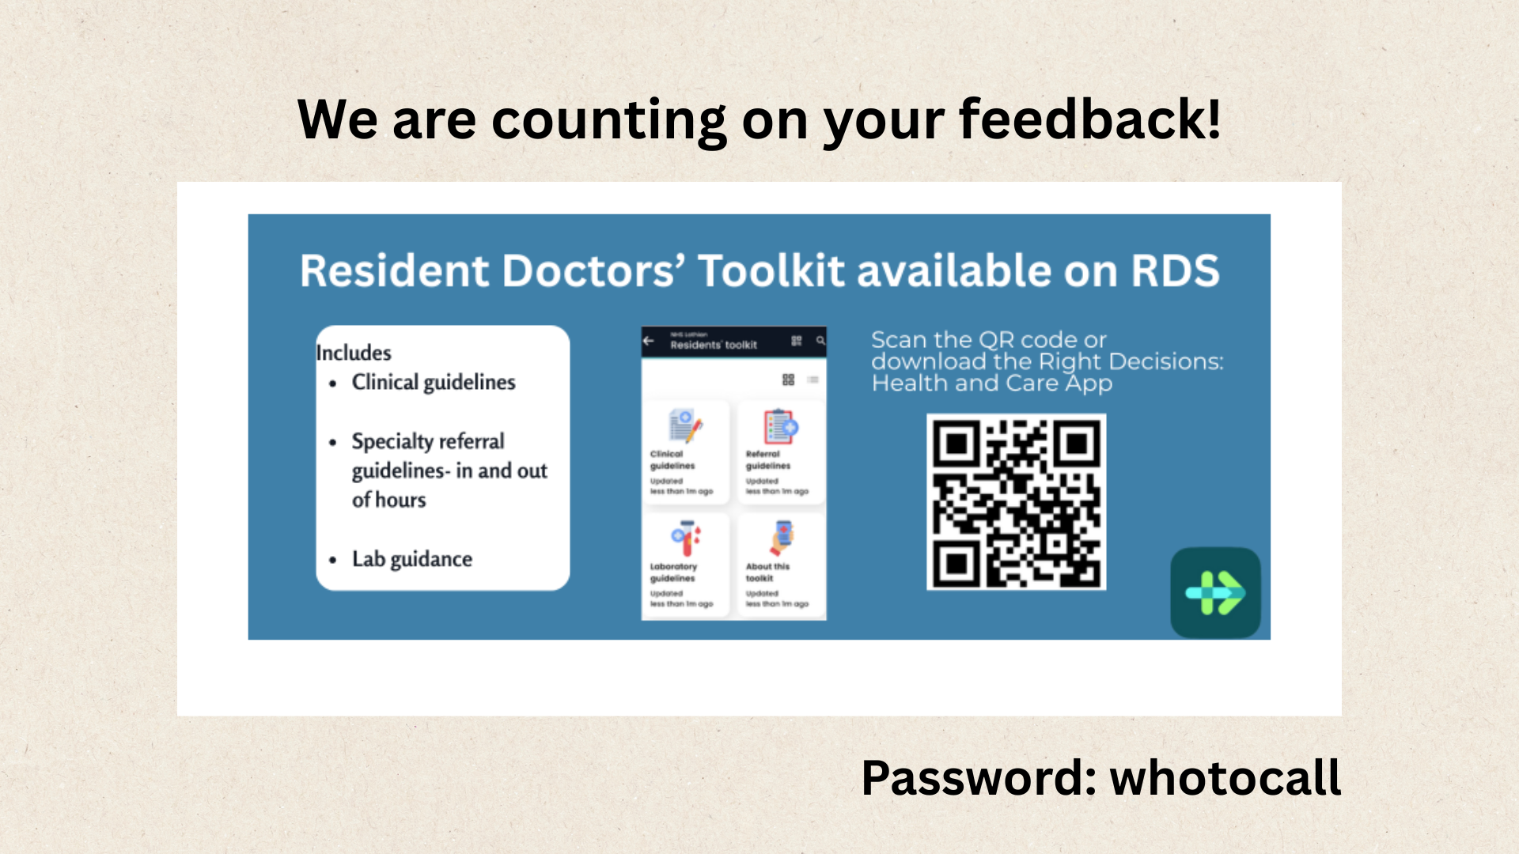

Slide 3
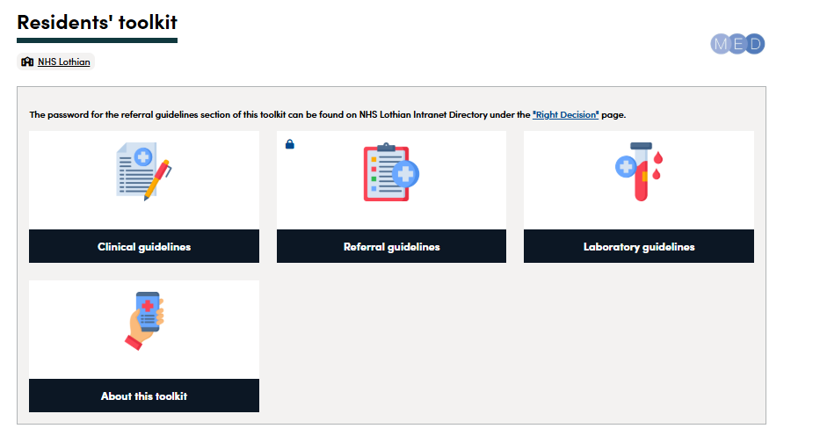

Slide 4
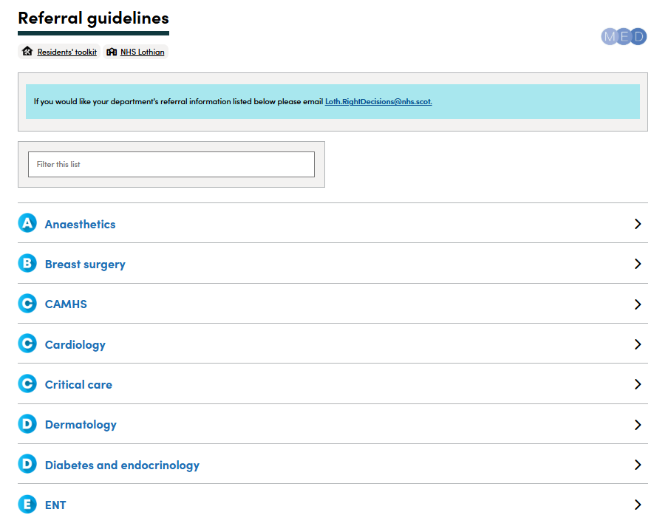
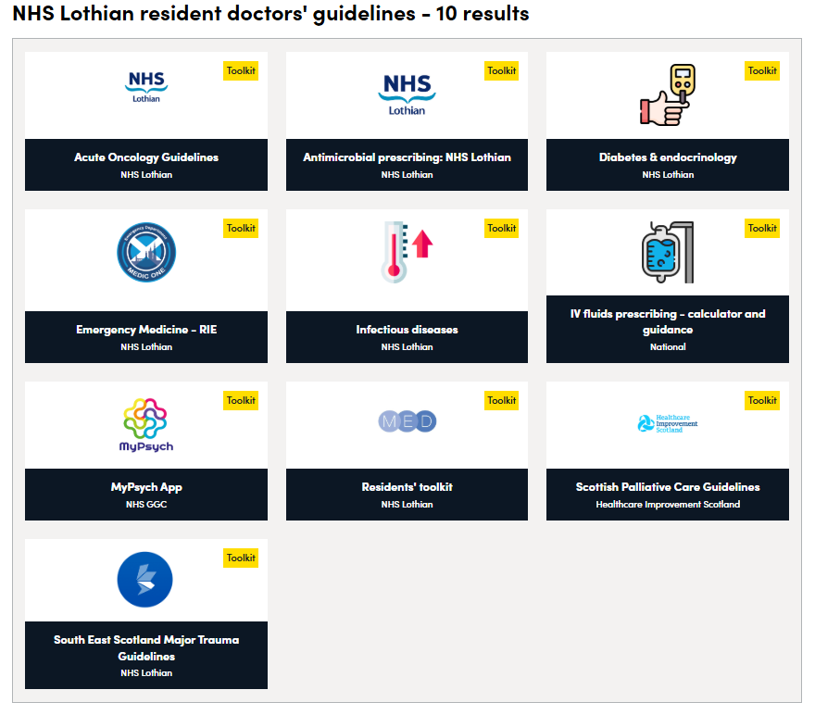


Slide 5

BEYOND
BYSTANDER

Slide 6
SMALL BEHAVIOURS, BIG IMPACTS
“microaggressions are everyday slights, snubs or insults which are hostile or derogatory in nature and are directed towards people based on their protected characteristics or minoritised group status. They can be verbal, non-verbal or environmental, and may or may not be intentional.”

Slide 7
Age
PROTECTED
CHARACTERISTICS
Gender reassignment
Sexuality
Being pregnant or on maternity leave
Disability
Race including colour, nationality, ethnic or national origin
Religion or belief
Sex
Being married or in a civil partnership

Slide 8
A MOMENT TO CONSIDER “INTENT”

Slide 9
INTERVENING

Slide 10
REASONS FOR NOT
INTERVENING
No-one else is
Someone else will
Fear of retaliation or reprisal
I don’t know them, don’t get involved
Belief that others accept the behaviour

Slide 11
BECOMING AN ACTIVE BYSTANDER
.
Notes:
To be an active bystander, we must confront our own thoughts and concerns and choose to intervene.
This can be challenging, particularly in hierarchical situations.
To address this, we need to clearly identify unacceptable behaviours in our minds and avoid making excuses for, or enabling the person responsible

Slide 12
THE ACTIVE BYSTANDER PROCESS
01: Notice
the event or behaviour
02: Interpret
it as a problem
03:
Feel
empowered to take action
04: Possess
the necessary skills to act
This is about being informed about what is inappropriate or unacceptable, and noting the behaviour to ourselves.
Don’t presume that the problem has been solved, or underestimate its importance even if the person who is the target doesn’t say anything.
Realising that it’s our responsibility to be active in some way. Do not assume that someone else will intervene, or that because we are not causing the problem, it is not our responsibility to be part of the solution.
This can involve having had training or information on how to intervene. This is what this resource and workshop will support.

Slide 13
The 5Ds of bystander intervention

Slide 14


The 5Ds of bystander intervention
Distraction
Direct Action
Delegation
Delay
Document

Slide 15
Distraction
Interrupt the person, change the subject, start a conversation, create a diversion. Applies in a situation you think might escalate if a direct action is used.

Slide 16
Direct Action
First, before you decide to respond directly, assess the situation. Only intervene if it is safe to do so. Do not use a direct action if you feel the situation may escalate or you feel it may jeopardise the physical or psychological safety of yourself or the person experiencing the microaggression. If you feel direct action is the right approach, challenge the person responsible for the microaggression’s behaviour.

Slide 17
Delegation
Find someone else who can help. It can be that simple to make a positive impact. Especially when you do not feel you are able to get more directly involved.

Slide 18
Delay
If you can’t do anything while the situation is happening, you can still make a difference by checking in on the person who was subjected to the microaggression. Whether the incident happened quickly or took time to finish, sometimes you cannot do the other 4 Ds, but you can still actively use the Delayed tactic. You may then be able to use another bystander intervention later.

Slide 19
Document
Make a note of what happened and who was involved. This can involve reporting the incident through appropriate channels, or may be as simple as giving the person experiencing the microaggression information that might help or empower them.

Slide 20
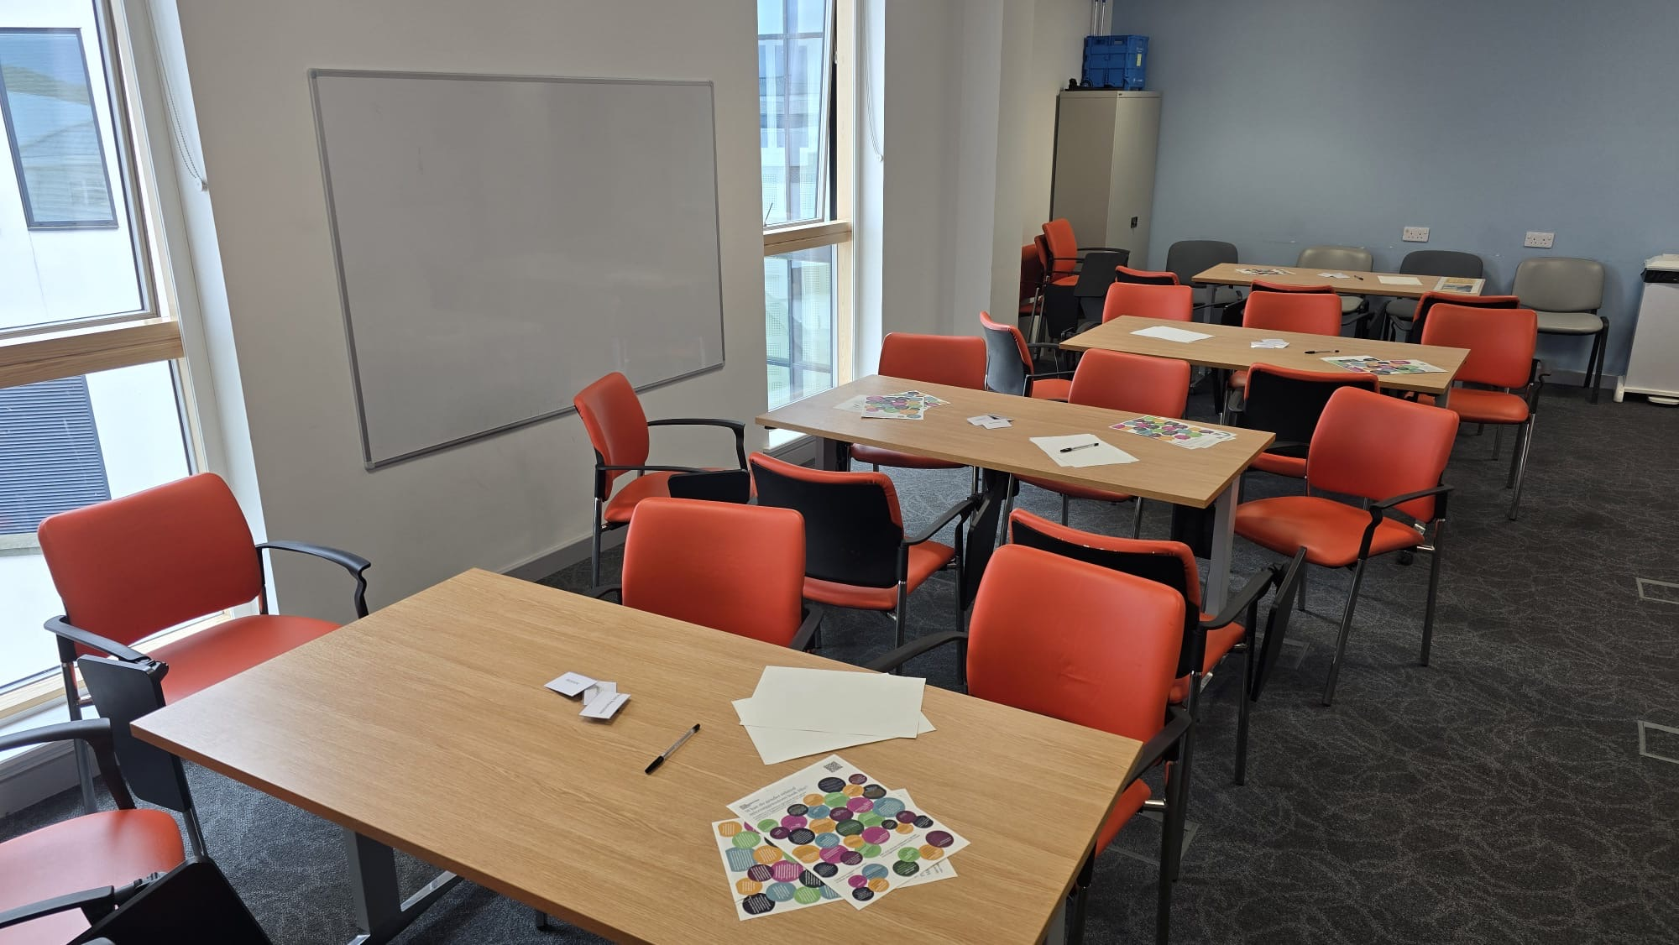
THE BEYOND BYSTANDER WORKSHOP
Notes:
We know from staff feedback that whilst training in bystander techniques can be informative, many staff still don’t feel confident to actively intervene in a situation.
Finding personal word-choices and phrases can be difficult, and is often the remaining barrier to staff when it comes to actively intervening.
We have created the Beyond Bystander workshop as an extension to bystander intervention training, to enable staff to explore and rehearse interventions safely in a supported environment.
The workshop is designed using a range of simulation approaches to facilitate discussion, exploration, and rehearsal of bystander interventions in a safe and supported environment.
We will build on the bystander intervention training presented here, working through storytelling and script-writing, and building up to role-play and rehearsal.
The workshop does not use any immersive simulation and no role-play elements involve any observation or other similar scrutiny. We hope to create a relaxed and comfortable environment for participants to explore their own word-choices and phraseology for the different bystander intervention techniques.

Slide 21
THANK
YOU
Please get in touch - jan.engel@nhs.scot
WE LOOK FORWARD TO SEEING YOU AT THE WORKSHOP

