Slide 1



Short Term Leave (STL) Meds
HOW TO GUIDE
Please Note: Pharmacy (08:30-5pm Mon-Fri) have a 4 hour turn-around time
Open HEPMA & Click “Short Term Leave Rx”
Click “create new STL”
Click “Create new STL Rx” & input start and end dates + times
Check on PRN use and confirm how many / if any are required before completing STL meds (often not needed for STL)
Click “add from current drugs”
Doses required will be calculated based on timings of STL
Save changes
Click “STL letter”
Add name of prescribing doctor from drop down menu + save
Click “complete STL”, select "save + print“ and send
Download STL prescription (“letter”) (appears after selecting "print" option)
Email a copy to REH Dispensary (loth.rehdispensary2@nhs.scot) + your clinical pharmacist
OR print, sign, and drop off in person at REH Dispensary if Controlled Drugs (CDs) in STL
DO:
DON’T:
Scan + email over STL meds with CDs in so pharmacy can begin verifying + preparing before you’re able to drop off physical copy
Ensure CDs have doses and frequency written in words and figures with a physical (not digital) signature added
Clarify any queries regarding PRNs with senior doctor or clinical pharmacist before sending over - amending later will cause delays
Create a new episode and don’t edit other passes – this causes verification issues for pharmacy and inaccurate documentation
For more detailed guidance search the intranet for ‘HPSC0011 Short Term Leave Procedure’

Slide 2
Discharge Meds
HOW TO GUIDE
Please Note: Pharmacy (08:30-5pm Mon-Fri) have a 4 hour turn-around time
Create new inpatient IDL on Trak as will be required later
\mhidl + press spacebar to bring up IDL template
Note clearly when d/c meds are required - this is essential so pharmacy can prioritise appropriately
Add a one-line summary for admission details (can complete in full later, does not need to be complete to send d/c meds)
Open HEPMA
Confirm before starting d/c meds if PRNs required + how many days' supply
Click “create discharge prescription”
Select “add drug from inpatient”
Select if GP is to continue for each, then click “save”
Click “discharge letter” and add name of doctor prescribing
Click “complete discharge medications”
After sending, d/c meds should now have pulled through to Trak
Type 1 in ‘number of copies’ to print - printing will occur after IDL is saved
Sign and date printed copy
Scan in to your email
Email copy to REH Dispensary (loth.rehdispensary2@nhs.scot) + clinical pharmacist
Drop off physical copy in person if includes controlled drugs
DO:
DON’T:
Scan + email over d/c meds with CDs in so pharmacy can begin verifying + preparing before you’re able to drop off physical copy
Ensure CDs have doses and frequency written in words and figures with a physical (not digital) signature added
Clarify any queries regarding PRNs with senior doctor or clinical pharmacist before sending over - amending later will cause delays
Send PRN meds without total number of tablets to supply - care with overdose risks (default is a 28-day supply unless stated otherwise)
For more detailed guidance search the intranet for ‘’ HPSC0007 Discharge Procedure With TrakCare Interface’

Slide 3

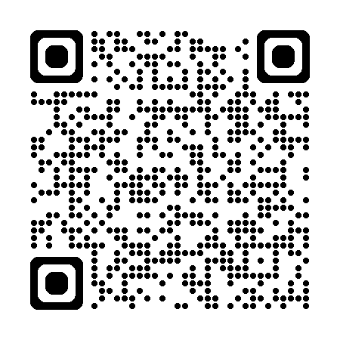
Clozapine repeat scripts & medicines for
self-administration (inc blister packs)
HOW TO GUIDE
Please Note: Pharmacy (08:30-5pm Mon-Fri) have a 4 hour turn-around time
First open the HEPMA inpatient tab and update the prescription. (For clozapine supplies you only need to include clozapine. For self-administration & blister packs you must include all the medicines required)
Create new inpatient IDL on Trak
Enter \mhrepeat and press spacebar to bring up template
Fill out details, typically:
For “weekly” dispensing
Doses and timings of doses
Details on any dose change and when this has occurred
Review date (1 month from date of completing this form)
For self-administration and blister packs please indicate this on the \MHREPEAT script
Details from HEPMA should have pulled through to Trak
Type 1 in ‘number of copies’ to print - printing will occur after IDL is saved
Sign + date prescription
Scan to your email
Email to REH Dispensary (loth.rehdispensary2@nhs.scot) and clinical pharmacist
Send original in due course
OTHER USEFUL INFO:
If a patient is completing the standard clozapine dosage escalation (when starting), instead complete clozapine days 1-7 and days 7-14 prescriptions, scan + send to pharmacy (forms on intranet).
The above process is for general clozapine repeats once established on a dose (or if deviating from standard clozapine initiation regime).
The above process needs to be repeated at the time of any dose change, or pharmacy will not be able to dispense to the ward.
For more information see the NHS Lothian Medical Education Directorate Pharmacy section.

