Slide 1
SimConverse
A Quick guide

Slide 2
What is it?
Feedback from previous groups- struggle with difficult conversations
SimConverse- Simulated conversations
Help with improving communication skills
Can feel artificial- treat it as a genuine conversation
Practice makes perfect

Slide 3
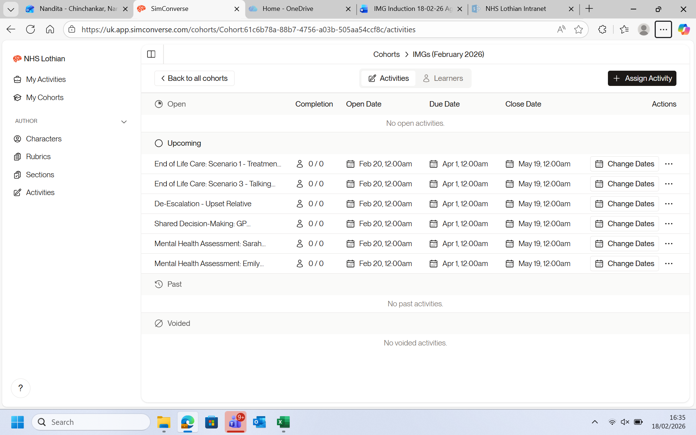

Slide 4
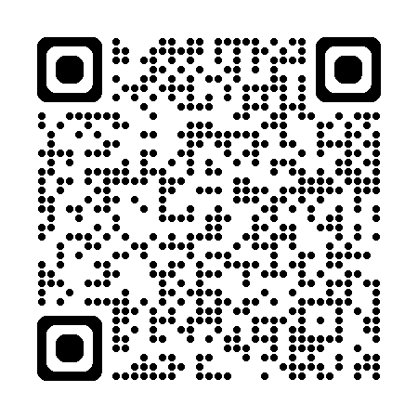
SimConverse quick guide
Once your account has been created you should receive an invite email to your Lothian email address, follow the instructions to finish creating your account. If you have not received an invite email you can still access your account via the following steps;
Go to https://uk.app.simconverse.com
When prompted to select an institution, select NHS Lothian
Enter your university email
Click 'forgot password'
Follow email link to set a password and gain access to your account
QR link to wesbite
SimConverse top tips
If NHS Lothian isn't coming up as an institution option, check you're on the UK SimConverse website, the American/Australian sites won't have NHS Lothian as an option
Interact with the program like it's a real person as much as possible – try to suspend belief!
I will have access to a record of your conversations and feedback but won't be able to see anything you write in the reflections section
Practice makes perfect! Use the chance to rehearse, rehearse, rehearse and you can try introducing a time limit as you progress

