Slide 1
NHS structure
Dr Sara Robinson
Consultant in Emergency Medicine
Deputy Director of Medical Education

Slide 2
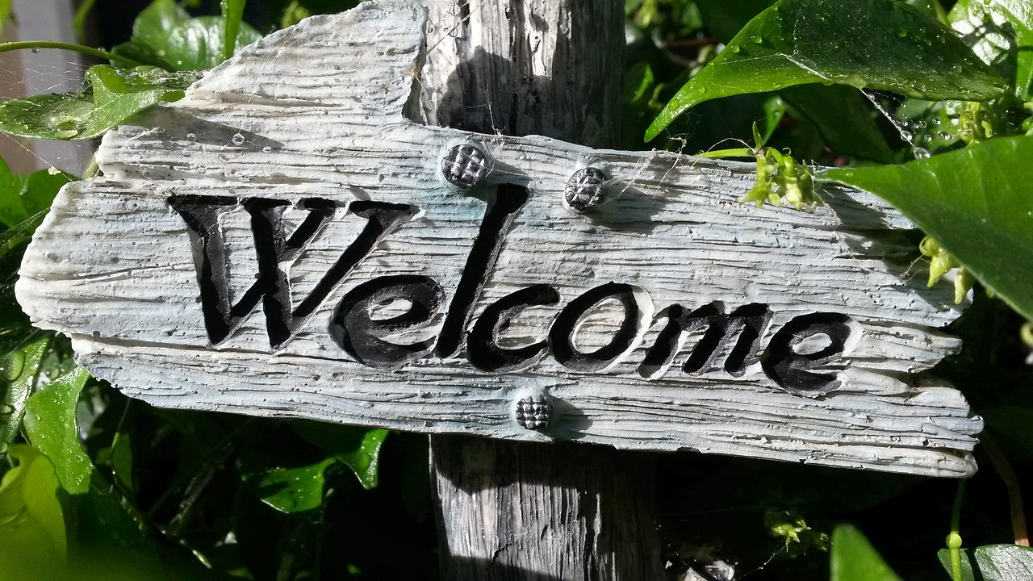

Slide 3


Slide 4

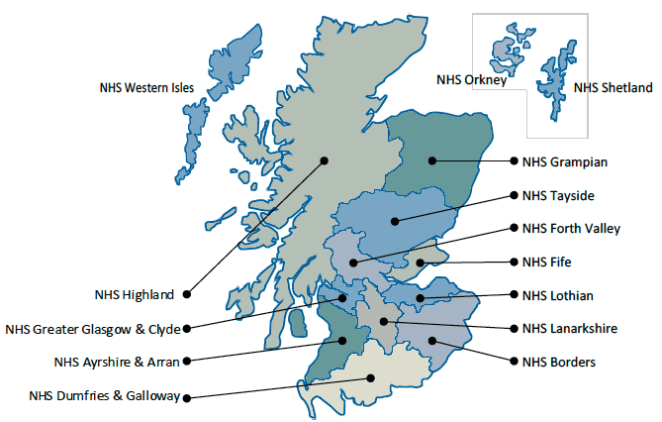
Notes:
NHS Scotland is the largest employer in Scotland. (£15.3 billion 20-21)
We currently employs approximately 160,000 staff who work across 14 regional NHS Boards, seven Special NHS Boards and one public health body (Public Health Scotland).
The special NHS boards are NES, NHS national waiting times centre, NHS 24; SAS; State hospitals board; NHS national services Scotland (inc health protection and Blood transfusion); HIS.
Each NHS Board is accountable to Scottish Ministers, supported by the Scottish Government Health and Social Care Directorates
Regional NHS Boards are responsible for the protection and the improvement of their population's health and for the delivery of frontline healthcare services. Special NHS Boards support the regional NHS Boards by providing a range of important specialist and national services.

Slide 5

Notes:
The management structures generally follow 3 streams managers, nursing, medical and each layer has what they call a triumverate. The balance of power/decision making will depend on the question eg medical very little say over nursing workforce but more say over clinical processes.
Clinical Directors
Clinical Nurse manager
Clinical Service manager
Locally our Medical Director for acute services – Mike Gillies
To the side of clinical services you then have our Directorate of Medical Education headed by Simon Edgar.
Overseeing all the work in NHS Lothian you then have our board

Slide 6
The important people
Clinical Multidisciplinary Team
Clinical and Educational Supervisor
(CS & ES)
Rota coordinator

Slide 7
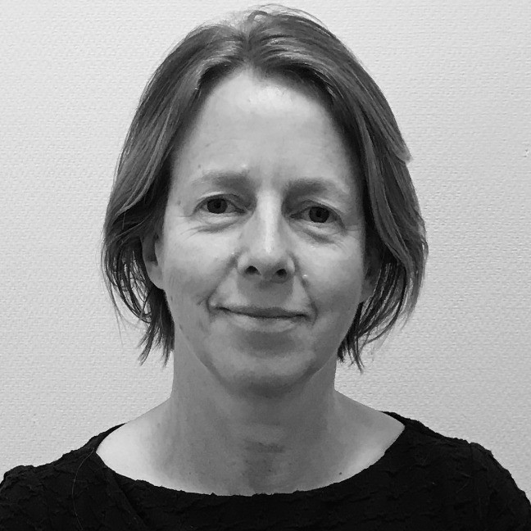
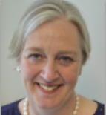
NHS Lothian Medical Management line
Your line manager is the Clinical Director for your service
Associate Medical Director
Medical Director for Acute Services-
Dr Caroline Whitworth
Executive Medical Director- Ms Tracey Gillies
(also GMC Responsible Officer for LEDs)

Slide 8


Slide 9
Medical Training Management structure
Clinical matters
Training matters
Educational Supervisor
Training Programme Director
Associate Postgraduate Dean
Postgraduate Dean
Medical Director NES-
Dr Emma Watson
(GMC Responsible Officer for DiT)
Your line manager is the Clinical Director for your service
Associate Medical Director
Medical Director for Acute Services
Executive Medical Director

Slide 10
