Slide 1
What Would Your Supervisor Expect From You?
Reem Al Soufi – EM Consultant and Associate PG Dean for Quality
Feb 2026

Slide 2


”expectations”..

Slide 3
Educational Supervisor (ES)
'A trainer who is selected and appropriately trained to be responsible for the overall supervision and management of a specified doctor's educational progress during a placement or series of placements. '

Slide 4
Clinical Supervisor (CS)
‘a trainer who is selected and appropriately trained to be responsible for overseeing a specified trainee's clinical work and providing constructive feedback during a training placement. Some training schemes appoint an educational supervisor for each placement.’

Slide 5
CDF VS TRAINING POSTS
CDF: CS and ES are fulfilled by the same person
Training Posts: usually will have an ES providing overall guidance and longitudinal mentorship while the CS will provide support during a limited period or placement.
The aim of ”supervision” is support the doctor develop and meet their clinical and training requirements

Slide 6
What to Expect from Your Supervisor
Welcoming and approachable
Supportive
Will enquire about your past experience and learning needs
Will discuss your progress with other consultants and senior nurses
Will receive any positive or negative feedback about your performance from other colleagues
Will complete annual formal reports on your progress: appraisal (CDFs) or end of placement reports for trainees.

Slide 7


The Spectrum of Supervision

Slide 8
Understanding the “culture”
Welcoming, approachable and supportive, may seek feedback on your performance:
Being proactive in identifying your learning needs and seeking guidance on how to achieve them
Not spoon-feeding or 1:1 tuition
Maintaining professionalism at all times
Honesty and transparency when making mistakes
Seeking feedback is not “gossip” and should be constructive

Slide 9
Understanding Expectations from the CS/ES
Initial Meeting and end of placement meeting (6-months rotation)
Clear and achievable targets (SMART)
Written summary of actions agreed
Completing Annual reports:
Appraisal: SOAR platform
Maintain a CPD Diary
Evidence of Work Place Assessments
Multi-Source Feedback
Quality Improvement or Audit projects
Personal Development Plan (PDP)
Trainees: various e-portfolios such as Kaizen and Turas

Slide 10
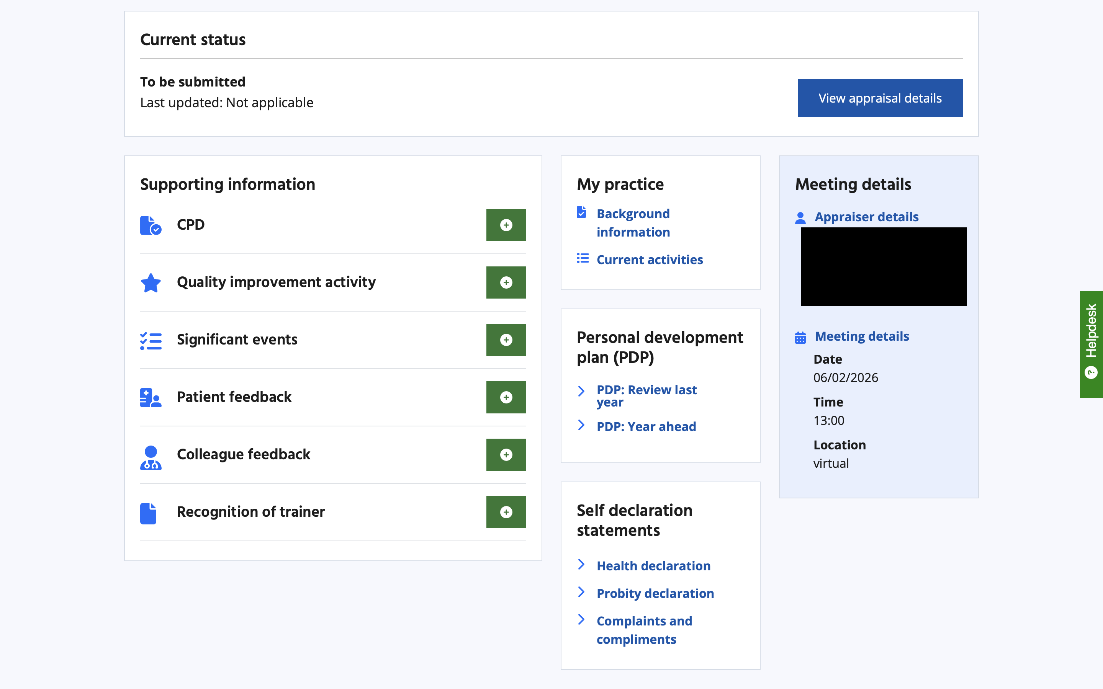
SOAR: Scottish Online Appraisal Resource

Slide 11
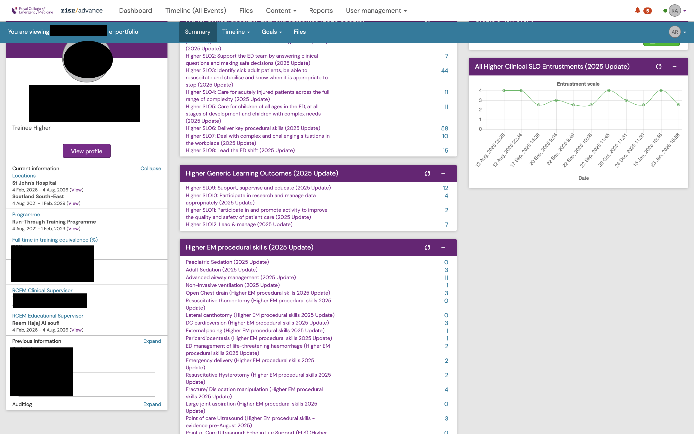
E-Portfolios (trainees)

Slide 12
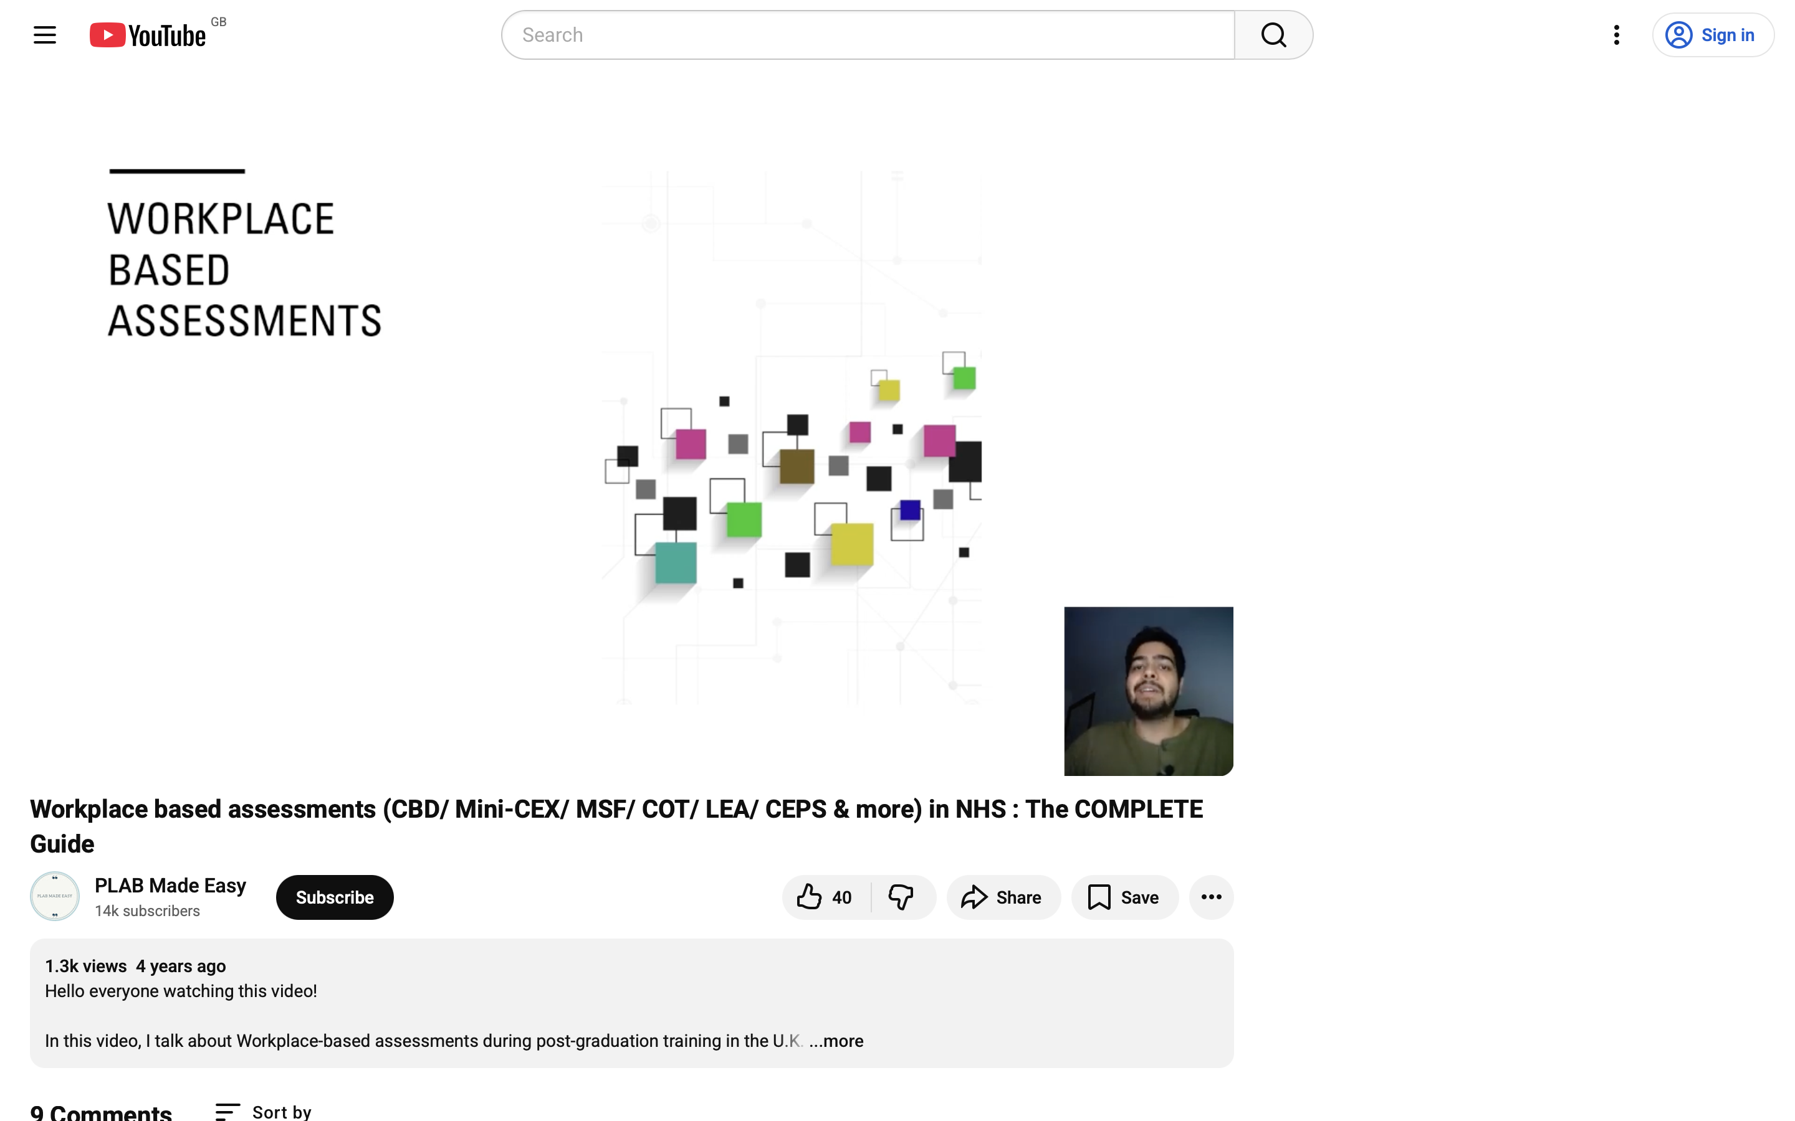
Workplace Based Assessments

Slide 13
Take Home Message
Your Supervisor is there to support you during your placement
The priority will always be patient safety and your safety
It takes time to adjust to the change, be kind to yourself (and to your supervisor)
Clarity and honesty are essential for a successful supervisor-supervisee relationship
Set realistic goals early and ensure you have a written summary of agreed actions after meeting your supervisor

Slide 14

Questions?

