Slide 1
Scottish Clinical Leadership Fellowship
Dr Amritha Sastry
SCLF Cohort 15
Host Organisations: NHS Lothian and GMC Scotland
Specialty Registrar – General Adult Psychiatry (West of Scotland)

Slide 2
What is SCLF?
An incredible opportunity to develop the skills required to lead change in NHS Scotland and gain insight into management structures and healthcare at a national level.
One-year post, open to Medics, Dentists and Pharmacists working in NHS Scotland
Programme is run by NES
Part of NHS Scotland’s approach to developing Professionalism and Excellence in medical and dental professions.
Fellows work closely with leading figures in the host organisations and find themselves immersed in the practicalities of running an organisation at a national level.
The programme aims to provide NHS Scotland with a cadre of doctors/dentists/pharmacists who are committed to living and working in Scotland and who have enhanced capability to offer leadership in their work place and potentially at national and international levels.
In addition to work with their host organisation, SCLFs are enrolled in a Leadership Management and Development Programme, offered 1:1 professional coaching, given formal career planning sessions, and have the opportunity to attend national level meetings and leadership events.

Slide 3

Who are the host organisations?
NHS Education for Scotland (NES)
Scottish Government- Various Directorates
General Medical Council
Centre for Sustainable Delivery of Health and Social Care (CfSD)
Royal College of Physicians and Surgeons of Glasgow (RCPSG)
Royal College of Surgeons of Edinburgh (RCSEd)
NHS Tayside
NHS Grampian
NHS Lanarkshire
NHS Highland
NHS National Services Scotland (NSS)
NHS Greater Glasgow and Clyde
NHS Lothian
Healthcare Improvement Scotland

Slide 4
Who can apply?
Doctors and Dentists currently working in Scotland are eligible to apply; those in medical specialties are required to have successfully completed CT2/IMT2/ST2 or equivalent
Applications are also welcome from SAS Doctors and First Five GP's.
As the fellowship may require an Out-Of-Programme application, doctors holding a National Training Number (NTN) must have been in post for at least 12 months by the time of application.

Slide 5

Recruitment
Applications for Cohort 16 are now closed
Timelines can vary so keep an eye on the website – eligible doctors are emailed directly in advance of application opening
Adverts went out in December 2025- applications invited via NHS Scotland Jobs Portal
Applicants shorlisted and interviews scheduled- Feb 2026
Offer made shortly after this
Successful candidates will need to apply for OOPE if in training
Post start 1st Wednesday in August

Slide 6
My personal story...

Slide 7
What do you gain from the year?
Incredible experience
Perspective of wider healthcare setting in Scotland
Greater understanding of management and leadership
Opportunities to network with leaders and professional within healthcare nationally and internationally
Opportunities to contribute to meaningful change including various projects within your host organisations
Time out of clinical practice
Focus on your career development, areas of professional growth and support to consider and improve this
Excellent for CV and longer-term career as a clinical or non-clinical leader within healthcare
Start of a portfolio career (if you want it to be)- SCLF is only the beginning of linking into other opportunities as a doctor
Can be a steep learning curve but no limits to what you can do and achieve if you have the vision and creativity

Slide 8
What to consider if think this might be for you?
Look at the routes to apply- not just at the time but in advance ( what do you want your career to look like, when would it be a good time to apply?)
Discuss with TPDs or CDs early if considering
Look at what is expected in application – download and look at application pack to see what is expected and how you can start working towards what you might need.
Consider this or other opportunities out of clinical training
Utilise sources like the SIGN group and wider network of IMGs
Talk to people who have done it!

Slide 9
Common Concerns
Do I need to relocate?
What will I be paid?
Can I do clinical work alongside?
Are there any negatives?
Will it affect my Visa Status?
For more information or any questions not on website FAQs: Medical Resident Doctors, SAS Doctors and GP First Five: Dr Greg Logan, SCLF Operational Lead greg.logan4@nhs.scot Professor Lindsay Donaldson, Deputy Medical Director lindsay.donaldson3@nhs.scot

Slide 10
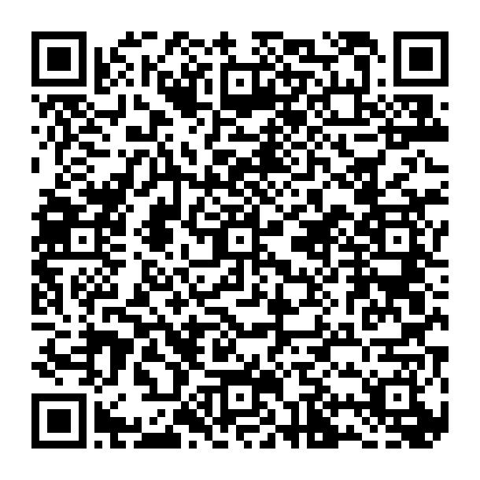
Link to SCLF website for more information Any Questions?

