Slide 1










MEDICAL EDUCATION FELLOWS
Dr Jenny Houston / Dr Jocelyne Velupillai

Slide 2

Welcome!

Slide 3

Medical education directorate

Slide 4
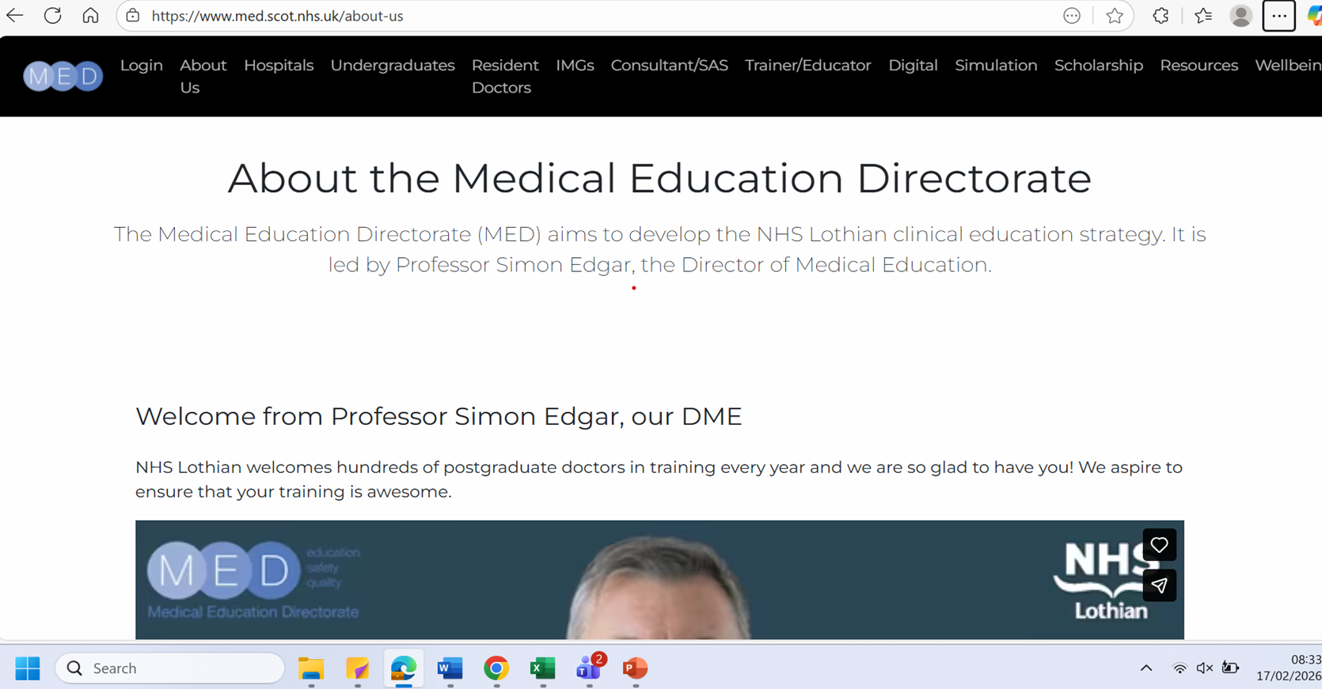

Slide 5
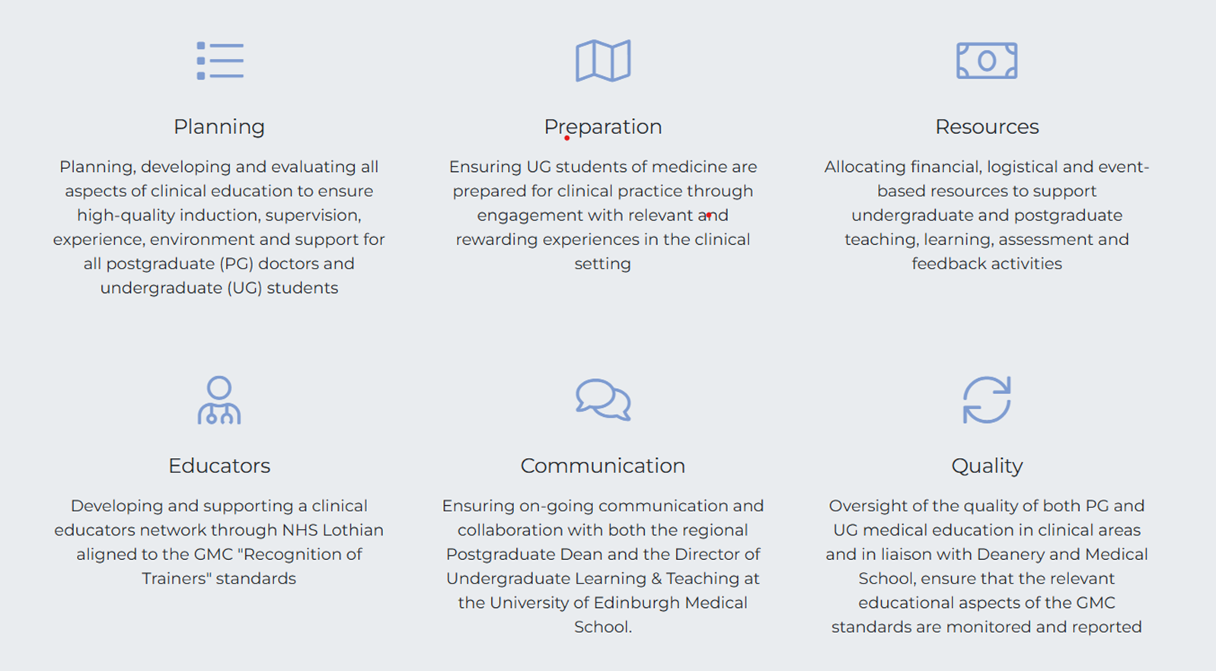

Slide 6
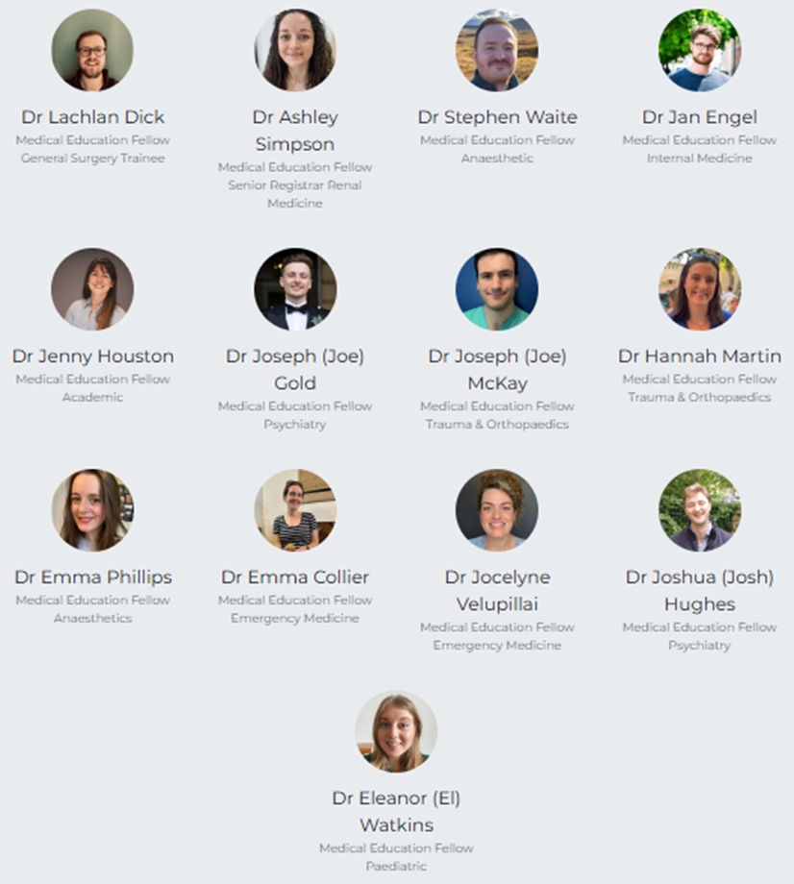
One big team to help you !

Slide 7

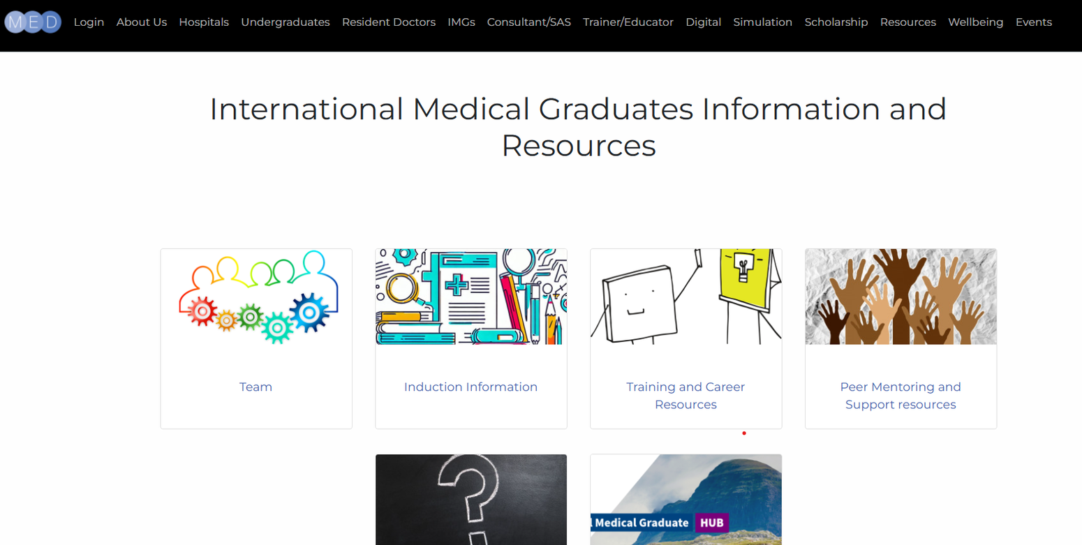

Slide 8




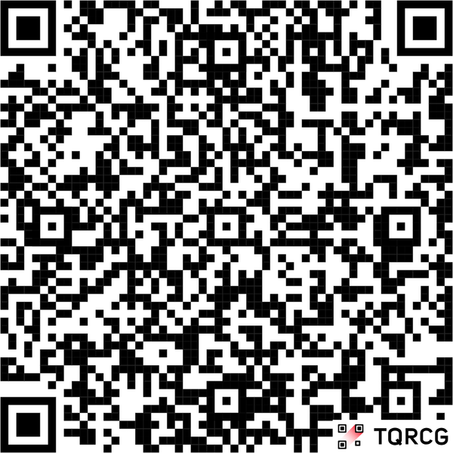
Get involved!
WANT TO TEACH MEDICAL STUDENTS
OR RESIDENT DOCTORS?
JOIN THE MEDUCATOR NETWORK FOR
TEACHING OPPORTUNITIES
EDUCATOR DEVELOPMENT
EDUCATOR RESOURCES
RECOGNITION AND FEEDBACK

Slide 9

Medical education fellow role

Slide 10







Current programme support
Teaching delivery
40%
30%
MEF
Clinical development
10% - in own specialty
Personal scholarship
20%
QI and leadership

Slide 11
Project examples
Beyond Bystander
Meducator network
IMG
Clinical debriefing

Slide 12

how to apply
Medical Education Fellows
https://www.med.scot.nhs.uk/trainee-doctors/medical_education_fellows

Slide 13
GET IN TOUCH !
jocelyne.velupillai@nhs.scot
jenny.houston@nhs.scot

Slide 14
Thank you!

