Slide 1

PAST, PRESENT AND FUTURE:
The Development of Women & Girl’s Cricket

Slide 2

The Hundred… a brilliant new version of the game!

Slide 3

What is The Hundred?
Watch the promo!

Slide 4
What do you notice about The Hundred?

Slide 5
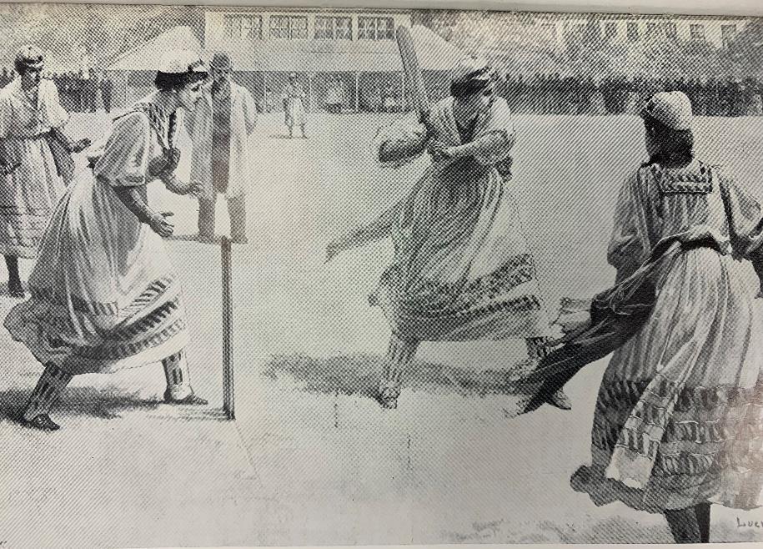
But it hasn’t always been like this…

Slide 6

We’ll learn…
How Women & Girl’s Cricket has developed
To be inspired by stories from game’s leading players of the past, present and future
What the future holds
How you can get involved in the game!

Slide 7
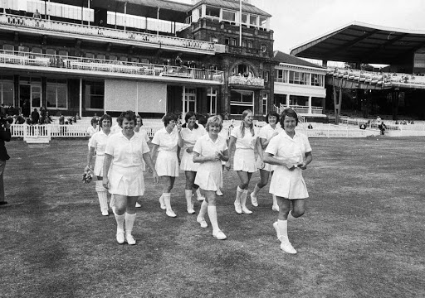
THE HISTORY OF WOMEN & GIRLS CRICKET
Women's Cricket has been played for 100’s of years all across the world. Here’s Raf Nicholson, one of the world’s experts on the history of the Game, describing how the game has developed from its early beginnings to the present…
https://www.icc-cricket.com/womens-world-cup/history

Slide 8

Explore The History…
Watch the video!

Slide 9
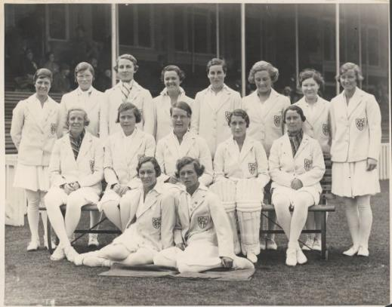
OVER TO YOU 1: THINK . . . .
Does anything surprise you in what you have just learnt about the history of the women’s game – and why?
What have been the major turning points in the development of the women’s game?
How have some of the barriers to the growth of the women’s game been overcome?

Slide 10

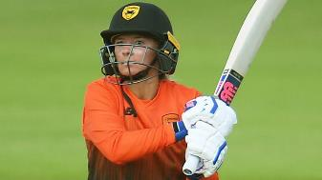
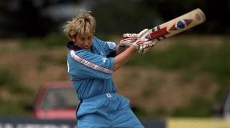
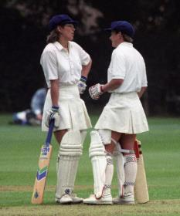
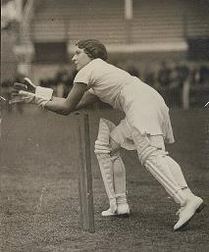
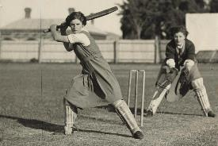
Produce an illustrated timeline to summarise the history of the women’s game

Slide 11
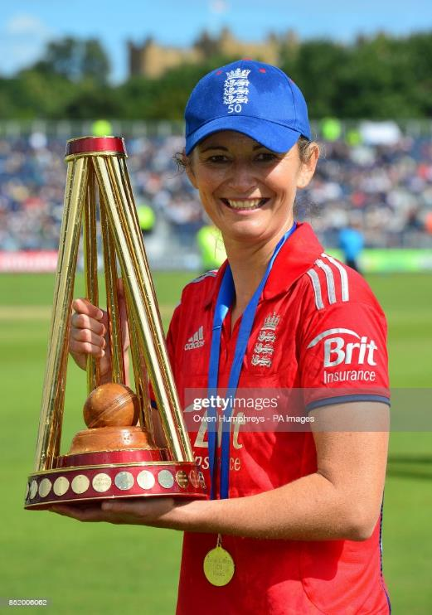
CHARLOTTE EDWARDS – ENGLAND’S GREATEST PLAYER?
Charlotte Edwards became the youngest Women to play for England at just 16 years of age. She went on to play 309 times for her country scoring over 10,000 runs and was Captain for more than 10 years. She even has a national competition named after her! This is her story…

Slide 12

Introducing…
Watch the interview!

Slide 13
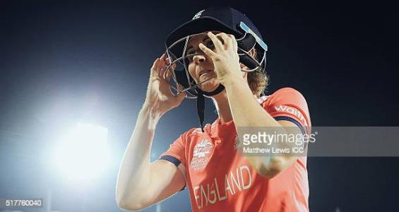
OVER TO YOU 2: THINK . . . .
What challenges did Charlotte first face on her journey?
What first inspired her to want to play?
What personal qualities and values has Charlotte shown in her journey through the game?

Slide 14
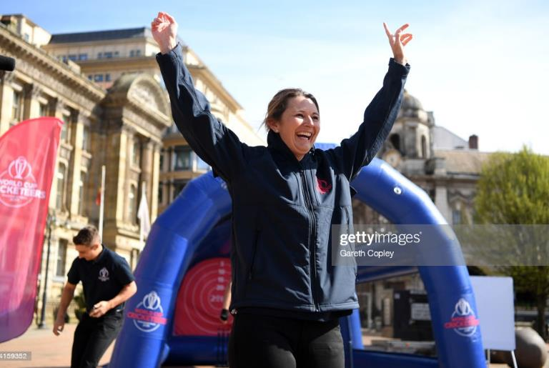
OVER TO YOU 2: THINK . . . .
What are the main changes to the game that she’s seen on her journey?
What future opportunities and roles in the games does she identify? Which ones excite you and why?
How has Charlotte inspired you? Write a letter or a Tweet to her explaining your feelings.
What next steps will you take after listening to Charlotte’s story?

Slide 15
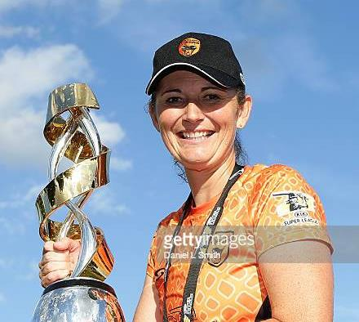
OVER TO YOU 2: THINKING FURTHER
Charlotte is a captain and leader? What do you see as the qualities of a leader?
How do you show those qualities now?
What will you do to develop them further in the future?

Slide 16
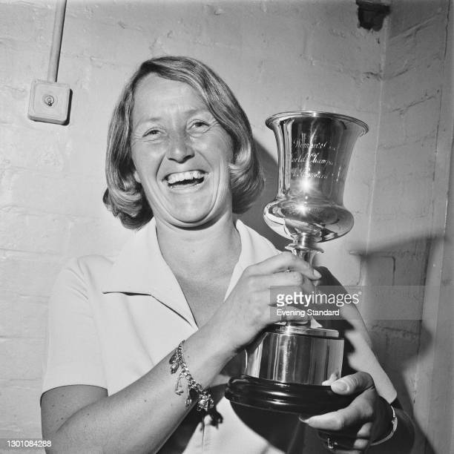
OVER TO YOU 2: THINKING FURTHER
Rachel Hayhoe-Flint has come up as an inspirational figure several times now.
What can you find out about her?
Why was she such an inspiration?

Slide 17
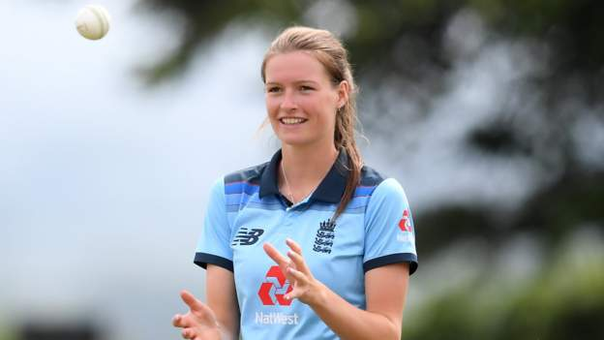
LAUREN BELL – STARTING A PROFESSIONAL CRICKET CAREER
Lauren Bell started her cricketing journey playing through the Chance to Shine scheme at her local primary school. She has become one of the first of a new generation of professional women's cricketers with her sites set on representing England in the near future….

Slide 18

Introducing…
Watch the interview!

Slide 19

OVER TO YOU 3: THINK…
What advice does Lauren offer?
Can you apply any of this to your learning?
What major changes and new opportunities does she identify?

Slide 20
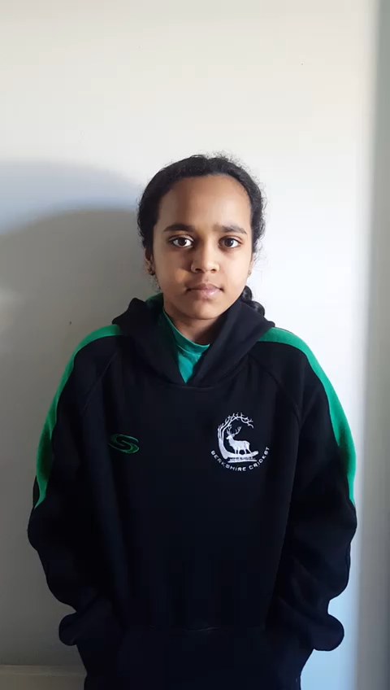
WHY GET INVOLVED IN CRICKET?
Shristi from Slough is a member of the Berkshire Under 13 girls team and one of thousands of young women from up and down the country who have taken up cricket over the last few years. It’s a great way to meet new friends, stay fit and be part of a team whilst also learning new skills.

Slide 21
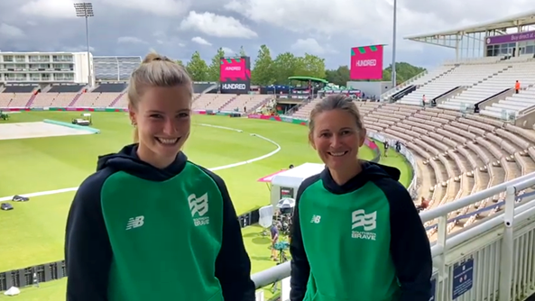
Get Involved…
Listen to Lauren & Charlotte!

Slide 22

HOW CAN I GET
INVOLVED?
There are cricket clubs all over the country who offer girls cricket sessions 5 year olds taking part in All Stars Cricket to Women's teams in hard ball leagues.
Head over to the Berkshire Cricket Foundation website to see how you can get involved in cricket in Berkshire . . . .
www.berkshirecricketfoundation.org

Slide 23
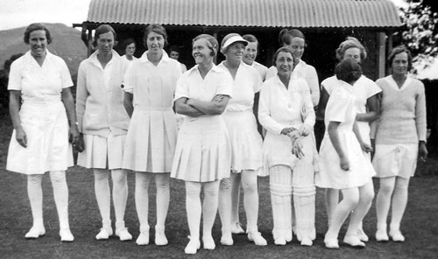
THINKING IT ALL THROUGH...
Produce an exhibition for your classroom, hall or corridor to show the history of the women’s game. Think about:
Important events and dates
Changes and things that
have stayed the same
Key players

Slide 24

THINKING IT ALL THROUGH…
Produce a poster or short video to inspire young women to try Cricket!

Slide 25




CREDITS & ACKNOWLEDGMENTS
Thanks go to the following for their contributions to this resource . . .
Sporting Heritage
The Berkshire Cricket Foundation
Raf Nicholson
Lauren Bell
Charlotte Edwards
Shristi Patil
Getty Images
ICC
Sky Sports
ECB
Cricket World
The Cricketer

