Slide 1

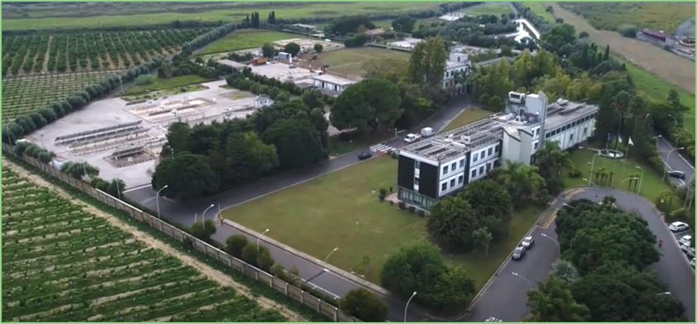
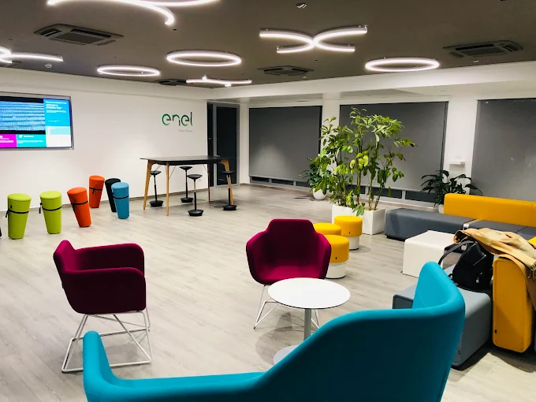
Innovation Lab Catania
A living lab to accelerate the adoption of innovative solutions
The Innovation Lab in Catania is a reference experimental facility in Italy dedicated to the study and validation of innovative technologies for the energy transition.
STRENGHTS:
10 hectares of experimental area
Accredited ISO17025 for the IEC 61215 standard
Specialized expertise and advanced infrastructure
The center also hosts the Enel Innovation Hub Italy location to connect with the external ecosystem: a co‑working space for startup and students
Catania Innovation Hub&Lab video available here

Slide 2
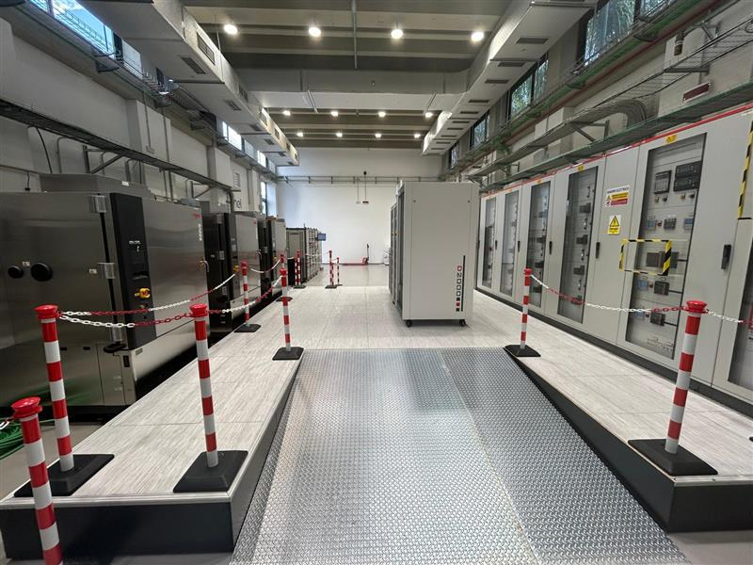
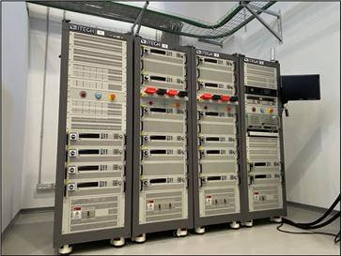
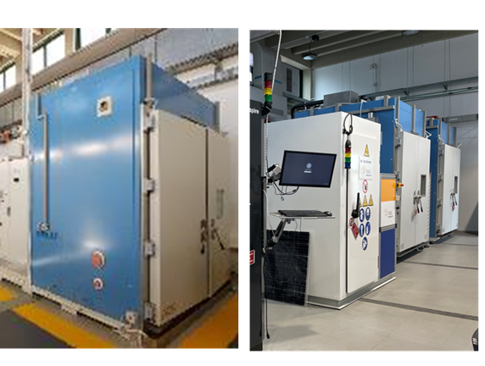
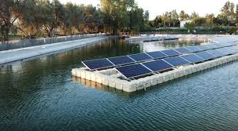
Innovation Lab Catania
INDOOR AREA
Testing in controlled laboratory environments to validate functionality, performance and operational reliability of
technologies enabling the energy transition, including innovative energy storage solutions, PV technologies, micro‑ and smart‑grid systems, automation and control systems, as well as edge computing architectures.
The outdoor area is dedicated to side‑by‑side test and in‑field sensors validation.
It facilitates benchmarking across technologies to compare real operating performances and degradation
OUTDOOR AREA

