Slide 1
Student Equality Data Dashboards - Introduction and Key Insights
Dr Panagiota (Peny) Sotiropoulou, Researcher
LinkedIn: @Panagiota Sotiropoulou

Slide 2
A new day has come…
What has changed

Slide 3
Old
Static, 356-page PDF report and accompanying Excel tables
Presentation by protected characteristic
New
7 interactive Tableau data dashboards
Thematic presentation
Multi-year dataset
Single-year dataset
No ability to tailor data
Multiple filter/segmentation options available
Notes:
These dashboards were launched on 15 November 2025. The publication was delayed due to a combination of the delayed release of HESA’s student data due to the first time use of the Data Future collection model as well as internal delays from our side in transforming this massive product into its new layout. 2024 marked the 17th year of publication of EDI data for the student population in UK HE published by Advance HE. We are going through the final steps before the publication of the 2025 student data dashboards, which we aim will launch in our annual EDI conference, taking place next week, between 25-26 March in Manchester. So, watch this space

Slide 4
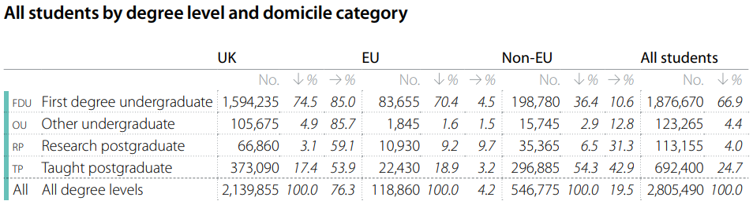
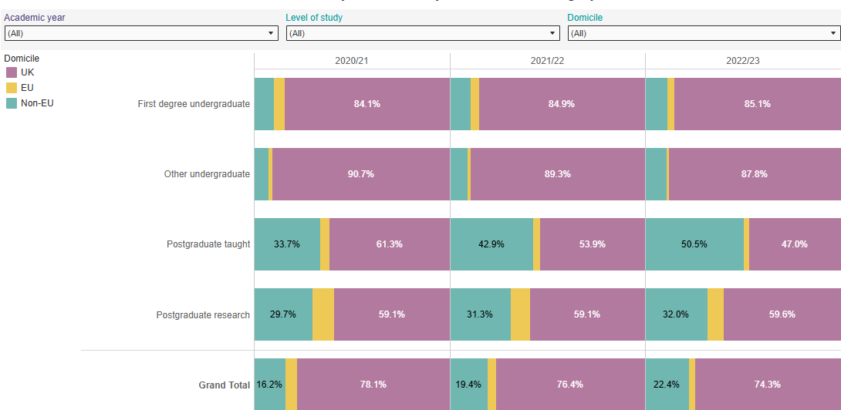

Slide 5
What the dashboards can be used for
To consider the diversity of the UK HE student body as a whole/by nation/ by mission group;
To consider change and progress over time, using previous AHE’s equality statistical reports, and/or data within these dashboards, as comparators;
By individual institutions for benchmarking purposes.
Notes:
Our student equality data dashboards provide data which can be used:
to consider the diversity of the HE student body as a whole
to consider change and progress over time, using previous Advance HE’s equality statistical reports, and/or data within these dashboards, as comparators
by individual institutions for benchmarking purposes.

Slide 6
Additional relevant resources

Slide 7
Contextual support information
‘About the data guide – PDF file with detailed information about:
  where we source the data from;
  how we measure and define the concepts we use;
  AHE relevant publications and resources
User guidance and contents page
Data dashboards video walkthrough
Launch news piece publication, including key data insights

Slide 8
Live demonstration of the Student Equality Data Dashboards
Student domicile
Ethnicity degree‑awarding gap
Continuation by disability
Intersectional insights
Notes:
https://public.tableau.com/app/profile/advance.he/viz/2024StudentEqualityStatisticalReport/Coverpage

Slide 9
A request for feedback

Slide 10
How do you see these dashboards fitting within your practice?
Aim and ambition for data dashboards to become the new ‘go to’ place for data exploration for a vast array of audiences, from strategic decision-makers to EDI-enthusiasts with an interest in the UK HE student population.
Let us know:
What works
How and for what purposes are you using these dashboards?
Is there anything missing?
Reach out to let us know at: insights@advance-he.ac.uk
Notes:
Aim and ambition to deliver what is relevant and useful to our key audiences

Slide 11
Many thanks for your time and attention!
Any questions?
Dr Panagiota (Peny) Sotiropoulou
Panagiota.Sotiropoulou@advance-he.ac.uk

