Slide 2
Balancing students’ identities as learners and consumers
Dr Louise Taylor

Slide 3

Student identities workshop
To what extent do you identify as a learner and consumer of your education?
Notes:
Image from https://ichef.bbci.co.uk/news/2048/cpsprodpb/CD59/production/_98296525_gettyimages-539017648.jpg

Slide 4
Workshop plan
Complete online quiz to discover your student type
Learn about the research on student identities
Small group discussions
Activity to co-create set of attitudes and behaviours that support learning by developing a shared identity as a student of our discipline
Complete short feedback form

Slide 5
Quiz
Please complete the Student Identity Quiz here:
Student Identities and Inclusion - Student Profiler Quiz (google.com)
When you have finished, you should write down your identity scores and student type. You will not be asked to share this information
If you finish early, start reading this blog post: Bunce, L. (2020) A degree of studying: Students who treat education as a commodity perform worse than their intrinsically motivated peers. London School of Economics Impact Blog post.
Notes:
15 minutes

Slide 6
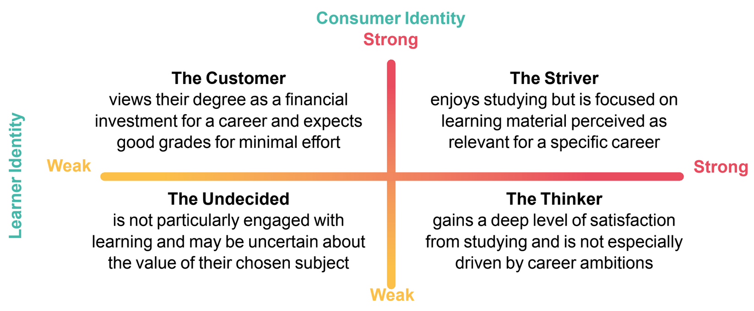
Student Types
Notes:
You will have been categorised as one of the following four student types (read descriptions of each type)
[You might like to write down your scores and student type on the handout]
These descriptions are simplistic, and may not fully describe you, but they give an indication of some of the characteristics of each student type

Slide 7
Student Types
4%
39%
4%
53%
Notes:
Research shows that the majority of students are ‘Thinkers’ (53%) or ‘Strivers’ (39%)
Although the actual number of customers is small, there are 39% of student who have both a strong customer identity and learner identity (strivers).
[Based on a diverse sample of 780 students across England, UK, who completed a very similar questionnaire (Taylor Bunce, L., Rathbone, C. & King, N. (forthcoming 2022) Students as consumers: A barrier for student engagement? In T. Lowe (Ed.), Critically reflecting on student engagement. Routledge)]

Slide 8

Identities
Why does your identity matter?
Your identities as learners and/or consumers will affect your university experience and degree outcomes
Notes:
Why does your student identity matter?
Your identities as learners or consumers will affect your experience of university and your degree outcomes
We will see that students who identify more as learners have a more satisfying experience, enjoy learning, and have better grades and degree classifications
However, students who identify more strongly as consumers have a less satisfying experience of learning, and poorer grades
Image from https://unsplash.com/photos/YQYacLW8o2U

Slide 9
Identities
Identities, or self-concepts, describe who we think we are
They influence:
how we think (our beliefs and attitudes)
how we behave
They are affected by the groups to which we belong
Notes:
We have many identities and they describe who we think we are
They influence our beliefs and attitudes, which affect how we decide to do things and what we do
Importantly, identities are influenced by others around us - the social groups that we belong to
Examples of groups we belong to might be the group of students studying your subject, membership of a sports team or band, membership of a student union society, or member of a group of friends or family
Image from https://unsplash.com/photos/YQYacLW8o2U

Slide 10
Alternative Identities
Students may hold numerous identities:
learners/scholars of their discipline
customers of their university
even party-goers!
Identities will affect attitudes towards learning and studying behaviours
Identities are not fixed. They are flexible, changing over time
Notes:
For example, students who identify more strongly as learners or scholars are more likely to complete their studies (Jetten et al., 2017) and have better motivation and concentration (Ommundsen et al., 2005; Zimmerman, 2000)
In contrast, students who have strong identities as socialisers or party-goers are less invested understanding material, and more invested in just getting good grades (Komarraju & Dial 2014)
Identities will change over time, for example, in response to doing well in as assessment or getting help from a tutor, a student may feel a stronger learner identity, whereas if a student isn’t able to get help from tutors or access to resources they need, they may identify more strongly as a consumer

Slide 11
Traditional learner identities
Students with strong identities as learners
engage in deeper processing of material
use more meaningful strategies to try and understand
experience satisfaction from studying
spend time learning about a topic because it is interesting
come to classes prepared
achieve higher grades
(Bliuc et al., 2011)
Notes:
[read slide first]
Identities as learners have been understood particularly in relation to a particular subject or field of study. Students with a strong identity as a learner in their discipline, such as a ‘psychology student’ or ‘music student’ agree with statements such as ‘I feel strong ties to other students in my subject’ and ‘I’m pleased to be student in my field of study’ and ‘I identify with other students in my field of study’.
In other words, students with a sense of belonging to their peers studying their subject have strong learner identities, more positive attitudes towards learning, a more positive learning experience, and approach studying in a way that produces better grades
Bliuc et al., 2011

Slide 12

Consumer identities
A relatively new student identity: ‘customer’ of their university or ‘consumer’ of their education
A consumer = someone who pays for goods/services
Can you really buy your degree?
Notes:
A relatively new identity that contrasts a learner identity is that of a consumer.
In many countries in the global north, responsibility for the cost of tuition has been transferred away from the state and onto individual students. This means that students are now technically their university’s customers, and they are protected by policies and legislation to ensure that they are getting value for money, e.g. in England and Wales, UK, they are protected by the Consumer Rights Act
Image from https://unsplash.com/photos/QsYXYSwV3NU

Slide 13
Education can’t be consumed
Paying for your degree is not like buying a new TV
It’s more like going to the gym
How much effort you put in affects the end result
Its affected by your previous experience / performance
What the customer wants may not be what is best

Slide 14
Consumer identities
Students with a strong consumer identity
feel that grades are more important than learning
work the minimum necessary
don’t find learning very interesting
only learn things perceived as relevant to their career
gain little satisfaction from studying
feel that learning is more the responsibility of their tutors than themselves
achieve low grades
(Bunce et al., 2017; 2019)

Slide 15
Conclusion
Education can’t be ‘consumed’ like other products
The effort you put in has a vital role in your experience and outcome
Strong learner identities mean learning will be enjoyable and support good grades
Consuming education could result in
  lower engagement and satisfaction
  poorer quality learning
  lower academic achievement
  fewer employability skills

Slide 16
Small group discussions
Spend approx. 30 minutes in your groups discussing the questions available here
1. First, reflect on what you think is the purpose of your university education. What were your reasons for attending? Do these reasons relate to the student type Customer, Striver, Thinker, or Undecided?
2. How does the Thinker type differ from the Striver and Customer types? Consider the expectations of these different student types in terms of their attitudes towards learning and their behaviours, both on campus and in the classroom.
3. To what extent do you think that your university treats you as a Customer? What about your tutors and fellow students?
4. How is the 'service' provided by your institution similar or different from other types of customer services such as gyms and restaurants? What are the roles of the service provider, in this case lecturers compared to fitness instructors or waiters, and what are the roles and expectations of the customer?

Slide 17
Small group discussions
Spend approx. 30 minutes in your groups discussing the questions available here
5. What do you think was the impact of the Covid-19 pandemic on the strength of students' learner and consumer identities? Do you think the prevalence of the different student types may have changed, and if yes, how?
6. What are the possible effects of the four student types on the mental health and emotional wellbeing of students?
7. Research has shown that students with a strong learner identity have higher grades than students with a strong consumer identity (Bunce, Baird & Jones, 2017). What approaches to learning are associated with strong learner identities and strong consumer identities? (Hint: see this short blog post by Bunce, 2020). Relatedly, who has greater responsibility for ensuring that students pass their course - universities or students?
8. Do you think that your student type is fixed or is it flexible? What factors might influence whether your learner and consumer identities get stronger or weaker?

Slide 18
Reflection on discussions
What are the negative impacts of identifying as a consumer on your education?
How can you develop your learner identity to ensure that you get the best experience from your education?
How can you use your ‘consumer’ voice to make a positive impact on your learning?
Notes:
[OPTIONAL SLIDE]

Slide 19
Plenary: Developing a shared identity
Together, we are going to create a list of attitudes and behaviours that support learning in our discipline to create a shared sense of belonging as members of our discipline (e.g., Psychology student)
“Being a successful X student means….”
Notes:
Notes to educator:
The aim of the plenary is for you and your students to co-create a summary of attitudes and behaviours that support learning in your discipline, in order to create a shared social identity as a ‘X student’, where X = name of discipline (e.g., ‘Psychology student).
You could use the heading ‘Being a X student means….’ (where X = name of discipline) to begin the discussion. Then you could ask students to produce some example attitudes and behaviours that support learning in their discipline, e.g., ‘…being curious about new ideas by using resources available to me to find out more’ or ‘…asking questions of my tutor if I don’t understand something’. This could be done using a tool such as ‘padlet’ or ‘poll everywhere’, which enables students to write their ideas anonymously, and be visible to everyone. If they are finding this difficult, they could take inspiration from statements in the self-assessment questionnaire, or get back into their small groups and brainstorm some ideas.
Students could then vote for the top 3-5 suggestions to create a bullet point list of attitudes and behaviours that describe a successful student of their discipline.
The final agreed list of statements could be shared with students on their online learning platform, and returned to during personal tutoring sessions for their cohort

Slide 20
Evaluation
Please complete the evaluation form to give your feedback on the workshop (it takes less than one minute)
Student Identities and Inclusion - Discussion Questions (google.com)
Thank you

Slide 21
References
Bunce, L. (2020) A degree of studying: Students who treat education as a commodity perform worse than their intrinsically motivated peers. London School of Economics Impact Blog post [free access]
Bunce, L., Baird, A. & Jones, S.E. (2017) The student-as-consumer approach in higher education and its effects on academic performance. Studies in Higher Education, 43(11): 1958-1978 [free access]
Bunce, L. & Bennett, M. (2019) A degree of studying? Approaches to learning and academic performance among student ‘consumers’ Active Learning in Higher Education [free access]
Please see www.brookes.ac.uk/SIIP for more information

