Slide 2


EXPLORING ESS:
SURVEY RESPONSES ANALYSIS
OVERALL ANALYTICAL SUMMARY

Slide 3

Data Collection
Following a series of focus groups with senior members of each school leadership team, a pulse survey was sent to academic and professional staff members across the whole institution in May 2022.
The pulse survey was sent out to 829 academic and professional staff; we heard from 108 staff members, which translates as a 13% response rate. Therefore, the sample provides a 95% confidence level at a 9% margin of error.
The survey asked a total of 20 questions, These were a mixture of agree and disagree statements on a 6-point scale
The key objectives were threefold:
• To examine how an institution can encourage a new culture to evolve
• To investigate the differences in the facilitation of cultural transformation between four diverse Academic Schools
• To measure the impact in relation to benefits to staff in terms of wellbeing, a sense of belonging, value, and career development.

Slide 4

Analytical Approach
A three-stage thematic analysis was used
The first stage was Pattern Coding in Annotated Transcripts (Miles & Huberman, 1994).
This was followed by Invivo Coding in NVivo software (Stringer, 2013). (Guest et al. 2011).
Finally a written thematic analysis identified primary themes and values
Through the analysis initial key markers that help drive the success of transformational change were drawn out
The analysis also helped identify critical positive values that enable change
The analysis was then also combined against the data from the focus group analysis
These values were then mapped against the Salford Behaviours framework

Slide 5

Results Overview
58.9% of respondents agree that ESS has impacted student success
72.9 % of respondents agree that ESS was the appropriate approach for Salford to address external HE policy changes
62.6% of respondents agree that ESS brought student outcome delivery under a single framework
60% of respondents agree that their area was prepared for the cultural change required to facilitate ESS
66.6% of respondents agreed that the culture of their area contributed to the implementation of ESS
Communication, challenge and collaboration were the top three keywords respondents associated with the cultural change in their area following ESS
The primary strength themes are 'The Student Experience' and 'Inclusive Solutions', highlighting student outcomes and collaborative working as key drivers
The primary improvement themes are 'Divisions' and 'Impact on Staff', highlighting communication, inclusion and support as key areas of focus

Slide 6


Primary Strength Themes
INCLUSIVE SOLUTIONS
A highly positive, valued-based theme focused on a collaborative "working together" way. A truly open and inclusive approach to communication, practice and creating solutions together. The realisation of a partnership approach.
THE STUDENT EXPERIENCE
Underpins the key motivations and values of the institution: a positive student experience with clear outcomes. High-quality higher education is driven by staff commitment and passion that is central to Salford's workplace culture.

Slide 7


Secondary Strength Themes
BEING HEARD AND VALUED
Open and reciprocal conversations to ensure staff are; supported, heard, understood and valued. This was a central element to staff belonging and overall well-being.
FOCUS AND DIRECTION
Clear and effective communication, planning and delivery to establish agreed priorities that inform focus, vision and direction.

Slide 8



Barrier Themes
IMPACT ON STAFF
The importance of how change 'feels' to staff, particularly in terms of workload, belonging and well-being. The more positive the overall culture, and the closer it is to Salford Behaviours, the more positive ESS will have 'felt' to staff.
DIVISIONS
Where gaps in communication or relationships occur, this can create frustration, confusion and ultimately divisions between different departments across the institution. This can create silo working and an 'Us and Them' culture.
OBJECTIVE EVIDENCE
Objective evidence is necessary to achieve staff 'buy in' of change; this may need to respond to a degree of scepticism, particularly as some prefer to consider the impact of change over a period of time.

Slide 9


Golden Threads
COMMUNICATION
Communication often underpins many themes in both data sets; where it is effective, it draws out positive values and strengths. If communication is felt or seen to be lacking, this can create barriers. The data correlates with several of the Salford behaviours, particularly; Connecting, Inspiring and Co-Creating. These behaviours are central to developing strong working relationships to build effective networks across the organisation. These networks are essential in delivering effective communication that helps drive a common purpose; this fosters inclusion and collaboration so staff can work creatively to respond to differing needs and issues.
THE JOURNEY
The connections between the 'Me', 'We' and 'University' from the Salford Behaviours framework are highlighted as relevant in how ESS is experienced and perceived culturally. Staff often frame cultural transformation as a journey, not just something that occurs over time but something that needs to bring everyone with it on that journey. Part of this is staff being able to position themselves within the framework of ESS. This translates as being able to see how I have contributed to ESS's outcomes and how I have been valued and heard. It also means drawing direct connections between your own work, your students, and the overall framework as ESS.

Slide 10

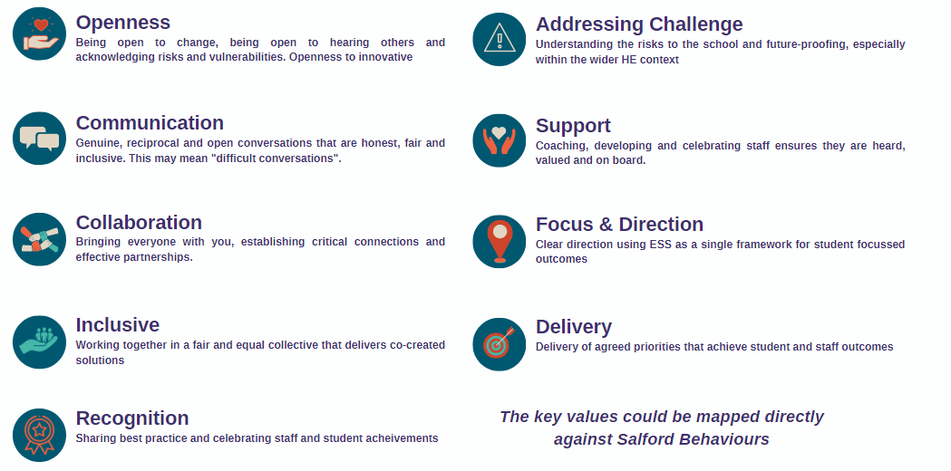
Values for cultural change
These were critical positive values across all responses that enabled change

Slide 11

References
Dyer, C. (2018). Creating "sticky" culture: how to drive lasting behavioral change. Strategic HR Review.
Gilbert, D.E. (2019, 4 June). Sticky Culture is about the People. Dennis. E.Gilbert. Sticky Culture is about the People. - Dennis E. Gilbert (dennis-gilbert.com)
Guest, G., MacQueen, K. M., & Namey, E. E. (2011). Applied thematic analysis. Sage.
Miles, M. B., & Huberman, A. M. (1994). Qualitative data analysis: An expanded sourcebook. Sage.
Saldaña, J. (2015). The coding manual for qualitative researchers. Sage.
Stringer, E. T. (2013). Action research. Sage Publications.

