Slide 2


EXPLORING ESS:
FOCUS GROUP ANALYSIS
OVERALL ANALYTICAL SUMMARY

Slide 3

Methodology
Four focus groups were held with members of each Academic School Leadership team. As the locus of responsibility for the delivery of ESS, the leadership teams have a detailed understanding of their respective School’s experience of the changes required and their approach to implementation. Consequently, engagement in the focus groups was high, enabling in-depth exploration of three key questions:
What culture changes in your Academic School were needed to facilitate the ESS framework?
ESS is delivering improvements in key KPIs…​
What positive impact has this had on academic staff in your school in terms of: sense of belonging, valued contribution, professional development, and well-being?
3. Have there been any challenges in achieving the culture required to facilitate this rapid transformational change, and how has this been managed/responded to by the School Leadership Team?

Slide 4

Analytical Approach
A three-stage thematic analysis was used
The first stage was Pattern Coding in Annotated Transcripts (Miles & Huberman, 1994).
This was followed by Invivo Coding in NVivo software (Stringer, 2013). (Guest et al. 2011).
Finally a written thematic analysis identified primary themes and values
Through the analysis initial key markers that help drive the success of transformational change were drawn out
The analysis also helped identify critical positive values that enable change
The analysis was then also combined against the data from the focus group analysis
These values were then mapped against the Salford Behaviours framework

Slide 5

Overall: Question 1
1. What culture changes in your School were needed to facilitate the ESS framework?
The Narrative
Key Drivers
Understanding and mitigating risks
The value in KPIs and data
Honest, open & reciprocal conversations
Improving student outcomes
Structural and resource changes
The importance of pre-existing culture
Placing 'self' within ESS
Bringing ESS into focus
Supporting and coaching staff
Communication
Data & KPIs
Risks future-proofing
Student Focussed
Staff commitment
Honesty & transparency
Reciprocity
CRITICAL VALUES FOR CHANGE

Slide 6

Overall: Question 2
2.What positive impact has this had on academic staff in your school in terms of: sense of belonging, valued contribution, professional development, and well-being?
The Narrative
Key Drivers
A cohesive & joined up approach
Bottom up culture
Creating inclusive solutions
Student Outcomes as staff motivation
Staff passion, commitment & workload
Celebration & recognition of achievement
The hearing of all voices
Access to training & development
On the journey 'together'
Collaboration
Openness
Inclusive Solutions
Communication
Student Focussed
Focus & Direction
Transformation as a journey
CRITICAL VALUES FOR CHANGE

Slide 7

Overall: Question 3
3. Have there been any challenges in achieving the culture required to facilitate this rapid transformational change?
The Narrative
Key Drivers
Change can feel difficult
Resource and workload implications
Managing and understanding risk
Ensuring communication across the institution
Wider HE contexts
Negating the impact on staff
Including all colleagues
Duplication and overlap
Change as a journey
'Salford' as a community
Collaboration
Openness
The student as a priority
Challenge & Resistance
Inclusive Solutions
Communication
Focus & Direction
CRITICAL VALUES FOR CHANGE

Slide 8



Primary Strength Themes
INCLUSIVE SOLUTIONS
A highly positive, valued-based theme focused on a collaborative "working together" way. A truly open and inclusive approach to communication, practice and creating solutions together. The realisation of a partnership approach.
THE STUDENT EXPERIENCE
Underpins the key motivations and values of the institution: a positive student experience with clear outcomes. High-quality higher education is driven by staff commitment and passion that is central to Salford's workplace culture.
OPENNESS
There is an open culture in terms of honest and inclusive dialogue where everyone can speak freely and be heard. Additionally, an open culture embraces change, creativity and innovation.

Slide 9



Secondary Strength Themes
BEING HEARD AND VALUED
Open and reciprocal conversations to ensure staff are; supported, heard, understood and valued. This was a central element to staff belonging and overall well-being.
FOCUS AND DIRECTION
Clear and effective communication, planning and delivery to establish agreed priorities that inform focus, vision and direction.
FUTURE PROOFING
Being responsive to a range of challenges and contexts in higher education to move forward positively and minimise risk.

Slide 10


Barrier Themes
IMPACT ON STAFF
The importance of how change 'feels' to staff, particularly in terms of workload, belonging and well-being. The more positive the overall culture, and the closer it is to Salford Behaviours, the more positive ESS will have 'felt' to staff.
DIVISIONS
Where gaps in communication or relationships occur, this can create frustration, confusion and ultimately divisions between different departments across the institution. This can create silo working and an 'Us and Them' culture.

Slide 11

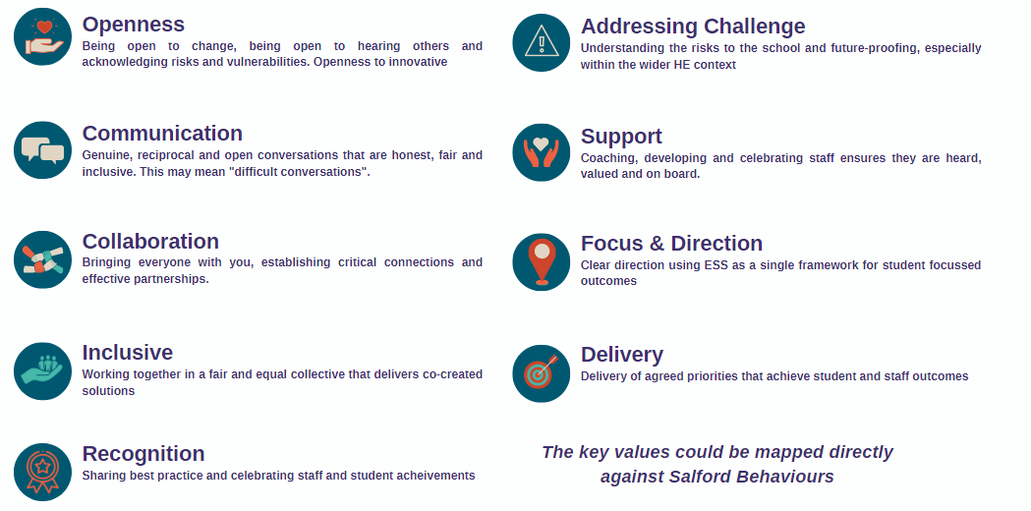
Values for cultural change
These were critical positive values across all responses that enabled change

Slide 12

Markers for Success
The following markers were found to be drivers for positive change:
Student focussed
Staff commitment
Inclusivity
The drive for survival
Sticky/Positive culture
Pre-existing culture
Transformation as a 'journey’
Openness
ESS as a single framework
ESS as a shared language
These markers were dependent on cultural nuances and aligned directly to the Salford behaviours

Slide 13

References
Dyer, C. (2018). Creating "sticky" culture: how to drive lasting behavioral change. Strategic HR Review.
Gilbert, D.E. (2019, 4 June). Sticky Culture is about the People. Dennis. E.Gilbert. Sticky Culture is about the People. - Dennis E. Gilbert (dennis-gilbert.com)
Guest, G., MacQueen, K. M., & Namey, E. E. (2011). Applied thematic analysis. Sage.
Miles, M. B., & Huberman, A. M. (1994). Qualitative data analysis: An expanded sourcebook. Sage.
Saldaña, J. (2015). The coding manual for qualitative researchers. Sage.
Stringer, E. T. (2013). Action research. Sage Publications.

