Slide 1

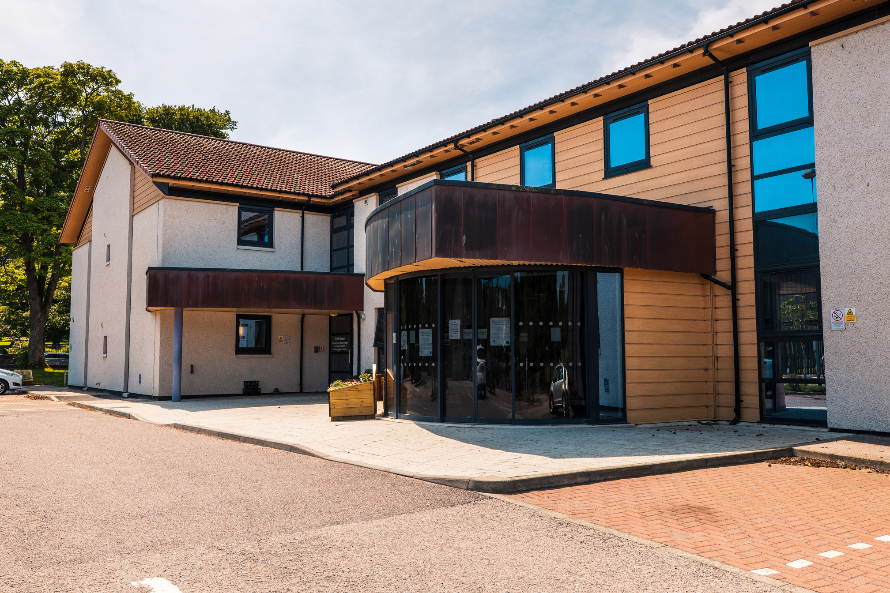


Welcome to Clan Accommodation
Clan Cancer Support Registered Scottish Charity No. SC022606

Slide 2
Welcome to Clan Cancer Support Bed and Breakfast facility. We are available to anyone impacted by cancer in the Northeast of Scotland, Moray, Orkney and Shetland.
Our centre is situated within a 20-minute walk of Aberdeen Royal Infirmary and is close to a wide range of shops and services in the city’s Rosemount area.
Clan Accommodation has its own entrance, with ample parking available immediately outside the centre. Frequent buses run to and from Aberdeen Royal Infirmary, Aberdeen City Centre, and the main bus and rail stations.
Opening Hours
Clan Accommodation is open 24 hours a day, 7 days a week. Check in is at 12.00pm. Please do not arrive before this unless previously discussed with staff
The centre is open and accessible:
Monday- Friday: 10.00am - 4.00pm
Please be aware that guests are responsible for any valuables during their stay at Clan.
We hope this information booklet is helpful. If you have any questions, please do not hesitate to ask our dedicated team.
We wish you a comfortable stay.
The Clan Team
Free Wi-Fi
Network ID
Clan Guest
Password
Haven_1983
1

Slide 3
Contents Page
1
2
3-4
5
6
7
8
9-11
12
13
14
15
Introduction
Contents Page
Access to Clan Accommodation and the Centre / Bedrooms
Lounge / Kitchen / Dining Room
Laundry / Toilets / Garden Area
Client Relations Team / Cleaning / Electrical Items / Fire Procedures
First Aid / Lifts / Reporting Faults / Recycling / Gifts / Mail Services / Payments
Additional Service
Aberdeen Useful Information
Supermarkets
Apps and Websites/Takeaways/Places to Eat
The Coffee Box at Westburn
2

Slide 4


Clan Accommodation
Access to Clan Accommodation and the Centre
Upon arrival, every guest is presented with a fob, providing direct access to the accommodation door 24/7.
You are free to come and go as you please. If you plan to stay overnight somewhere else, please inform us when you leave and when you return. This is for health and safety purposes; ensuring we know who is in the building in the event of a fire.
For your comfort and convenience, travel cots, highchairs, walkers, and wheelchairs are available for use by accommodation guests. Please contact the Client Relations Team for assistance.
Please note that smoking is strictly prohibited throughout Clan House, Clan Accommodation and within our car park and garden areas.
Bedrooms
The accommodation is on two floors offering a mix of single and twin rooms.
We have 27 ensuite rooms. This includes two family rooms on the first floor and two rooms adapted for disabled access on the ground floor.
The fire evacuation plan is on the back of each bedroom door. Please take the time to familiarise yourself with your nearest exit.
If you have any issues with the room or if you require any extra pillows, blankets etc. please let the Client Relations Team know immediately so we can rectify this as soon as possible.
All bedrooms have:
Alarm clock
Hairdryer located in bedside cabinet
Fridge with milk provided
Kettle
Tea/coffee
Smart television with remote control
Microwave
Dishes
Fold down table
Wardrobe
Fans
DAB Radio
3

Slide 5
Telephone
Each room has a personal external number (starting with 01224), which appears on the screen when you lift the receiver. You may share this with your family and friends. Alternatively, calls to the accommodation office can be transferred to your room.
A blinking red light on your telephone indicates a missed call. Press ‘View’ to check the caller and ‘X’ to exit.
To access the voicemail, dial 8400. Press 7 to delete the message. Please delete any voicemails and call history on departure.
Internal calls - put a 1 or 2 in front of the room number you require for internal calls.
External calls – phone works just like your normal house phone.
Microwave
Set the wattage to 700W by turning the top dial fully to the right. Then, turn the bottom dial clockwise to set the time.
Smart TV
Your TV has Freeview, Netflix, Prime Video and the catch-up apps. Use your own login for streaming services.
Each room either has a Sony or JVC TV.
Sony TV: Press Home -> Apps, then select your app. Netflix and YouTube have dedicated remote buttons.
JVC TV: Press the red home button (house icon) -> select your app. Alternatively, Netflix, Prime Video and YouTube have dedicated remote buttons.
Please sign out of any apps before departure.
Fridge
The in-room fridge is small and can only hold a few items. A larger fridge/freezer are available in the accommodation kitchen. Please feel free to store the majority of any frozen or fresh food in these.
Bathroom
Ensuite lights and fans activate when the door is opened and are on a timer which automatically switches off after 10 minutes. For fresh towels, please leave used towels in the shower and the cleaning team will replace them.
Heating
Bedroom heating is independently controlled. Temperature can be adjusted using the dial.
4

Slide 6
Lounge
The lounge, located on the ground floor, offers a welcoming and comfortable space. A large Smart TV is available for your entertainment, and a tablet is provided for ordering online shopping or takeaways at your convenience. There is also a printer for guest use.
In the lounge, you will find:
Books
Laptops
Craft Items
Games consoles with games
Guitar and electric keyboard with headphones
Puzzles
Wi-Fi access
Wool for knitting
Jigsaw puzzles
Kitchen / Dining Room
You are welcome to enjoy your meals in the dining room area within the kitchen or in the comfort of your own room. There are no set meals times for lunch or supper - eat whenever and wherever suits you.
The shared kitchen is fully equipped with:
Toasters & kettles
Electric hob
Oven & microwave
Fridge & freezer
Slow Cooker, toastie machine & omelette maker
Nutri Bullet & hand blender
Pots, cooking utensils, plates, cups & cutlery
Two communal fridges are available for extra storage. Please label your items with your name and room number. Blank stickers are provided next to the fridge/freezer for this purpose.
Single pints of milk are available for all guests in the kitchen fridge. Upon check-in, your in-room fridge will be stocked with milk. Once this is finished, you are welcome to help yourself. If you require whole milk, please let us know and we can arrange this for you.
The second drawer of the fridge/freezer contains a selection of frozen ready meals. These can be used for one-night stays/emergencies, or for use on arrival before you have arranged your meals.
5

Slide 7
The first and third drawers of the fridge/freezer are available for guests to store frozen items. Please write your name on any items. If you are struggling for space, please see a member of the Client Relations Team.
If you are left with any food items that are unopened or frozen and you do not require these; please pop a red sticker on them. Red stickers are kept by the phone beside the fridge/freezer.
Dishwasher - Any plates, cutlery, etc that you use must be rinsed to remove any excess food and then load these into the dishwasher. Please follow the signs on the dishwashers.
Hobs –switch on and off at the wall after use. These can remain hot for a long time after use so please be careful when working around the hob area. Please switch the extractor fan on whilst using both the hobs as well as the grill and oven. The fan is located above the hobs. The smoke detector is located above the hobs and is very sensitive.
Laundry
The accommodation laundry room is equipped with two washing machines and two tumble dryers. Powder and softener are provided, please help yourself. There is a donation box provided if you wish to donate. Both machines have an express wash of 35 minutes. If you require any assistance, please ask the Client Relations Team
Please put the washing powder in the first powder slot.
Tumble dryers operate best on Normal Plus.
There is an Ironing Board, Iron and two folding air dryers.
Toilets
There is both an accessible toilet and a toilet with a bath located opposite the Accommodation laundry room. If you require any extra towels whilst using this, please let a member of the team know.
Garden Area
The garden can be accessed via the main accommodation door, reception, or the door beside the accommodation laundry and stairwell (exit only).
Guests are welcome to enjoy the garden’s seating areas, including chairs and sofas. We are always looking for garden helpers - whether by weeding or general upkeep - please talk to a member of the team if you are interested.
6

Slide 8
Client Relations Team
A member of the Client Relations Team is available daily from 8am –8pm at reception. For immediate assistance, you can direct dial from the bedroom phones to reception by calling 303.
After 8pm, a night porter is stationed at Clan House/Reception Office. The building is manned 24/7 for your safety and convenience.
The support team are available Monday to Friday from 9am-4.30pm in the drop in area of Clan House. At the weekends, there is a member of the accommodation team in reception between 8am-8pm.
Cleaning
Our cleaning staff operates Monday to Friday 9:15am-12:15pm & 5.00pm-8.00pm and on a Saturday from 9:15am-12:00pm. We are committed to maintaining the highest standards of cleanliness throughout Clan Accommodation and Clan House.
Electrical Items
Guests are welcome to bring personal electrical items, however for safety reasons we do ask that items are not left plugged in and unattended.
For fire safety we do not allow any toasters within the bedrooms.
Fire Alarm
The fire alarm is tested every Tuesday between 16:00pm-16:30pm. The alarm will sound for a short period of time and there is no requirement to vacate the building.
Fire Evacuation
If the fire alarm sounds continuously, you should vacate the building calmly and quickly using the nearest available emergency exit and assemble at the nominated muster point in the main car park.
Please make sure you know the location of the nearest emergency exit and muster point by referring to the diagram on the back of your room door. We ask that guests do not stop to collect personal belongings and that you close the door as you leave the room.
Please refrain from moving vehicles in the car park and be aware of emergency vehicles when accessing the muster point.
7

Slide 9
First Aid
All members of the Client Relations Team are trained in first aid and can assist when required.
A first aid kit is available in the accommodation kitchen and the reception.
Additionally, a defibrillator is positioned under the stairs by the main accommodation door. If you require a medical assistance, please speak to the Client Relations team.
Lifts
There are two lifts on-site: one near the main entrance of the accommodation, the other in the drop in area. Each lift is equipped with an emergency telephone which should be used in the event of any problems.
Reporting Faults
We do our best to ensure that all the bedrooms and shared areas are kept clean, tidy, and well maintained. However, if you notice any faults or maintenance issues, please highlight them to the Client Relations Team immediately. They will try to help or alert the facilities team.
Recycling
We encourage all guests to participate in our recycling efforts. Recycling bins can be found in the accommodation kitchen/dining room.
Gifts
We are very grateful to all those who support us, whether through volunteering, making a donation or giving gifts. However, it is Clan’s policy that individual staff members cannot accept personal gifts.
If you do wish to give a gift, please be aware this will be distributed between all Clan staff and volunteers. If you would like to make a financial donation, please see the Client Relations Team.
Mail Services
Any mail will be delivered directly to your room. If you need to send stamped outgoing mail, you can hand it to the Client Relations Team for posting, Monday- Friday.
Payments
Payments should be made at reception. We accept cash or debit/credit cards and can provide a printed receipt.
On the morning of departure, check out time is between 9:30am-10:00am. We can store any luggage for you until your pickup time and you can use the accommodation facilities for as long as you require.
8

Slide 10
Additional Service
Each site offers a range of services which includes a drop-in service for information and support, complimentary therapies and access to our counselling and children and family services. We offer Clan Cancer Support services at the following locations:
Extended Hours
Open till 8pm every second Wednesday - please call reception to check dates.
Aberdeen
Drop In Opening Times
Monday - Friday
10am - 4pm
Clan House
120 Westburn Road
AB25 2QA
01224 647000
aberdeen@clancancersupport.org
Mintlaw
Macbi Community Hub
Newlands Rd
Mintlaw
AB42 5GP
Drop In Opening Times
Tuesday - Thursday
10am - 4pm
01779 487176
northaberdeenshire@clancancersupport.org
Drop In Opening Times
Monday - Thursday
10am - 4pm
Extended Hours
Open till 8pm on the last Tuesday of every month
Elgin
Clan Cancer Support
227 High Street
IV30 1DJ
01343 544132
moray@clancancersupport.org
Forres
Drop In Opening Times
Masonic Lodge
3 High Street
IV36 1BU
Fridays (Fortnightly)
1.30pm-3.30pm
01343 544132
moray@clancancersupport.org
9

Slide 11
Drop In Opening Times
Lossiemouth
Moray Coast Medical Practice
Muirton Road
IV31 6TU
Thursdays
1pm-4pm
07809 339820
moray@clancancersupport.org
Orkney
Clan Cancer Support
30 Victoria Street
Kirkwall
KW15 1DN
Drop In Opening Times
Monday-Thursday
10am-4pm
01856 873393
orkney@clancancersupport.org
Outreach
Whalsay Health Centre
Last Monday of the Month 10.30am-3.00pm
Shetland
Clan Cancer Support
Islesburgh Community Centre
King Harald St
Lerwick
ZE1 0EQ
Drop In Opening Times
Monday-Thursday
10am - 4pm
01595 697275
shetland@clancancersupport.org
Aberlour
Flemming Hospital
Health Services Hub
Speyside
AB38 9PR
Drop In Opening Times
Thursday (Fortnightly)
10am - 12pm
We are here for you even after you leave our accommodation. Once you’re home, we can provide telephone support, or you are welcome to visit your local Clan support centre.
10

Slide 12
Clan Support Centres
Our guests are encouraged to use any of the services available at Clan support centres. Whether you’d like to enjoy a cup of tea in the conservatory, access complimentary therapies, join one of our support or exercise groups or explore the resources in our information centre, we are here to help.
Support Volunteers
Our fully trained support volunteers are available throughout the day in our drop-in area. They are happy to provide information about any of our services and offer a listening ear if you would like someone to talk to.
Children and Family Services
Our dedicated Children and Family support team is available for guidance and support whilst you are in Aberdeen. This support can continue when you return home. If you would like to find out more, our Client Relations team will be happy to arrange for you to meet with one of our CFS staff members.
Complementary Therapies
Clan offers a wide range of complimentary therapies, designed to promote a sense of relaxation and well-being. The therapists work out of our fully equipped therapy suites at Clan House and are registered and experienced in the therapies they offer.
There is no charge for any therapies although donations are always appreciated. Treatments can be booked at reception.
Groups and Activities
Clan offer various group sessions and activities. For the latest programme, please see the noticeboard in the accommodation kitchen or near the main entrance. These are free of charge although donations are always welcome.
Clan in the Community
Clan is committed to providing support and services in the community to anyone impacted by cancer.
Once you return home, your local Clan base will give you a call to see if you need any help or support. Alternatively, information is available at www.clancancersupport.org
11

Slide 13
Aberdeen Useful Information
Clan
Clan House
Clan Accommodation
01224 647000
01224 651030
Health
Aberdeen Royal Infirmary
NHS 24
Cancer Care Line
Foresterhill Medical Centre
0345 566000
111
08009 177711
03453 370710
Chemists
Charlies Michie Rosemount
Rosemount Pharmacy
01224 636593
01224 630101
Travel
Aberdeen airport
NorthLink Ferries
08444 816666
01224 654881
Taxi Companies
Comcabs
Rainbow City
01224 353535
01224 878787
Car Hire
Enterprise
Europcar
01224 062228
+4403713840295
Bus Companies
Stagecoach
Bluebird
First Group
01224 597591
01224 597540
01224 650100
Closest Bus stop to Clan
Number 59 Northfield – Balnagask
Exit Clan car park and turn left
2-minute walk; less than 300 yards at Loanhead Terrace
Bus stop is on Westburn Road.
This bus takes you to the Foresterhill Road stop at Aberdeen Royal Infirmary
12

Slide 14





Supermarkets
Lidl
Hutcheon Street, AB25 3TB
15/20-minute walk (downhill)
5-minute drive.
Co-op
293 Rosemount Place, AB25 3TB
10/15-minute walk (uphill)
2-minute drive (limited parking)
Herds The Butcher
77 Rosemount Place, AB25 2YB
10/15 -minute walk (uphill)
2-minute drive (limited parking)
Sainsburys
Berryden Road, AB25 3SA
15/20-minute walk
5-minute drive.
Taxi rank outside entrance.
Delish Fish
66 Esslemont Avenue, AB25 1SR
15/20-minute walk (uphill)
5-minute drive (limited parking)
13

Slide 15



Apps and Websites
www.deliveroo.co.uk
www.just-eat.co.uk
www.ubereats.com
Takeaways
Curry Mount Indian
112 Rosemount Place, AB25 2YW
Open daily: 4.15pm - 10.00pm
01224 626020
Panda Valley Chinese
114 Rosemount Place, AB25 2YW
Open Wed-Sun: 5.00pm - 10.30pm
01224 630691
Fish N Hook
89-93 Rosemount Place, AB25 2YE
Open Wed-Sun: 4.00pm - 8.00pm
01224 635067
Lows Fish & Chips
Unit 4 Berryden Business Park, Berryden Road AB25 3SA
Open daily: 12.00pm - 9.00pm
01224 561212
Places to Eat
Milton on the Corner
1 Midstocket Road, AB15 5NE
10-minute walk (uphill) | 4-minute drive Limited parking
Open 12.00pm - 11.00pm (closed Mondays)
Booking recommended: 01224 977896
Koi Thai Restaurant
104-106 Rosemount Place, AB25 2XN
10-minute walk | 5-minute drive (paid street parking)
Open 5.00pm - 10.00pm (closed Tuesdays)
Booking recommended: 01224 478900
Bagel Society
68 Rosemount Place, AB25 2XJ
15-minute walk | 5-minute drive (limited parking)
Open daily 8.00am - 4.00pm.
Corner Tree Café
3 Whitehall Road, AB25 2PP
20-minute walk | 5-minute drive (paid street parking)
Open daily 8.30am - 4.30pm
Booking recommended: 01224 642442
Fearless Coffee
213 Rosemount Pl, AB25 2XS
10-minute Walk | 5-minute drive (paid street parking)
Open daily 8.30am - 5.00pm
The Cult of Coffee
28 Esslemont Avenue, AB25 1SN
20-minute Walk | 7-minute drive (limited parking)
Open daily 8.30am - 5.00pm
Atholl Hotel
54 Kings Gate, AB15 4YN
Open 12.00pm - 2.00pm/5.30pm-9.00pm
Booking recommended: 01224 323505
Car Park Available
14

Slide 16

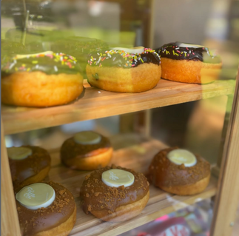
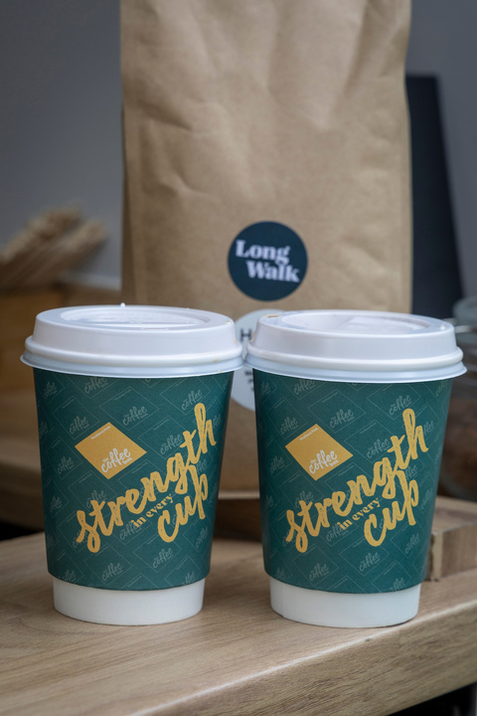
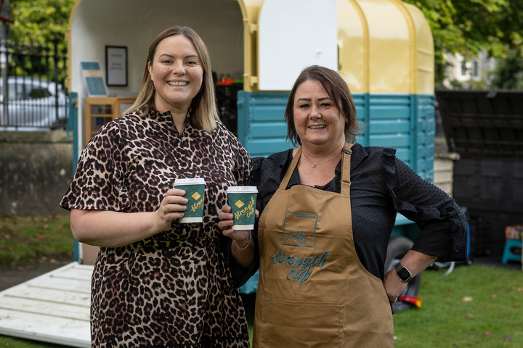
Just a five-minute walk from Clan House, The Coffee Box is located at the entrance of Westburn Park.
Serving a selection of hot and cold beverages alongside tasty treats from Dough and Co.
Proudly supporting Clan Cancer Support.
@thecoffeeboxatwestburn

Slide 17
Follow us on social media
/clancancersupport
@clancancersupport
@ClanNow
/clancancersupport

