Slide 1



Verification and Reconciliation of Gas Composition Using Speed of Sound
Juan Martin
Phil Stockton
Bob Peebles
Daniel Laing
Allan Wilson
Graeme Birks (TOTAL)

Slide 2
Agenda

Slide 3
Agenda

Slide 4
Agenda
Standards

Slide 5
Agenda
Standards
The system

Slide 6
Agenda
Standards
The system
Sampling

Slide 7
Agenda
Standards
Simulation
The system
Sampling

Slide 8
Agenda
Standards
Simulation
The system
Verification
Sampling

Slide 9
Agenda
Standards
Simulation
The System
Verification
Sampling
Reconciliation

Slide 10
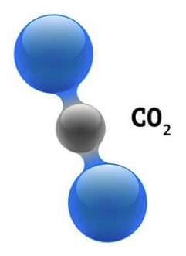
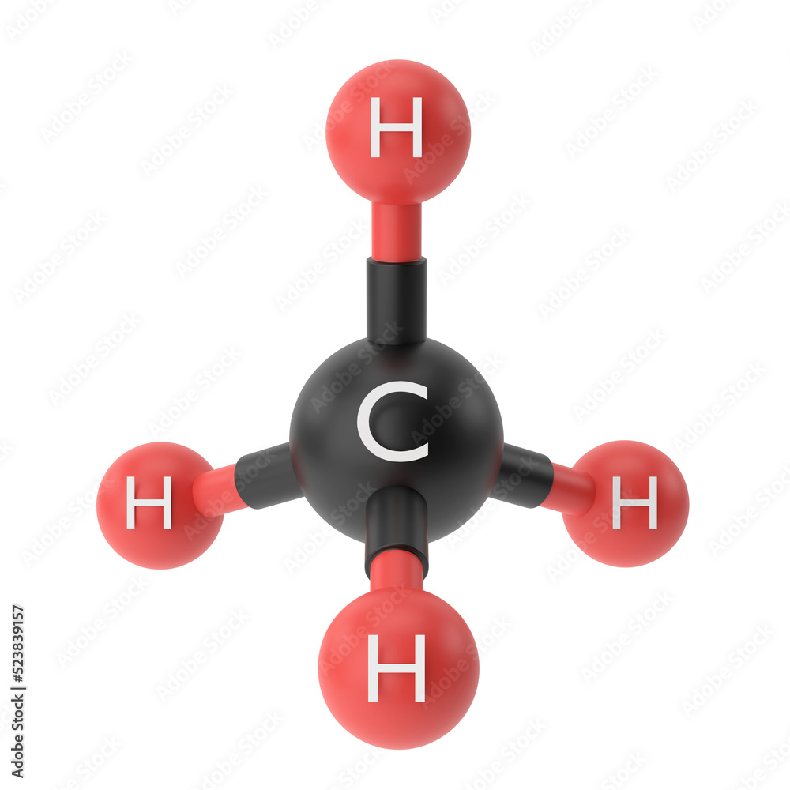
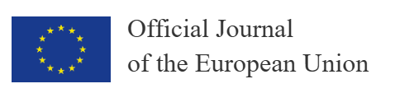




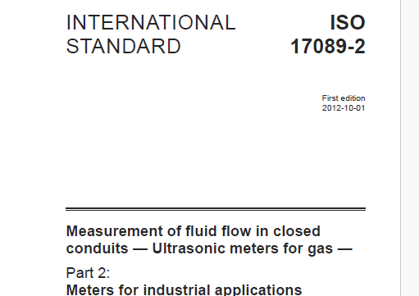
Flare Gas Reporting
EU regulation 2024/1787, ‘On the reduction of methane emissions in the energy sector’

Slide 11

Flare Gas Reporting
EU regulation 2024/1787, ‘On the reduction of methane emissions in the energy sector’

Slide 12

Flare LHV Measurement
Calculate:
LHV
Exit velocity
Gas density
CE, CO2e
Require a representative composition of the flare gas at this point
Flare
stack
Flare
header
M
S
Can we check?
Flare Knock Out Drum
Sample
Continuous?
Intermittent?

Slide 13
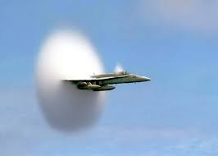
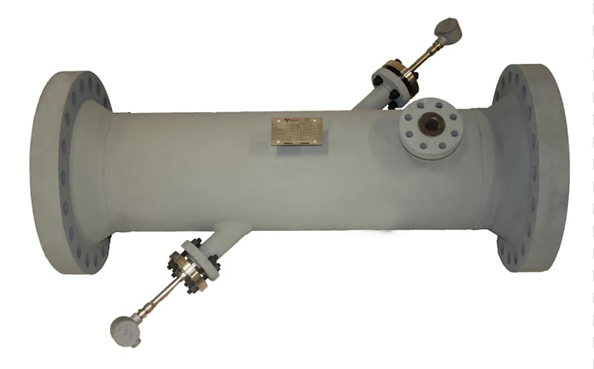
Flare LHV Measurement
Require a representative composition of the flare gas at this point
Flare
stack
Flare
header
M
S
Speed of sound measured directly
Flare Knock Out Drum
Sample
Continuous?
Intermittent?

Slide 14
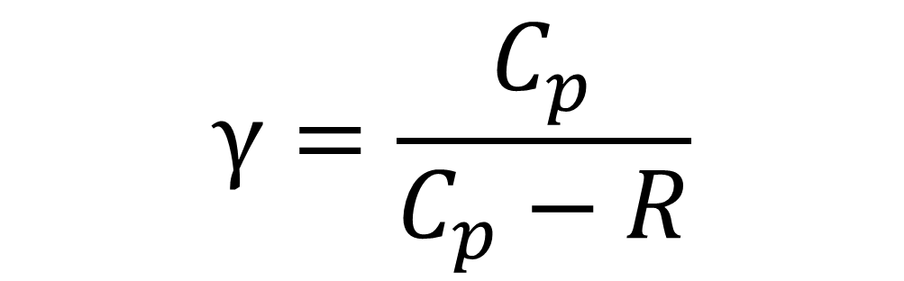

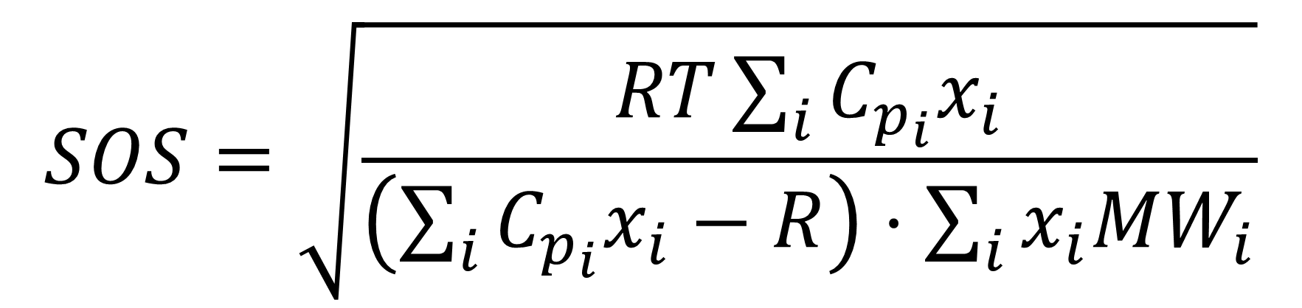


Ideal Gas
$$γ=\frac{C_{p}}{C_{p}−R}$$
$$SOS=\sqrt{\frac{γRT}{MW}}$$
$$SOS=\sqrt{\frac{γRT}{\sum_{i}{x_{i}}MW_{i}}}$$
$$SOS=\sqrt{\frac{RT\sum_{i}{C_{p_{i}}x_{i}}}{\left(\sum_{i}{C_{p_{i}}x_{i}}−R\right)⋅\sum_{i}{x_{i}MW_{i}}}}$$
$$SOS=\sqrt{γ⋅\frac{p}{ρ}}$$

Slide 15
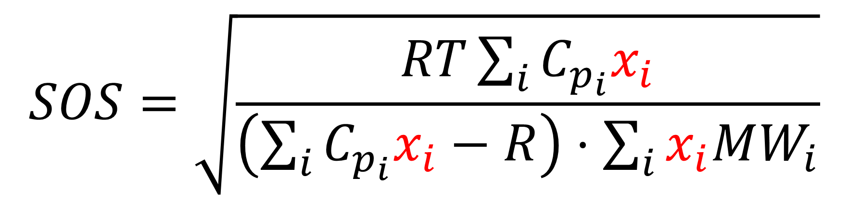
Ideal Gas
$$γ=\frac{C_{p}}{C_{p}−R}$$
$$SOS=\sqrt{\frac{γRT}{MW}}$$
$$SOS=\sqrt{\frac{γRT}{\sum_{i}{x_{i}}MW_{i}}}$$
$$SOS=\sqrt{\frac{RT\sum_{i}{C_{p_{i}}x_{i}}}{\left(\sum_{i}{C_{p_{i}}x_{i}}−R\right)⋅\sum_{i}{x_{i}MW_{i}}}}$$
$$SOS=\sqrt{γ⋅\frac{p}{ρ}}$$
Real Gas use AGA 10

Slide 16
LP Flare - SOS

Slide 17
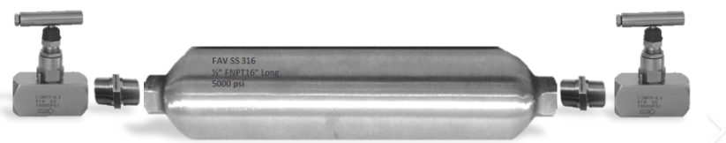
Issues with Sampling
Sample point location may be less than ideal
No dedicated sample quill or sample equipment installed
Low process pressure in the flare gas system
The presence of liquids or other contaminants at the sample location

Slide 18
Flare LHV Measurement
Calculate:
LHV
Exit velocity
Gas density
Interface with flare meter
Require a representative composition of the flare gas at this point
Flare
stack
Flare
header
M
Flare Knock Out Drum

Slide 19

Process Simulation
Composition
Lower Heating Value (LHV)
Lift Gas
Compression Train
Export Gas
Composition
Flow
Temperatures
Pressures
Train B
~
Wellstream
1st Stg
2nd Stg
~
Export Oil
Train A
~
Wellstream
1st Stg
2nd Stg

Slide 21


Process Simulation

Slide 22
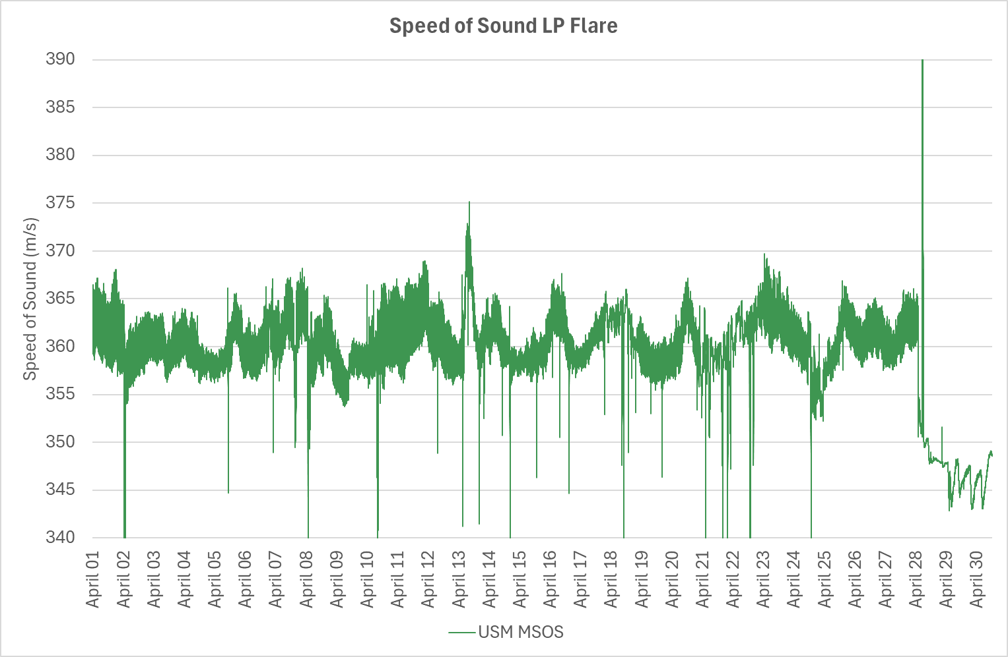

Slide 23
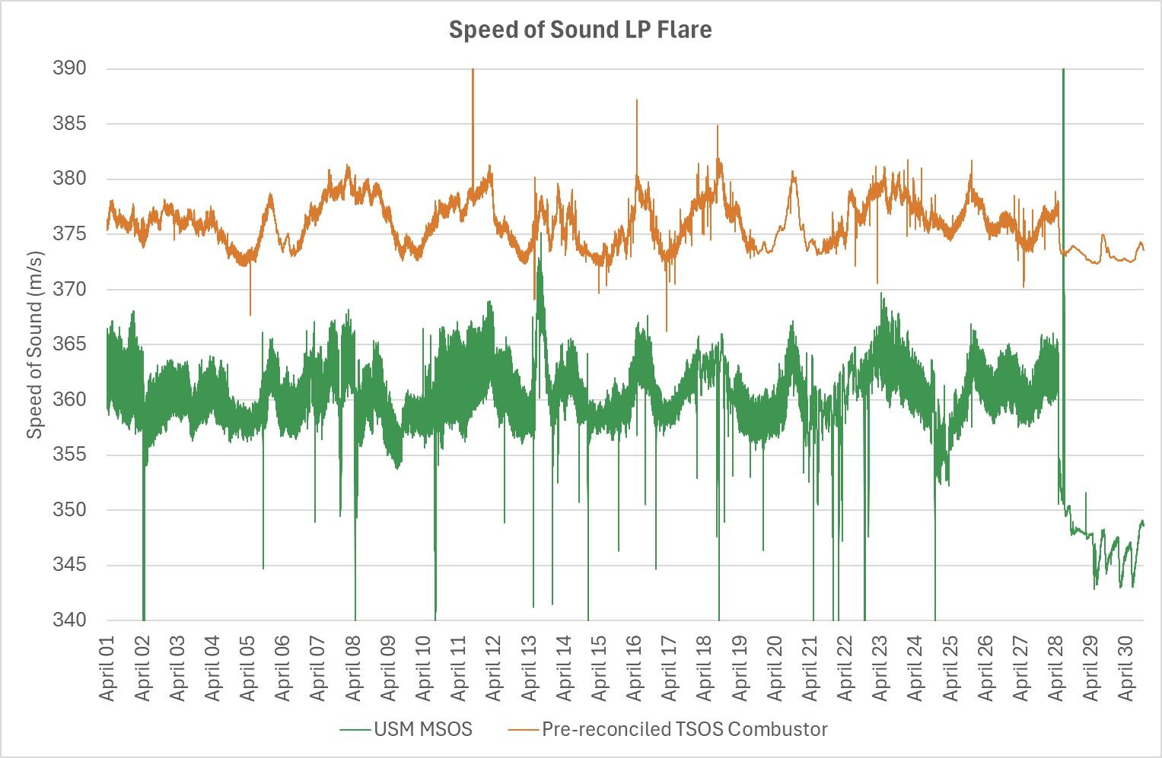

Slide 24
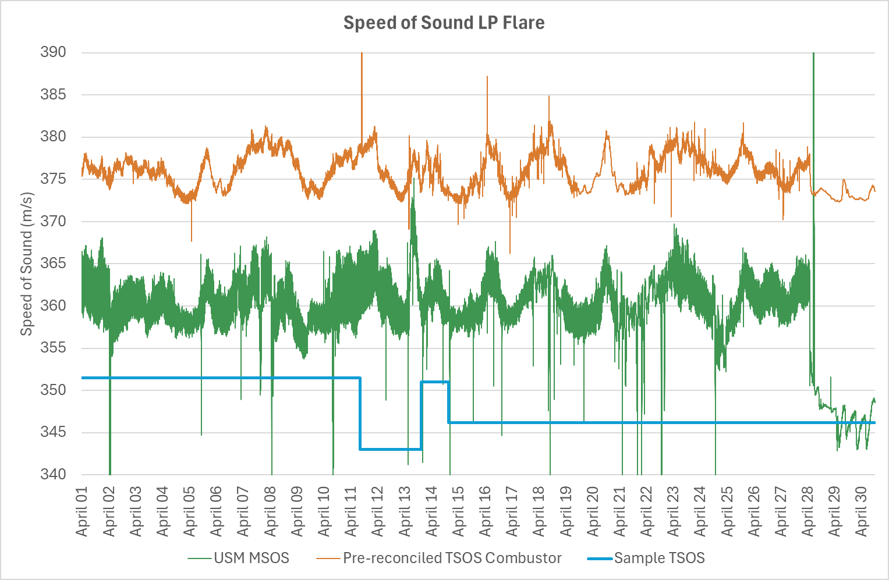

Slide 25
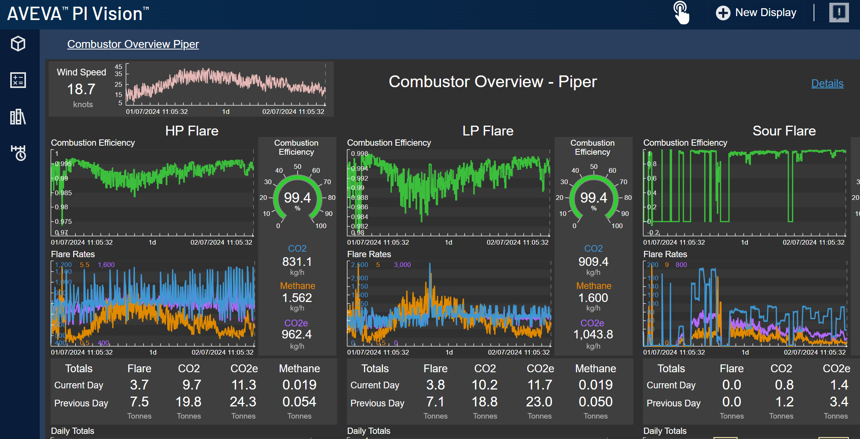
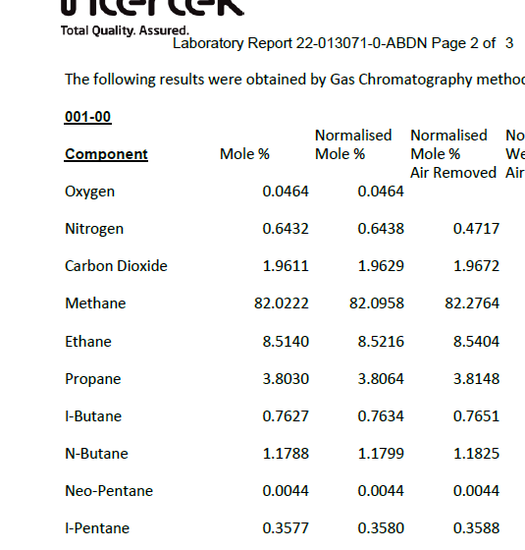
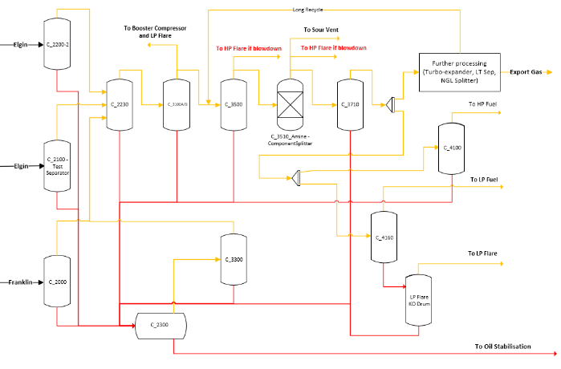


Verification of VoS
MSOS = 360 m/s
TSOS = 370 m/s
TSOS = 350 m/s
360
m/s
PROCESS SIMULATION

Slide 26
Unmeasured streams
Flare
stack
M
S
Sample

Slide 27
Unmeasured streams
Compressor seal gas
chiefly nitrogen
Flare
stack
M
S
Could we infer composition from SOS?
Sample

Slide 28


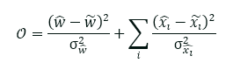
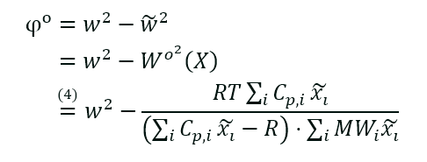
VoS VCR Example Case
Constrained nonlinear optimization used for data reconciliation
SOS
360 m/s
SOS
360 m/s
“Unknown” Seal Gas
Flowrate & Comp
CHARM HC Stream
Flowrate & Comp

Slide 29
Accord and Data Reconciliation
Papers
PUFMW 2008: Experiences in the Use of Uncertainty Based Allocation in a North Sea Offshore Oil Allocation System
NSFMW 2011: Gross Meter Error Detection and Elimination by Data Reconciliation
NSFMW 2013: Allocation in an Uncertain World: Maximising the Use of Data with UBA on Global Producer III
NSFMW 2019: Data Reconciliation in Microcosm – Reducing DP Meter Uncertainty. Oculus European Patent Awarded 2024
Projects with successful application
UBA in ExxonMobil’s Beryl Area offshore oil allocation system
MAERSK: Allocation of oil and gas between the Dumbarton and Lochranza fields produced across Maersk’s Global Producer III (GPIII) FPSO (Floating Production Storage and Offloading)
REPSOL: Introduced UBA to the Flotta pipeline system 2024

Slide 30
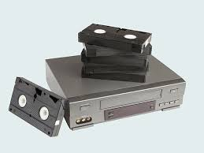

VoS VCR Example Case
Constrained nonlinear optimization used for data reconciliation
SOS
360 m/s
SOS
360 m/s
“Unknown” Seal Gas
Flowrate & Comp
CHARM HC Stream
Flowrate & Comp

Slide 31



Slide 32
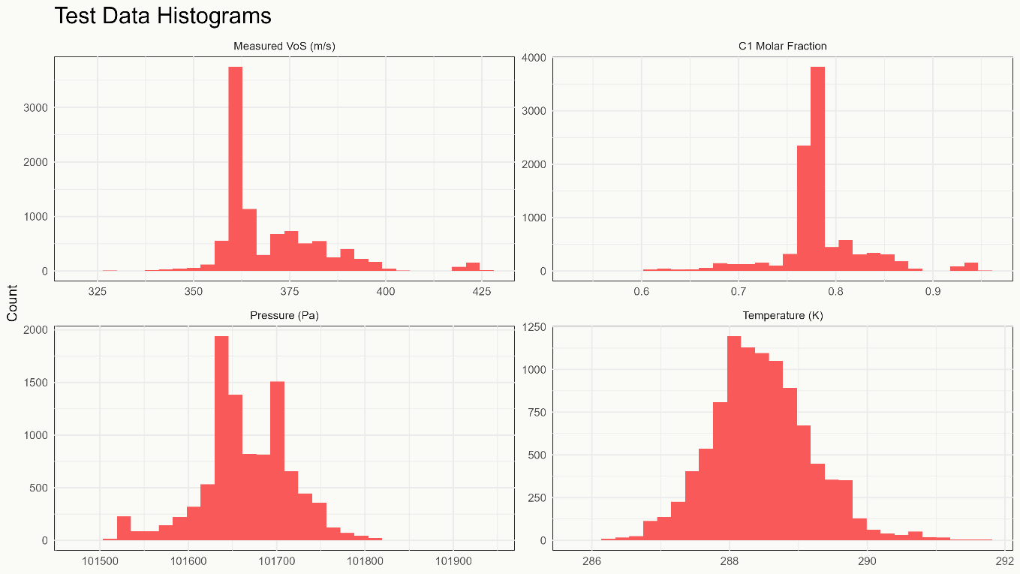
Testing the Reconciliation
About 10k gas compositions
Increasing levels of noise
Do we get closer to the true composition?

Slide 33
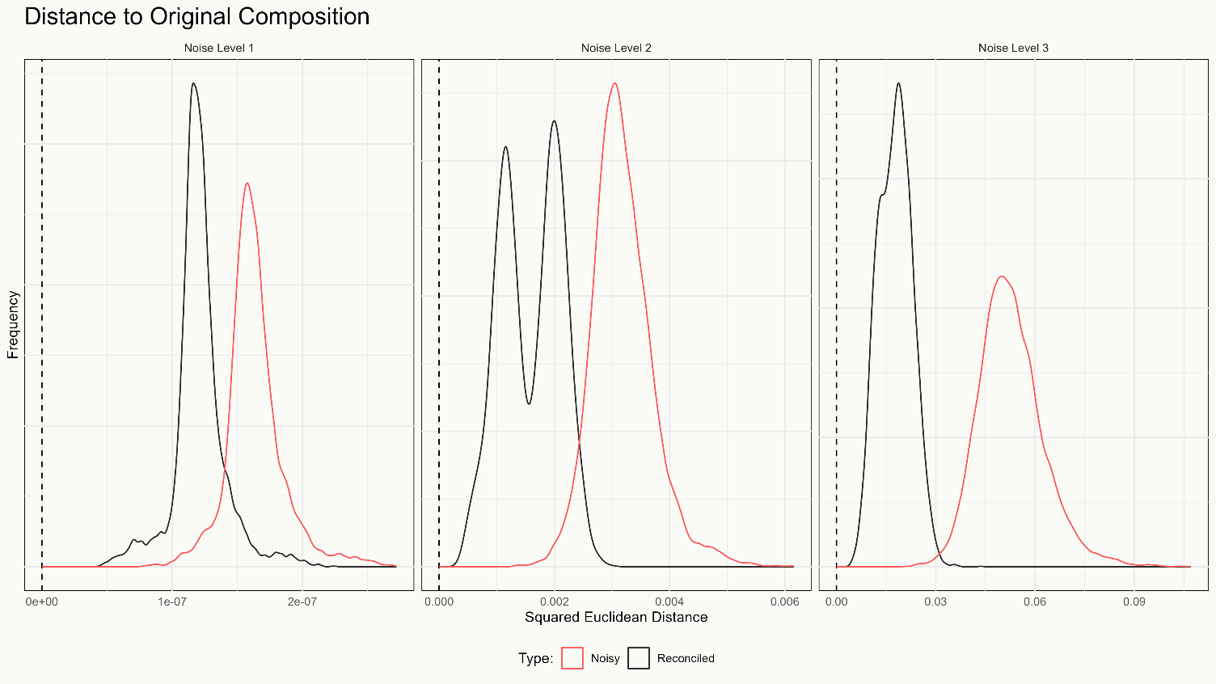
Testing the Reconciliation

Slide 35
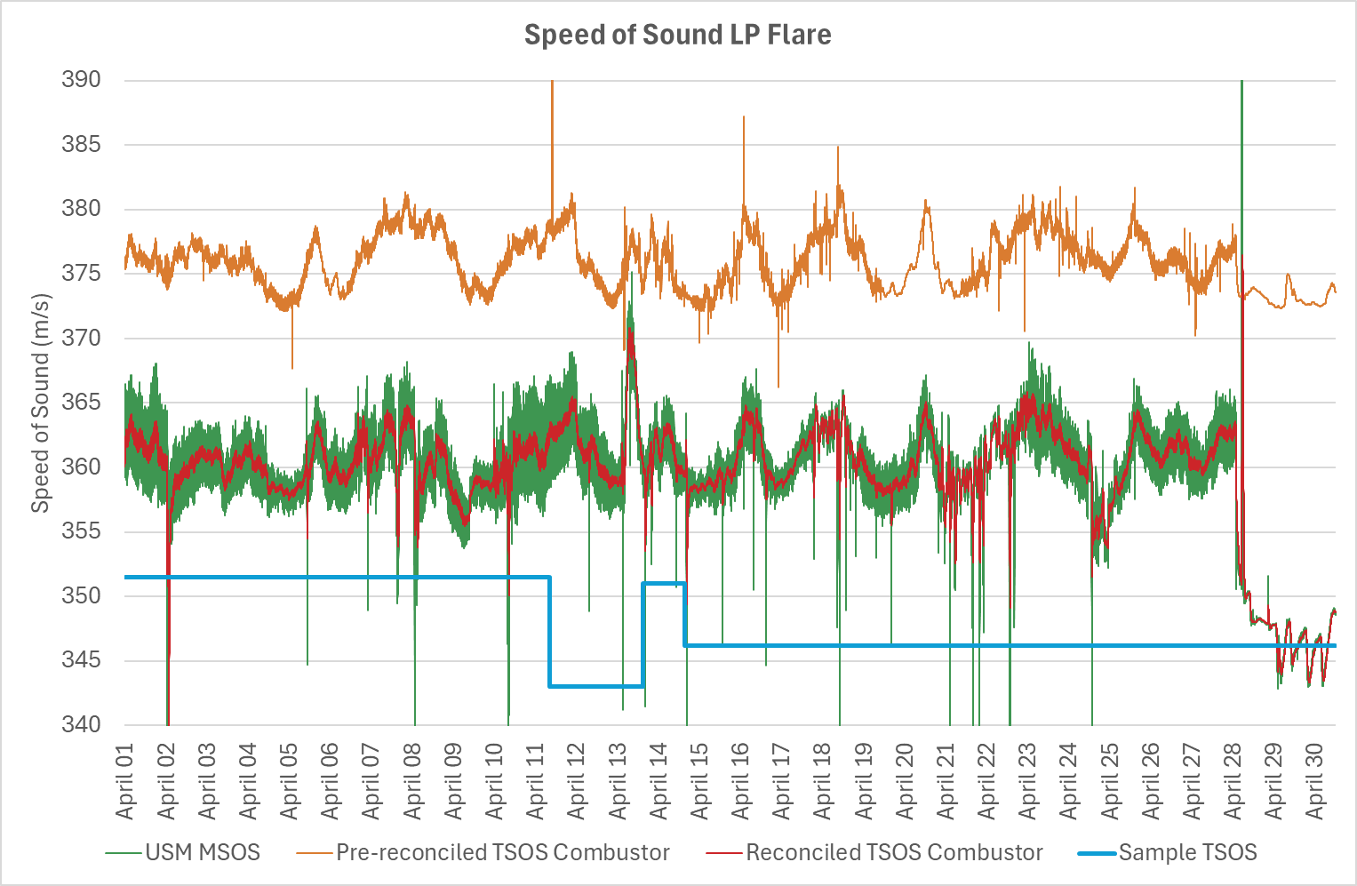

Slide 36
VoS VCR Example Case
Constrained nonlinear optimization used for data reconciliation
SOS
360 m/s
SOS
360 m/s
“Unknown” Seal Gas
Flowrate & Comp
CHARM HC Stream
Flowrate & Comp
Sensitivity of LHV and CE is small, much more dramatic on composition
LHV₃₆₁ = 40.23 MJ/kg
CE₃₆₁ = 99.61%
LHV₃₇₅ = 42.40 MJ/kg
CE₃₇₅ = 99.67%

Slide 37
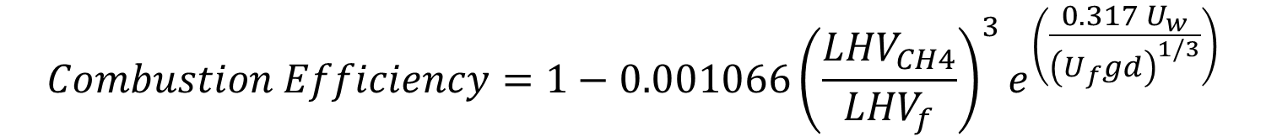
$$Combustion Efficiency=1−0.001066{\left(\frac{{LHV}_{CH4}}{{LHV}_{f}}\right)}^{3}e^{\left(\frac{0.317 U_{w}}{{\left(U_{f}gd\right)}^{1/3}}\right)}$$
But what about the CO2e emissions?

Slide 38
CO2e Total Emissions

Slide 39
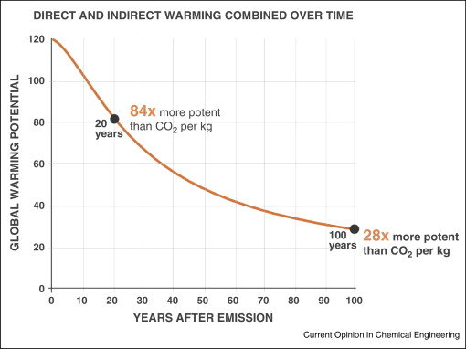




CO2e Total Emissions
$${GWP}_{CH4}$$
Q_{CH4}
Q_{CO2}
Q_{f}
$$M_{f}$$
$$M_{f}$$

Slide 40
CO2e Total Emissions
M_{CH4}
M_{CO2e}
M_{CO2}
M_{f}

Slide 41
CO2e Total Emissions
M_{CH4}
M_{CO2e}
M_{CO2}
M_{f}

Slide 42
CO2e Total Emissions
M_{CH4}
M_{CO2e}
M_{CO2}
M_{f}

Slide 43
Conclusions

Slide 44
Conclusions
USM SOS

Slide 45
Conclusions
USM SOS
Verification

Slide 46
Conclusions
USM SOS
Verification
Flare Comp’n

Slide 47
Conclusions
USM SOS
Reconciliation
Verification
Flare Comp’n

Slide 48
Conclusions
USM SOS
Reconciliation
Verification
Improved Comp
Flare Comp’n

Slide 49
Conclusions
USM SOS
Reconciliation
Verification
Improved Comp
Flare Comp’n
Burning $?

Slide 51

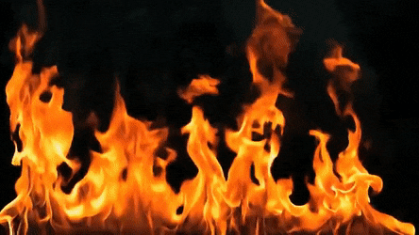

Slide 52
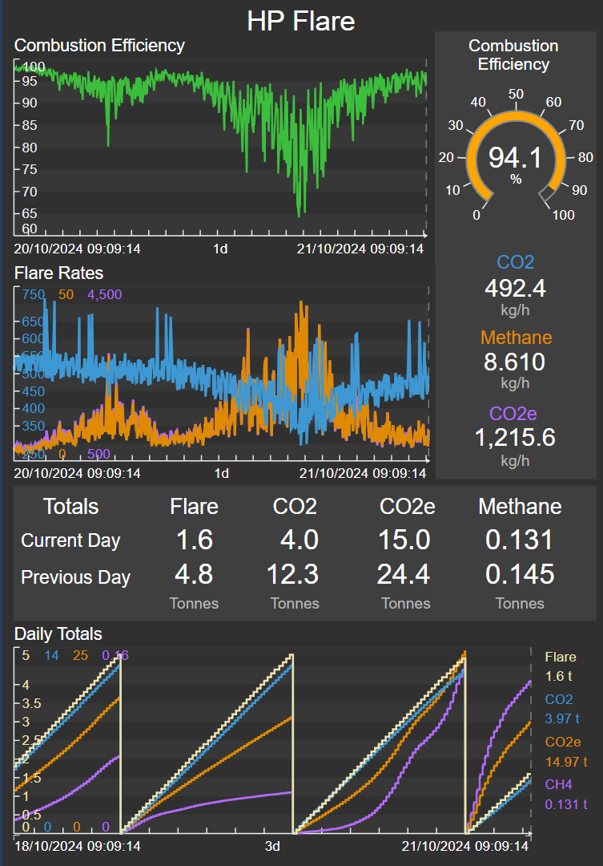
Accord Energy Solutions Limited
58 Carden Place, Aberdeen, AB10 1UP
www.accord-esl.com
Phil.Stockton@accord-esl.com
Bob.Peebles@accord-esl.com
Allan.Wilson@accord-esl.com
Juan.Martin@accord-esl.com

