Slide 1


Further Adventures in Integrated Risk Exposure for Cost Benefit Analysis – from Economics to Quarks
Phil Stockton

Slide 2
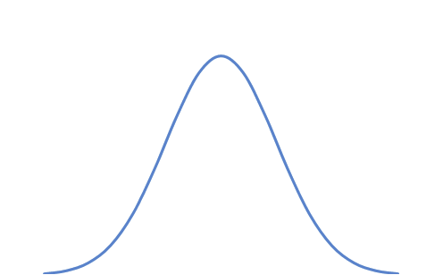
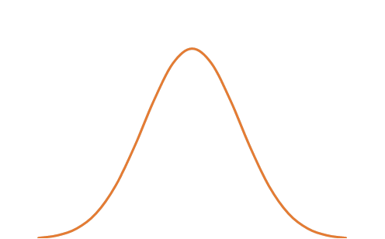
Cost Benefit Example
$1370m
5 years
?
1,000 t/d
$750/t
±0.25%
±1%
$1,000,000
$250,000

Slide 3
Cost Benefit Example
$1370m
5 years
?
1,000 t/d
$750/t
$3.4m ??
$13.7m ??
±0.25%
±1%
$1,000,000
$250,000

Slide 4
Cost Benefit Example
$1,370m
5 years
?
1,000 t/d
$750/t
$0.70m 
$2.8m 
±0.25%
±1%
$1,000,000
$250,000

Slide 5

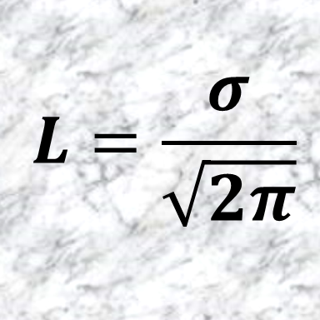
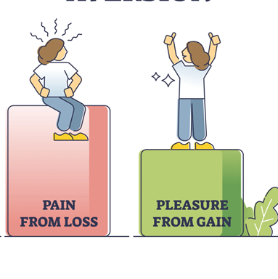

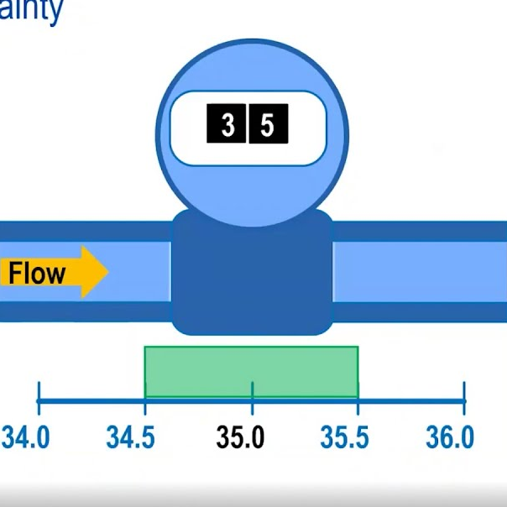
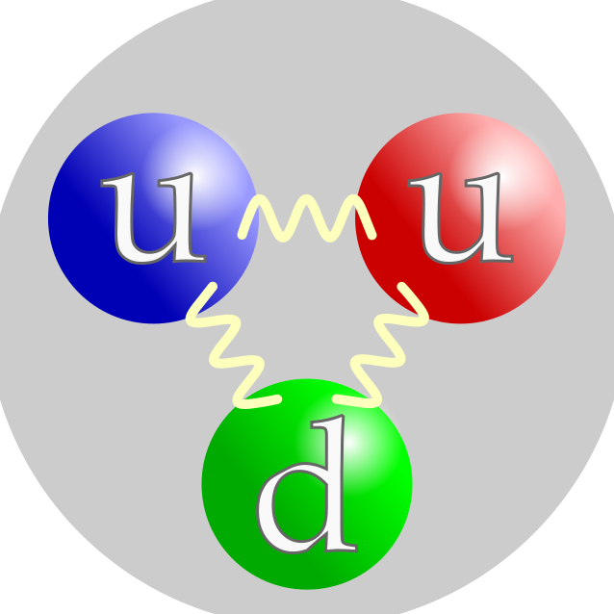

Slide 7


Offered a Gamble
H
Win $5
T
Lose $4
$100

Slide 8
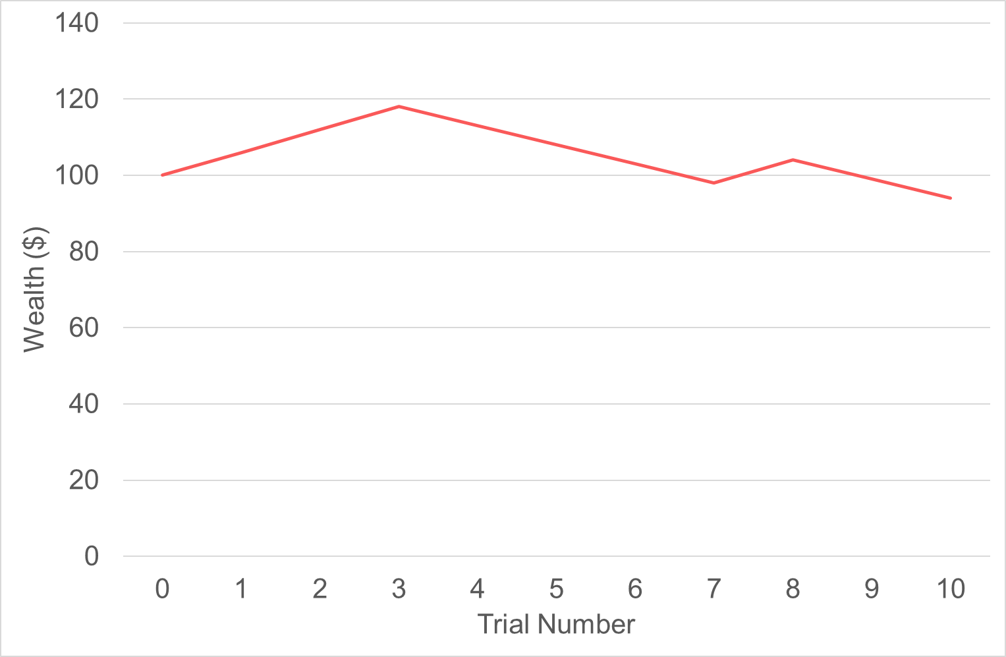
Offered a Gamble

Slide 9
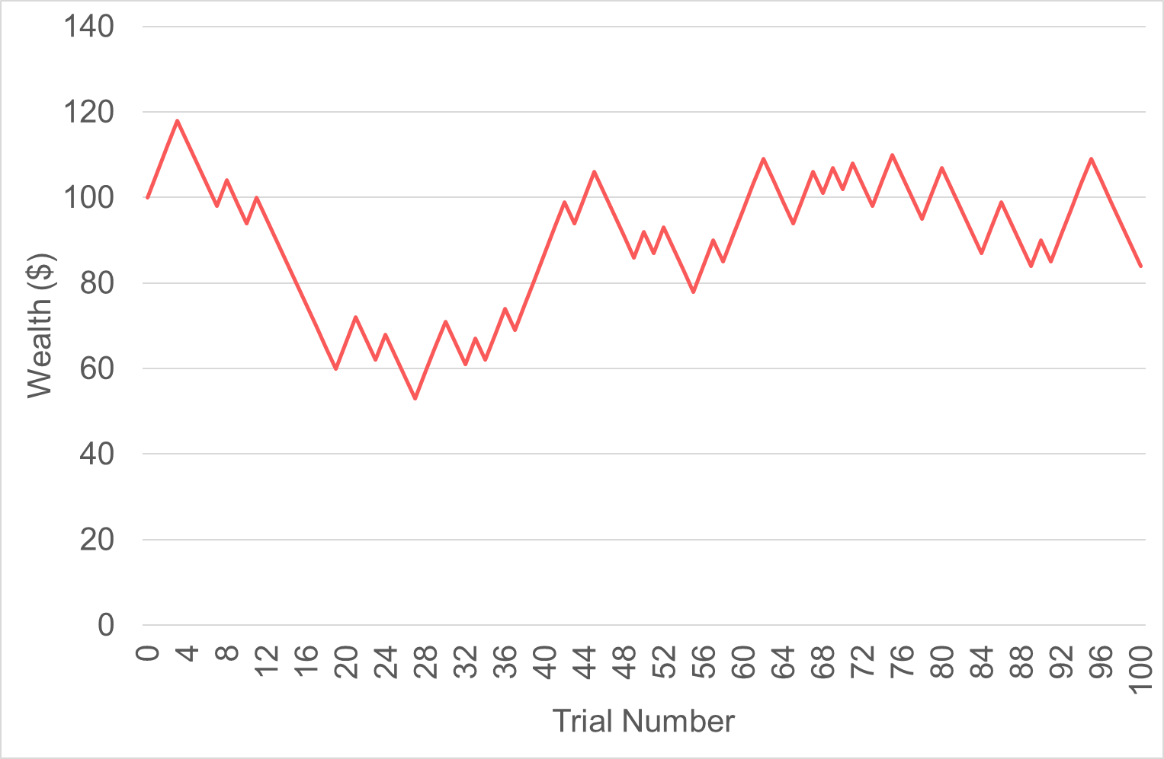
Offered a Gamble

Slide 10
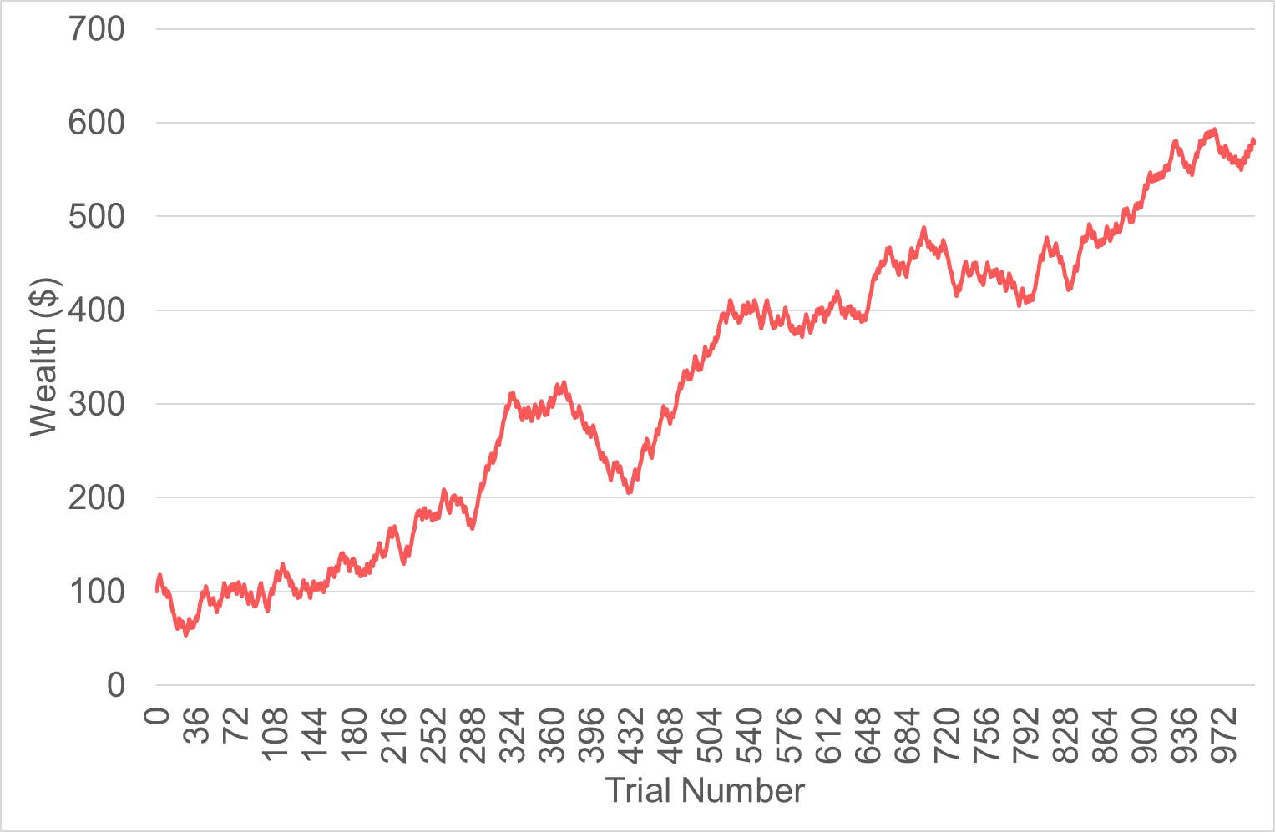

Offered a Gamble
One Million Trials

Slide 11
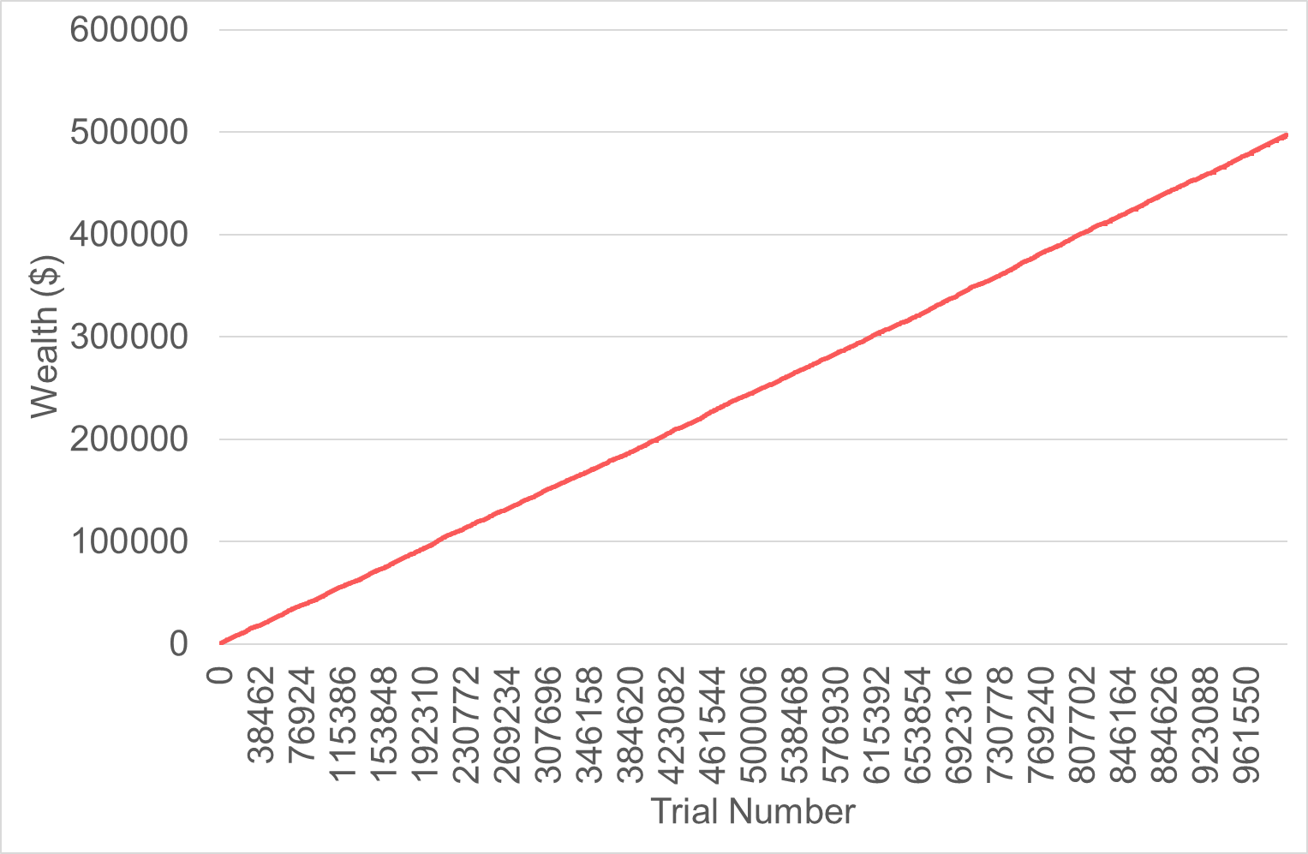
Offered a Gamble
One Million Trials

Slide 12
Offered a New Gamble
H
Win 50%
$100
T
Lose 40%

Slide 13
Offered a New Gamble
H
Win 50%
$100
T
Lose 40%

Slide 14
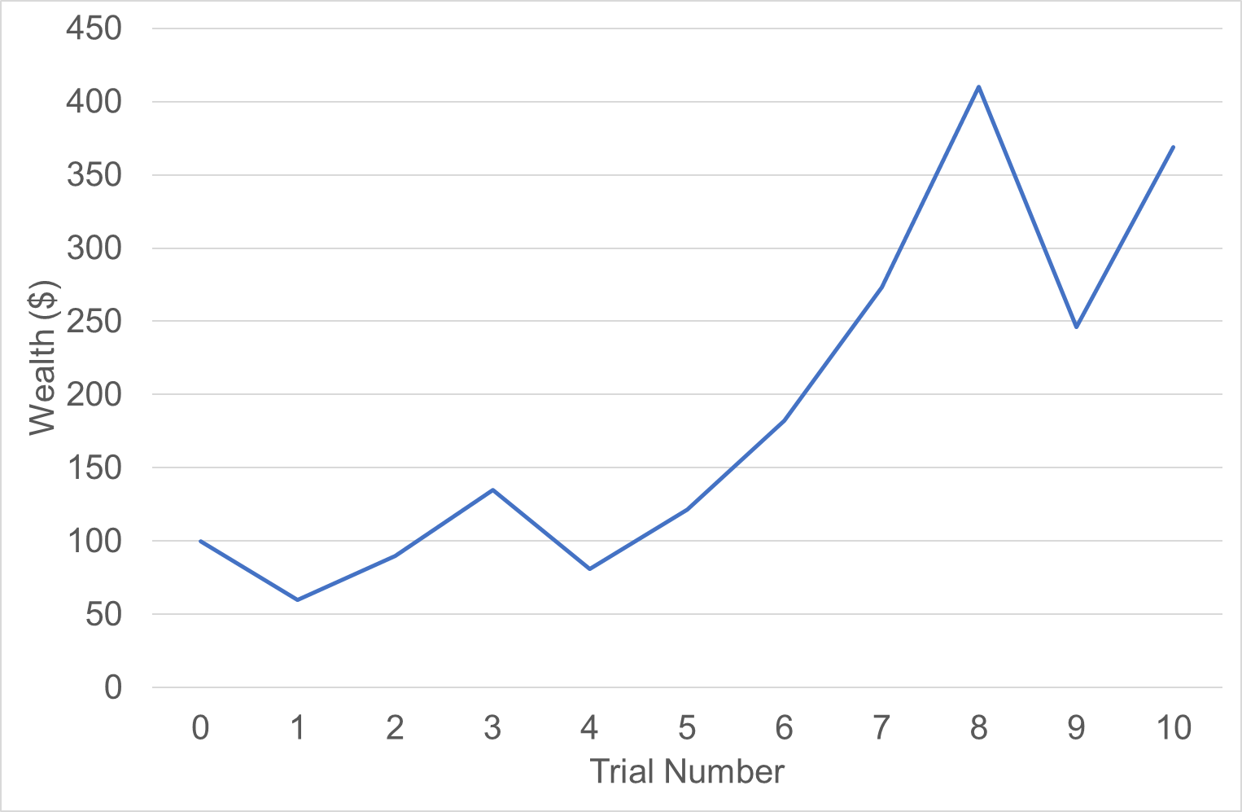
Offered a Gamble

Slide 15
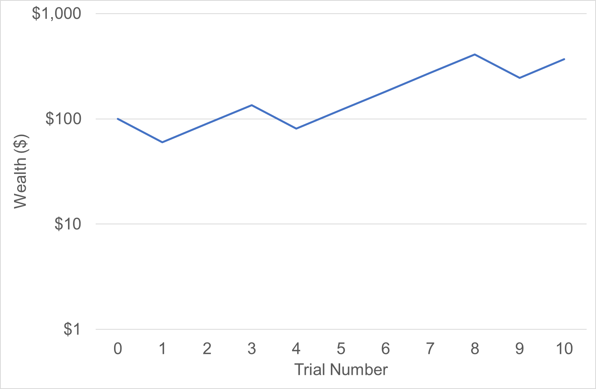
Offered a Gamble

Slide 16
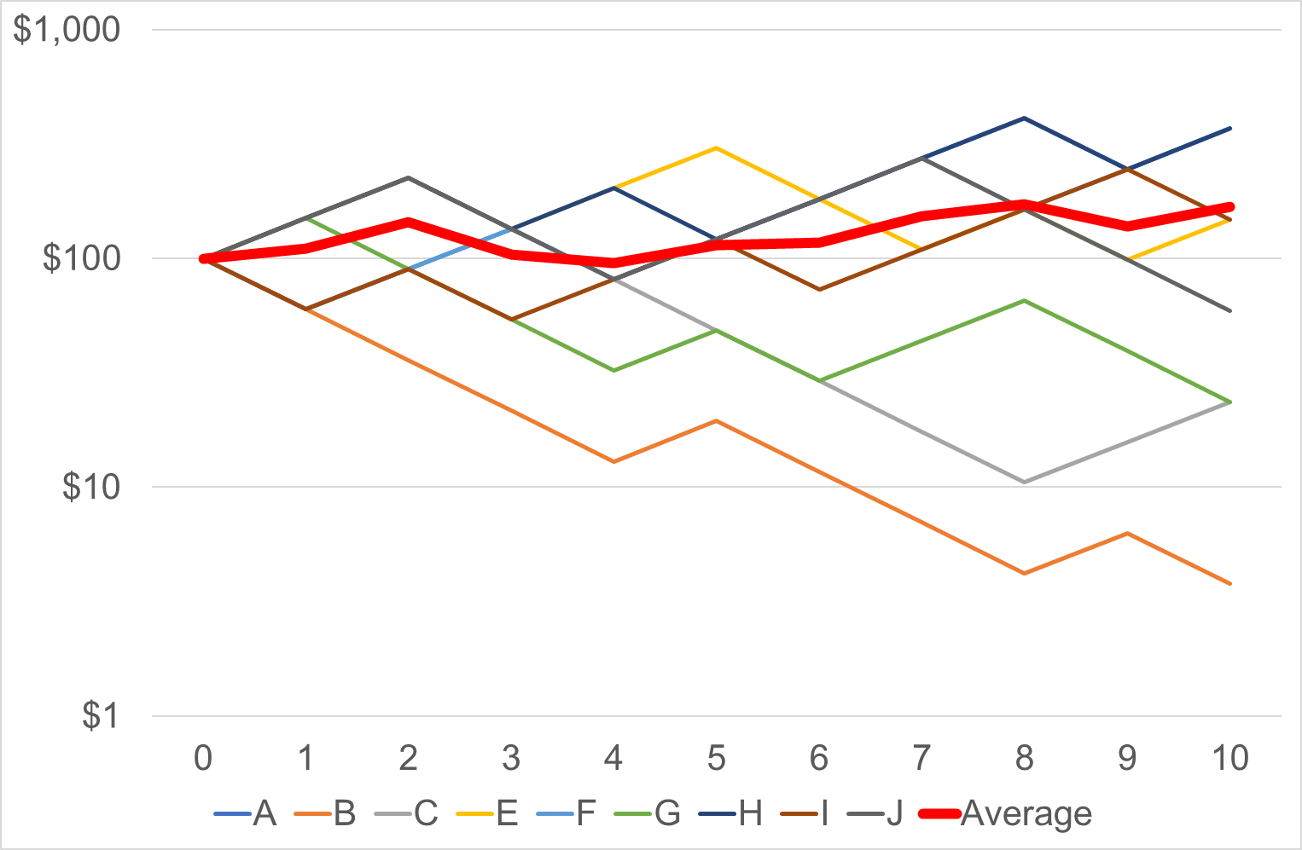
Offered a Gamble

Slide 19
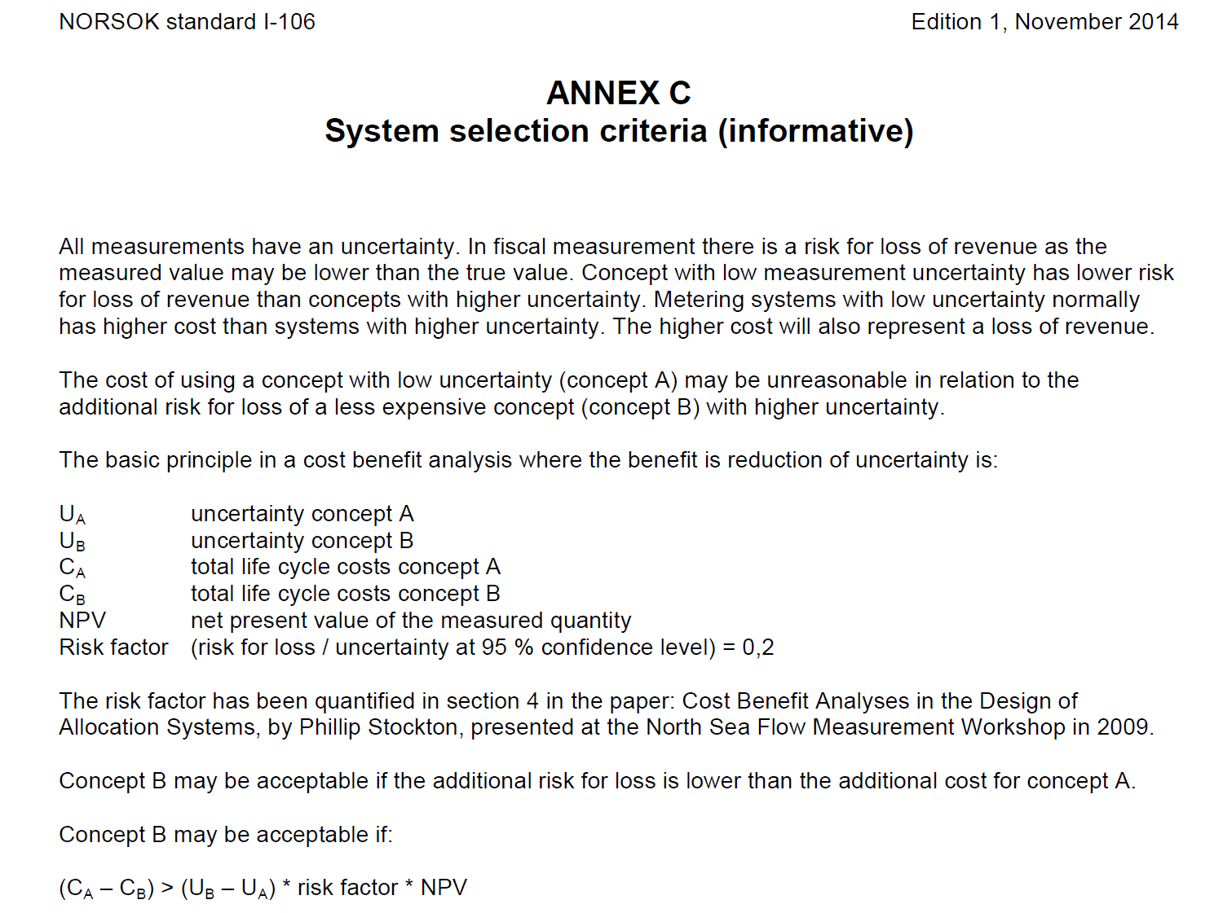
NORSOK I-106

Slide 20

NORSOK I-106

Slide 21
NORSOK I-106

Slide 22
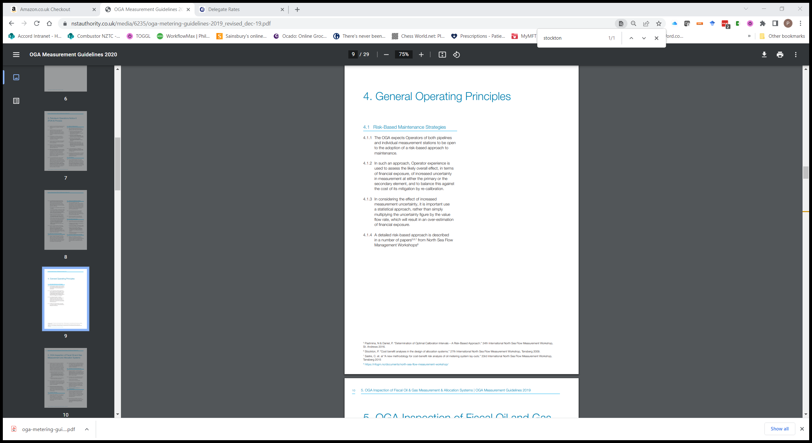
UK OGA (Now NSTA) Guidelines

Slide 23
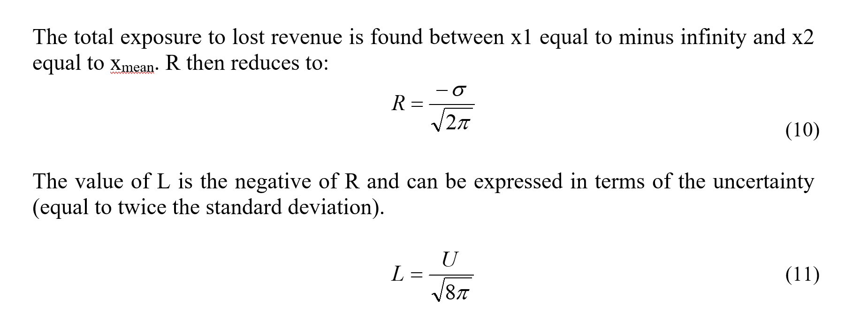

NSFMW 2009 Paper
$$\frac{1}{\sqrt{8π}}≅0.2$$
Only applies when U is expressed at the 95% confidence level !

Slide 24
Cost Benefit Example
$1,370m
5 years
?
1,000 t/d
$750/t
$0.70m 
Δ=$2.1m
$2.8m 
±0.25%
±1%
$1,000,000
Δ=$0.75m
$250,000

Slide 25

$$L=0.2U$$
Gaussian
Utility
1
2
Uncertainty
Loss Averse

Slide 26
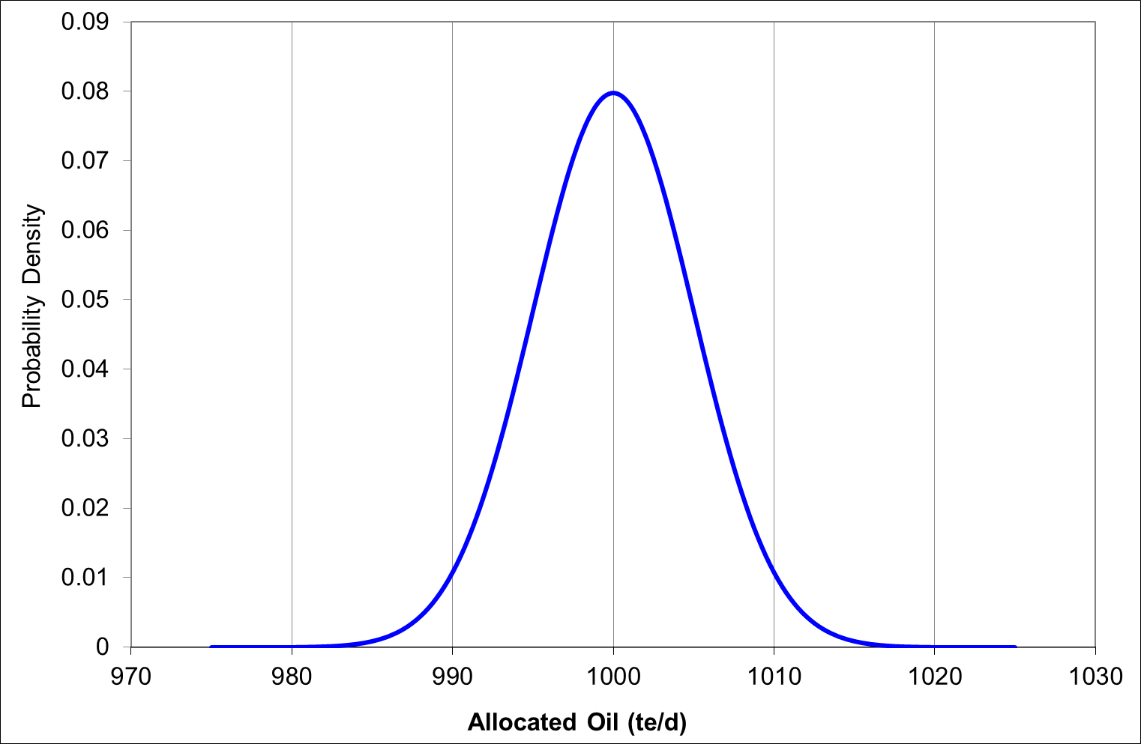
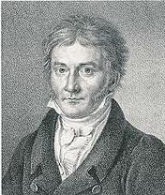
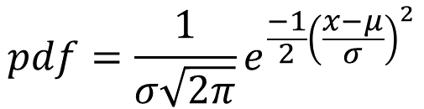
$${pdf=\frac{1}{σ\sqrt{2π}}e}^{\frac{−1}{2}{\left(\frac{x−μ}{σ}\right)}^{2}}$$

Slide 27
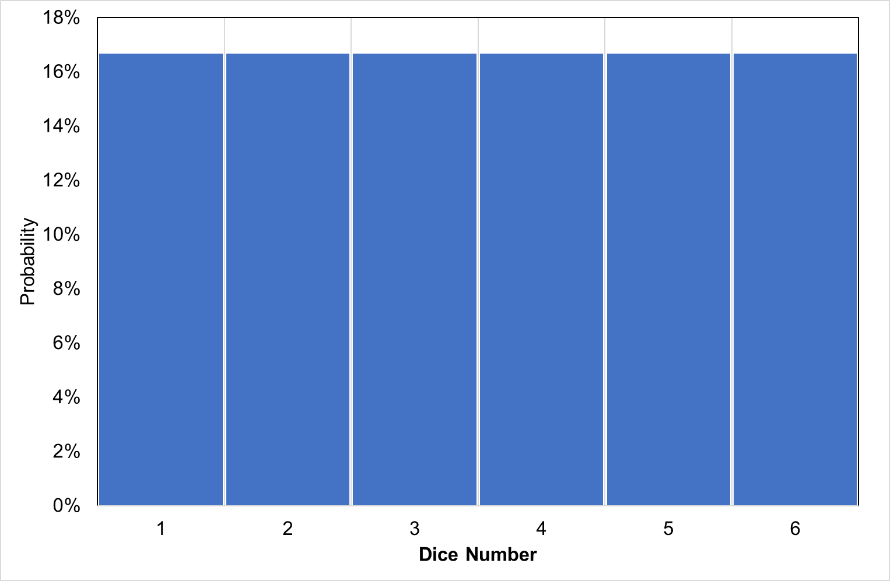


Slide 28
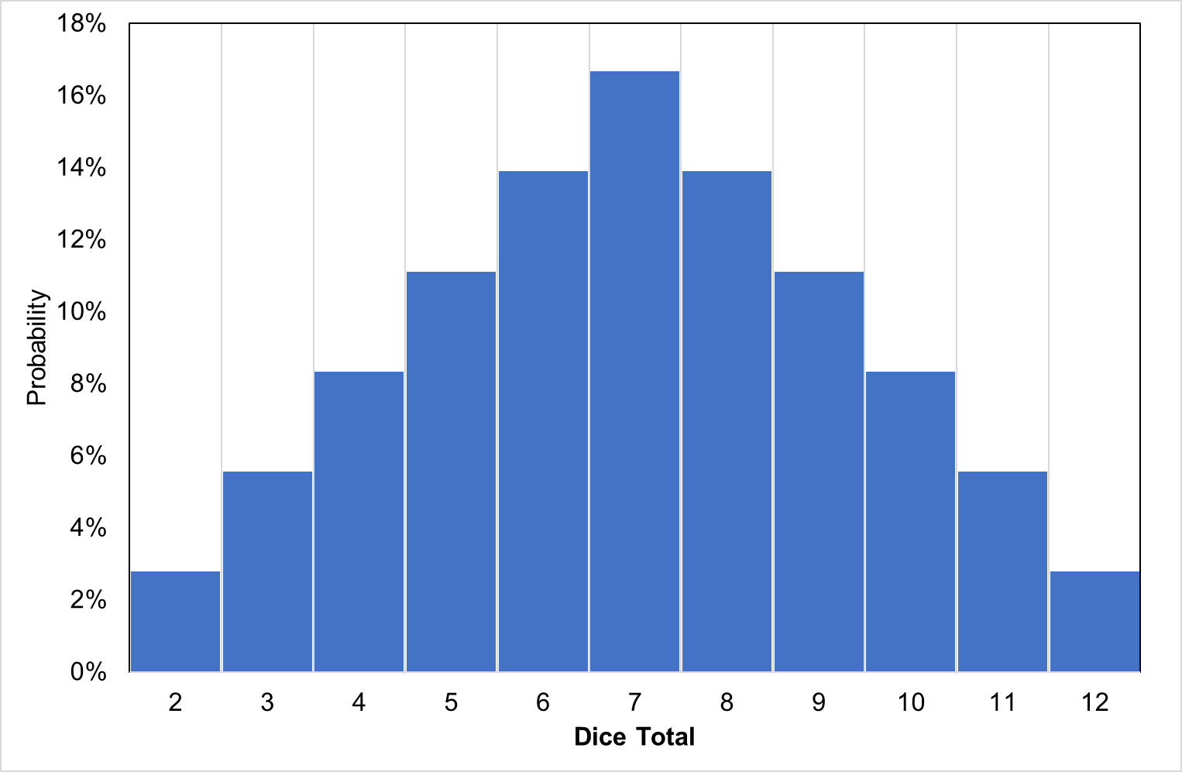


Slide 29
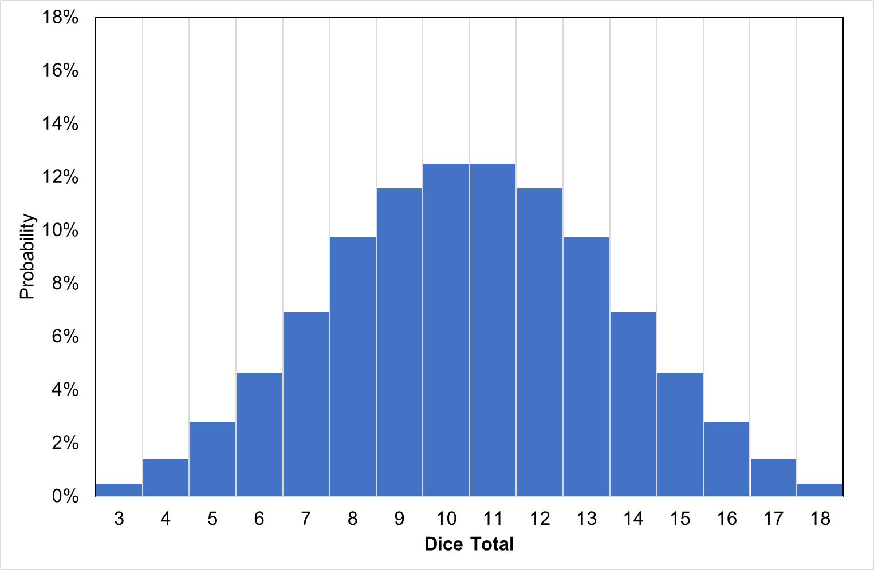
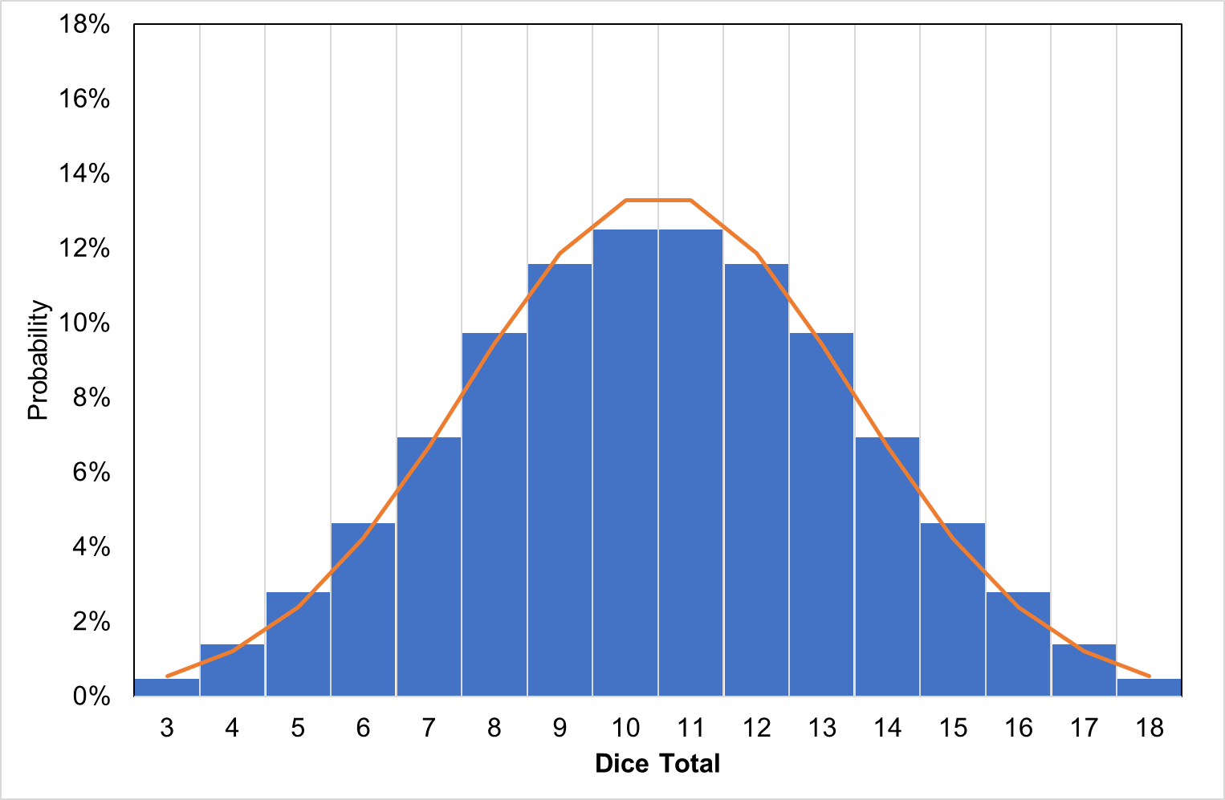


Slide 30
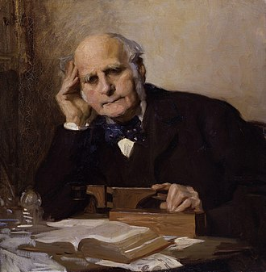
Central Limit Theorem
“I know of scarcely anything so apt to impress the imagination as the wonderful form of cosmic order expressed by the [Central Limit Theorem]. The law would have been personified by the Greeks and deified, if they had known of it.”
Sir Francis Galton

Slide 31
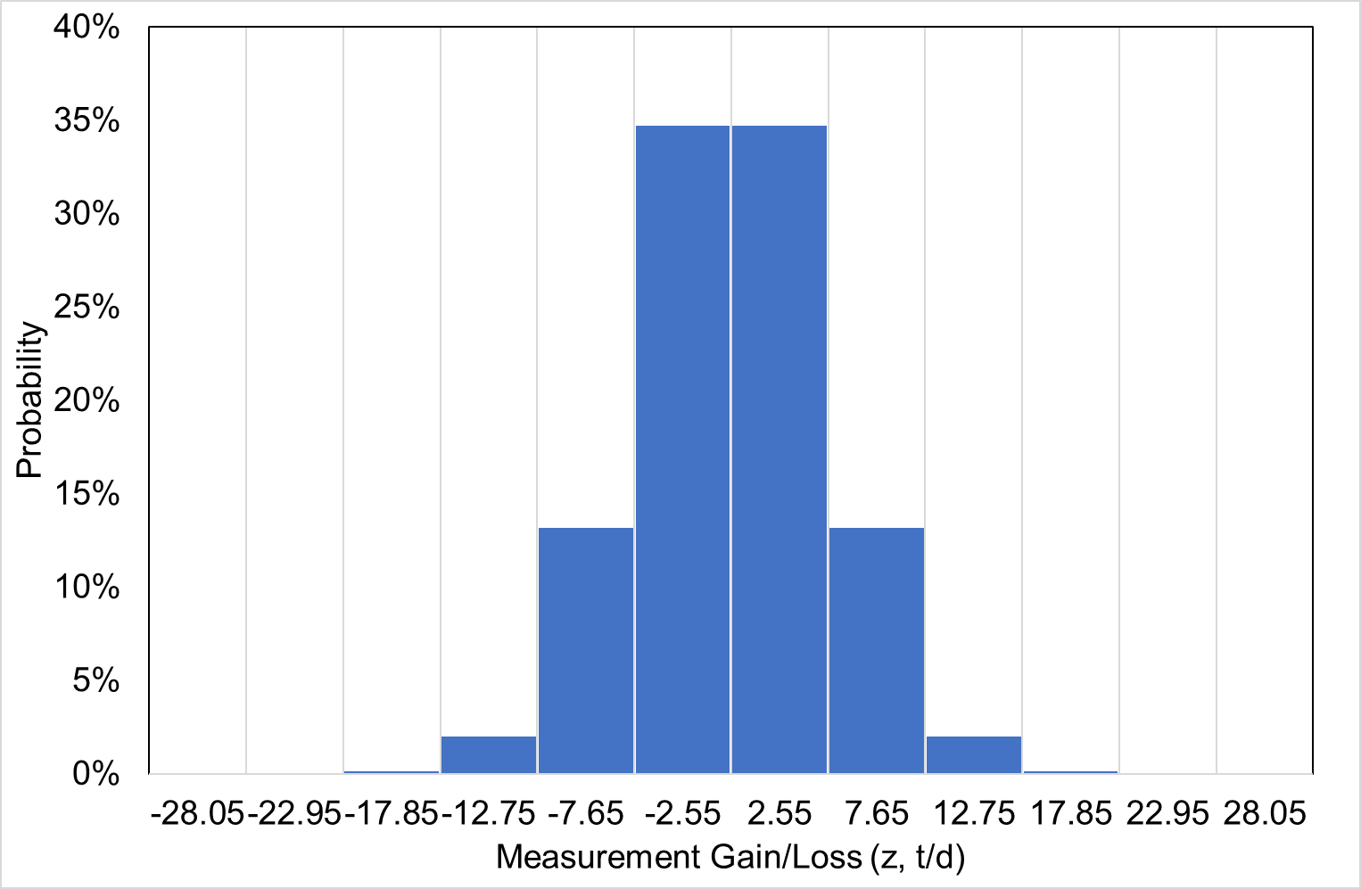
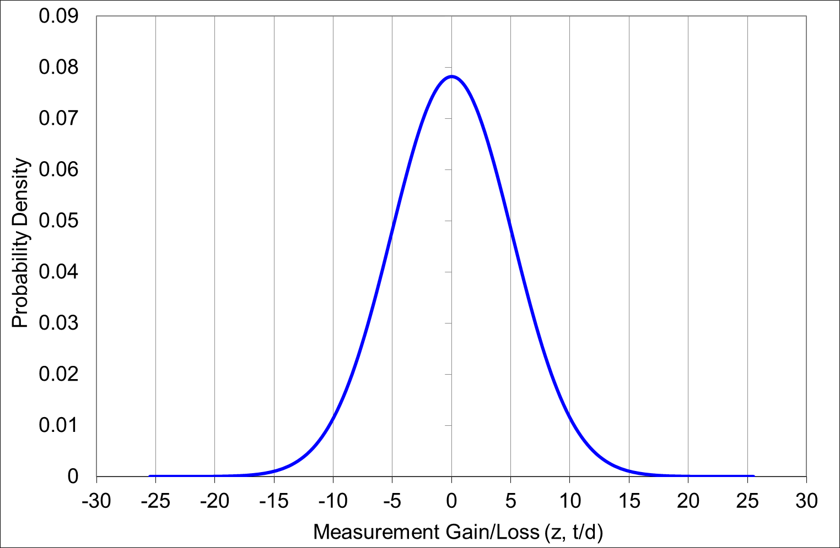
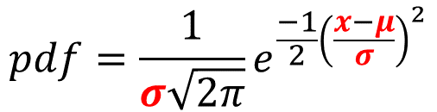
$${pdf=\frac{1}{σ\sqrt{2π}}e}^{\frac{−1}{2}{\left(\frac{x−μ}{σ}\right)}^{2}}$$

Slide 32
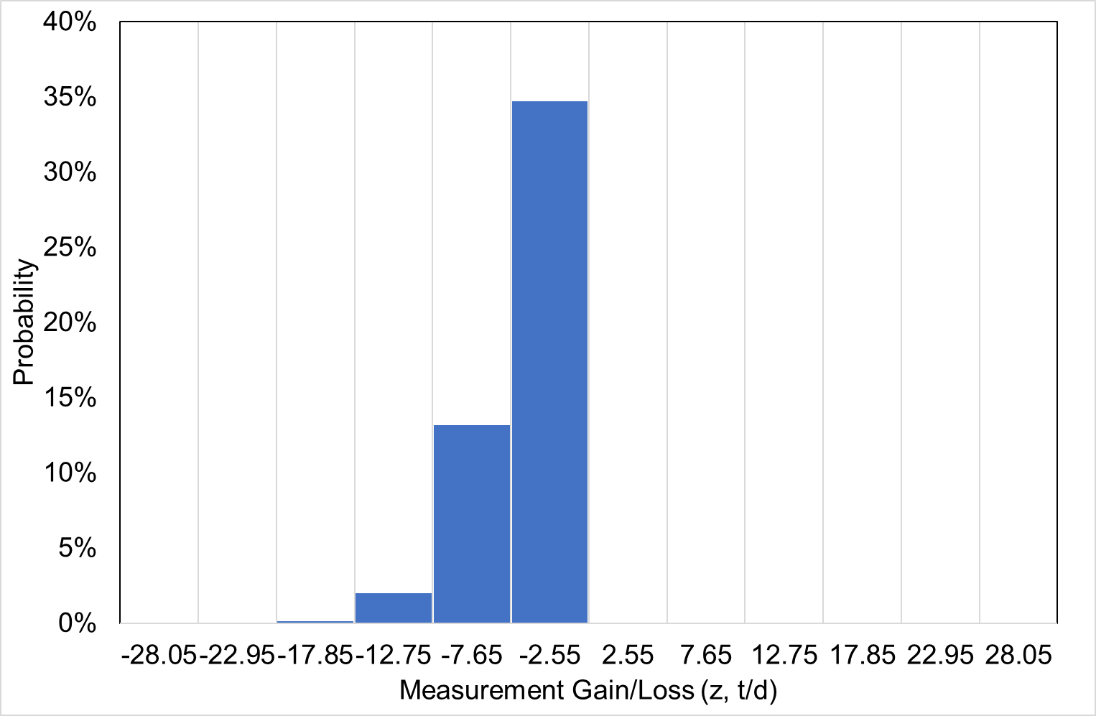

Slide 33
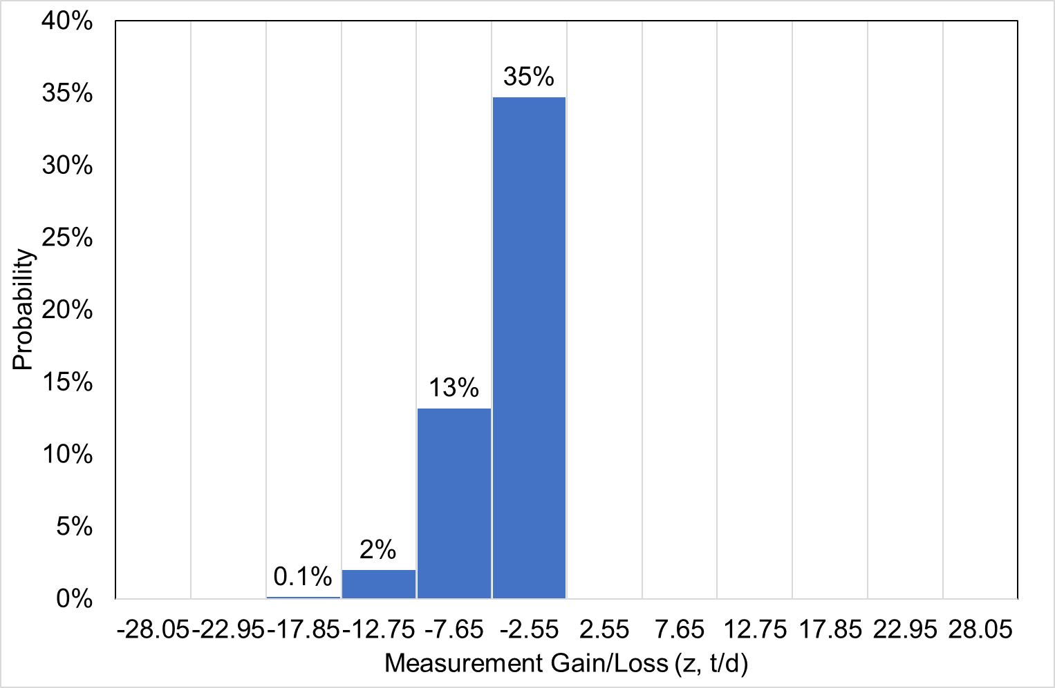
Risked Loss = 0.35*2.55 = 0.89 te/d

Slide 34
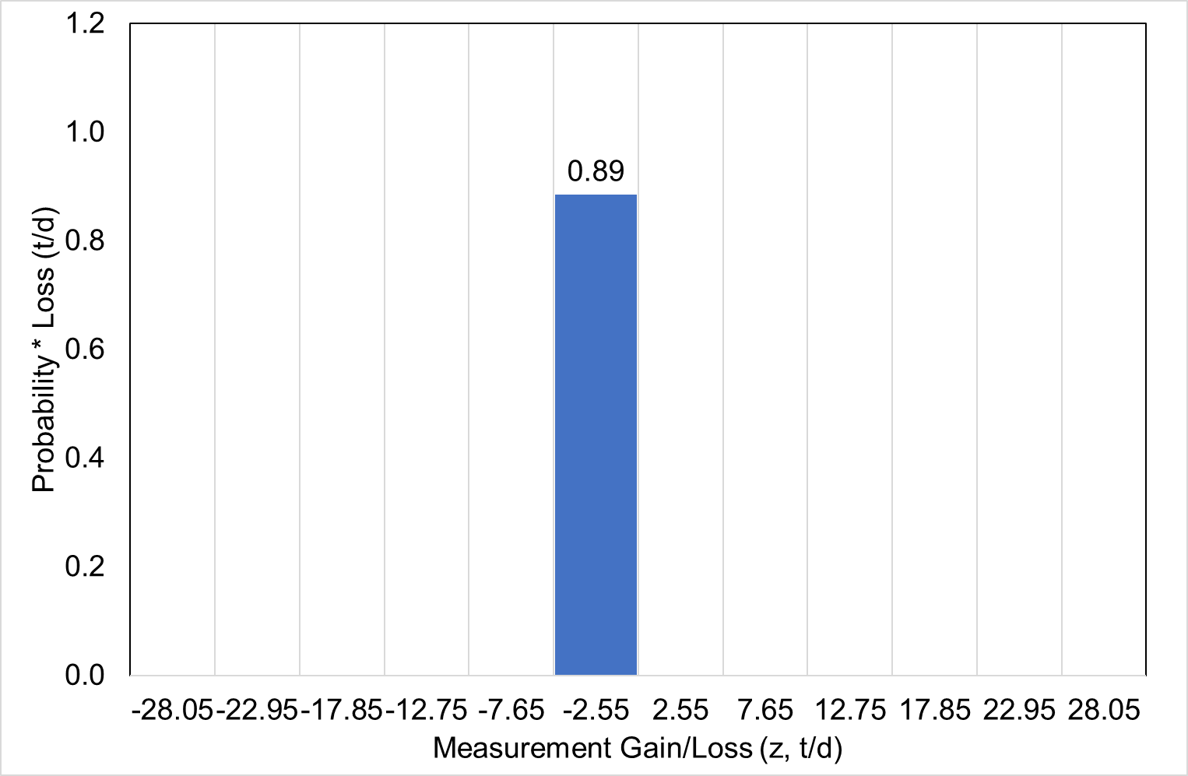
Risked Loss = 0.35*2.55 = 0.89 te/d

Slide 35
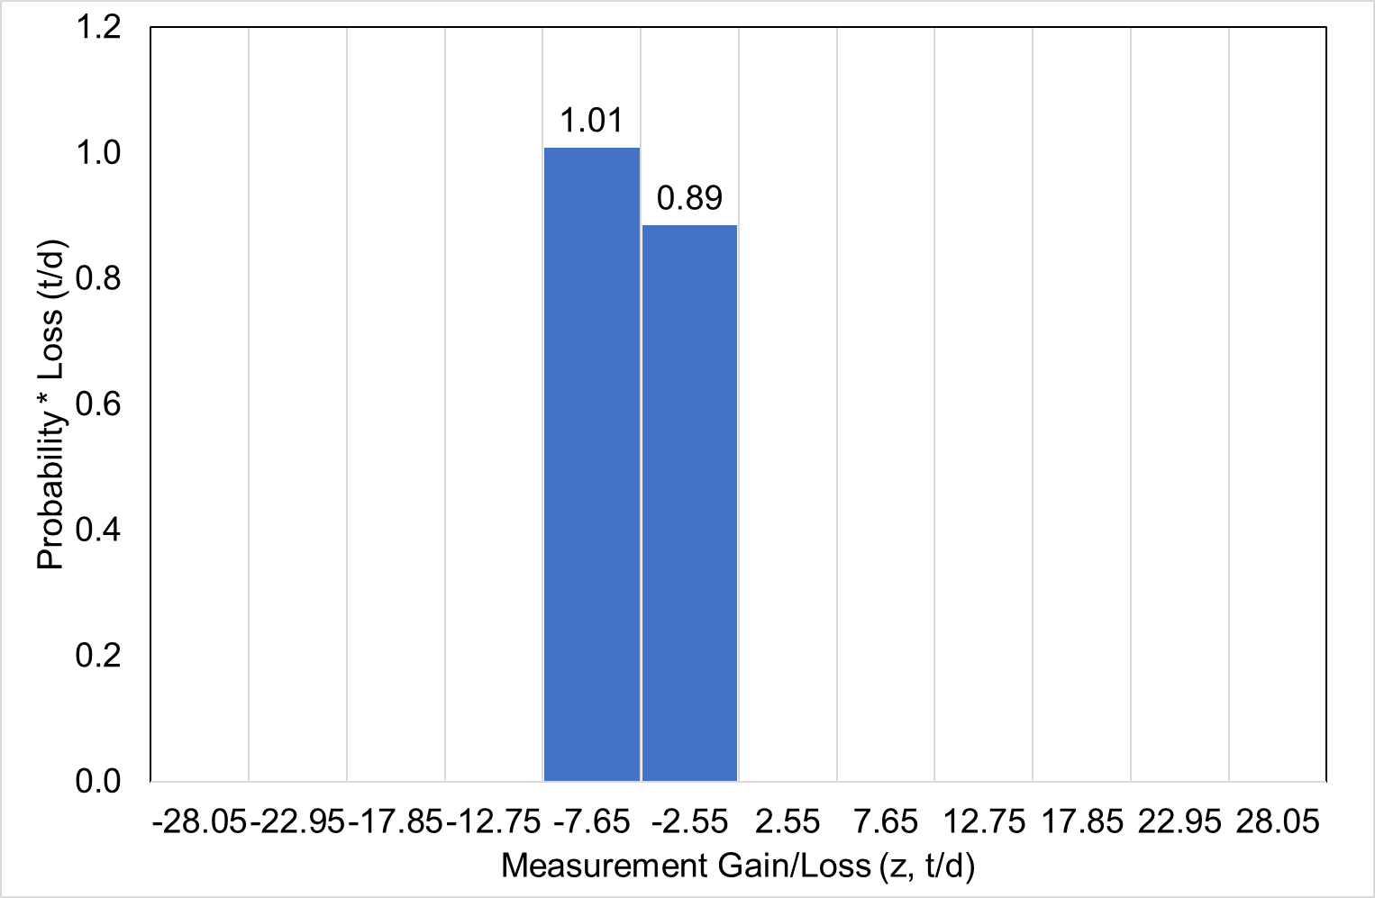
Risked Loss = 0.13*7.65 = 1.01 te/d
Risked Loss = 0.35*2.55 = 0.89 te/d

Slide 36
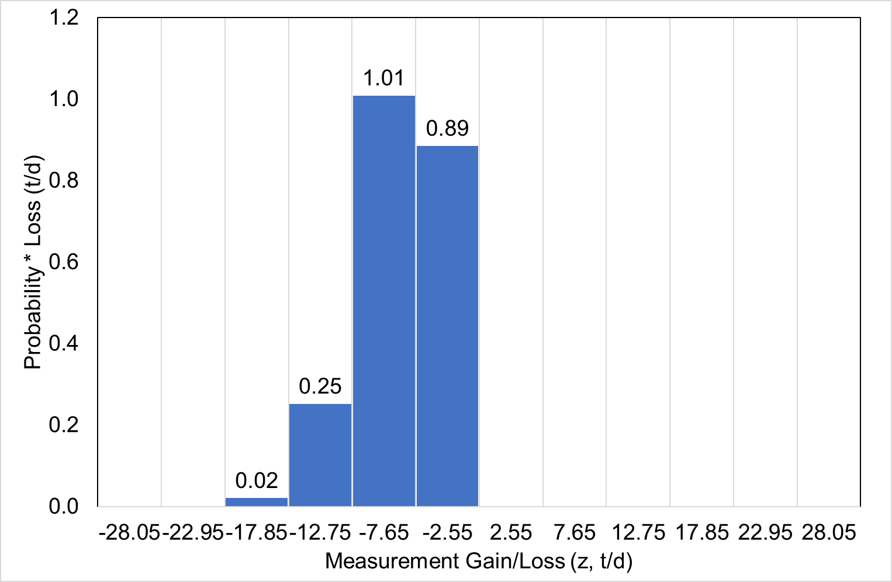
Risked Loss = 0.13*7.65 = 1.01 te/d
Risked Loss = 0.35*2.55 = 0.89 te/d
Total Risked Loss = 0.89 + 1.01 + 0.25 + 0.02 = 2.17 te/d

Slide 37
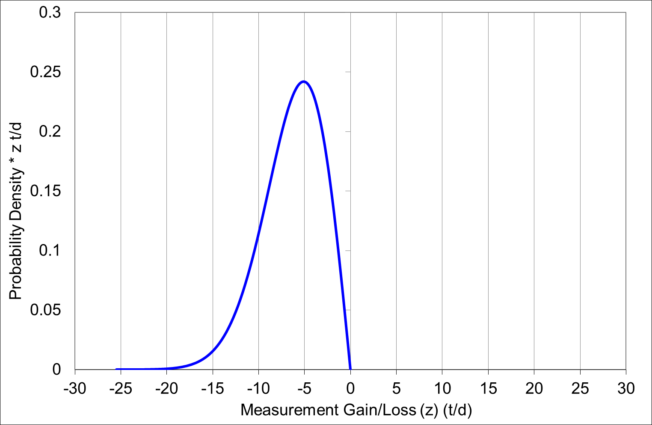
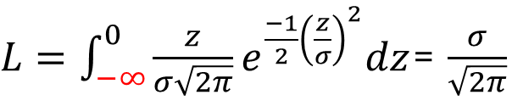
$L=\int_{−∞}^{0}{{\frac{z}{σ\sqrt{2π}}e}^{\frac{−1}{2}{\left(\frac{z}{σ}\right)}^{2}}dz}$= $\frac{σ}{\sqrt{2π}}$
Total Risked Loss = 0.89 + 1.01 + 0.25 + 0.02 = 2.17 te/d
Total Risked Loss = 10*0.2= 2.0 te/d
Total Risked Loss = 0.89 + 1.01 + 0.25 + 0.02 = 2.17 te/d

Slide 38


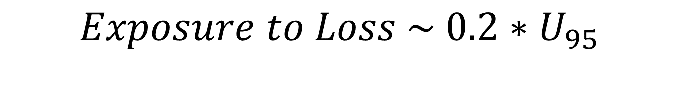
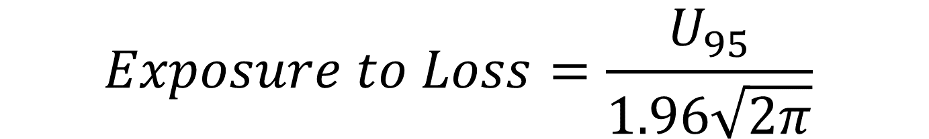
$$Exposure to Loss=\frac{σ}{\sqrt{2π}}$$
$$Exposure to Loss \sim 0.2∗U_{95}$$
$$Exposure to Loss=\frac{U_{95}}{1.96\sqrt{2π}}$$
$$Exposure to Loss=\frac{U_{k}}{k\sqrt{2π}}$$

Slide 41
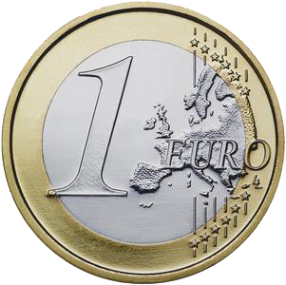

Expected Value
50% chance
100% chance
50% chance
Expected value = 0.5*0 +0.5*2 = 1 €

Slide 42

Utility
50% chance
1000000 €
100% chance
50% chance
Expected value = 0.5*0 +0.5*2000000 = 1000000 €

Slide 43
Utility
50% chance
900000 €
100% chance
50% chance
Expected value = 0.5*0 +0.5*2000000 = 1000000 €

Slide 44
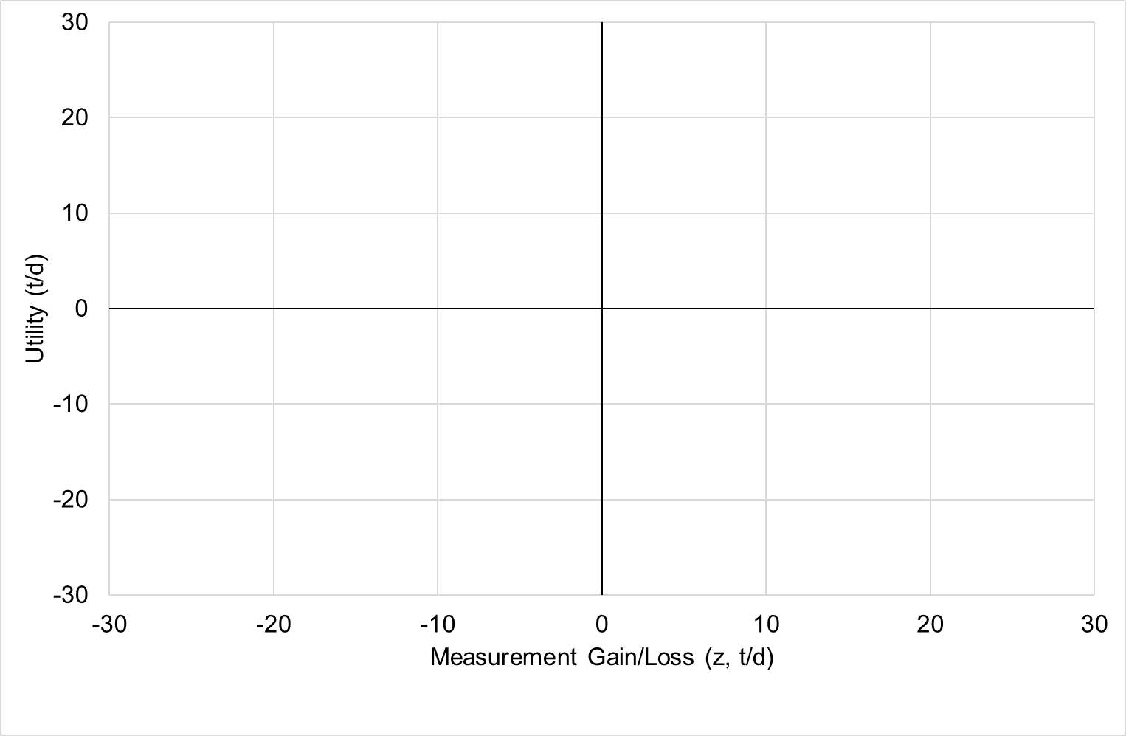
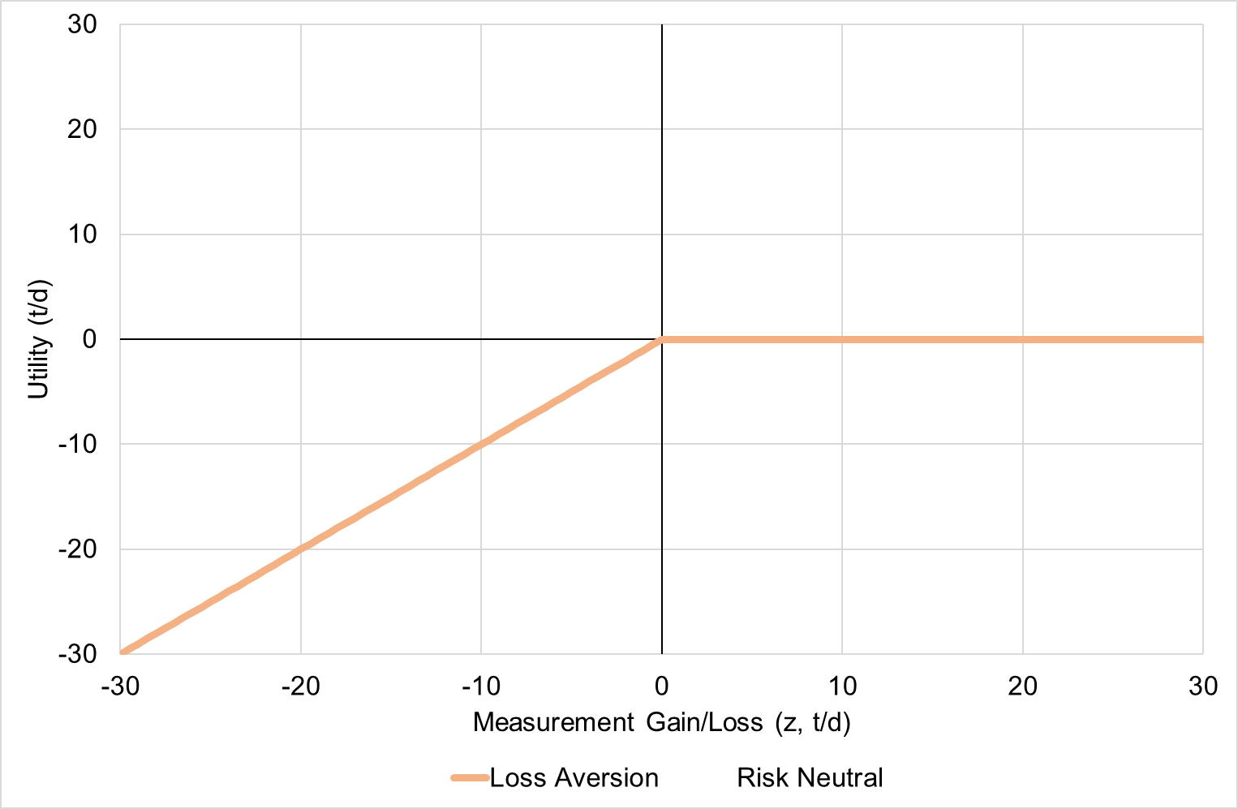
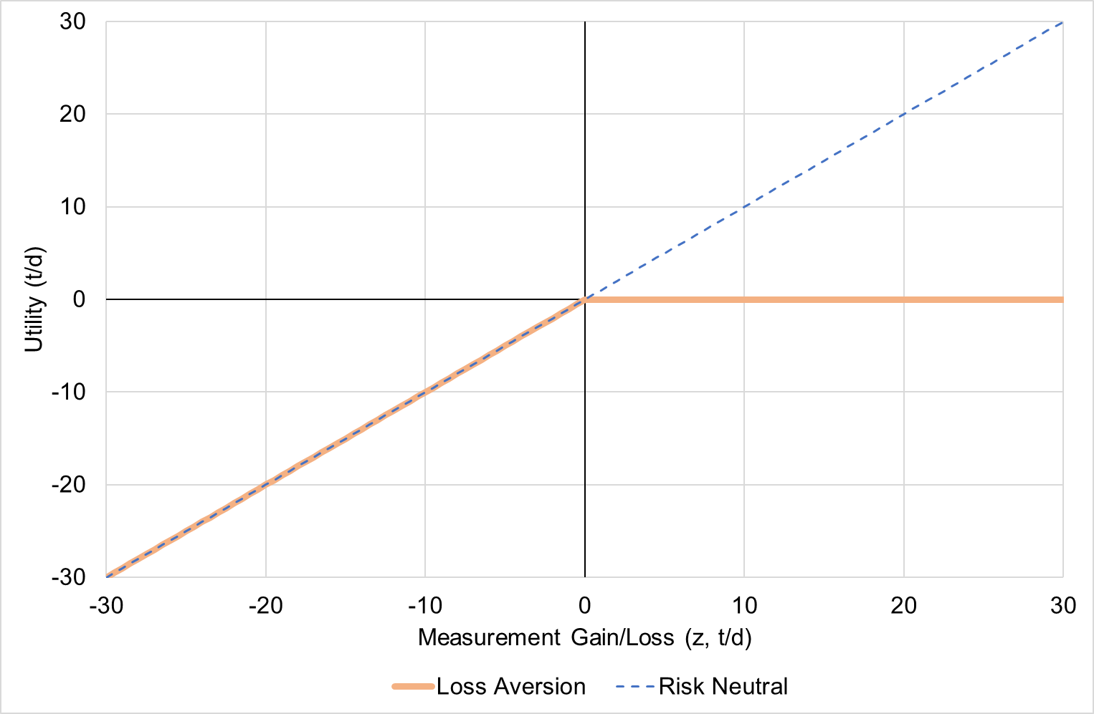

Slide 45
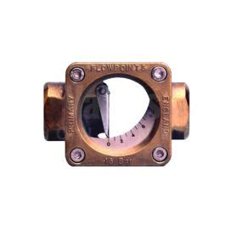
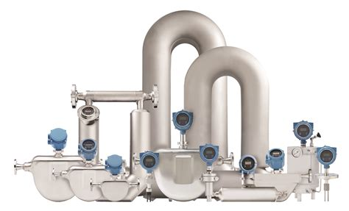

Slide 46
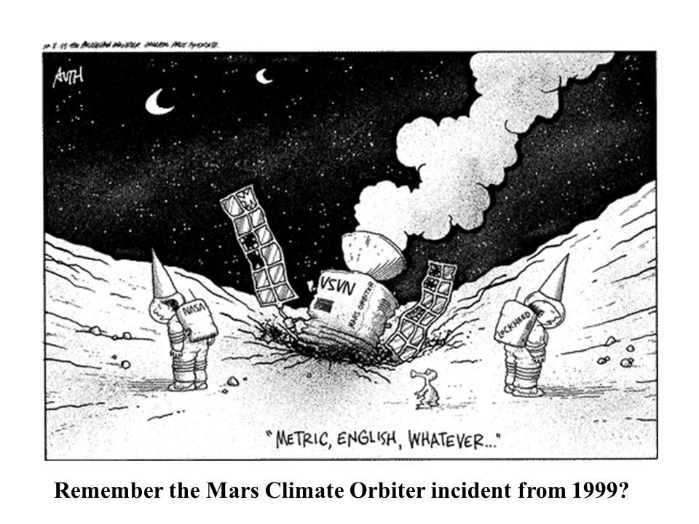
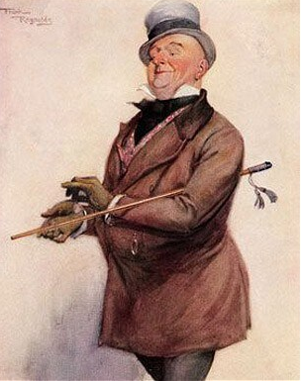
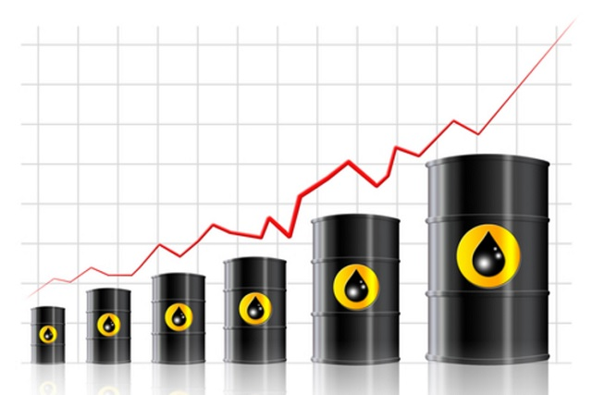
Annual income twenty pounds, annual expenditure nineteen nineteen and six, result happiness. Annual income twenty pounds, annual expenditure twenty pound ought and six, result misery.

Slide 47
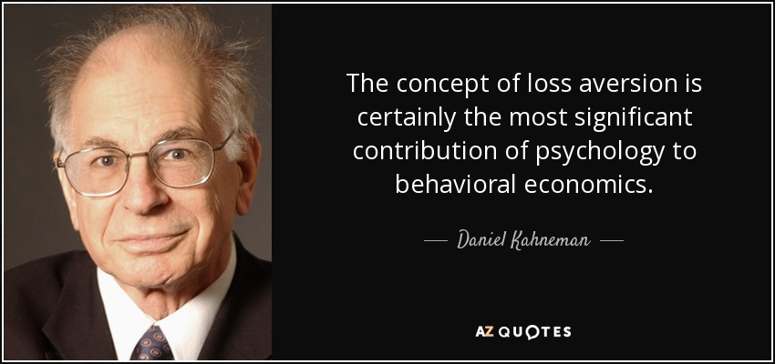
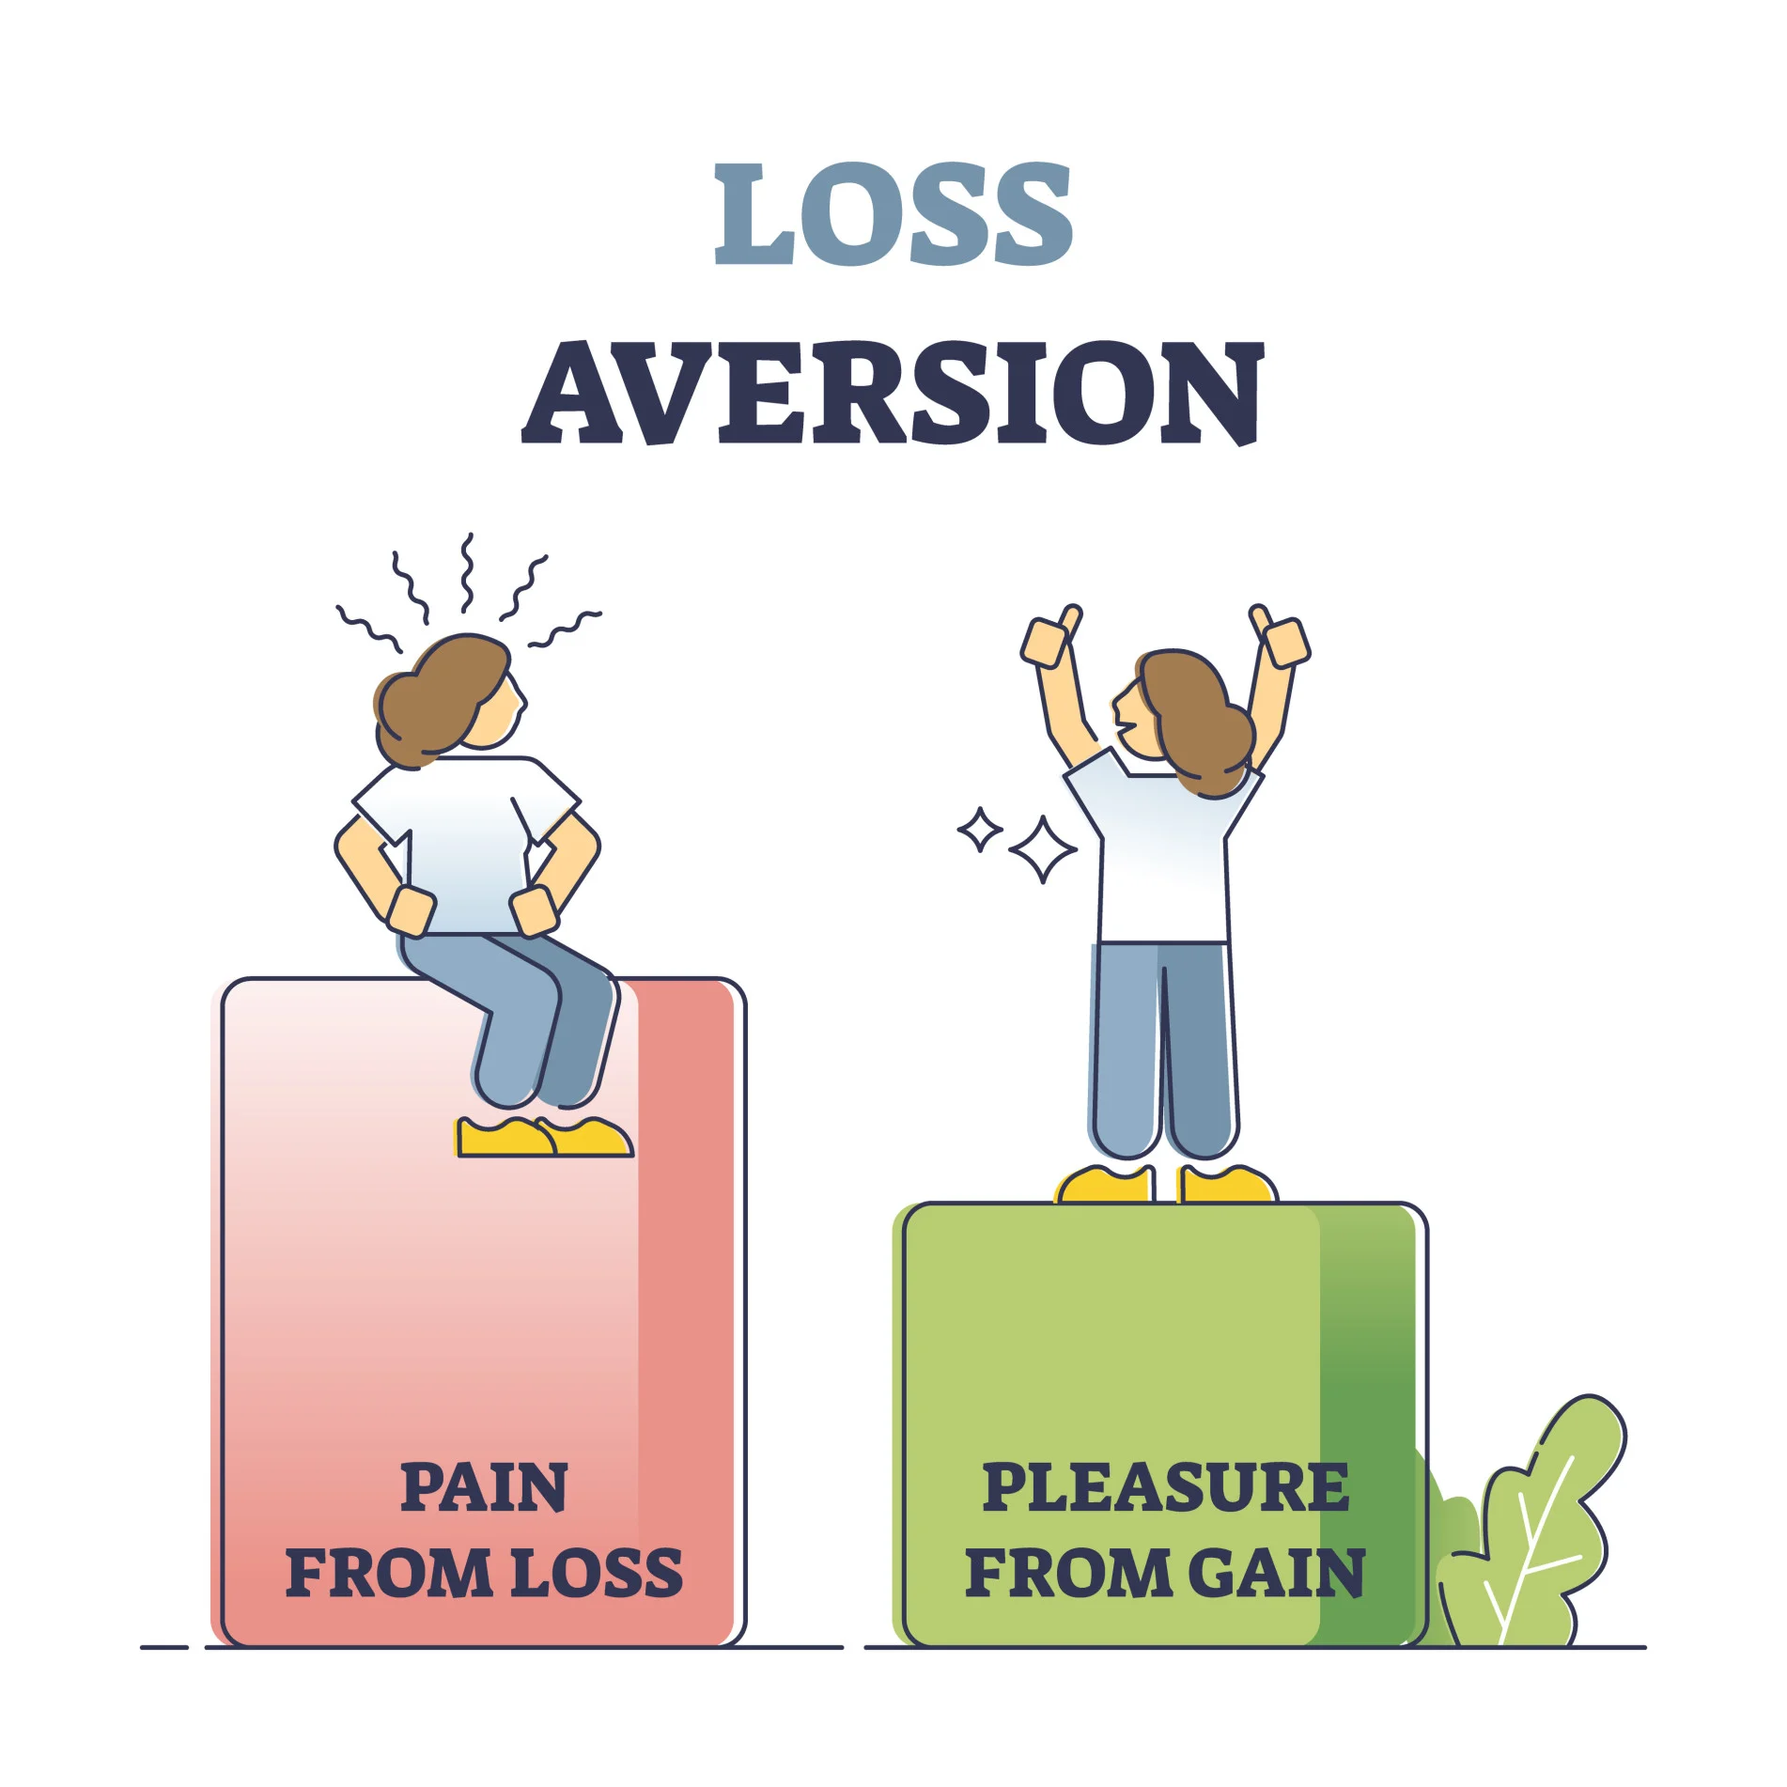
Prospect Theory - Loss Aversion
Pain of loss ~ twice joy of gain

Slide 48
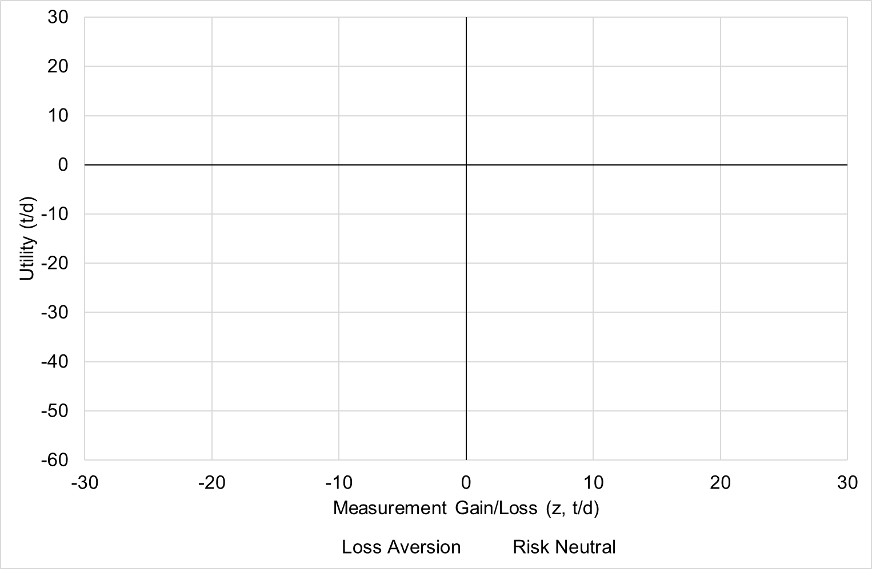

Slide 49
Prospect Theory

Slide 50
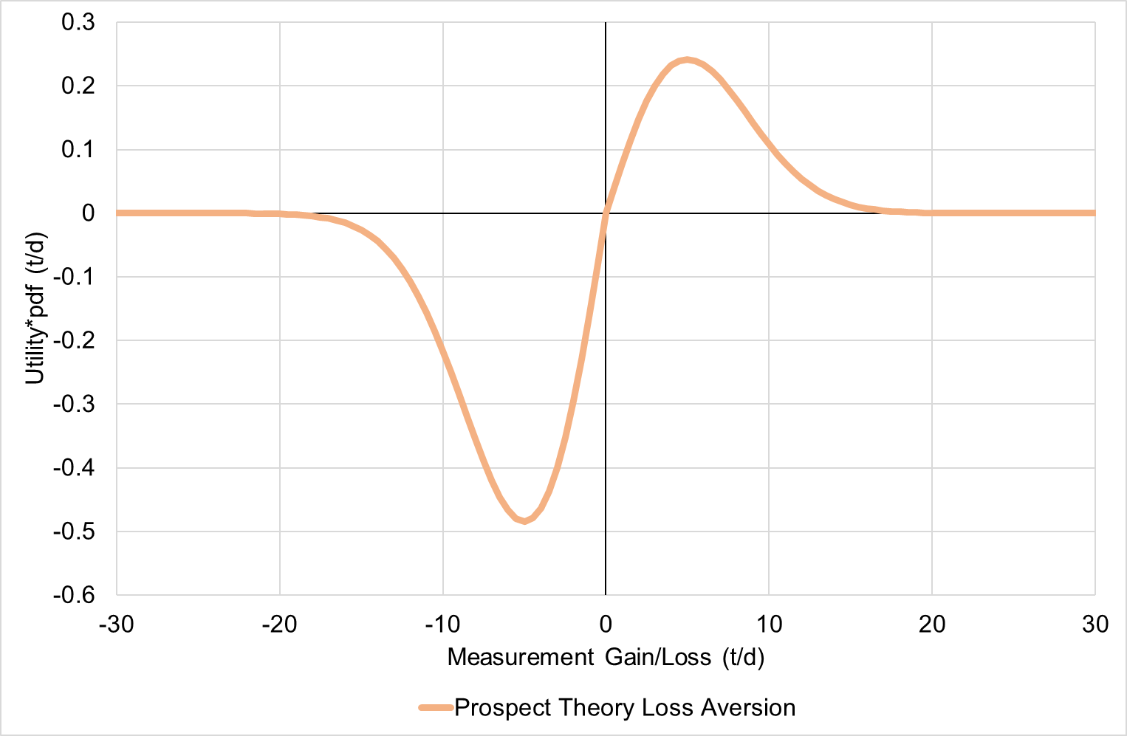


$$L=\int_{−∞}^{0}{{\frac{2z}{σ\sqrt{2π}}e}^{\frac{−1}{2}{\left(\frac{z}{σ}\right)}^{2}}dz}+\int_{0}^{∞}{{\frac{z}{σ\sqrt{2π}}e}^{\frac{−1}{2}{\left(\frac{z}{σ}\right)}^{2}}dz}$$
$$L=\frac{−σ}{\sqrt{2π}}$$

Slide 53
NORSOK I-106

Slide 54

NPV Example
 | Year 1 | Year 2 | Year 3 | Year 4 | Year 5
Cash Flow ($/y)
r_{p} = 10%
379,906
345,370
313,972
285,429
259,481
1,584,159 | Total DCF
417,897
417,897
417,897
417,897
417,897
Difference in exposure to loss
$$NPV=\sum_{n=1}^{N}{\frac{{CF}_{n}}{{\left(1+r_{p}\right)}^{n}}}−ΔCost Meter$$

Slide 55


NPV Example
 | Year 1 | Year 2 | Year 3 | Year 4 | Year 5
Cash Flow ($/y)
r_{p} = 10% ?
379,906
345,370
313,972
285,429
259,481
1,584,159 | Total DCF
417,897
417,897
417,897
417,897
417,897
Difference in exposure to loss
$$NPV=\sum_{n=1}^{N}{\frac{{CF}_{n}}{{\left(1+r_{p}\right)}^{n}}}−ΔCost Meter$$
$$r_{p}$$

Slide 56

NPV Example
 | Year 1 | Year 2 | Year 3 | Year 4 | Year 5
Cash Flow ($/y)
r_{p} = 10% ?
379,906
345,370
313,972
285,429
259,481
1,584,159 | Total DCF
750,000 | ΔCost ($)
834,159 | NPV ($)
417,897
417,897
417,897
417,897
417,897
Difference in exposure to loss
$$NPV=\sum_{n=1}^{N}{\frac{{CF}_{n}}{{\left(1+r_{p}\right)}^{n}}}−ΔCost Meter$$
$$r_{p}=r_{s}=r_{f}+β_{s}\left(r_{m}−r_{f}\right)$$
Capital Asset Pricing Model
$$r_{p}$$

Slide 57



CAPM
$$r_{p}=r_{s}=r_{f}+β_{s}\left(r_{m}−r_{f}\right)$$
Standard deviation of 20%
$${ave r}_{m}=11.6\% (1928 to 2020)$$
$$11.6\%$$
Expected Return (r_{s} or r_{p})
$$3.7\%$$
$${ave r}_{f}=3.7\% (1928 to 2020)$$
Risk

Slide 58





CAPM
$$r_{p}=r_{s}=r_{f}+β_{s}\left(r_{m}−r_{f}\right)$$
$$r_{f}$$
$$β_{s}\left(r_{m}−r_{f}\right)$$
$${ave r}_{m}=11.6\% (1928 to 2020)$$
$$11.6\%$$
Expected Return (r_{s} or r_{p})
$$Risk premium$$
$$Return for$$
$$risk$$
$$3.7\%$$
$${ave r}_{f}=3.7\% (1928 to 2020)$$
$$Return for$$
$$time$$
Risk

Slide 59




CAPM
$$r_{p}=r_{s}=r_{f}+β_{s}\left(r_{m}−r_{f}\right)$$
$${ave r}_{m}=11.6\% (1928 to 2020)$$
$$11.6\%$$
Expected Return (r_{s} or r_{p})
$$β_{s}\left(r_{m}−r_{f}\right)$$
$$Risk premium$$
$$Return for$$
$$risk$$
$$3.7\%$$
$${ave r}_{f}=3.7\% (1928 to 2020)$$
$$r_{f}$$
$$Return for$$
$$time$$
$$1.0$$
Beta
Risk

Slide 60
CAPM
$$r_{p}=r_{s}=r_{f}+β_{s}\left(r_{m}−r_{f}\right)$$
$$11.6\%$$
Expected Return (r_{s} / r_{p})
$$3.7\%$$
$$1.0$$
Beta

Slide 61






CAPM
$$r_{p}=r_{s}=r_{f}+β_{s}\left(r_{m}−r_{f}\right)$$
$$11.6\%$$
Expected Return (r_{s} / r_{p})
$$β=0.97$$
$$β=0.73$$
$$3.7\%$$
$$β=0$$
$$1.0$$
Beta

Slide 62

NPV Example
 | Yearly
Diff in revenue ($/y) | 417,897
ΔDepreciation ($/y) | -150,000
Profit before tax ($/y) | 267,897
Tax at 40% ($/y) | 107,159
Cash flow ($/y) | 310,738
DCF at r_{p} 3% ($) | 1,423,090
ΔCost ($) | 750,000
NPV ($) | 673,090

Slide 65


±1%
Million data points
2.037 t/d
Cumulative loss = 2,088 t
2.088 t/d
Integrated risked loss = 2,035 t
2.035 t/d

Slide 66



Daniel. P. Pashnina N, "Deternination of Optimal Calibration Intervals - a Risk Based Approach," in 34th North Sea Flow Measurement Workshop, St Andrews, Scotland, 2016.
Drift
Systematic
Random

Slide 67




Slide 69



Slide 70


Slide 71


Slide 72

Uncertainty ∝ √t

Slide 73

Uncertainty ∝ √t

Slide 76
Offered a Gamble

Slide 77

Offered a Gamble

Slide 78

Offered a Gamble

Slide 79





Slide 80

“Ergodicity economics is a research programme aimed at reworking the theoretical foundations of economics in the context of ergodic theory”

Slide 81
A glimpse into the future?

Slide 82

A glimpse into the future?

Slide 83
Ergodicity
Parallels with evolution of meter errors and uncertainties with time
Deeper explanation and possibilities regarding
‘subjective’ utility and measurement CBA

Slide 84
Measurement Uncertainty in Time
Random walk / Brownian motion
84

Slide 85
NPV
Use risk free discount rate
Account for tax and depreciation
85

Slide 86
Prospect Theory
Further evidence for
IRE Loss approach
86

Slide 87

IRE Loss equation
Derived from first principles
Recommended for CBA
L=0.2 U₀₅
Don’t use full uncertainty
87

Slide 89



Slide 90



