Slide 1
Allocation for CCUS Hubs
Gordon Inglis, Accord Energy Solutions Ltd

Slide 2
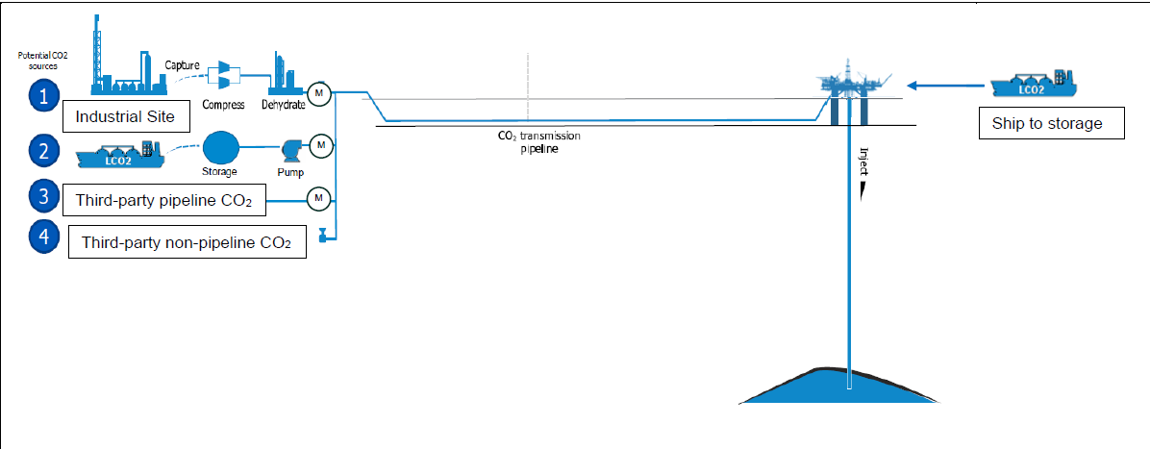
Allocation for CCUS Hubs
Agenda
What is a CCUS Hub?
What drives the need for Allocation?
Where do we Allocate?
Questions?

Slide 3
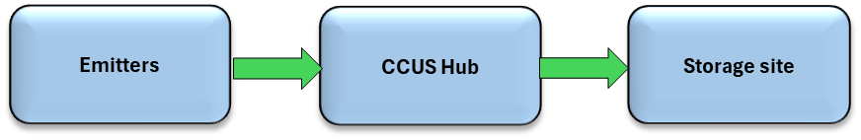
What is a CCUS Hub?
A CCUS Hub receives Carbon Dioxide (CO₂) from emitting sources and transports it to storage using common infrastructure
More than 250 projects around the world where CCUS hubs are at some stage of investigation/development
  Northern Lights; Greensands; Hynet; Northern Endurance; Aramis
Projects in progress consider storage of national and international emissions
CCUS Hubs have yet to reach maturity
What might a CCUS look like?

Slide 4
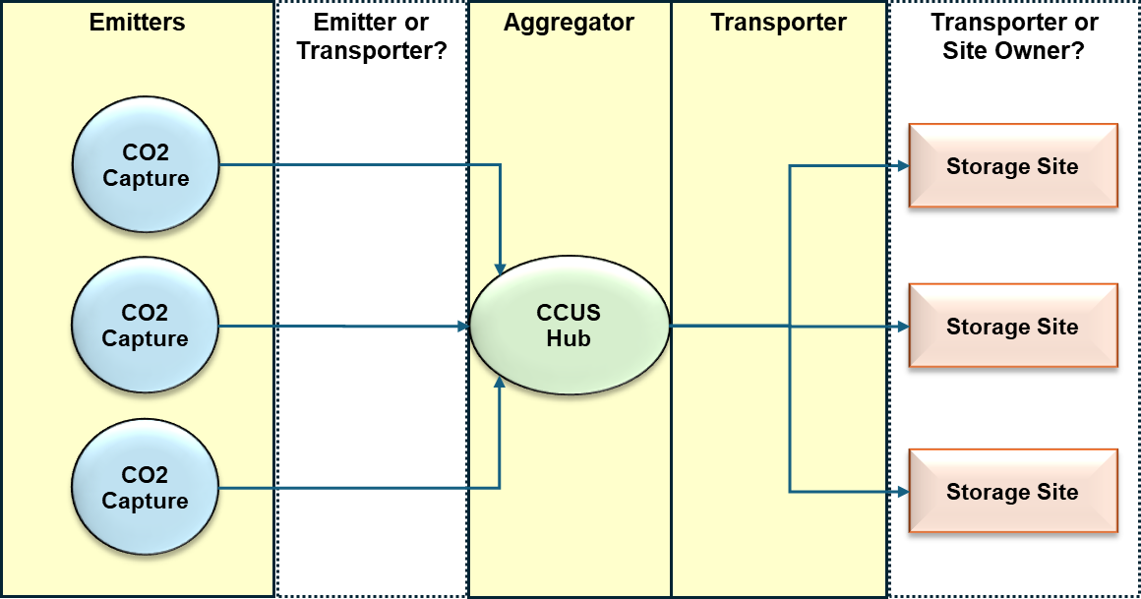
What is a CCUS Hub?
A more complex view of a CCUS Hub

Slide 5
What drives the need for Allocation?
National/International Regulation and Objectives
  EU-ETS / UK-ETS requirements
  UK CCS Network Code
  Measurement standards
Commercial considerations
  Robust and equitable rules
  Subsidies
  Monetisation of CCS hubs
Technical considerations
  Capacity management
  Curtailments
  Product quality
  Analogous to gas transportation systems

Slide 6
What drives the need for Allocation?
National/International Regulation
  EU-ETS / UK-ETS
    Reduction of compliance obligations and costs through CCS
    Monitoring, reporting and verification requirements
  UK CCS Network Code
    Heads of Terms consultation – December 2023
    Capacity management
    Maximisation of storage capacity
    Forecasting and Nominations
    Metering requirements
    Charging structures
    Analogous to the Uniform Network Code [Gas transportation systems]
  Measurement standards
    Guidelines published by NSTA (UK) – 28/3/24

Slide 7
What drives the need for Allocation?
Commercial considerations
  Robust and equitable rules
    Need to have a robust and reliable set of rules to measure, monitor, and allocate CO₂ movements
    Transportation system operation
  Subsidies
    No product to sell
    Subsidies in the form of CFDs required to make projects viable
  Monetisation of CCS hubs
    Capacity charge
    Flow charge
    Network charge
    Quality excursions?

Slide 8
What drives the need for Allocation?
Technical considerations
  Capacity management
  Curtailments
  Product quality
  Transportation and processing requirements
  Analogous to gas transportation systems

Slide 9
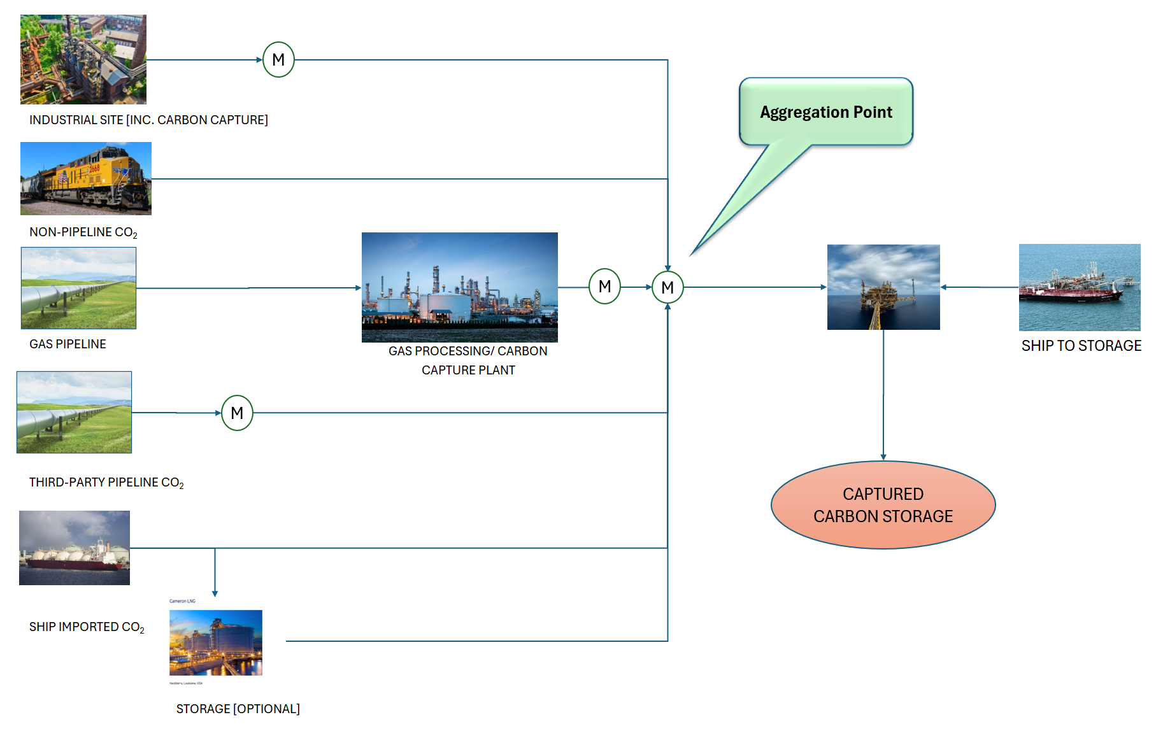
Where do we Allocate?

Slide 10
Concluding remarks
  Agenda
What is a CCUS Hub?
What drives the need for Allocation?
Where do we Allocate?
CCUS Hubs are an emerging business venture where Regulation, Commercial arrangements and Technology are under continual development.
The ideas expressed in this presentation are a view as to how allocation fits into this picture

Slide 11
Questions?

