Slide 1
Allocation for Carbon Capture and Storage (CCS); Requirements, Issues and Considerations
15th June 2022

Slide 2




5W’s
Hermagoras of Temnos
1st century BC
Aristotle
384 – 322 BC

Slide 3

5W1H
Why
What
Who
How
When
Where

Slide 4
Why, What, Who, Where, When and How?
Allocation
Why
What
Who
Where
How
When

Slide 5
Why?
Why

Slide 6
Why?
Why
Necessary?

Slide 7
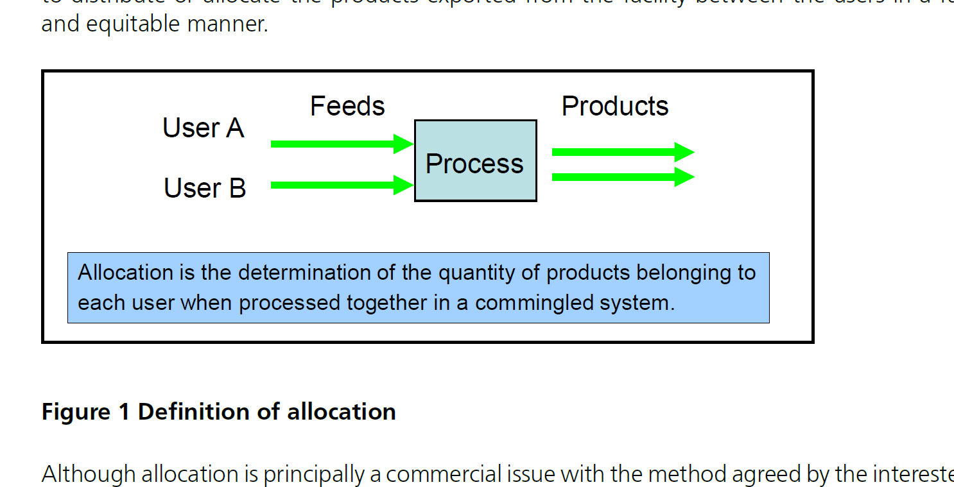
Energy Institute HM 96
Guidelines for the allocation of fluid streams
in oil and gas production

Slide 8
Why?
Why
Necessary?

Slide 9
Why?
Why
Necessary?
Shared

Slide 10
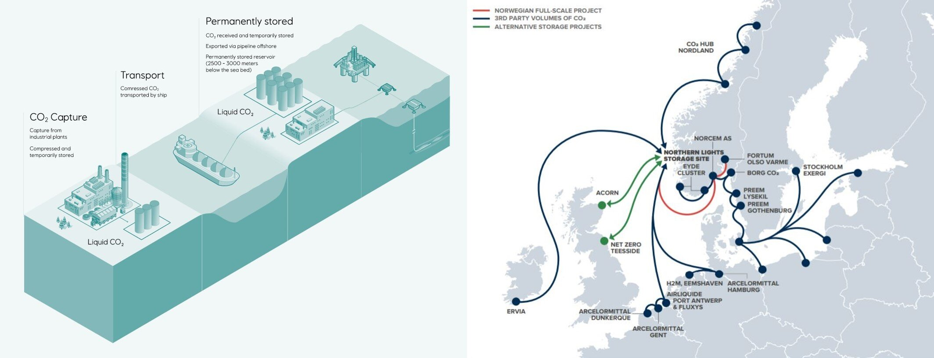
Northern Lights

Slide 11
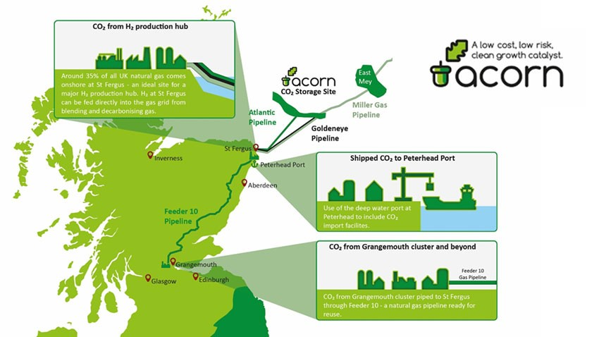
Acorn

Slide 12




Shared Facilities
Process/capture
Utilisation
Storage
Process
CO2 capture
CO2 Treatment
12

Slide 13
Why?
Why
Necessary?
Shared facilities

Slide 14
Why?
Why
Necessary?
Shared facilities
Emissions

Slide 15


Emissions Trading Scheme

Slide 16

Emissions
€

Slide 17
Emissions
CO2 Storage
CO2 capture

Slide 18
Emissions
CO2 Storage
CO2 capture

Slide 19

Emissions

Slide 20
Why?
Why
Necessary?
Shared facilities
Emissions

Slide 21
Why?
Why
Necessary?
Shared
Emissions
Financial

Slide 22
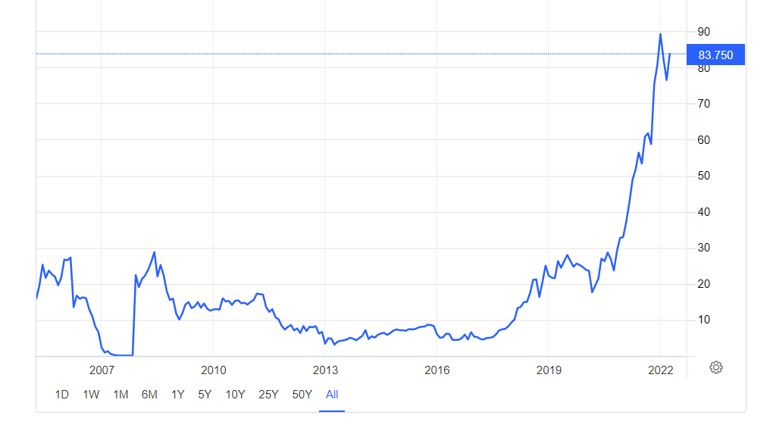

EU ETS CO₂ price €/tonne
Northern Lights will have capacity to transport and store 1.5 million tonnes CO₂ per year
€/te

Slide 23
EU ETS CO₂ price €/tonne
Total stream value of 1.5 million te/yr CO₂:
150 to 300 € million / year
±1.5% specified uncertainty
~ € millions / year
200
€/te
2030

Slide 24
Why?
Why
Necessary?
Shared
Emissions
Financial

Slide 25
Why?
Why
Necessary?
Shared
Emissions
Financial
Important

Slide 26

https://www.equinor.com/energy/northern-lights
Currently
27 CCS operational sites worldwide
“Many scientists and policymakers argue that this is crucial if the world is to limit temperature rise to under 2°C﻿, the goal of the Paris Agreement﻿. The International Energy Agency states that a tenfold increase in capacity﻿ is needed by 2025 to be on track for meeting that target and the Global CCS Institute estimates that 2,500 CCS facilities﻿ would need to be in operation by 2040 worldwide, each capturing around 1.5 million tonnes of CO2 per year.”

Slide 27
Why?
Why
Necessary?
Shared
Emissions
Financial
Important

Slide 28
Why?
Why
Necessary?
Shared
Emissions
Financial
Important
Get it right

Slide 29
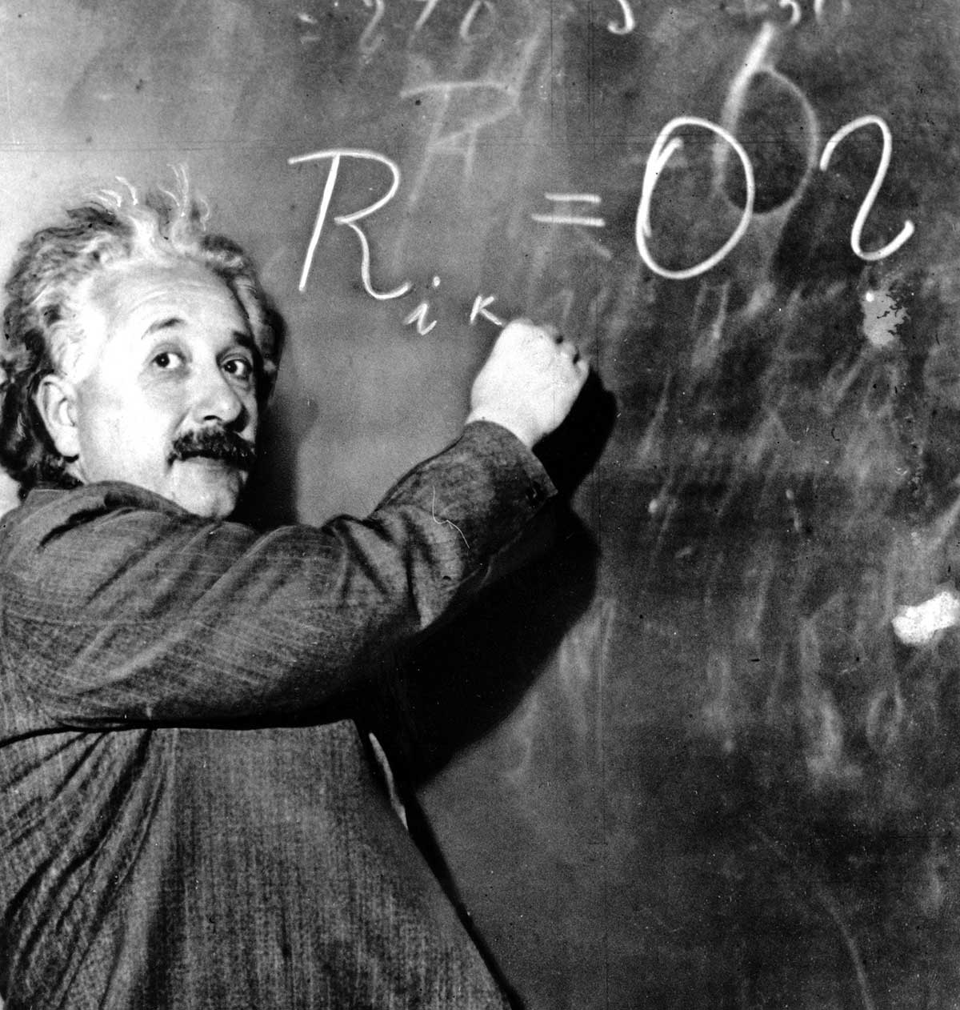
Keep it simple?
Everything should be made as simple as possible, but not simpler

Slide 30
Why?
Why
Necessary?
Shared
Emissions
Financial
Important
Get it right

Slide 31
Why?
Why

Slide 32
Why, What, Who, Where, When and How?
Allocation
Why
What
Who
Where
How
When

Slide 33
Why, What, Who, Where, When and How?
What

Slide 34
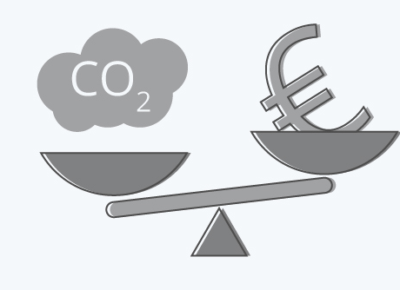
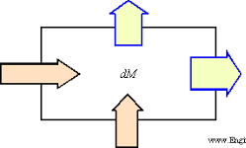
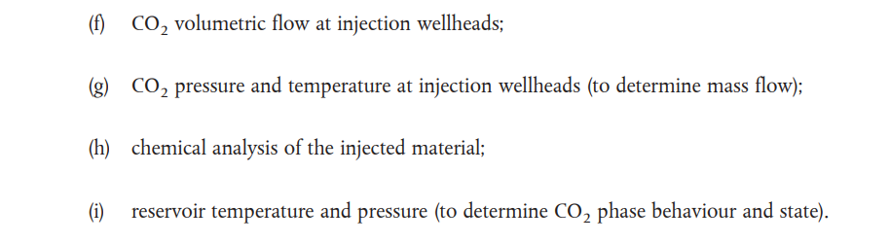

Units/ Basis
Mass
Volume
Composition

Slide 35

Increased transportation energy requirements
H₂O
O₂
CH₄
N₂
…
CO₂
> 95% ?
Reduced CO₂ storage capacity

Slide 36
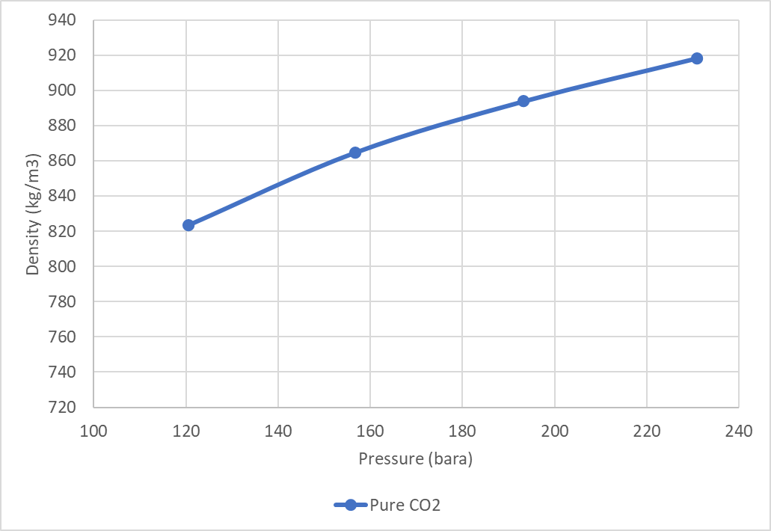
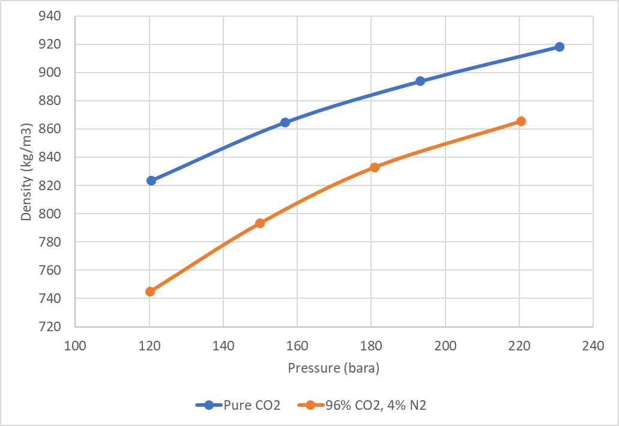
Density as a Function of Pressure
Pure CO₂
Impact on compression power requirements
96% CO₂
4% N₂

Slide 37
Why, What, Who, Where, When and How?
What

Slide 38
Why, What, Who, Where, When and How?
Allocation
Why
What
Who
Where
How
When

Slide 39
Why, What, Who, Where, When and How?
Who

Slide 40
Process/capture
Pipeline Operator
Storage
Process
CO2 capture
Interfaces
Storage Operator
40

Slide 41

Is allocation required?
Process/capture
Pipeline Operator
Storage
Process
CO2 capture
41

Slide 42

Is allocation required?
Process/capture
Pipeline Operator
Storage
Process
CO2 capture
Non-CCS
Clean electricity
42

Slide 43
Commercial
Tariff
Power consumption
Transparency
Mass balance
Pipeline Operator
Storage
43

Slide 44
Why, What, Who, Where, When and How?
Who

Slide 45
Why, What, Who, Where, When and How?
Allocation
Why
What
Who
Where
How
When

Slide 46
Why, What, Who, Where, When and How?
Where

Slide 47


Process/capture
Pipeline Operator
Storage
Process
CO2 capture
Storage Operator
47

Slide 48
Process/capture
M1
Pipeline Operator
Storage
Process
CO2 capture
M2
M3
48

Slide 49
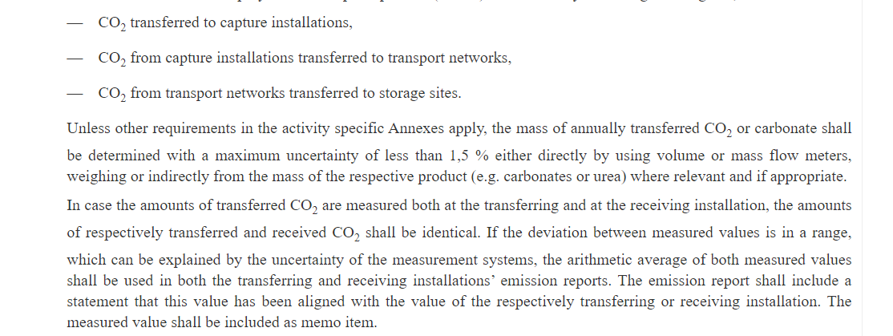
EU ETS

Slide 50
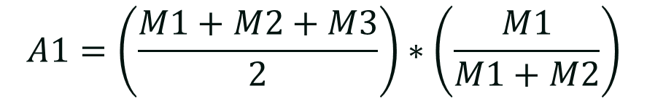
Process/capture
M2
Pipeline Operator
Storage
Process
CO2 capture
M1
M3
$$A1=\left(\frac{M1+M2+M3}{2}\right)∗\left(\frac{M1}{M1+M2}\right)$$
50

Slide 51
Why, What, Who, Where, When and How?
Where

Slide 52
Why, What, Who, Where, When and How?
Allocation
Why
What
Who
Where
How
When

Slide 53
Why, What, Who, Where, When and How?
When

Slide 54
Frequency
Yearly
Monthly
Daily
Monitoring, purity, forecasting, nominations, lifting, trading, capacity

Slide 55
Why, What, Who, Where, When and How?
When

Slide 56
Why, What, Who, Where, When and How?
Allocation
Why
What
Who
Where
How
When

Slide 57
Why, What, Who, Where, When and How?
How

Slide 58
Why, What, Who, Where, When and How?
How
Transfer

Slide 59
Transferred CO2 Allocation
User B
Process/capture
M2
±1.5%
Pipeline Operator
User A
Storage
Process
CO2 capture
M1
M3
±1.5%
±1.5%
$$A1=\left(\frac{M1+M2+M3}{2}\right)∗\left(\frac{M1}{M1+M2}\right)$$
Pro Rata
59

Slide 60
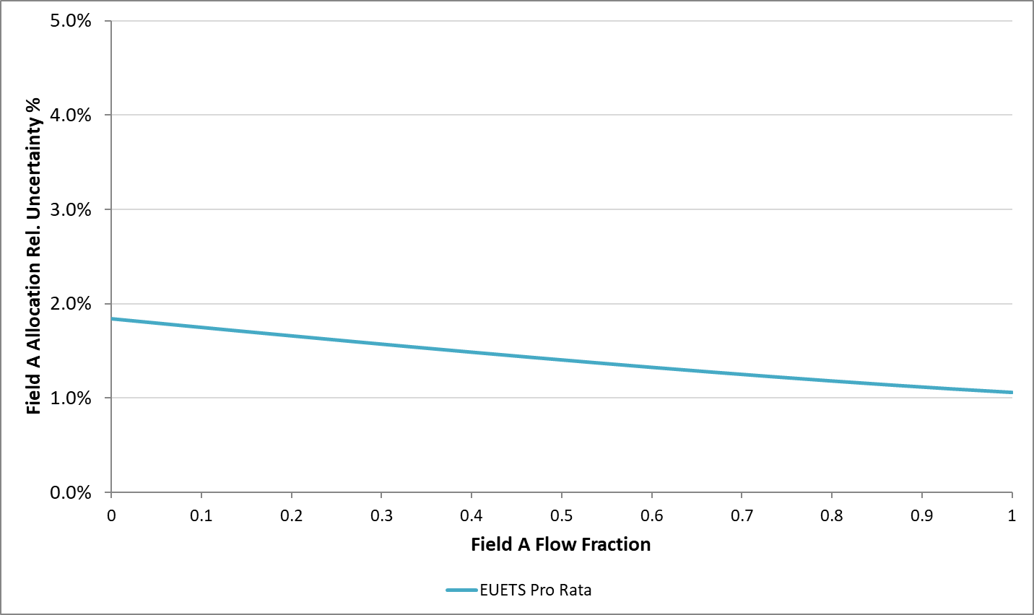
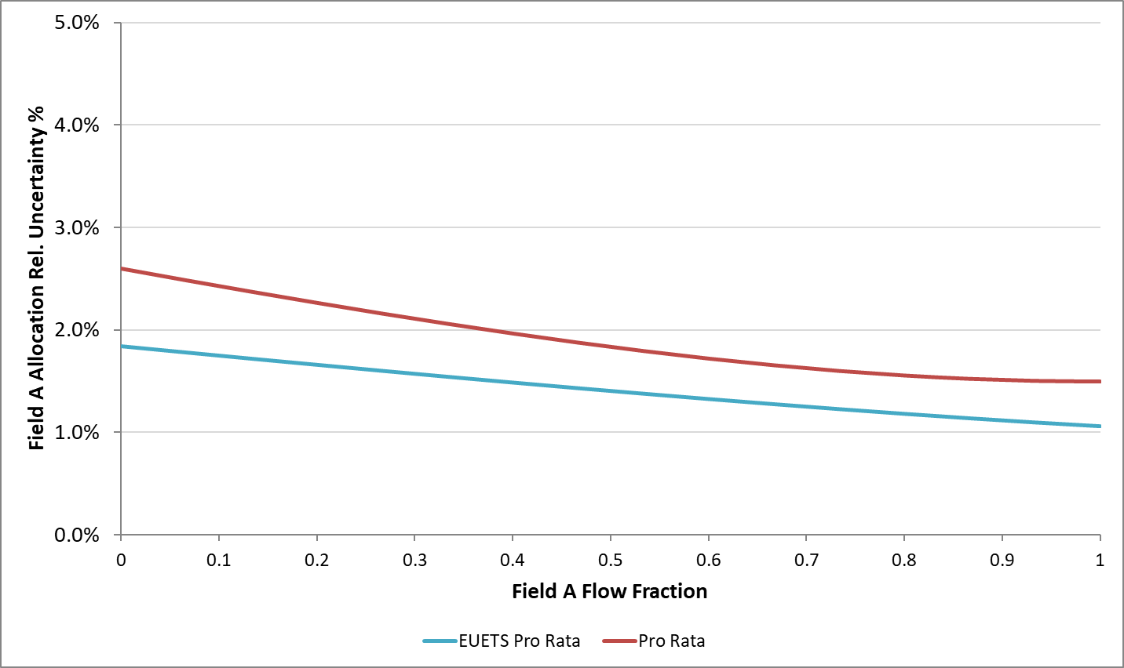
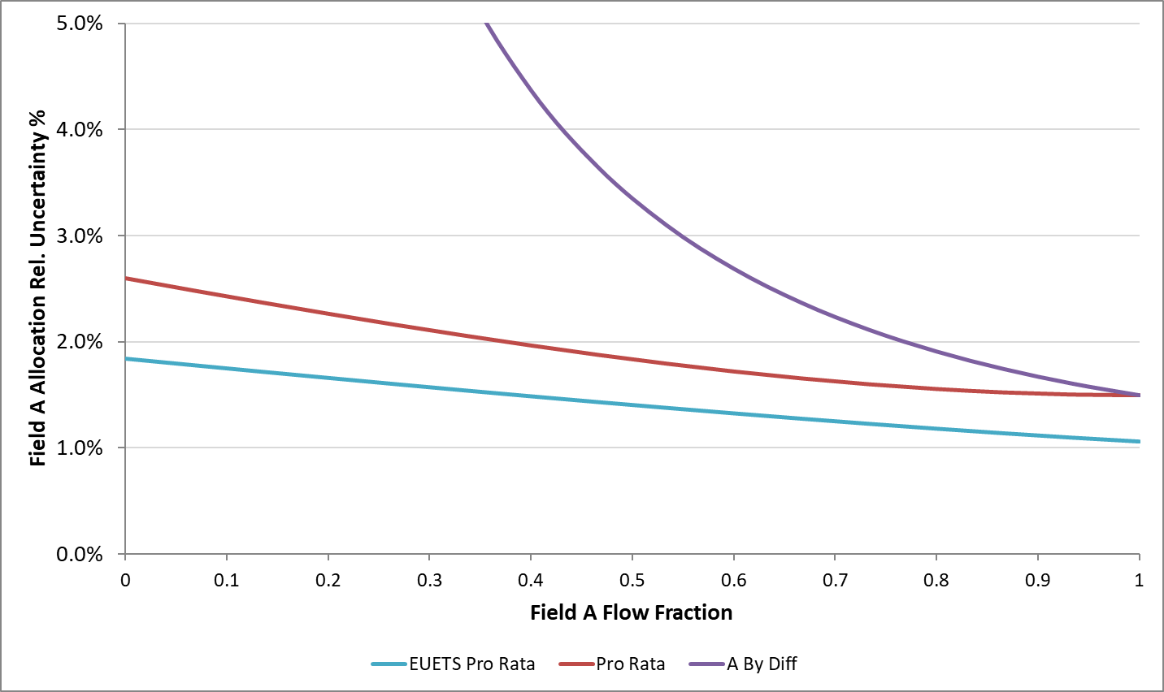
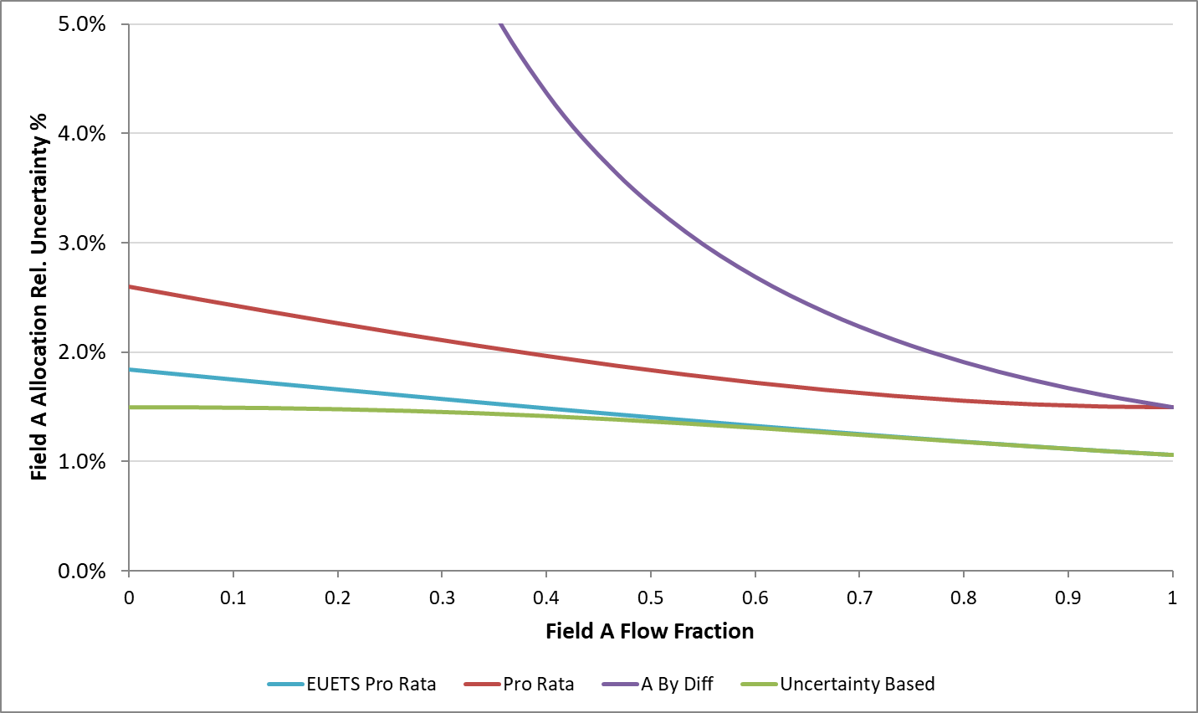
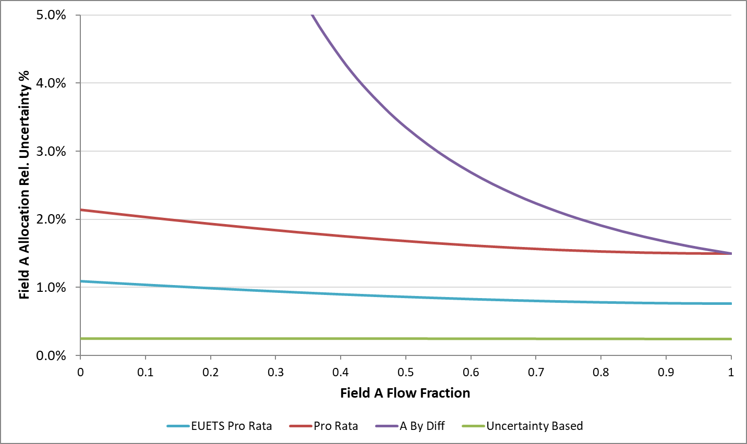
A Allocation Uncertainty
Reduce A Meter (M1) Uncertainty to ±0.25%

Slide 61
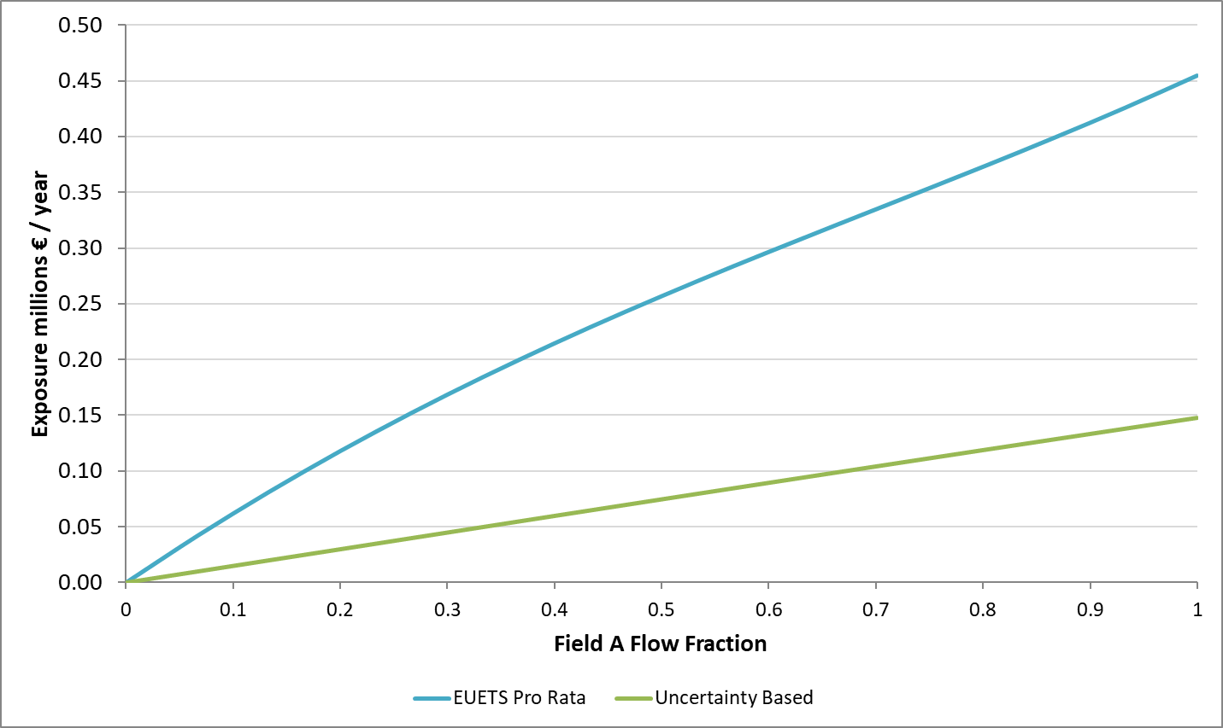
A Allocation Exposure
Carbon Price: € 200/te

Slide 62
Why, What, Who, Where, When and How?
How
Transfer

Slide 63
Why, What, Who, Where, When and How?
How
Transfer
Compression

Slide 64



Bat and Ball Problem
Bat and a ball together cost € 1.10
The bat cost one euro more than the ball
How much does the ball cost?
10 cents?
5 cents

Slide 65

Bat and Ball Problem
Bat and a ball together cost € 1.10
The bat cost one euro
How much does the ball cost?
10 cents?

Slide 66
Process/capture
Pipeline Operator
Storage
Process
CO2 capture
Storage Operator
66

Slide 67
200 bar
2 mcm/d
≈ 1.5 million te/y CO₂
10 - 20 MW
200 t/d CO2e
~40,000 €/d
~16 million €/y

Slide 68
Compressor Power Consumption
Compressor Recycling
Surge Point

Slide 69
User A 0.8 mcm/d
User B 0.4 mcm/d
0.2 mcm/d
Allocate in proportion to Field production
1.2 mcm/d
1.2 mcm/d
1.4 mcm/d
≡
50:50 split fairer?
93
A
CO2e
140 te/d
B
47

Slide 70


Game Theory
Define some properties wish the allocation to have
Pro rata appears arbitrary to some extent

Slide 71
User A 1.6 mcm/d
User B 0.4 mcm/d
2 mcm/d
≡
CO2e
200 te/d

Slide 72
Allocation
Proportional
User A 160 te/d
User B 40 te/d
Fuel to be allocated 200 te/d
User A 110 te/d
User B 90 te/d
Game theory

Slide 73
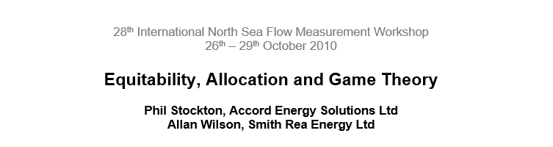
Allocation Value
Proportional
User A € 12.8 million/y
User B € 3.2 million/y
€ 4 million/y
User A € 8.8 million/y
User B € 7.2 million/y
Fuel to be allocated 0.02 mcm
Game theory

Slide 74
Why, What, Who, Where, When and How?
How
Transfer
Compression

Slide 75
Why, What, Who, Where, When and How?
How
Transfer
Compression
Pipelines

Slide 76
Process/capture
Pipeline Operator
Storage
Process
CO2 capture
Storage Operator
76

Slide 77
Allocation at Wellhead
B
M2
A
M1
M3
S
Transit time ~ 1.5 days
77

Slide 78
B
Steady state
Wellhead
A

Slide 79

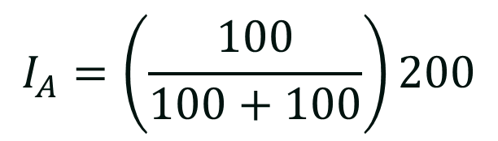

How should the inlet be allocated?
Keep it simple!
B
$$I_{A}=\left(\frac{100}{100+100}\right)200$$
$$I_{A}=\left(\frac{E_{A}}{E_{A}+E_{B}}\right)I$$
100
E_{B}
$$I_{A}=100$$
I_{B}
200
I
I_{A}
100
E_{A}
But what happens when it’s not steady state?
Inlet
A

Slide 80
Keep it simple!
B
100
E_{B}
$$I_{A}=100$$
I_{B}
200
I
I_{A}
100
E_{A}
But what happens when it’s not steady state?
Inlet
A

Slide 81
B
E_{B}
I
E_{A}
Inlet
A

Slide 82
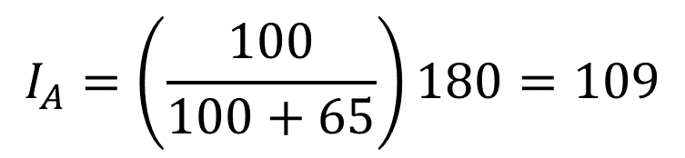
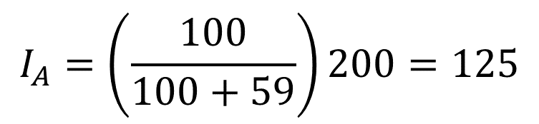

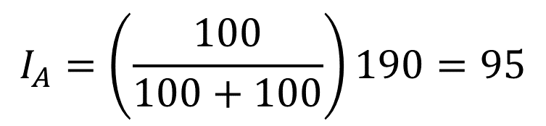
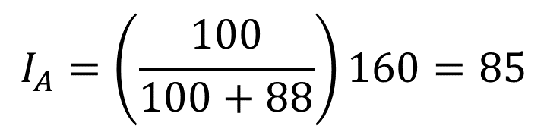
It will even out over time, won’t it?
B
$$I_{A}=\left(\frac{E_{A}}{E_{A}+E_{B}}\right)I$$
$$I_{A}=\left(\frac{100}{100+59}\right)200=125$$
$$I_{A}=\left(\frac{100}{100+65}\right)180=109$$
$$I_{A}=\left(\frac{100}{100+88}\right)160=85$$
$$I_{A}=\left(\frac{100}{100+100}\right)190=95$$
E_{B}
I
E_{A}
Let’s model it….
Inlet
A

Slide 83

What happens if one flow is more variable?
B
E_{B}
Varies randomly
0 to 100
I
E_{A}
Fixed at 100
Inlet
A

Slide 84
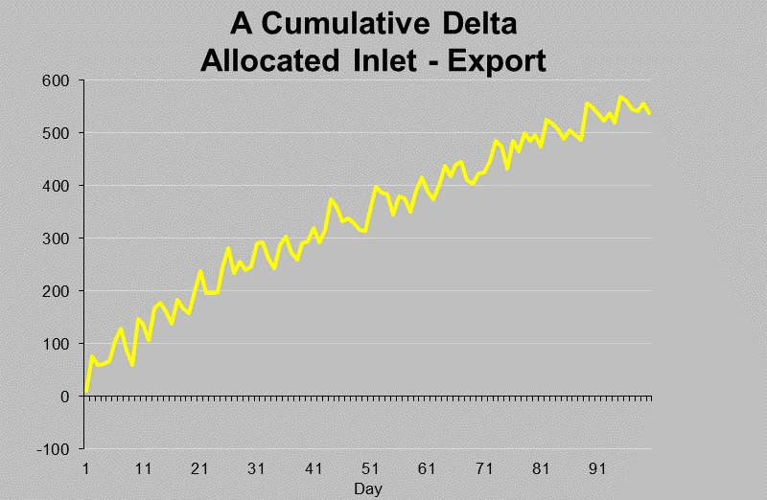
Field B Varying 0 to 100/day
Field A Constant at 100/day

Slide 85
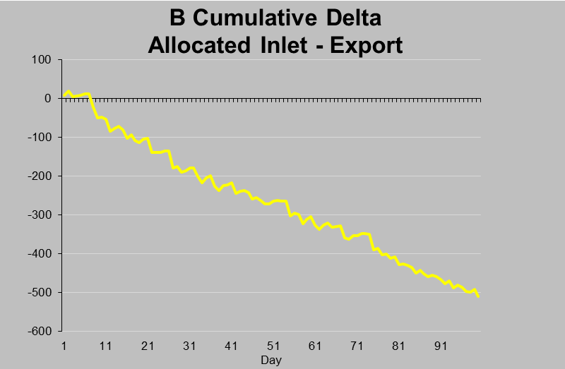
Field B Varying 0 to 100/day
Field A Constant at 100/day

Slide 86

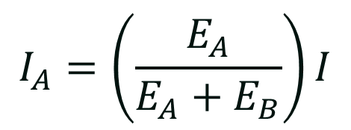
It will even out over time, won’t it?
B
No !!!
$$I_{A}=\left(\frac{E_{A}}{E_{A}+E_{B}}\right)I$$
E_{B}
I
E_{A}
Inlet
A
HCM Workshop 2018 Pipeline Allocation and How to Win the Lottery (Phil Stockton)

Slide 87
Why, What, Who, Where, When and How?
How
Transfer
Compression
Pipelines

Slide 88
Why, What, Who, Where, When and How?
Allocation
Why
What
Who
Where
How
When

Slide 89
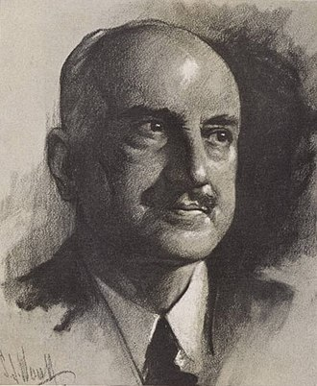
Those who fail to learn the lessons of history are doomed to repeat it.
George Santayana

